Slide 1
Revisiting Deep Learning Models for Tabular Data

Slide 2

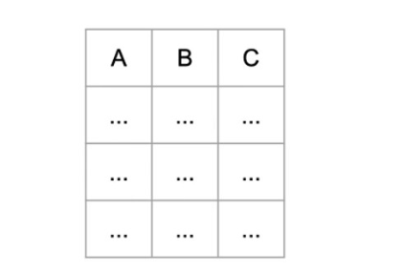
Context
Tabular data is common in industrial applications and ML competitions.
Neural networks face strong competition from Gradient Boosted Decision Trees (GBDT).

Slide 3
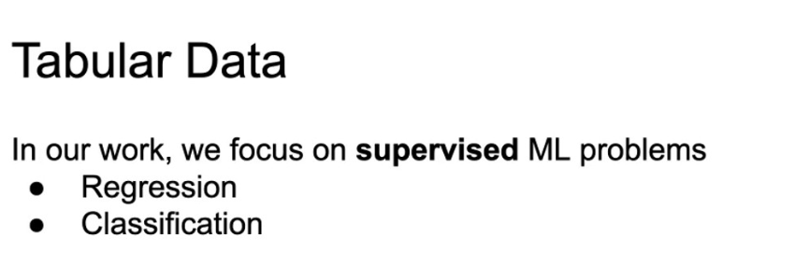
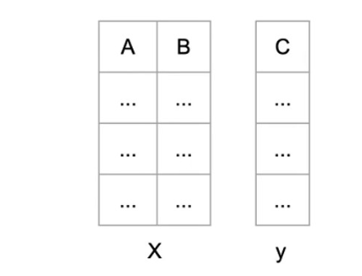

Slide 4
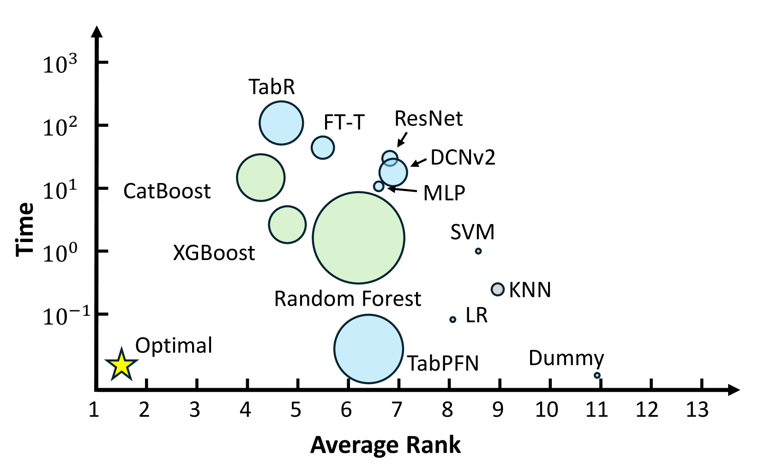
Binary Classification

Slide 5
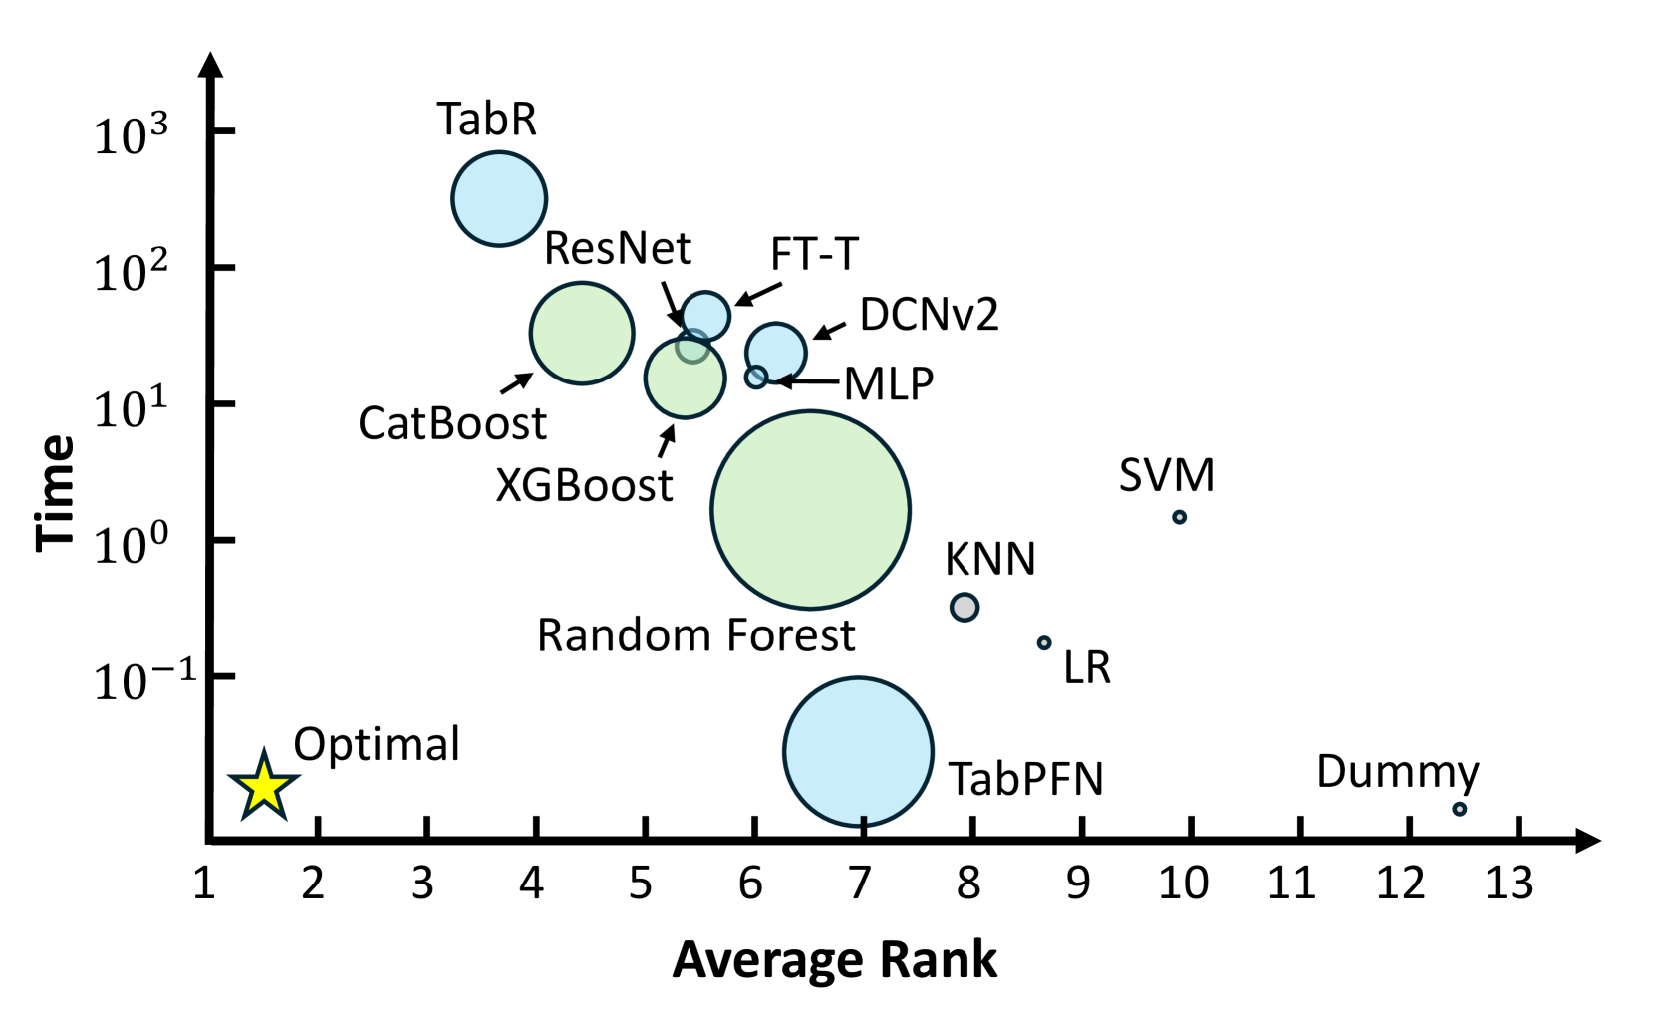
Multi-Class Classification

Slide 6
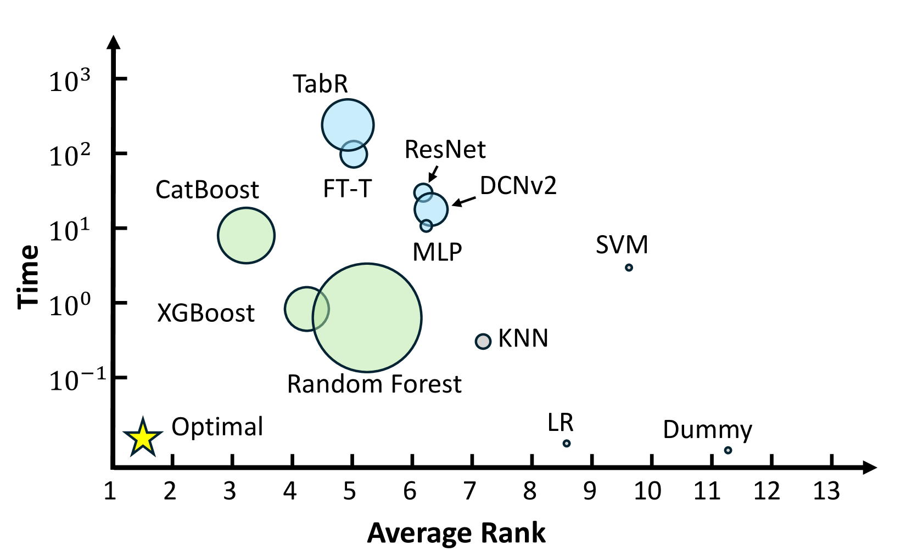
Regression Classification

Slide 7
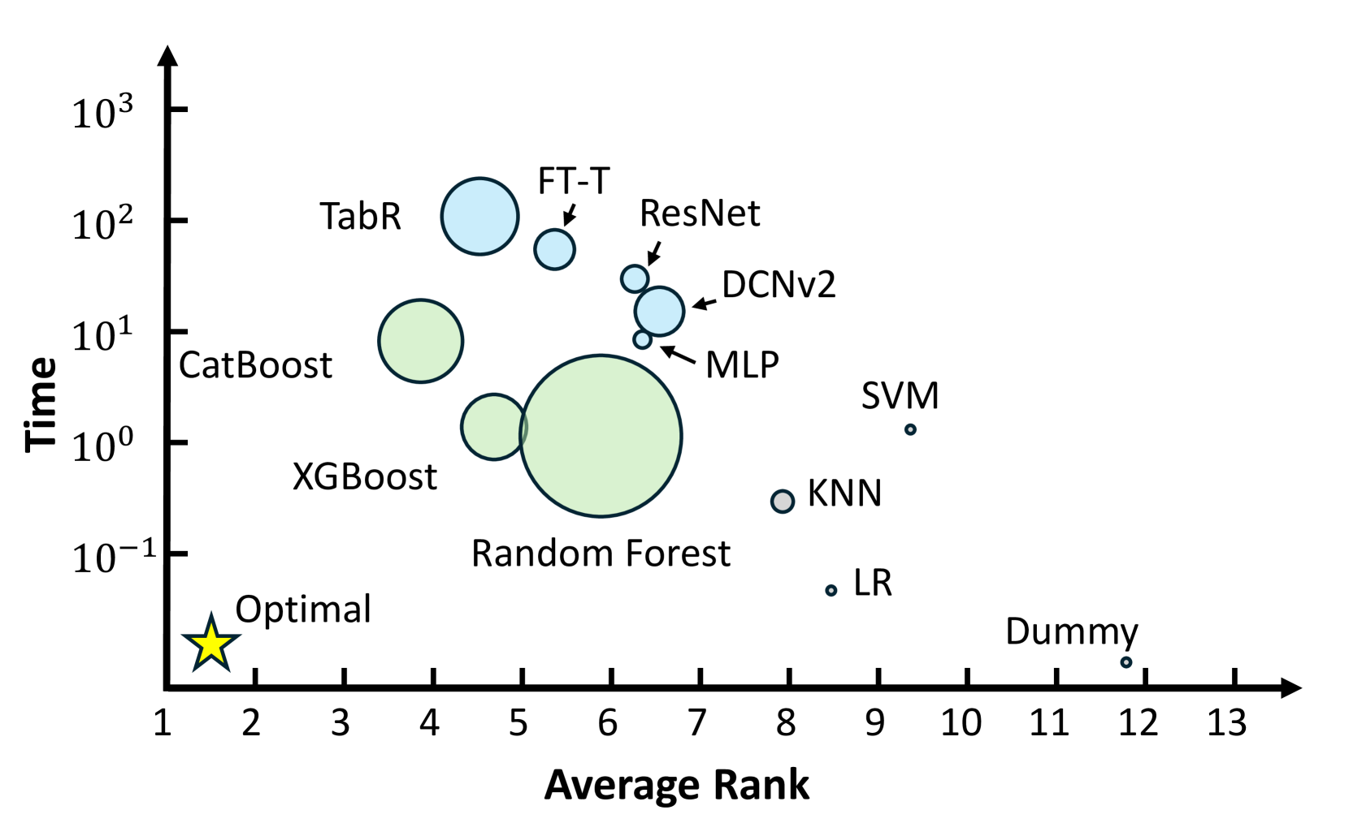
All Tasks

Slide 8
Problem
Lack of standardized benchmarks for tabular data.
Proposed deep learning models often use different evaluation protocols.
Difficulty in identifying universally effective solutions.

Slide 9
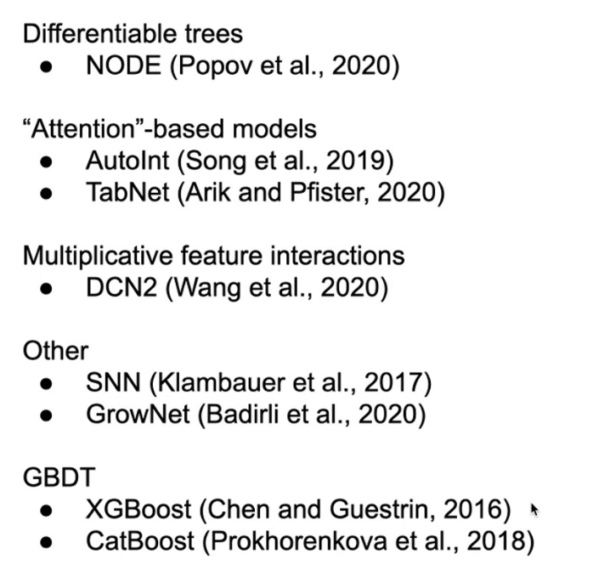
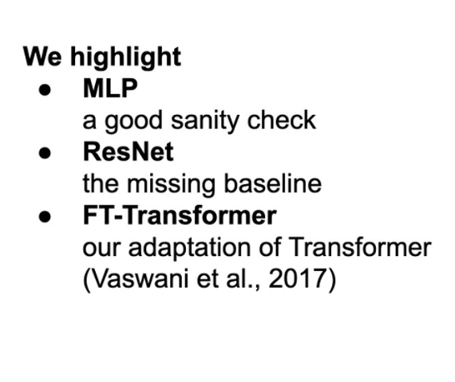
Models

Slide 10
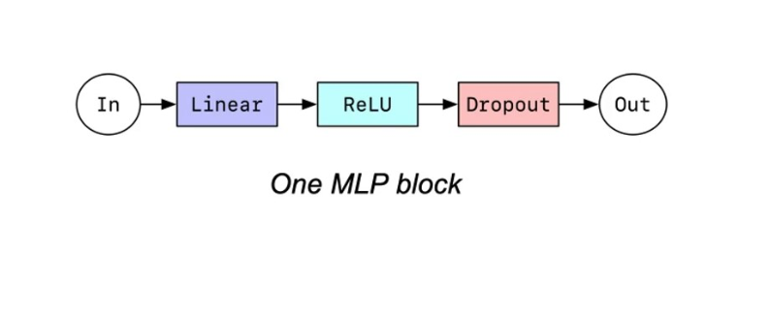
MLP Architecture
Multilayer Perceptron (MLP) serves as a simple baseline for tabular data.
Uses layers of fully connected neurons.
Limited performance due to difficulty in capturing complex feature interactions.

Slide 11
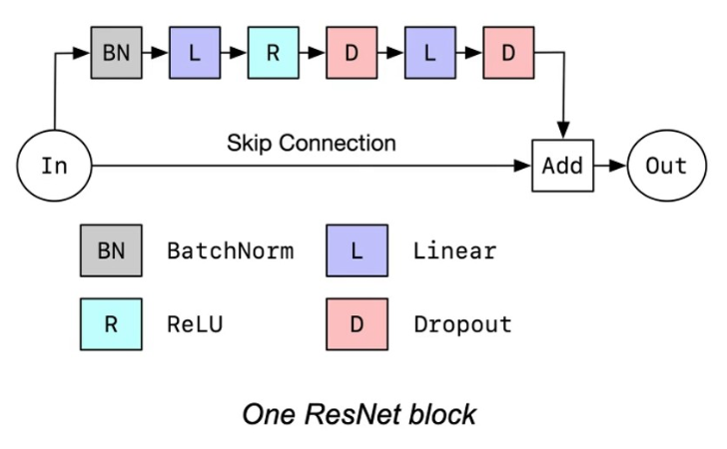
ResNet for Tabular Data
Adaptation of ResNet for tabular tasks.
Simplified architecture with residual connections.
Strong baseline, outperforming many complex architectures.

Slide 12
FT-Transformer
Combines a feature tokenizer with a Transformer module.
Operates on both categorical and numerical features.
Demonstrates superior performance on diverse tasks.

Slide 13
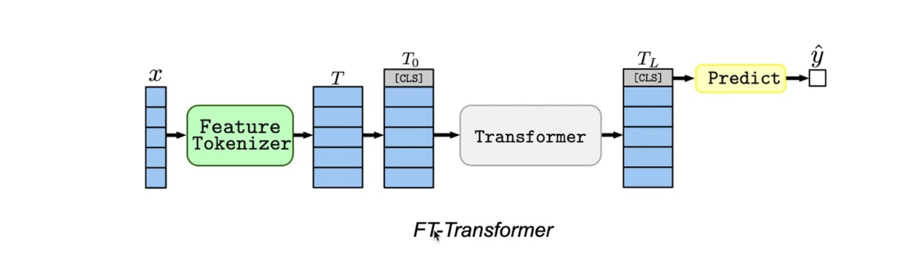
FT-Transformer
Based on Transformer (Vaswani et al. 2017).
May Slow but more accurate.

Slide 14
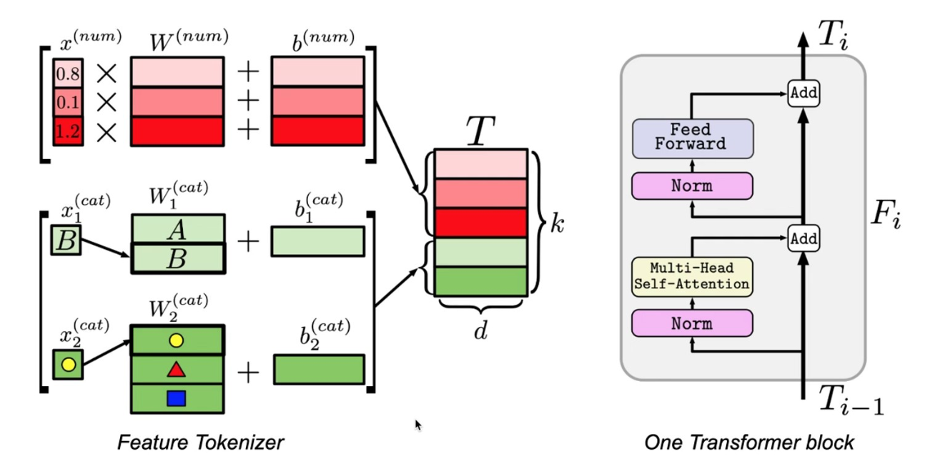
FT-Transformer

Slide 15
Evaluation Setup
Diverse datasets: Classification, regression tasks.
Uniform training and hyperparameter tuning protocols.
Performance metrics: Accuracy, RMSE, etc.

Slide 16
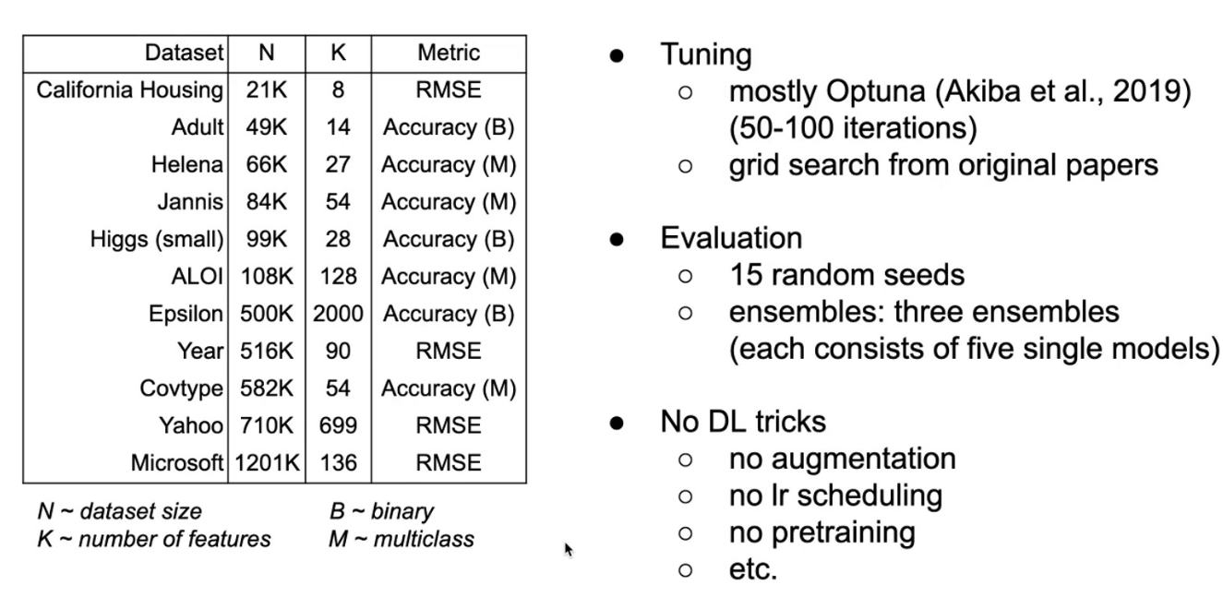
Evaluation Setup

Slide 17
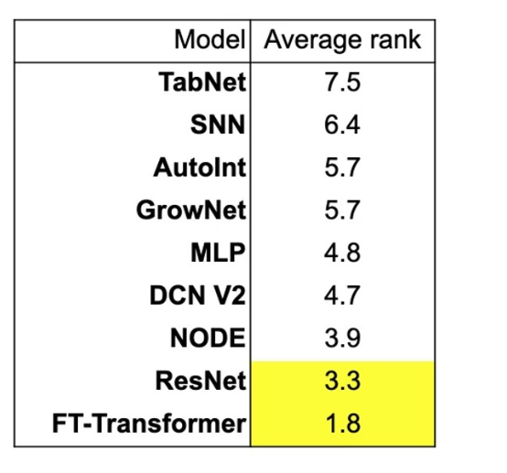
Results and Findings
MLP still good??.
ResNet is strong baseline.
TabNet is not good????.

Slide 18
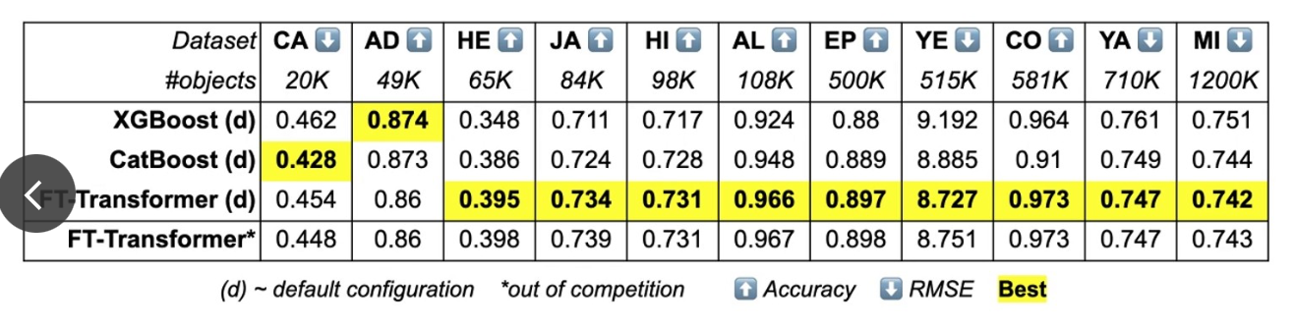
Results and Findings

Slide 19
Results and Findings
ResNet provides strong baseline performance.
FT-Transformer is a universal architecture, excelling on most tasks.
No single model outperforms GBDT consistently.

