Slide 1
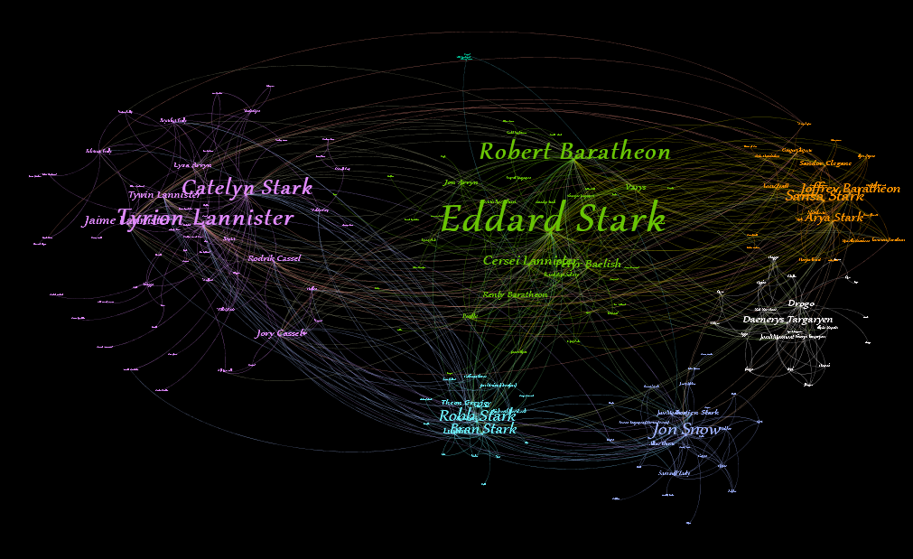
Game of Thrones Network Analysis
Lecturer:
Nguyen Thi Kim Phung
Students:
Nguyen Hoang An – 18520430
Duong Trong Van – 18521630

Slide 2
Data analyst
Number of edges: 684 (0 – 683)
Duplicate edges: 0
Number of nodes: 187 (0 – 186)
Number of Null values: 0

Slide 3
Network building
Geometric measures
Degree Centrality
Closeness Centrality

Slide 4
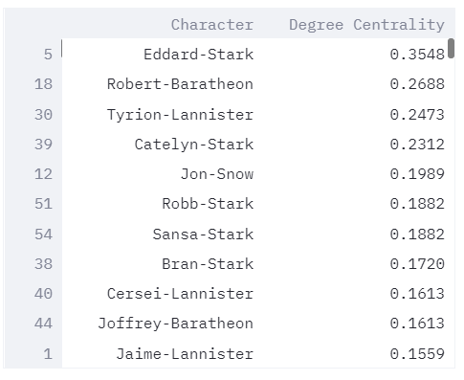
Geometric measure
Degree Centrality

Slide 5
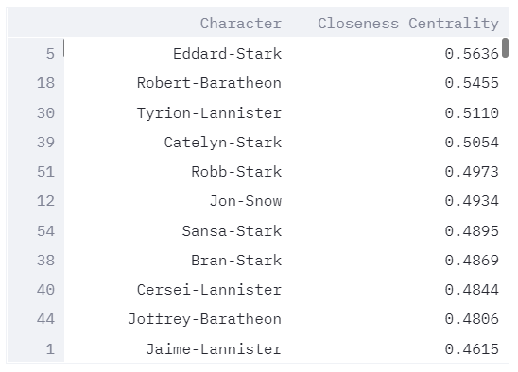
Geometric measure
Degree Centrality

Slide 6
Network building
Spectral measures
Page-rank
Eigenvector Centrality

Slide 7
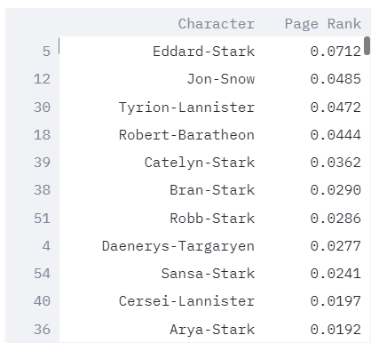
Spectral measure
Page-rank

Slide 8
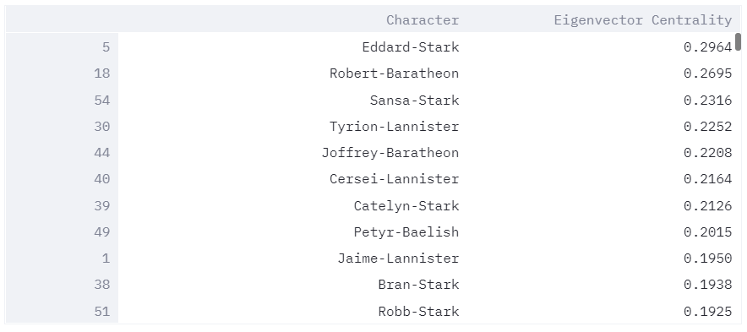
Spectral measure
Eigenvector centrality

Slide 9
Network building
Path-based measures
Betweenness Centrality

Slide 10
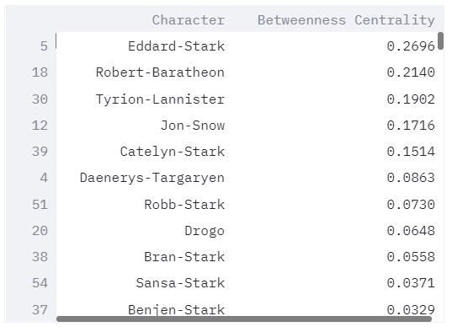
Path-based measure
Betweenness Centrality

Slide 11
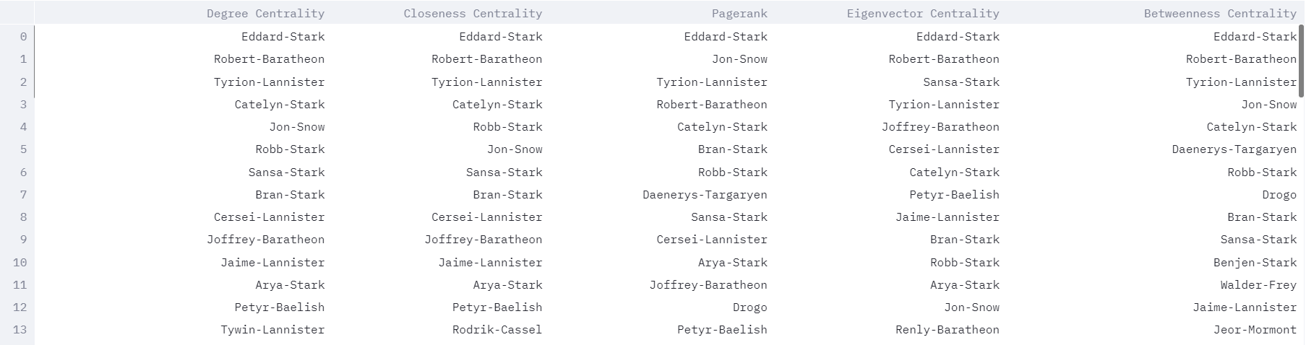
Network Centrality summary

Slide 12
Network building
Community detection
Modularity Clustering
K-mean Clustering

Slide 13
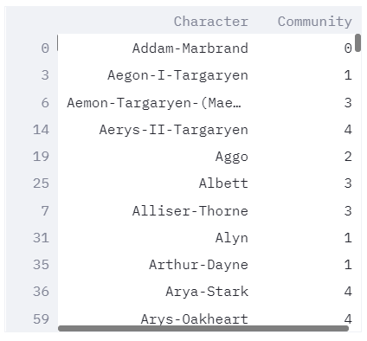
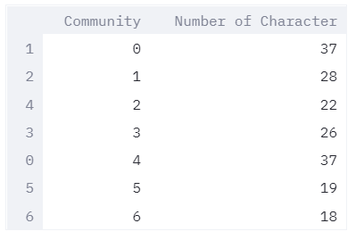
Community detection
Modularity Clustering
Number of characters in each community

Slide 14
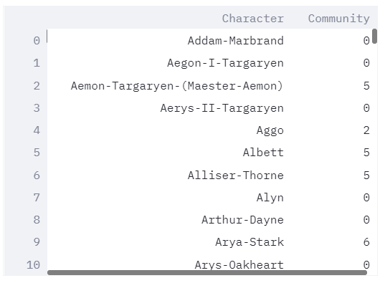
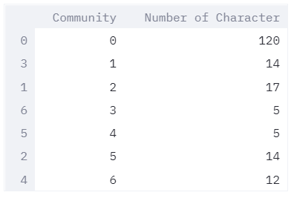
Community detection
K-mean Clustering
Number of characters in each community

Slide 15
Gephi visualization

