Slide 1


CITS1003 Introduction to Cybersecurity [3] Introduction to Computers and Networks exercises
Dr Zhi Zhang

Slide 2
Sniffing
Remote shell

Slide 3
Sniffing
Sniffing is a passive attack
active attack: an attacker interacts with the victim system
passive attack: an attacker does not need the interaction
What is it: capture network traffic between two communicating nodes
Key characteristics?

Slide 4
Sniffing
Sniffing is a passive attack
What is it: capture network traffic between two communicating nodes
Key characteristics?
Detection: hard to detect such attacks, as the attack does not leave any traces in the network.
Prevention: can be prevented via encryption

Slide 5



Sniffing
Establishing a secure channel to communicate is important
Insecure Channel
Alice
Bob
Eavesdropper

Slide 6
Sniffing
Establishing a secure channel to communicate is important
Any example?
Insecure Channel
Alice
Bob
Eavesdropper

Slide 7
Sniffing
Establishing a secure channel to communicate is important
It is also critical to consider the coverage of the channel
Secure Channel
Alice
Bob
Eavesdropper

Slide 8
Sniffing
Establishing a secure channel to communicate is important
It is also critical to consider the coverage of the channel
Insecure Channel
Gateway
Secure Channel
Gateway
sniffing
Alice
Eavesdropper
Private Company
Bob

Slide 9
Insecure channel is not encrypted, e.g., http
Secure channel is encrypted, e.g., https
Google Chrome notifies users that http is no longer secure
https://security.googleblog.com/2018/02/a-secure-web-is-here-to-stay.html

Slide 10
Why is https secure?
SSL/TLS
SSL: Secure Socket Layer
TLS: Transport Layer Security
Is https 100% secure given that it has mathematical proof?

Slide 11
Why is https secure?
SSL/TLS protocol
SSL: Secure Socket Layer
TLS: Transport Layer Security
Is https 100% secure?
a gap between theory and implementation, e.g., heartbleed

Slide 12
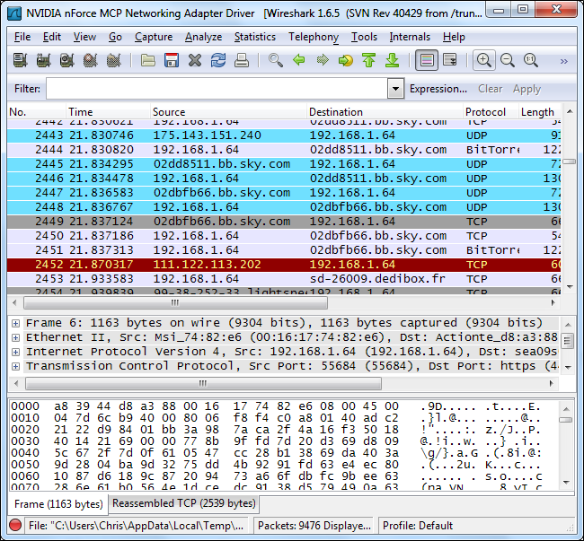
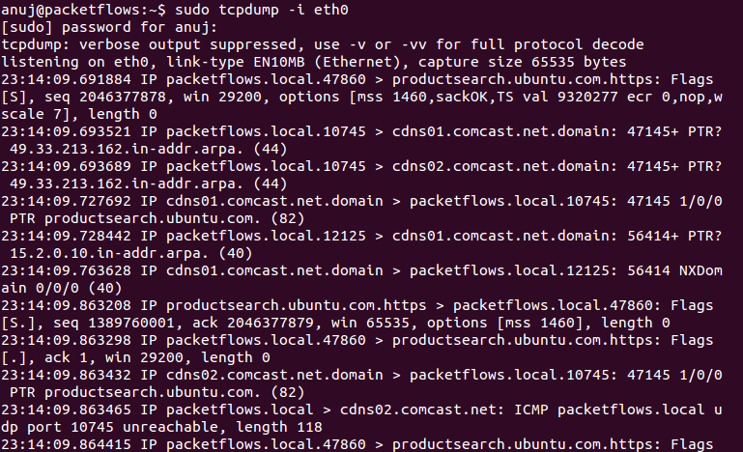
Sniffing
There are a list of tools for sniffing
e.g., Wireshark, tcpdump.

Slide 13
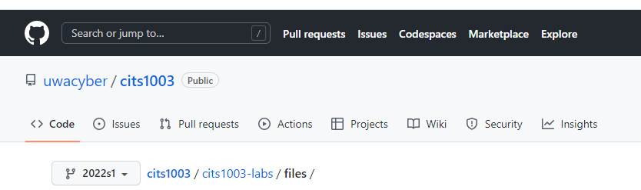

Sniffing
Demo: use our VM
https://github.com/uwacyber/cits1003/files password for decryption: infected

Slide 14
Updating
Update sniffex.c (source file) with VM’s IP address
Jump to line 513, update the IP address with your VM’s IP address.
How to find your VM’s IP address?

Slide 15
Updating
Update sniffex.c with VM’s IP address
Jump to line 513, update the IP address.
How to find your VM’s IP address?
IP address command: ip addr show

Slide 16
Compiling
gcc -o sniffex sniffex.c –lpcap

Slide 17
Compiling
gcc -o sniffex sniffex.c –lpcap
if the error “gcc has no installation candidate” occurs
if “no gcc” is reported
if the error “pcap.h: No such file or directory compilation terminated” occurs

Slide 18
Compiling
gcc -o sniffex sniffex.c –lpcap
if the error “gcc has no installation candidate” occurs
sudo apt-get update
if “no gcc” is reported
sudo apt-get install gcc
if the error “pcap.h: No such file or directory compilation terminated” occurs
sudo apt-get install libpcap-dev

Slide 19
Sniffing
How to run the demo
One terminal runs the sniffing executable
sudo ./sniffex
The other terminal connects with a telnet service
telnet telehack.com

Slide 20
Sniffing
Demo

Slide 21
Sniffing
Is sniffing attack a concern with all the advances in cybersecurity today?
What conditions would make sniffing attacks more likely to succeed?

Slide 22
Sniffing
Is sniffing attack a concern with all the advances in cybersecurity today?
e.g., cloud computing vs IoT
Cloud providers guarantee data security and privacy.
IoT vendors focus more on performance

Slide 23
Sniffing
Is sniffing attack a concern with all the advances in cybersecurity today?
e.g., cloud computing vs IoT
What conditions would make sniffing attacks more likely to succeed?

Slide 24
Sniffing
Is sniffing attack a concern with all the advances in cybersecurity today?
e.g., cloud computing vs IoT
What conditions would make sniffing attacks more likely to succeed?
e.g., a non-encryption or weak-encryption channel

Slide 25
Remote Shell
What is it: remotely execute shell commands on a target system over the internet.
shell commands, e.g., create/edit/remove files and folders, fetch data, and launch applications
Malicious use: remote shell can be abused by malicious users to cause system damage.
e.g., delete all files on the system, stealing and/or corrupting sensitive data

Slide 26
Remote Communication
Demo: use our VM
https://github.com/uwacyber/cits1003/files

Slide 27
Updating
Update client.c and client2.c with VM’s IP address
Jump to line 26, update the IP address with your VM’s IP address
IP address command: ip addr show
For client2.c, repeat the above steps
Besides the source file updates, README.txt and Makefile are also interesting

Slide 28
Compiling
README.txt: serves as a basic documentation for a open-source project
Makefile: serves as a script to automatically compile and link a set of source files for the project
To use Makefile, simply run the ‘make’ command.
If the command “make” is not found
sudo apt-get install make

Slide 29
Remote Communication
How to run the demo
One terminal runs an executable called server
./server
The other terminal runs three executables, each of which connects with the server
./client (sends “hello I am Alice ”)
./client2 (sends “hello I am Bob”)
./quit (terminates the connection)

Slide 30
Remote Communication
Demo

Slide 31
Remote Shell
Two types:
Forward shell
The malicious client executes shell commands on the server
Reverse shell
The malicious server executes shell commands on the client
Notes:
Forward shell 指的是通过网络连接从本地计算机（攻击者）向远程目标计算机（受害者）发起的 shell 连接 Reverse Shell 指的是通过网络连接从远程目标计算机（受害者）向本地计算机（攻击者）发起的 shell 连接。

Slide 32
Forward Shell
Malicious clients can exploit a weakness in their normal connection with the server to gain unauthorized access, thus executing arbitrary commands on the server.
e.g., we embed a weakness within a server program for our demo

Slide 33
Forward Shell
$: a normal user
#: a root user
$: a normal user

Slide 34
Forward Shell
How to run the demo
One terminal runs an executable called server
sudo ./server
The other terminal runs an executable called hacker
./hacker

Slide 35
Forward Shell
Demo

Slide 36
Forward Shell
In what scenarios forward shell is useful?
What are possible methods we can use to mitigate forward shell?

Slide 37
Forward Shell
In what scenarios is useful?
e.g., steal/delete/lock sensitive data stored in a high-value server.

Slide 38
Forward Shell
In what scenarios forward shell is useful?
e.g., steal/delete/lock sensitive data stored in a high-value server.
What possible countermeasure can be used to mitigate forward shell?

Slide 39
Forward Shell
In what scenarios forward shell is useful?
e.g., steal/delete/lock sensitive data stored in a high-value server.
What possible countermeasure can be used to mitigate forward shell?
e.g., regular security patches to software

Slide 40
Reverse Shell
A malicious server lures victim clients (victims) for connection
e.g., we craft a vulnerability within a client program for our demo

Slide 41
Reverse Shell
Demo

Slide 42
Reverse Shell
Is reverse shell as easy as forward shell? Why?
Can mitigations for forward shell be used for reverse shell? Why?

Slide 43
Reverse Shell
Is reverse shell as easy as forward shell? Why?
No, e.g., a high-value server might enforce more strict security polices, compared to a client.

Slide 44
Reverse Shell
Is reverse shell as easy as forward shell? Why?
No, e.g., a high-value server might enforce more strict security polices, compared to a client.
Can mitigations for forward shell be used for reverse shell? Why?

Slide 45
Reverse Shell
Is reverse shell as easy as forward shell? Why?
No, e.g., a high-value server might enforce more strict security polices, compared to a client.
Can mitigations for forward shell be used for reverse shell? Why?
Yes, e.g., regular security patches to software

