Slide 1


CITS1003 Introduction to Cybersecurity [4] Threats exercise
Dr Zhi Zhang

Slide 2
What is a malware?
oligomorphic malware
polymorphic malware
metamorphic malware
How to detect a malware?
Virus Total
Yara
Ember
Notes:
Virus Total：free online service

Slide 3
Malware
Malware: Malicious Software
definition: it refers to all malicious software designed to compromise a computer system
what does “a system compromise” mean?
Notes:
Compromise:损害

Slide 4
Malware
Malware: Malicious Software
definition: it refers to all malicious software designed to compromise a computer system
what does “compromising a system” target? Breaking the CIA triad

Slide 5
Malware
Malware: Malicious Software
definition: it refers to all malicious software designed to compromise a computer system
what does “compromising a system” target? Breaking the CIA triad
What can we do to break integrity?
e.g., modifying or deleting system files
What can we do to break confidentiality?
e.g., stealing user data
What can we do to break availability?
e.g., causing system panic

Slide 6
Malware
Representative malware types:
e.g., Worm, Trojan, and Ransomware.

Slide 7
Malware
Worm: replicates itself and spreads across networks and systems without user interaction (the way it spreads relies on exploiting vulnerabilities in network protocols or systems)
Trojan: appears as a benign program (actually containing malicious code) and relies on social engineering to deceive users into installing them.

Slide 8
Malware
Worm: replicates itself and spreads across networks and systems without user interaction (the way it spreads relies on exploiting vulnerabilities in network protocols or systems)
Trojan: appears as a legitimate program, which actually contains malicious code.
Ransomware: generates an encryption key on its own, uses the key to encrypt a victim’s files and demands payments for decryption.
Note a symmetric key is preferred but why?
Cuz another one is slower

Slide 9
Malware evasion:
encrypts/modifies its code to evade the detection by anti-malware
Common evasion techniques:
oligomorphic
polymorphic
metamorphic

Slide 10
Malware
Malware
body
pattern

Slide 11
Malware
Malware
Anti-malware pattern detection
body
pattern

Slide 12
Malware
Anti-malware pattern detection
Malware
pattern
encrypted body

Slide 13
Malware
single decryptor
pattern
Malware
pattern
Anti-malware pattern detection
encrypted body

Slide 14
Oligomorphic Malware
n decryptors
e.g., 10^2
pattern

Slide 15
Oligomorphic Malware
n decryptors
e.g., 10^2
pattern
Malware replicates itself and infects others

Slide 16
Oligomorphic Malware
n decryptors
e.g., 10^2
pattern
Malware
encrypted body
decrypted body
encrypted body
Malware replicates itself and infects others

Slide 17
Oligomorphic Malware
n decryptors
e.g., 10^2
pattern
Malware
encrypted body
decrypted body
encrypted body
Malware replicates itself and infects others
Same?
Notes:
No.Cuz they use difference encryter to encryte body

Slide 18
Oligomorphic Malware
n decryptors
e.g., 10^2
pattern
Malware
encrypted body
decrypted body
encrypted body
Malware replicates itself and infects others
Different
(most cases)

Slide 19
Oligomorphic Malware
Anti-malware pattern detection
n decryptors
e.g., 10^2
pattern
Malware
encrypted body
decrypted body
encrypted body
Malware replicates itself and infects others

Slide 20
Polymorphic Malware
n mutated decryptors
e.g., 10^9

Slide 21
Polymorphic Malware
Anti-malware pattern detection
n mutated decryptors
e.g., 10^9

Slide 22
Polymorphic Malware
n mutated decryptors
e.g., 10^9
Malware
original body
encrypted body
decrypted body
encrypted body
Malware replicates itself and infects others

Slide 23
Polymorphic Malware
n mutated decryptors
e.g., 10^9
Malware
original body
encrypted body
decrypted body
encrypted body
Malware replicates itself and infects others
Same?
Notes:
Yes.we didn’t mutate the malware body

Slide 24
Polymorphic Malware
n mutated decryptors
e.g., 10^9
Malware
original body
encrypted body
decrypted body
encrypted body
Malware replicates itself and infects others
Same
Notes:
Same, we didn’t built new body

Slide 25
Polymorphic Malware
Malware
pattern
pattern
original body
decrypted body
Same
What can we do to detect polymorphic malware?

Slide 26
Polymorphic Malware
What can we do to detect polymorphic malware?
dynamic decryption: provide a sandbox environment to execute malware and identify the pattern of malicious code at runtime
decryption occurs
at runtime
Malware
pattern
pattern
original body
decrypted body
sandbox
Anti-malware dynamic decryption
Notes:
Anti-malware dynamic decryption: 反恶意软件动态解密

Slide 27
Oligomorphic and Polymorphic Malware
What can we do to detect oligomorphic or polymorphic malware?
pattern detection: identify patterns/signatures in the decryptors.
dynamic decryption: provide a sandbox environment to execute malware and identify the pattern of malicious code at run-time

Slide 28
Metamorphic Malware
Different
Malware
Malware
Malware
Malware
original body
muted body
muted body
muted body
Malware replicates itself and infects others

Slide 29
Metamorphic Malware
Garbage (or flower) instruction: insertion of unnecessary instructions within a malware to obfuscate software analysis but retain the main logic of the malware.
mov eax, ebx; move the value of ebx into eax
nop; no operation
Notes:
Use heuristic detection:启发式检测

Slide 30
Metamorphic Malware
pattern detection
dynamic decryption
Different
?
?
Malware
Malware
Malware
Malware
original body
muted body
muted body
muted body
Malware replicates itself and infects others

Slide 31
Metamorphic Malware
pattern detection
dynamic decryption
Different
Malware
Malware
Malware
Malware
original body
muted body
muted body
muted body
Malware replicates itself and infects others

Slide 32
Metamorphic Malware
What can we do to detect metamorphic malware?
heuristic detection: provide a sandbox environment to execute malware and identify suspicious behaviours at run-time.

Slide 33
Malware
Summarize the main characteristics of oligomorphic, polymorphic and metamorphic malware

Slide 34
Malware
Summarize the main characteristics of oligomorphic, polymorphic and metamorphic malware
oligomorphic: it decrypts itself with a limited number of decrpytors each time it infects others.
polymorphic: it decrypts itself with an unlimited number of decrpytors each time it infects others.
metamorphic: it mutates itself significantly each time it infects others.

Slide 35
Malware
What are the benefits of studying evasive malware?
e.g., the attacker’s perspective/the defender’s perspective
Notes:
Evasive malware: 规避恶意软件

Slide 36
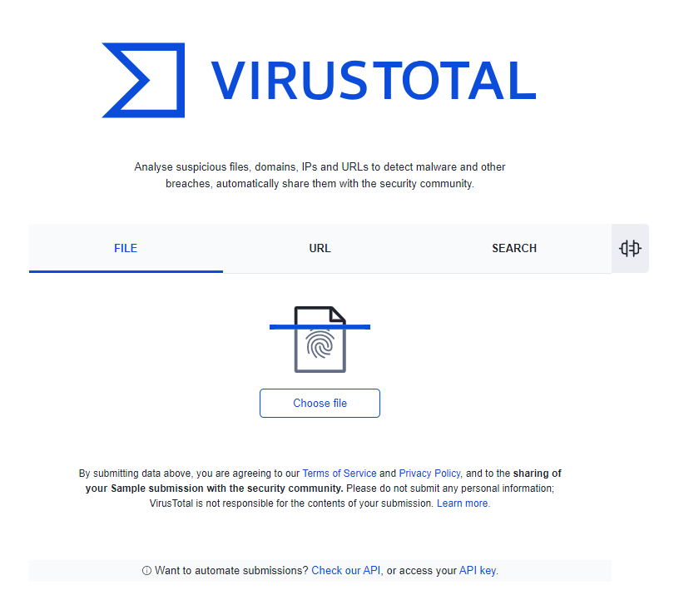
Malware Detection
Virus Total is a website (https://www.virustotal.com/gui/home/upload) that provides free online malware scanning.
It is a collection of no less than 60 malware-detection engines.
Provides a comprehensive view of whether a file or website is malicious.

Slide 37
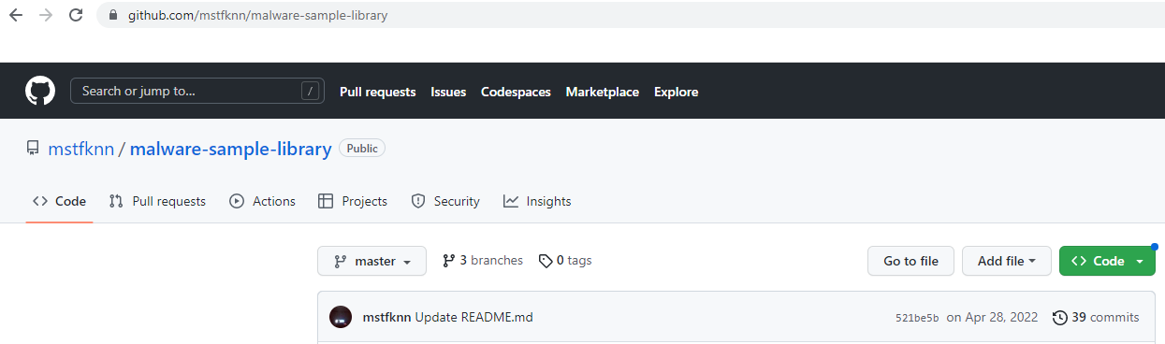
Malware Detection
Demo: use our VMs to download malware samples
https://github.com/mstfknn/malware-sample-library

Slide 38
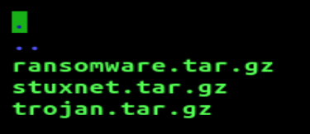
Malware Detection
https://github.com/mstfknn/malware-sample-library
3 malware samples are downloaded

Slide 39
Malware Detection
How to run the demo
Upload each compressed malware onto virustotal

Slide 40
Malware Detection
demo

Slide 41
Malware Detection
How does VirusTotal detect malware?
Can VirusTotal detect all malware? Why or Why not?

Slide 42
Malware Detection
How does VirusTotal detect malware?
e.g., it submits a given file or URL to many anti-malware engines, which apply different techniques for scanning. The techniques can be pattern detection, dynamic decryption, heuristic detection, etc.

Slide 43
Malware Detection
How does VirusTotal detect malware?
e.g., it submits a given file or URL to many anti-malware engines, which apply different techniques for scanning. The techniques can be pattern detection, dynamic decryption, heuristic detection, etc.
Can VirusTotal detect all malware?

Slide 44
Malware Detection
How does VirusTotal detect malware?
e.g., it submits a given file or URL to many anti-malware engines, which apply different techniques for scanning. The techniques can be pattern detection, dynamic decryption, heuristic detection, etc.
Can VirusTotal detect all malware?
e.g., mutated/sandbox-aware malware.

Slide 45
Malware Detection
Yara is a rule-based signature matching tool.
It is an open-source project.
It uses a set of rules to generate a pattern/signature.
The signature describes characteristics of malware, e.g., file size, file hash, certain strings of code, etc.

Slide 46
Malware Detection
How to run the demo
sudo docker run -it --rm uwacyber/cits1003-labs:ai-malware
Inside the container
apt-get install yara
git clone https://github.com/Yara-Rules/rules.git

Slide 47

Malware Detection
How to run the demo
sudo docker run -it --rm uwacyber/cits1003-labs:ai-malware
apt-get install yara
git clone https://github.com/Yara-Rules/rules.git

Slide 48
Malware Detection
How to run the demo

Slide 49
Malware Detection
How to run the demo

Slide 50

Malware Detection
How to run the demo

Slide 51
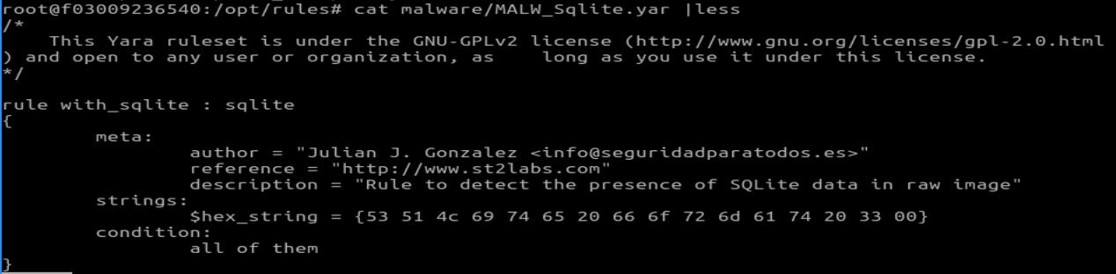
Malware Detection
How to run the demo

Slide 52
Malware Detection
demo

Slide 53
Malware Detection
List a few practical use-cases of YARA in cybersecurity

Slide 54
Malware Detection
List a few practical use-cases of YARA in cybersecurity
e.g., malware detection/intrusion detection/system monitoring

Slide 55
Malware Detection
Ember is an AI-based signature detection tool.
It is an open-source project.
It uses a deep-learning-based model to predict whether a given file is malicious.
The file type is limited to windows-specific PE (portable executable).

Slide 56
Malware Detection
How to run the demo
sudo docker run -it --rm uwacyber/cits1003-labs:ai-malware
python3 scripts/classify_binaries.py -m ember_model_2018.txt /opt/malware-sample-library/Trojans/NanocoreRAT.bin

Slide 57
Malware Detection
demo

Slide 58
Malware Detection
What is the main difference between Yara and Ember?
What can be done to improve them?

Slide 59
Malware Detection
What is the main difference between Yara and Ember?
e.g., Yara is rule-based while Ember is DL-based.
Yara supports multiple file types while Ember is limited to one type.

Slide 60
Malware Detection
What is the main difference between Yara and Ember?
e.g., Yara is rule-based while Ember is DL-based.
Yara supports multiple file types while Ember is limited to one type.
What can be done to improve them?

Slide 61
Malware Detection
What is the main difference between Yara and Ember?
e.g., Yara is rule-based while Ember is DL-based.
Yara supports multiple file types while Ember is limited to one type.
What can be done to improve them?
e.g., Yara’s limitation: rule-based signature matching, which makes it hard to work against advanced mutation techniques.
Ember’s limitation: its dataset used for DNN model training is outdated and it supports Windows PE only.

