Slide 1


CITS1003 Introduction to Cybersecurity [7] Incidents exercises
Dr Zhi Zhang

Slide 2
Incident Analysis and Modelling
ADTool
CALDERA

Slide 3
ADTool
What is ADTool?
ADTool, short for Attack-Defense Tree Tool, allows a user to model and analyze attack-defense scenarios using attack-defense trees.

Slide 4
ADTool
Installation
In a windows OS, download JDK (Java Development Kit):
Filename: jdk-17_windows-x64_bin.exe
https://www.oracle.com/java/technologies/downloads/
Install JDK
Double click the exe file

Slide 5
ADTool
Installation
Download JDK
Install JDK
Download ADTool: https://satoss.uni.lu/members/piotr/adtool/
Filename: ADTool-1.4-jar-with-dependencies.jar

Slide 6
ADTool
Installation
Download JDK
Download ADTool
Run the tool
Open PowerShell from the directory where the tool is downloaded
Run this command: java –jar .\ADTool-1.4-jar-with-dependencies.jar

Slide 7
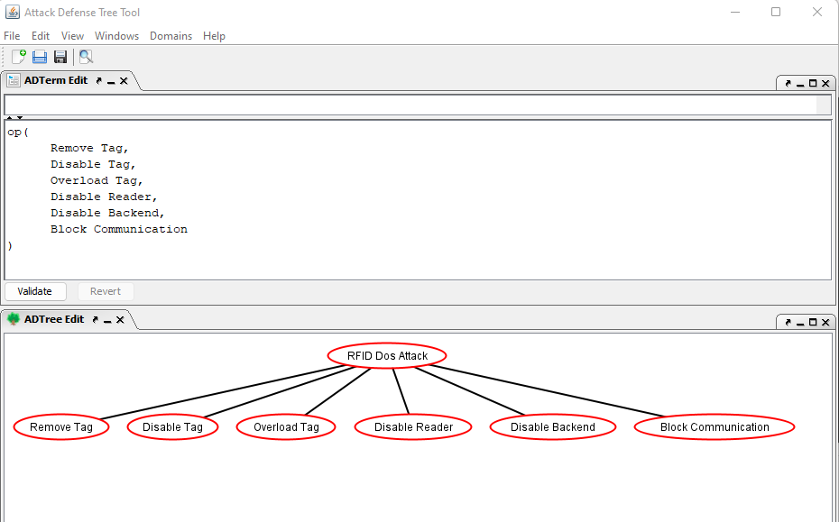

Slide 8
or proponents

Slide 9
or proponents
or
proponents

Slide 11
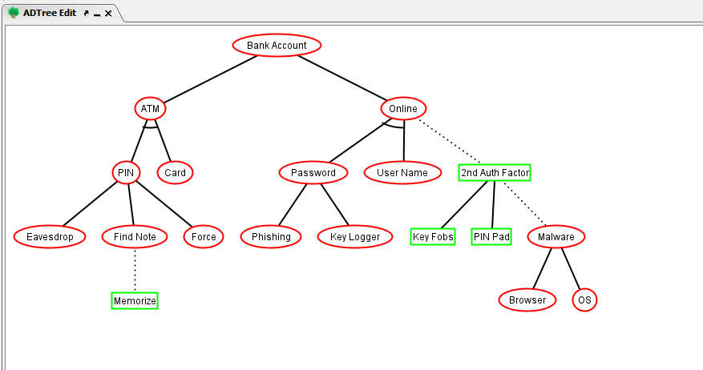
or proponents
op
op
op

Slide 12
op: or proponents
ap: and proponents
ap
?
op
op
?
?
op
?

Slide 13
op: or proponents
ap: and proponents
ap
?
opponent
op
op
oo: or opponents
?
opponent
opponent
op
?
opponent

Slide 14
op: or proponents
ap: and proponents
ap
cp
opponent
op
op
oo: or opponent
co: counter opponent
opponent
opponent
op
cp: counter proponent
opponent

Slide 15
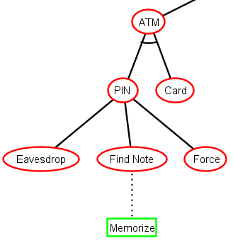
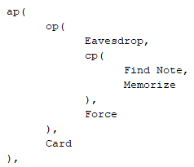

Slide 16
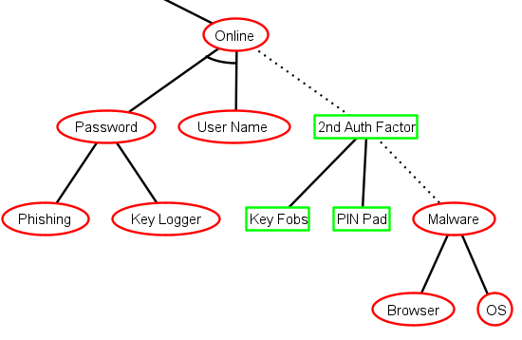
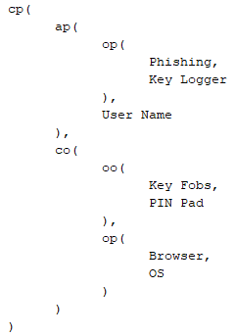

Slide 17
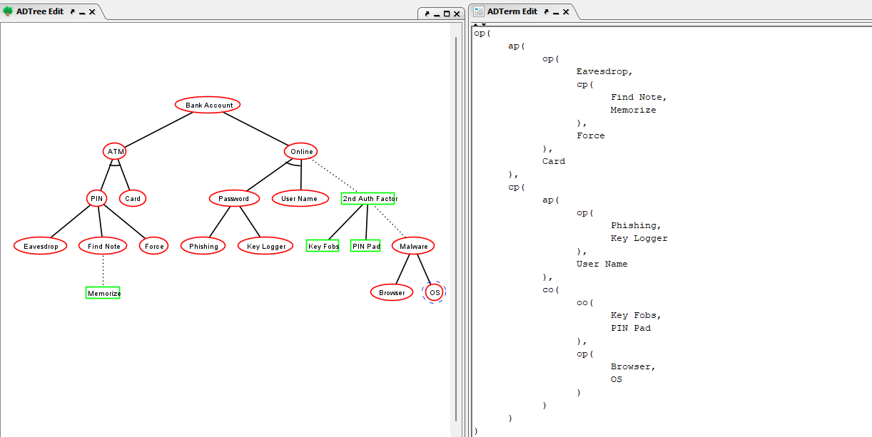

Slide 18
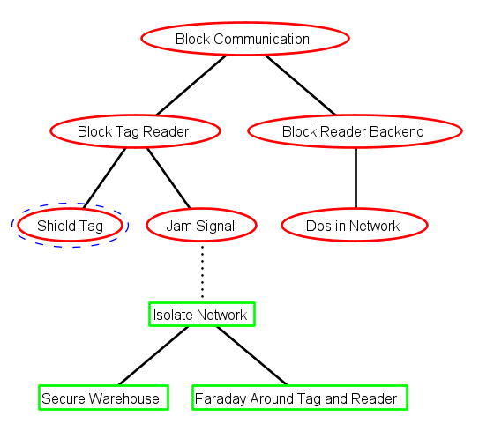
Exercise (tree translation)

Slide 19
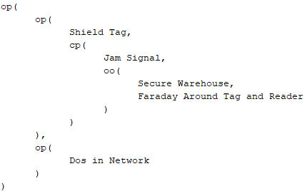
Exercise (tree translation)

Slide 20
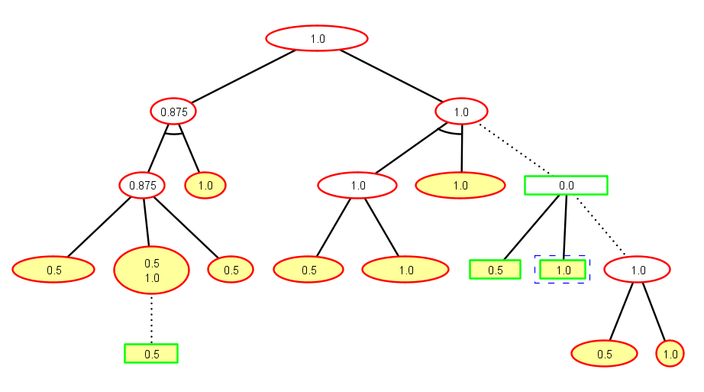
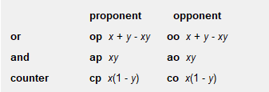
Exercise (success probability for the nodes)
0.75
1.0
0.0
1.0
0.5

Slide 21
Exercise (success probability for the nodes)
0.75
1.0
0.0
1.0
0.5

Slide 22
Exercise (success probability for the nodes)
0.75
1.0
0.0
1.0
0.5

Slide 23
Exercise (success probability for the nodes)
0.75
1.0
0.0
1.0
0.75
0.5

Slide 24
Exercise (success probability for the nodes)
0.75
1.0
0.0
0.75+0.5-0.75*0.5
1.0
0.5

Slide 25
Exercise (success probability for the nodes)
0.75
1.0
0.0
0.75+0.5-0.75*0.5
1.0
0.5

Slide 26
Exercise (success probability for the nodes)
0.75
1.0
0.0
0.75+0.5-0.75*0.5
1.0
0.75
0.5

Slide 27
Exercise (success probability for the nodes)
0.75
1.0
0.0
0.75+0.5-0.75*0.5
1.0
0.75
0.5

Slide 28
Exercise (success probability for the nodes)
0.75
1.0
0.25
0.75+0.5-0.75*0.5
1.0
0.75
0.5

Slide 29
Exercise (success probability for the nodes)
0.75
1.0
0.25
0.75+0.5-0.75*0.5
1.0
0.75
0.5

Slide 30
Exercise (success probability for the nodes)
0.75
1.0
0.25
0.75+0.5-0.75*0.5
1.0
0.75
0.5

Slide 31
Exercise (success probability for the nodes)
0.75
1.0
0.25
0.75+0.5-0.75*0.5
1.0
0.75
0.5

Slide 32
Exercise (success probability for the nodes)
0.875+0.75-0.875*0.75
0.96875
0.75
1.0
0.25
0.75+0.5-0.75*0.5
1.0
0.75
0.5

Slide 33
CALDERA
cyber range simulates real-world network environment that can be used to replicate real-world cyber scenarios.
red team is a group of security professionals who simulate cyber attacks and thus identify weaknesses that can be exploited by real attackers
blue team is a group of security professionals who respond to the simulated attacks and test their incident responses.

Slide 34
CALDERA
CALDERA provides a cyber-range environment.
A red team can automate simulated attacks that are modelled from real-world threat actors, identify weaknesses in a target organization’s network and test the incident-response mechanisms that are deployed.
A blue team can inspect the effectiveness of their deployed defenses and incident-response mechanisms, thus improving their incident response capabilities, better preparing for real-world cyber threats and mitigating the risks associated with cyber attacks.

Slide 35
CALDERA
Installation
Open a Linux VM
Run the following commands:
sudo apt install python3-pip
git clone https://github.com/mitre/caldera.git --recursive
cd caldera
pip3 install -r requirements.txt
python3 server.py --insecure

Slide 36
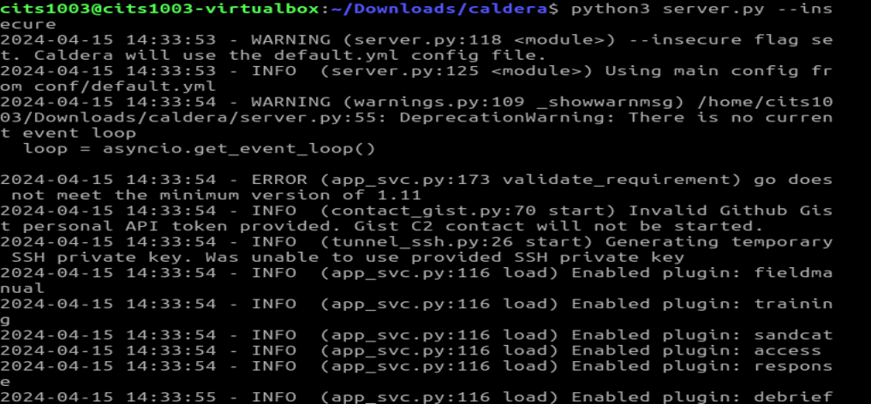
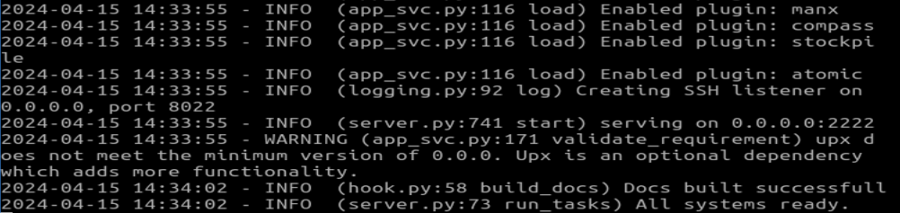

Slide 37
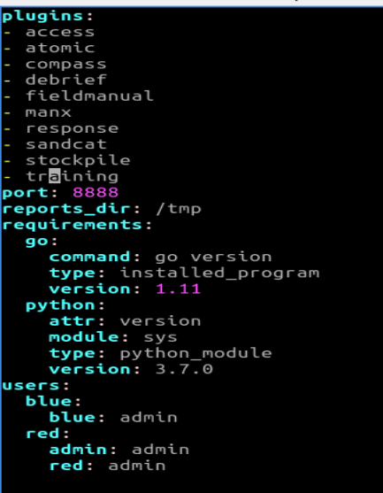
CALDERA
Login
In caldera/conf/default.vml,

Slide 38
CALDERA
Login
Open a browser
Enter the following URL in the address bar
http://localhost:8888
username: red
password: admin

Slide 39
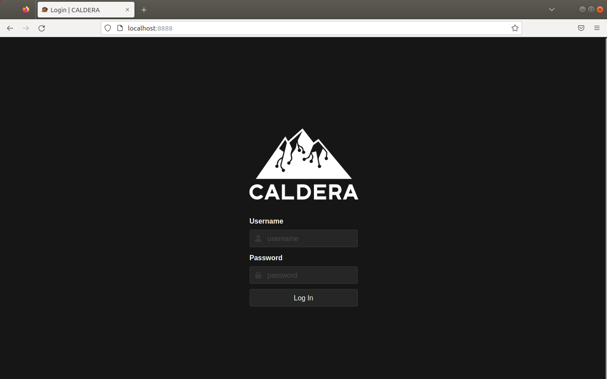
CALDERA

Slide 40
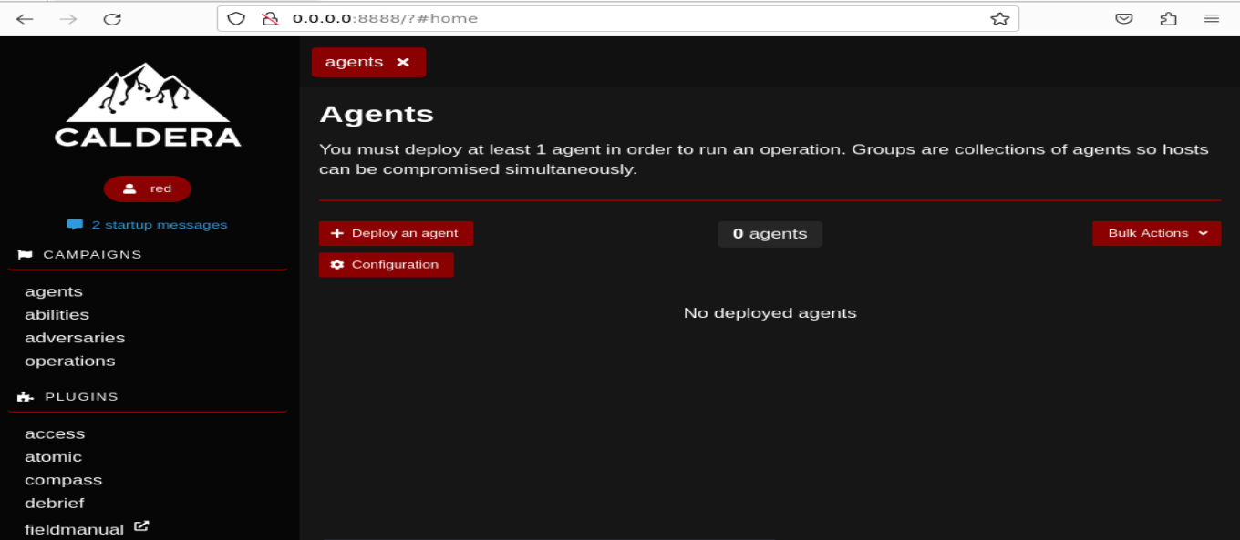
CALDERA

Slide 41
CALDERA
Adversary is a profile of instructions that describe various TTPs (Tactics, Techniques and Procedures) to be performed on a targeted system. An adversary profile can be used to simulate an attack automatically.

Slide 42
CALDERA
Tactic: high-level attack goal that attackers aim to achieve.
e.g., gaining unauthorized access.
Technique: specific method used by attackers to achieve a tactic.
e.g., exploiting vulnerabilities.
Procedure: step-by-step process followed by attackers when executing a technique.
e.g., specific Linux commands in each step.

Slide 43
CALDERA
Adversary is a profile of instructions that describe various TTPs to be performed on a targeted system. An adversary profile can be used to simulate an attack automatically.
Agent works as a spy program that is installed on the targeted system and responsible for executing TTPs specified in the adversary profile.

Slide 44
CALDERA
Adversary is a profile of instructions that describe various TTPs to be performed on a targeted system. An adversary profile can be used to simulate an attack automatically.
Agent works as a spy program that is installed on the targeted system and responsible for executing TTPs specified in the adversary profile.
Ability is a specific implementation of a tactic/technique including what commands to run and what OS the commands can run on.
e.g., display information about running processes in Linux by running ``ps –aux”

Slide 45
CALDERA
Adversary is a profile of instructions that describe various TTPs (tactics, techniques and procedures) to be performed on a targeted system. An adversary profile can be used to simulate an attack or evaluate the effectiveness of a security defense.
Agent works as a spy program that is installed on the targeted system and responsible for executing TTPs specified in the adversary profile.
Ability is a specific implementation of a tactic/technique including what commands to run and what OS the commands can run on.
Operation is to create an adversary profile and execute the profile via agent.

Slide 47
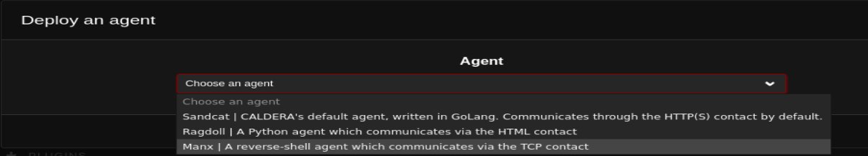

Slide 48
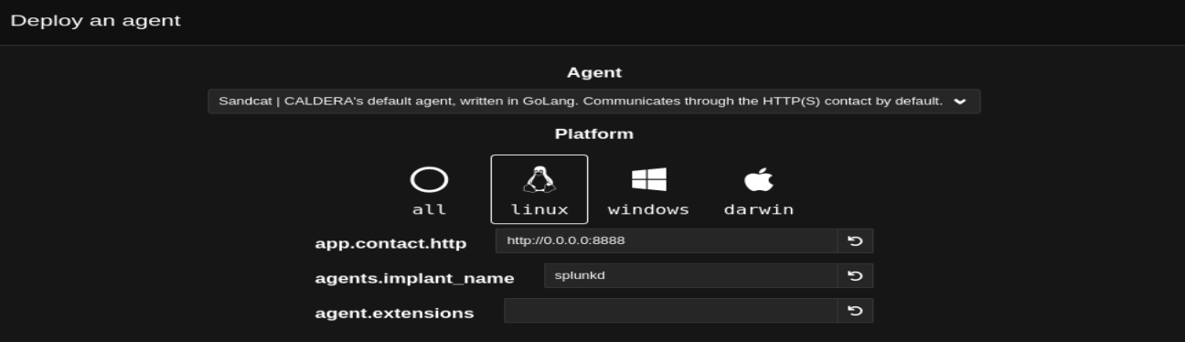
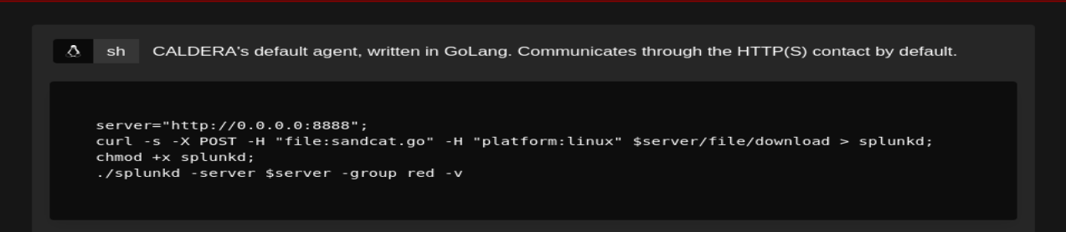

Slide 49

chmod +x agent.sh

Slide 50
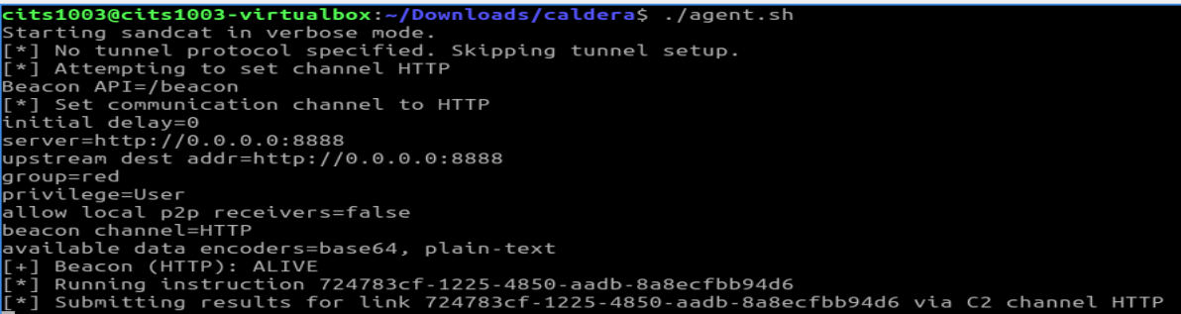

Slide 51
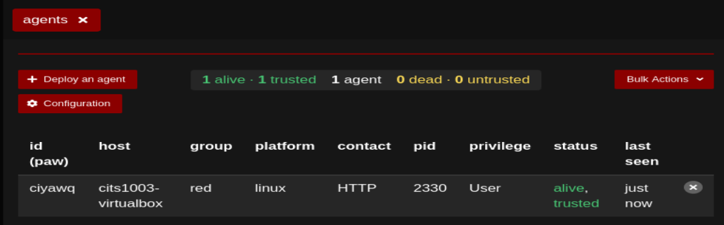

Slide 52
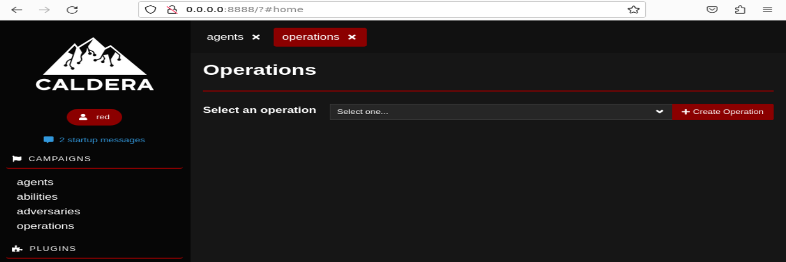

Slide 53
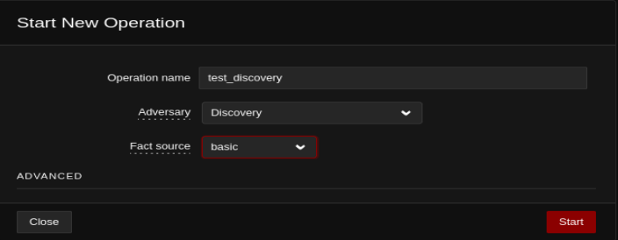

Slide 54
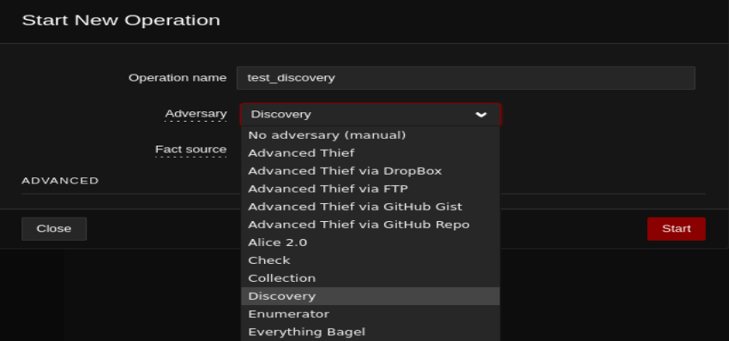
https://caldera.readthedocs.io/en/latest/plugins/stockpile/Exfiltration-How-Tos.html

Slide 55
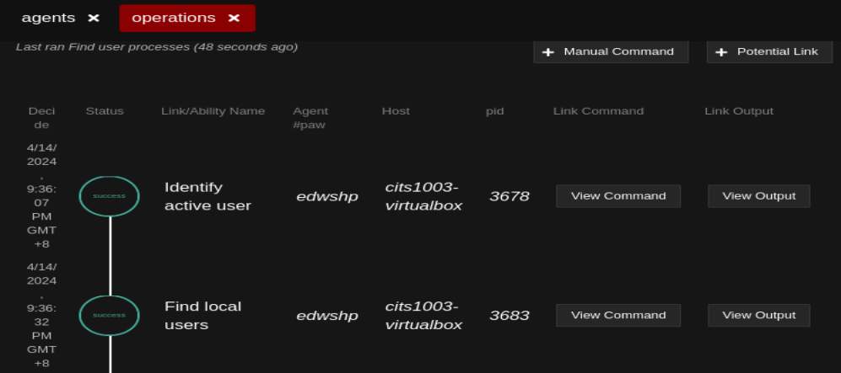

Slide 56
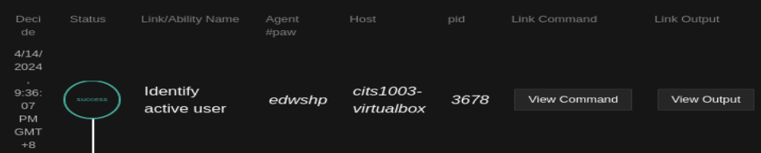
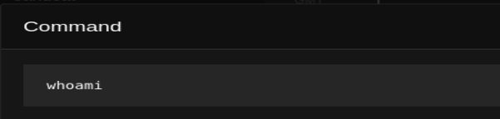
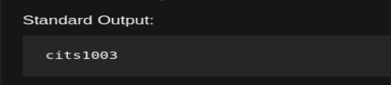

Slide 57
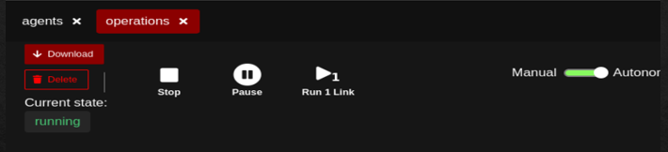
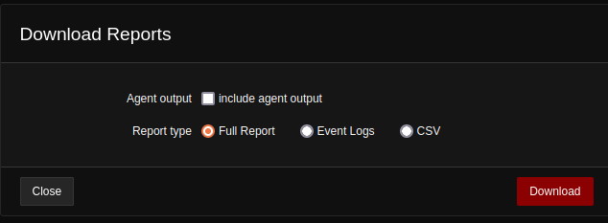

Slide 58
CALDERA
Demo

