Slide 1

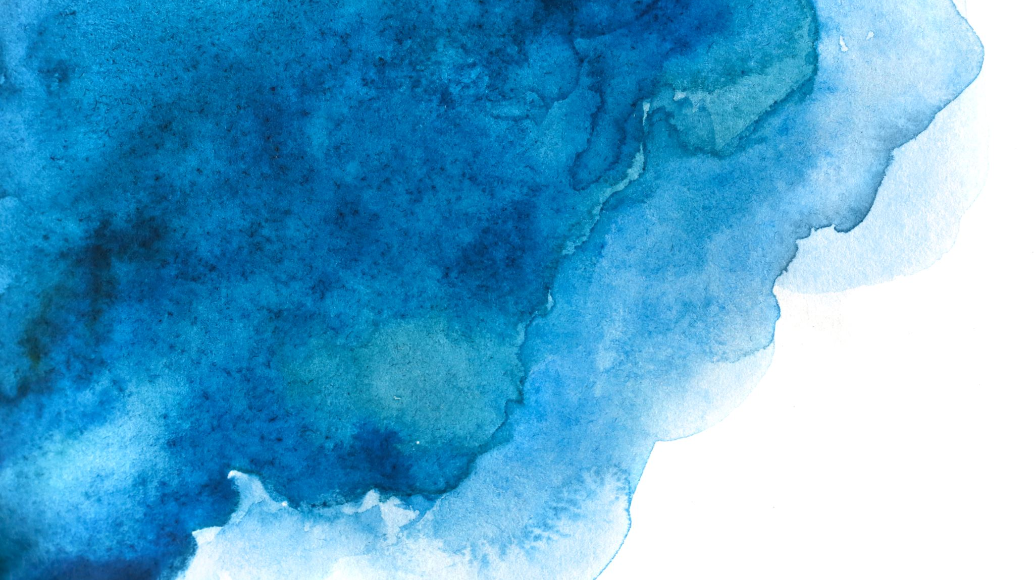
CITS1003 Introduction to Cybersecurity [8] Digital Forensics exercises
Dr Zhi Zhang

Slide 2
Steganography

Slide 3
Steganography
It is the practice of concealing a message, file, or other form of data within another file, or medium in order to hide the data’s existence.

Slide 4
Steganography
various mediums
e.g., text, image, video, audio, network
text steganography
image steganography

Slide 5
Stegosystem
Secret Message
Sender
Stego Encoder
Stego Medium
Cover Medium
Secret Message
Receiver
Stego Decoder
Cover Medium

Slide 6
Steganography
a stegosystem and a crypto system are different:
Goal
Approach

Slide 7
Stegosystem with Cryptography
Cover Medium
Sender
Stego Encoder
Secret Message
Encrypted Message
Stego Medium
Crypto Keys
Receiver
Cover Medium
Stego Decoder
Decrypted Message
Encrypted Message

Slide 8
Steganography
Text Steganography
e.g., alignment, font, position, white space
Demo
white space

Slide 9
Steganography
Alignment: The alignment of certain letters or words within a text can be used to hide a secret message.

Slide 10
Alignment
“I a e c t n a o h v a a a d d g”

Slide 11
Alignment
“I a e c t n a o
h v a a a d d g”
“I a e c t n a o h v a a a d d g”
->
I have a cat and a dog

Slide 12
Steganography
Alignment: The alignment of certain letters or words within a text can be used to hide a secret message
Font: The font itself can be used to hide a secret message.

Slide 13
Font
“Hello, world”

Slide 14
Font
Wingdings:
“Hello, world”
“Hello, world”

Slide 15
Steganography
Alignment: The alignment of certain letters or words within a text can be used to hide a secret message.
Font: The font itself can be used to hide a secret message.
Position: The position of letters or words within a text can be used to hide a secret message.

Slide 16
Position
“He encouraged leaving late on Wednesday only realising Laurie did!”

Slide 17
Position
“He encouraged leaving late on Wednesday only realising Laurie did!”
He encouraged leaving late on Wednesday only realising Laurie did
-> Hello World

Slide 18
Position
“Apparently neutral's protest is thoroughly discounted And ignored. Isman hard hit. Blockade issue affects Pretext for embargo on by products, ejecting suets and Vegetable oils.”

Slide 19
Position
“Apparently neutral's protest is thoroughly discounted And ignored. Isman hard hit. Blockade issue affects Pretext for embargo on by products, ejecting suets and Vegetable oils.”
“Apparently neutral's protest is thoroughly discounted And ignored. Isman hard hit. Blockade issue affects Pretext for embargo on by products, ejecting suets and Vegetable oils.”
-> PERSHING SAILS FROM NY R JUNE I

Slide 20
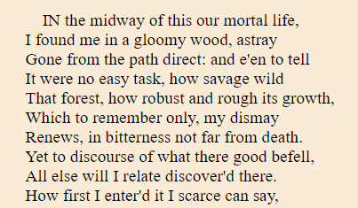
Position with A Key

Slide 21
Position with Crypto Key
Key

Slide 22
Position with Crypto Key
Key
10 pairs in total
10 lines in total

Slide 23
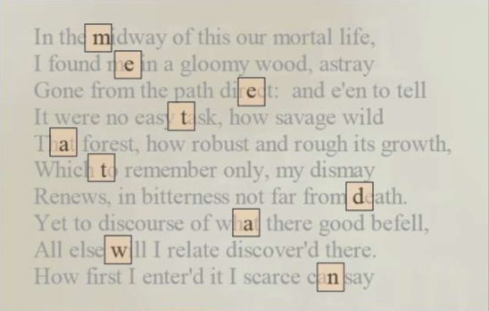
Position with Crypto Key
Key
-> meet at dawn

Slide 24
Steganography
Alignment: The alignment of certain letters or words within a text can be used to hide a secret message
Font: The font itself can be used to hide a secret message.
Position: The position of letters or words within a text can be used to hide a secret message.
White Space: The blank spaces or unused areas within a text are used to hide a secret message.

Slide 25
White Space
This sentence.
To be seen or not.
Regardless of the nature.
One cannot decide.
What to do, what not to do.
Hence, it could be argued.
Nevertheless, useless.
Only time will tell.
Again, tomorrow.

Slide 26
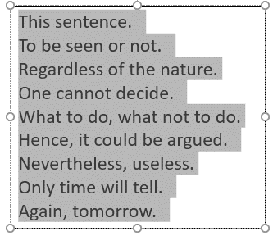
White Space
White spaces
This sentence.
To be seen or not.
Regardless of the nature.
One cannot decide.
What to do, what not to do.
Hence, it could be argued.
Nevertheless, useless.
Only time will tell.
Again, tomorrow.

Slide 27
White Space
White spaces
Encode 1s and 0s by the number of white spaces at the end of each line.
no space denotes 0
extra space denotes 1
-> 110101011

Slide 28
White Space
Demo
Download:
Find steg_demo.zip here: https://github.com/uwacyber/cits1003/tree/2022s1/cits1003-labs/files
Either host OS or VM is fine
Python 3 installed

Slide 29
Text Steganography
How difficult/easy is it to detect text steganography?
Compare position with key against white space?

Slide 30
Text Steganography
How difficult/easy is it to detect text steganography?
If it is easy, we assume the text steganography techniques are already known to us.

Slide 31
Text Steganography
How difficult/easy is it to detect text steganography?
If it is easy, we assume the text steganography techniques are already known to us.
If it is difficult, we can assume it is hard to know the techniques in practice.

Slide 32
Text Steganography
How difficult/easy is it to detect text steganography?
If it is easy, we assume the text steganography techniques are already known to us.
If it is difficult, we can assume it is hard to know the techniques in practice.
Compare position with key against white space?

Slide 33
Text Steganography
How difficult/easy is it to detect text steganography?
If it is easy, we assume the text steganography techniques are already known to us.
If it is difficult, we can assume it is hard to know the techniques in practice.
Compare position with key against white space?
For position w/ key, a key specifies the positions of secrets. The secrets are from the original text. The file size does not change.

Slide 34
Text Steganography
How difficult/easy is it to detect text steganography?
If it is easy, we assume the text steganography techniques are already known to us.
If it is difficult, we can assume it is hard to know the techniques in practice.
Compare position with key against white space?
For white space, blank spaces or unused areas are used for hiding secrets. The file size does change.

Slide 35
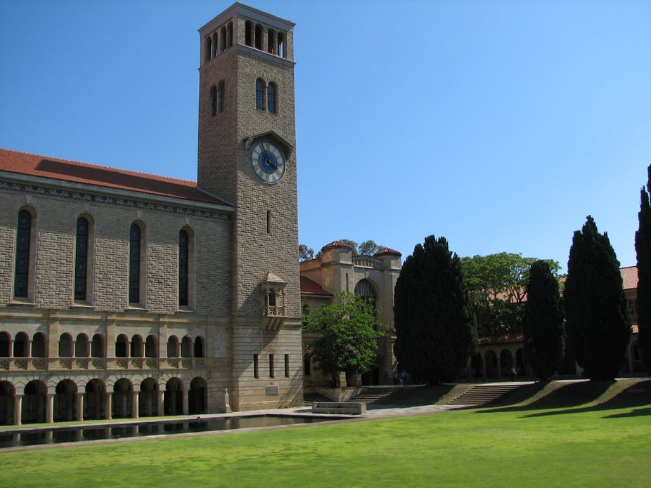

Image Steganography

Slide 36
Steganography
Image Steganography
e.g., LSB (Least Significant Bit), PVD (Pixel-Value Differencing)
Demo
LSB

Slide 37
Steganography
LSB: LSB of each pixel is replaced with a bit of the secret message to be hidden.

Slide 38
LSB
RGB: stands for Red, Green, and Blue. It is a color model to represent colors in digital images and on computer screens. In this model, each color is represented by 8 bits (0-255).
0000 0000 -> 0
1111 1111 -> 255
Pixel: is the smallest unit of an RGB image. It has an RGB (3 colors) value and a location in an image. Its 3 colors are determined by its RGB value.

Slide 39
LSB
RGB: stands for Red, Green, and Blue. It is a color model to represent colors in digital images and on computer screens. In this model, each color is represented by 8 bits.
Pixel: is the smallest unit of an image. It has a specific color in an image. Its color is determined by its RGB values.
LSB: embeds 3 secret bits per pixel in an RGB image. Why 3 bits?

Slide 40
LSB
RGB: stands for Red, Green, and Blue. It is a color model to represent colors in digital images and on computer screens. In this model, each color is represented by 8 bits.
Pixel: is the smallest unit of an image. It has a specific color in an image. Its color is determined by its RGB values.
LSB: embeds three secret bits per pixel in an RGB image. Why 3 bits?
A pixel has an RGB value of (X, Y, Z). X, Y, and Z are respectively represented by 8 bits and LSB of each 8 bits can be modified.

Slide 41
LSB
Given the following 3 RGB values
A secret bit stream of 101 101 101 needs to be hidden. How many LSBs will be changed at least?
10010101 00001101 11001001 10010110 00001111 11001010 10011111 00010000 11001011

Slide 42
LSB
Given the following 3 RGB values
A secret bit stream of 101 101 101 needs to be hidden. How many LSBs will be changed at least?
Can we use MSB for image steganography? Why or Why not?
10010101 00001101 11001001 10010110 00001111 11001010 10011111 00010000 11001011
10010101 00001100 11001001 10010111 00001110 11001011 10011111 00010000 11001011

Slide 43
LSB
110 needs to be hidden
RGB value
(149, 13, 73)
10010101 00001101 01001001
MSB
LSB
10010101 10001101 01001001
10010101 00001101 01001000
(149, 141, 73)
RGB value
(149, 13, 72)
RGB value

Slide 44
LSB
Demo
Either host OS or VM is fine
Python 3 and Python Pillow library installed

Slide 45
Steganography
LSB: LSB of each pixel is replaced with a bit of the secret message to be hidden.
PVD: modifies a pair of two adjacent pixels' values at one time to hide secret bits.

Slide 46
PVD
Greyscale Image: consists of shades of gray, varying from black to white, with different shades of gray in between. A shade of gray is represented by 8 bits or 16 bits.
Pixel: is the smallest unit of an image. It has a single value (0 to 255 for 8-bit images) or (0 to 65,535 for 16-bit images).
0000 0000 0000 0000
1111 1111 1111 1111

Slide 47



PVD
0
$$l_{i}$$
$$U_{i}$$
255
1 | 2 | 3 | 4 | i | n
$$r_{i}$$

Slide 48

PVD
0
$$l_{i}$$
$$U_{i}$$
255
1 | 2 | 3 | 4 | i | n
$$r_{i}$$
What are the values of $l_{1}$ and $U_{n}$?

Slide 49
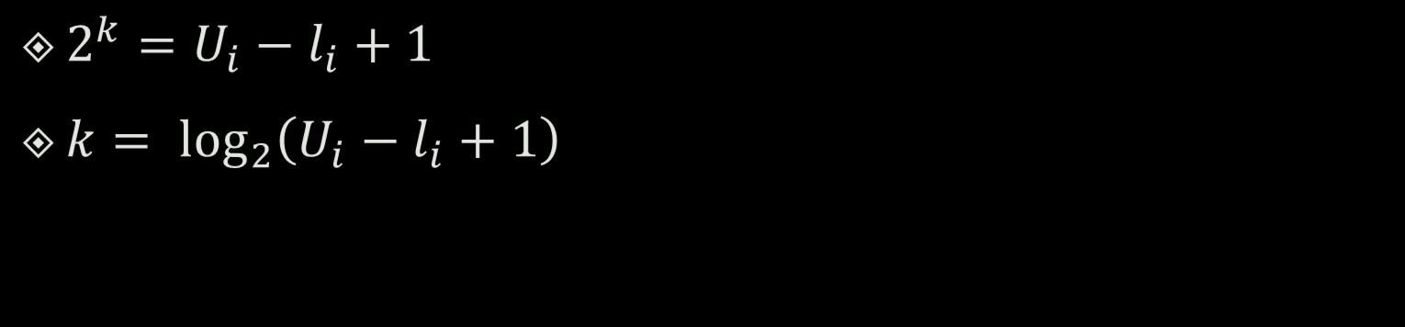
PVD
0
$$l_{i}$$
$$U_{i}$$
255
1 | 2 | 3 | 4 | i | n
$$r_{i}$$
$2^{k}=U_{i}−l_{i}+1$
$k= \log_{2}\left(U_{i}−l_{i}+1\right)$

Slide 50
PVD
0
255
8
8
16
32
64 = 2^{^6}
128

Slide 51
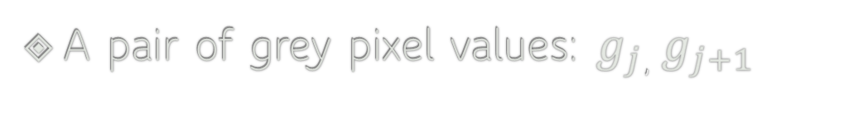

PVD
0
$$l_{i}$$
$$U_{i}$$
255
1 | 2 | 3 | 4 | i | n
$$r_{i}$$
A pair of grey pixel values: $g_{j}$, $g_{j+1}$
$$g_{j}$$ | $$g_{j+1}$$
Grey Image

Slide 52
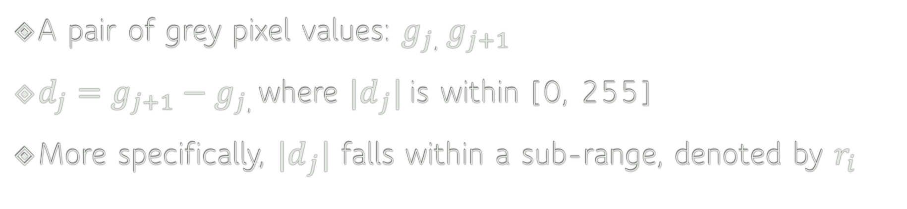
PVD
0
$$l_{i}$$
$$U_{i}$$
255
1 | 2 | 3 | 4 | i | n
$$r_{i}$$
A pair of grey pixel values: $g_{j}$, $g_{j+1}$
$d_{j}=g_{j+1}−g_{j}$, where ${|d}_{j}|$is within [0, 255]
More specifically, ${|d}_{j}|$ falls within a sub-range, denoted by $r_{i}$

Slide 53
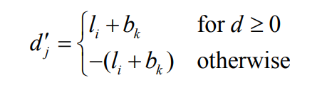
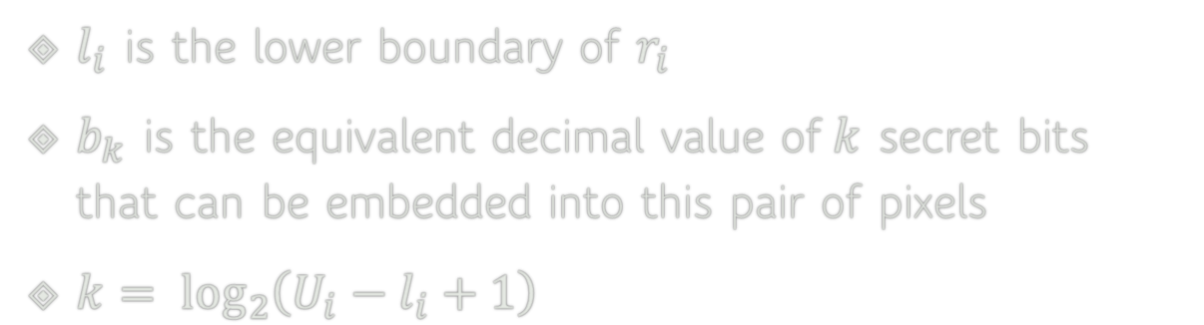
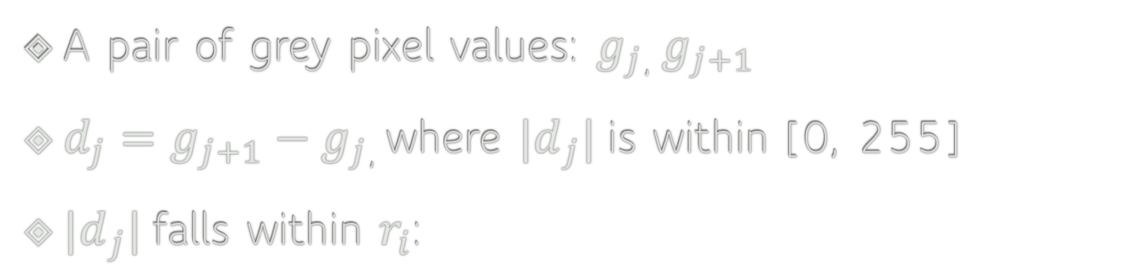




PVD
0
$$l_{i}$$
$$U_{i}$$
255
1 | 2 | 3 | 4 | i | n
$$r_{i}$$
A pair of grey pixel values: $g_{j}$, $g_{j+1}$
$d_{j}=g_{j+1}−g_{j}$, where ${|d}_{j}|$is within [0, 255]
${|d}_{j}|$falls within $r_{i}$:
$l_{i}$ is the lower boundary of $r_{i}$
$b_{k}$ is the equivalent decimal value of$k$ secret bits that can be embedded into this pair of pixels
$k= \log_{2}\left(U_{i}−l_{i}+1\right)$
$$j$$

Slide 54
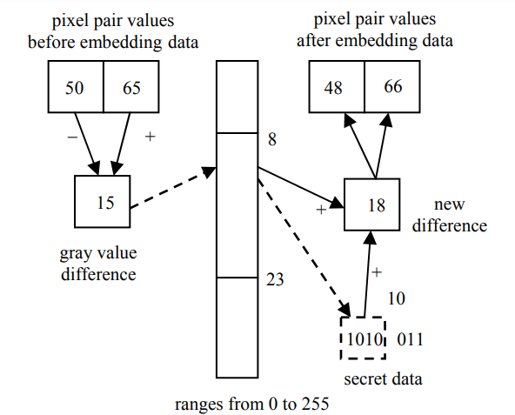
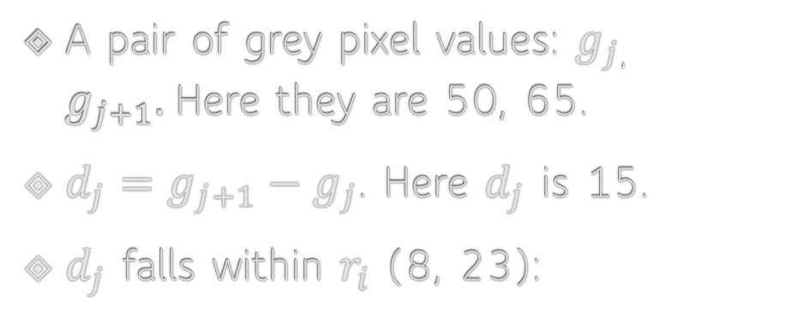
PVD
A pair of grey pixel values: $g_{j}$, $g_{j+1}.$Here they are 50, 65.
$d_{j}=g_{j+1}−g_{j}$. Here $d_{j}$ is 15.
$d_{j}$ falls within $r_{i}$ (8, 23):

Slide 55

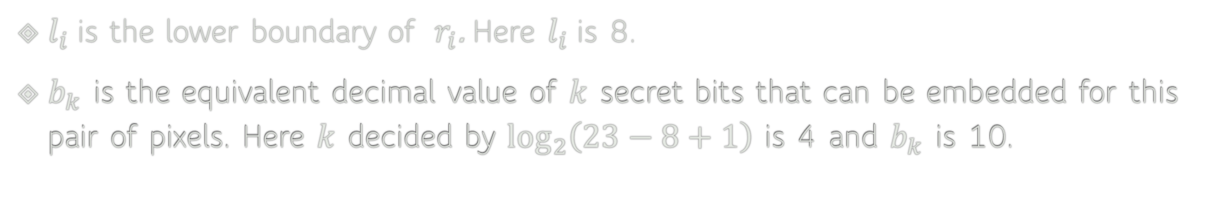
PVD
A pair of grey pixel values: $g_{j}$, $g_{j+1}.$Here they are 50, 65.
$d_{j}=g_{j+1}−g_{j}$. Here $d_{j}$ is 15.
$d_{j}$ falls within $r_{i}$ (8, 23):
$$j$$
$l_{i}$ is the lower boundary of $r_{i}$. Here $l_{i}$is 8.
$b_{k}$ is the equivalent decimal value of $k$ secret bits that can be embedded for this pair of pixels. Here $k$ decided by $\log_{2}\left(23−8+1\right)$ is 4 and $b_{k}$ is 10.

Slide 56
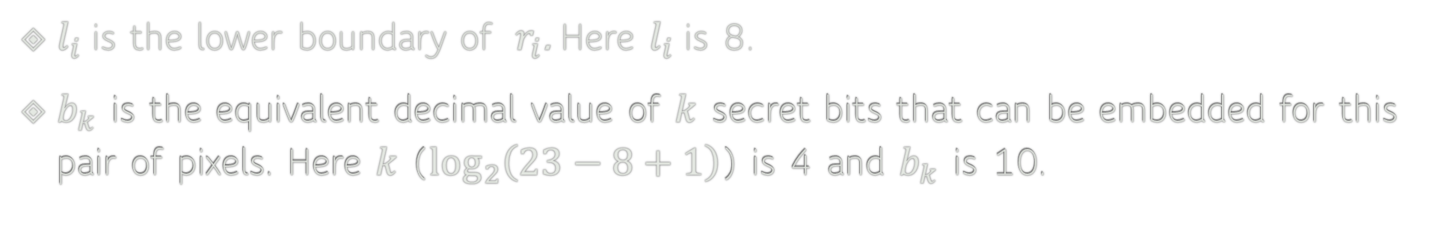
PVD
A pair of grey pixel values: $g_{j}$, $g_{j+1}.$Here they are 50, 65.
$d_{j}=g_{j+1}−g_{j}$. Here $d_{j}$ is 15.
$d_{j}$ falls within $r_{i}$ (8, 23):
$$j$$
$l_{i}$ is the lower boundary of $r_{i}$. Here $l_{i}$is 8.
$b_{k}$ is the equivalent decimal value of $k$ secret bits that can be embedded for this pair of pixels. Here $k$ ($\log_{2}\left(23−8+1\right)$) is 4 and $b_{k}$ is 10.

Slide 57
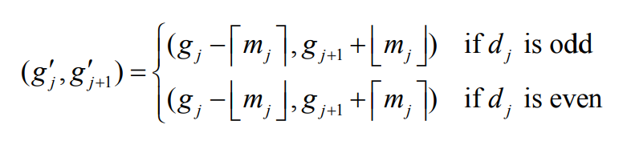
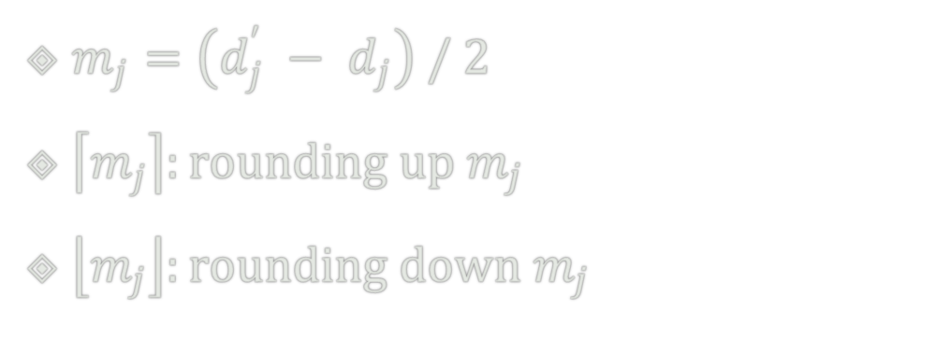
PVD
$m_{j}=\left(d_{j}^{′} − d_{j}\right) / 2$
$\left\lceil m_{j}\right\rceil :rounding up m_{j}$
$\left\lfloor m_{j}\right\rfloor :rounding down m_{j}$

Slide 58
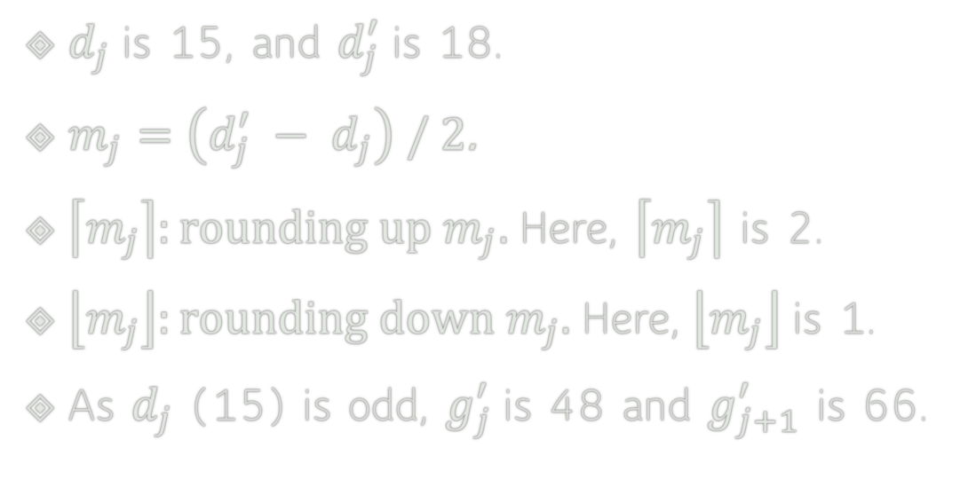
PVD
$d_{j}$ is 15, and $d_{j}^{′}$is 18.
$m_{j}=\left(d_{j}^{′} − d_{j}\right) / 2$.
$\left\lceil m_{j}\right\rceil :rounding up m_{j}.$Here, $\left\lceil m_{j}\right\rceil$ is 2.
$\left\lfloor m_{j}\right\rfloor :rounding down m_{j}.$ Here, $\left\lfloor m_{j}\right\rfloor$ is 1.
As $d_{j}$ (15) is odd, $g_{j}^{′}$is 48 and $g_{j+1}^{′}$ is 66.

Slide 59

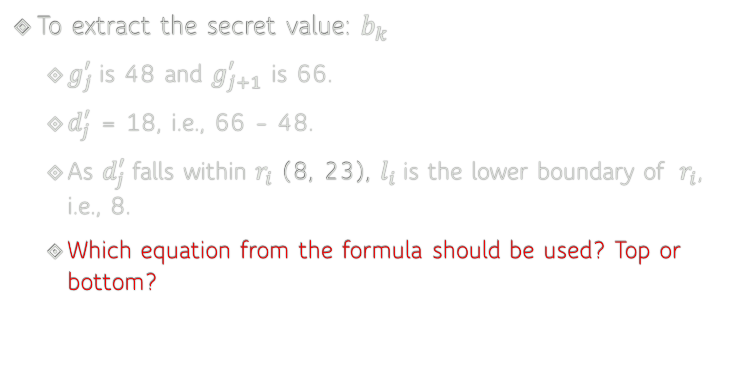

PVD
To extract the secret value: $b_{k}$
$g_{j}^{′}$is 48 and $g_{j+1}^{′}$ is 66.
$d_{j}^{′}$ = 18, i.e., 66 – 48.
As $d_{j}^{′}$falls within $r_{i}$ (8, 23), $l_{i}$ is the lower boundary of $r_{i}$, i.e., 8.
Which equation from the formula should be used? Top or bottom?
$$j$$

Slide 60
Image Steganography
How difficult/easy is it to detect image steganography?
What kinds/types of images are more resistant to image steganography?

Slide 61
Image Steganography
How difficult/easy is it to detect image steganography?
What if it is easy?
What if it is difficult?

Slide 62
Image Steganography
How difficult/easy is it to detect image steganography?
What if it is easy?
What if it is difficult?
What kinds/types of images are more resistant to image steganography?

Slide 63
Image Steganography
How difficult/easy is it to detect image steganography?
What if it is easy?
What if it is difficult?
What kinds/types of images are more resistant to image steganography?
Lossless compression images, e.g., PNG or BMP

