Slide 1


CITS1003 Introduction to Cybersecurity Exam Example Exercises
Dr Zhi Zhang

Slide 2
Peer-marking project reports
https://docs.google.com/document/d/1oCKSoVzA9gqzbp3TsFma1NxgVsglXZWjOVT0VTFUK3E/edit?usp=sharing
Exam

Slide 3
Exam Format
The exam is F2F and has a time limit of 2 hours.
The exam is marked out of 100 points and is worth 50% of the overall unit mark.
The exam is open book: any printed or written materials are allowed.
UWA approved calculators with stickers are permitted.

Slide 4
Exam Instructions
For F2F exam :
You will be provided with an answer booklet
You should clearly state which questions of the final exam you are answering.
Please do NOT use a pencil or a red pen.
Please use readable handwriting. What cannot be read cannot be marked.

Slide 5
Exam Topics
6 topics (pre-recorded videos and live-lectures)
AI in cybersecurity (1 themed question)
Computers including cyber concepts in week 1 and lab 3 (1 themed question)
Cryptography (1 themed question)
Networks (including lab 4) and Vulnerabilities (1 themed question)
Incidents (1 themed question)
Forensics (1 themed question)
A themed question describes a scenario where a few questions are asked.
Demos in the live lectures will NOT be examined.

Slide 6
Example Question 1
You are a malicious actor wanting to physically infiltrate the corporate headquarters of Company X. To do so, you will need to bypass the security camera system installed at the front door (the front door is the only way in). The camera system records video footage of people coming into the building and based on this, determines whether or not they have proper access. You do not know the specifics of the system, but you are at least certain that AI facial recognition is involved in identifying individuals. You thus begin to devise adversarial attack strategies to circumvent the system and gain illegal access to the building.
Part 1. [2 marks] Would this strategy be a white-box or a black-box attack? Justify your answer.
Part 2. [3 marks] Design an adversarial attack that can negatively affect the AI model in its prediction capabilities. Justify your design. Part 3. [3 marks] Describe 3 possible challenges in devising mitigations against adversarial attacks for this system in the long-term.
Notes:
1.black-box att

Slide 7
Example Question 1
Part 1. [2 marks] Would this strategy be a white-box or a black-box attack? Justify your answer.

Slide 8
Example Question 1
Part 1. [2 marks] Would this strategy be a white-box or a black-box attack? Justify your answer.
[1 mark] black box
[1 mark] for justification: we have no knowledge of how the AI system works including its model architecture, parameters and training dataset.

Slide 9
Example Question 1
Part 2. [3 marks] Design an adversarial attack that can negatively affect the AI model in its prediction capabilities. Justify your design.

Slide 10
Example Question 1
Part 2. [3 marks] Design an adversarial attack that can negatively affect the AI model in its prediction capabilities. Justify your design.
[2 marks] a reasonable design (such as creating distortions) with an example (such as makeup).
[1 mark] the impact of the design on the AI system: the system will misidentify the attacker as an authorized individual or simply fail to recognize a face at all

Slide 11
Example Question 1
Part 3. [3 marks] Describe 3 possible challenges in devising mitigations against adversarial attacks for this system in the long-term.

Slide 12
Example Question 1
Part 3. [3 marks] Describe 3 possible challenges in devising mitigations against adversarial attacks for this system in the long-term.
[1 mark] The trade-off between security and user convenience: Implementing more stringent security measures may increase the system's resilience to attacks but could also make it more cumbersome for authorized users to access the building.
[1 mark] The complexity and resource requirements of maintaining a robust AI system: regularly updating the AI's training data, implementing new defenses, and monitoring the system can be time-consuming and resource-intensive.
[1 mark] Updates or modifications to the system can inadvertently introduce new vulnerabilities to the system.

Slide 13
Example Question 2
Dirty COW (Dirty copy-on-write) is a computer security vulnerability for the Linux kernel that affected many Linux-based operating systems. It is a local privilege escalation bug that exploits a race condition in the implementation of the copy-on-write mechanism in the kernel's memory-management subsystem. The exploit allows an attacker to obtain root permissions on a Linux device, also known as privilege escalation.
Part 1 [4 marks] Describe some malicious actions that an attacker with root permissions gained through privilege escalation can perform. Include the associated linux commands for each action, or the commands at each step of the action.
Part 2 [4 marks] What do these directories contain?
- /home
- /mnt
- /usr/local
- /opt
Part 3 [2 marks] Write a command to find all files that start with the string "host" (e.g., host123.txt, host_cmd.conf, hostname, etc.) located in the currently logged-in user’s home directory.
Part 4 [4 marks] You are provided with a permission string as follows: -rwxrw-r--
What does it mean?

Slide 14
Example Question 2
Part 1 [4 marks] Describe some malicious actions that an attacker with root permissions gained through privilege escalation can perform. Include the associated linux commands for each action, or the commands at each step of the action.

Slide 15
Example Question 2
Part 1 [4 marks] Describe some malicious actions that an attacker with root permissions gained through privilege escalation can perform. Include the associated linux commands for each action, or the commands at each step of the action.
[2 marks] recursively deleting all files and directories in the current directory: rm –rf *
[2 marks] Changing the permission of a regular user Alice: usermod –u 0 Alice

Slide 16
Example Question 2
Part 2 [4 marks] What do these directories contain?
- /home
- /mnt
- /usr/local
- /opt

Slide 17
Example Question 2
Part 2 [4 marks] What do these directories contain?
- /home
- /mnt
- /usr/local
- /opt
[1 mark] user home directory
[1 mark] location for mounting temporary filesystems
[1 mark] users programs that users have installed from source.
[1 mark] optional add-on applications

Slide 18
Example Question 2
Part 3 [2 marks] Write a command to find all files that start with the string "host" (e.g., host123.txt, host_cmd.conf, hostname, etc.) located in the currently logged-in user’s home directory.

Slide 19
Example Question 2
Part 3 [2 marks] Write a command to find all files that start with the string "host" (e.g., host123.txt, host_cmd.conf, hostname, etc.) located in the currently logged-in user’s home directory.
[2 marks] find ~/ -name 'host*'

Slide 20
Example Question 2
Part 4 [4 marks] You are provided with a permission string as follows: -rwxrw-r—
What does it mean?

Slide 21
Example Question 2
Part 4 [4 marks] You are provided with a permission string as follows: -rwxrw-r—
What does it mean?
[1 mark] The first character indicates the file type. Here, the "-" denotes a regular file.
[1 mark] The next three characters indicate the permissions granted to the owner of the file. Here, the owner has read, write, and execute permissions.
[1 mark] The following three characters indicate the permissions granted to the group that the file belongs to. Here, the group has only read and write permissions.
[1 mark] The last three characters indicate the permissions granted to other users who are not the file owner or part of the group. Here, others only have read permission.

Slide 22
Example Question 3
The CEO of Australia’s leading take-away chicken restaurant, ‘Chicken Delight’, received an email to his company email at ceo@chickendelight.com from a sender at chockendelight@gmail.com. The email claims to be the new Chicken Delight finance executive. The email asked the CEO to verify the company’s bank details for a new finance system by clicking on a bit.ly link provided in the email. The CEO clicked the link, causing Chicken Delight to lose over $80,000. As a result, the CEO was fired last night.
Part 1 [1 mark] Which specific Social Engineering Threat is this?
Part 2 [2 marks] How could the company mitigate similar attacks in the future?
Part 3 [2 marks] Can you name some features of the email that the CEO have failed to pick up on?
Part 4 [3 marks] Let’s assume you have developed a spam email filter that is currently 100% effective at filtering out spam emails. Will this solve the spam email threat? Why or why not? Justify your answer.

Slide 23
Example Question 3
Part 1 [1 mark] Which specific Social Engineering Threat is this?

Slide 24
Example Question 3
Part 1 [1 mark] Which specific Social Engineering Threat is this?
Whale phishing

Slide 25
Example Question 3
Part 1 [1 mark] Which specific Social Engineering Threat is this?
Whale phishing
Part 2 [2 marks] How could the company mitigate similar attacks in the future?

Slide 26
Example Question 3
Part 1 [1 mark] Which specific Social Engineering Threat is this?
Whale phishing
Part 2 [2 marks] How could the company mitigate similar attacks in the future?
[2 marks] Security awareness training: employees should be trained to verify the authenticity of emails, especially those requesting sensitive information or financial transactions.
[2 marks] Improving spam email filtering: implement robust email filtering solutions to detect and block phishing emails before they reach employees' inboxes.

Slide 27
Example Question 3
Part 1 [1 mark] Which specific Social Engineering Threat is this?
Whale phishing
Part 2 [2 marks] How could the company mitigate similar attacks in the future?
[2 marks] Security awareness training: describe it.
[2 marks] Improving spam email filtering: describe it.
Part 3 [2 marks] Can you name some features of the spam email that the CEO have failed to pick up on?

Slide 28
Example Question 3
Part 1 [1 mark] Which specific Social Engineering Threat is this?
Whale phishing
Part 2 [2 marks] How could the company mitigate similar attacks in the future?
[2 marks] Security awareness training: describe it.
[2 marks] Improving spam email filtering: describe it.
Part 3 [2 marks] Can you name some features of the spam email that the CEO have failed to pick up on?
[1 mark] an external email as a non-company email: the CEO email has chickendelight.com and the scammer has gmail.com)
[1 mark] the short URL link is unknown and can be malicious.

Slide 29
Example Question 3
Part 4 [3 marks] Let’s assume you have developed a spam email filter that is currently 100% effective at filtering out existing spam emails. Will this solve the spam email threat? Why or why not? Justify your answer.

Slide 30
Example Question 3
Part 4 [3 marks] Let’s assume you have developed a spam email filter that is currently 100% effective at filtering out existing spam emails. Will this solve the spam email threat? Why or why not? Justify your answer.
[1 mark] saying “no” here is easier.
[2 marks] spam email senders are constantly evolving their techniques to bypass filters and deceive recipients. They can employ various tactics such as image-based spam. As such, new types of spam emails can emerge that may not be effectively blocked by the existing filter.

Slide 31
Example Question 4
Assume Alice is flatting in a house with others, and everyone uses the same router to access the internet. One of the flatmate, Bob, has been annoying Alice recently and Alice wants to break the CIA triad when Bob is searching the internet (please don't do this in real-world).
Part 1 [2 marks] Describe a possible attack to violate the confidentiality of Bob’s computer system, and the limitation of the attack.
Part 2 [2 marks] Describe a possible attack to violate the integrity of Bob’s computer system, and the limitation of the attack.
Part 3 [2 marks] Describe a possible attack to violate the availability of Bob’s computer system, and the limitation of the attack.

Slide 32
Example Question 4
Part 1 [2 marks] Describe a possible attack to violate the confidentiality of Bob’s computer system, and the limitation of the attack.

Slide 33
Example Question 4
Part 1 [2 marks] Describe a possible attack to violate the confidentiality of Bob’s computer system, and the limitation of the attack.
[1 mark] Packet Sniffing: Alice could use the packet sniffing technique to filter and capture Bob’s network packets passing through the router. By capturing the packets, Alice could potentially analyze the data to extract Bob’s sensitive information, such as websites visited and login credentials.
[1 mark] Encryption: Bob can use anonymous networks such as Tor where transmitted data are encrypted, making it difficult for Alice to decrypt the data.

Slide 34
Example Question 4
Part 2 [2 marks] Describe a possible attack to violate the integrity of Bob’s computer system, and the limitation of the attack.

Slide 35
Example Question 4
Part 2 [2 marks] Describe a possible attack to violate the integrity of Bob’s computer system, and the limitation of the attack.
[1 mark] Malware Injection: Alice could attempt to inject malicious software, such as a keylogger or spyware, into Bob’s computer system. The malware can delete Bob’s sensitive files.
[1 mark] Security Software: Bob could regularly update and maintain antivirus and antimalware to mitigate the risk of malware injection.

Slide 36
Example Question 4
Part 3 [2 marks] Describe possible a attack to violate the availability of Bob’s computer system, and the limitation of the attack.

Slide 37
Example Question 4
Part 3 [2 marks] Describe possible a attack to violate the availability of Bob’s computer system, and the limitation of the attack.
[1 mark] DoS attack: Alice could disrupt Bob's access to online services by sending a massive volume of network traffic to the router. This excessive traffic causes the router to become overloaded and unavailable for Bob.
[1 mark] Network Monitoring: modern routers often have built-in security features, such as Intrusion Detection Systems (IDS) or Intrusion Prevention Systems (IPS), which can monitor network traffic. Bob can log into the router to identify who initiated the DoS attack.

Slide 38
Example Question 5
A power company has deployed smart meters to its customers to provide better power usage reports. To do this, the company needs to outsource some power usage data to a third party for data analysis. The company is concerned with user privacy as it has to send customer data to third parties.
Part 1 [2 marks] The first solution is to anonymize customer data. List a specific technique of this solution and what could go wrong with this technique?
Part 2 [2 marks] The company decided to use a privacy-preserving technique. Which one and why?
Part 3 [2 marks] There is a malicious employee in the company that wants to sell customer data. What could be done to mitigate such attacks?

Slide 39
Example Question 5
Part 1 [2 marks] The first solution is to anonymize customer data. List a specific technique of this solution and what could go wrong with this technique?

Slide 40
Example Question 5
Part 1 [2 marks] The first solution is to anonymize customer data. List a specific technique of this solution and what could go wrong with this technique?
[1 mark] data masking: it removes personally identifiable data such as user names and credit card details that may lead to an individual being identified
[1 mark] the technique is vulnerable to data linking attack, which correlates anonymized data with publicly available data sources to re-identify customers.

Slide 41
Example Question 5
Part 2 [2 marks] The company decided to use a privacy-preserving solution. Which one and why?

Slide 42
Example Question 5
Part 2 [2 marks] The company decided to use a privacy-preserving solution. Which one and why?
[1 mark] Homographic Encryption (HE).
[1 mark] Because HE allows data analysis to be performed on encrypted data, the power company does not have to outsource its raw user data.

Slide 43
Example Question 5
Part 3 [2 marks] There is a malicious employee in the company that wants to sell customer data. What could be done to mitigate such attacks?

Slide 44
Example Question 5
Part 3 [2 marks] There is a malicious employee in the company that wants to sell customer data. What could be done to mitigate such attacks?
[2 marks] Implement a monitoring system to track access to customer data. By doing so, data access, modifications, and transfers will be tracked to detect any suspicious or unauthorized behaviors.

Slide 45
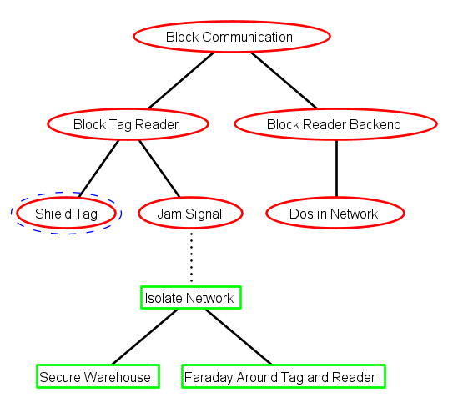
Part 1 Translate the attack-defense tree described below into code.
Example Question 6

Slide 46
Part 2 In the attack-defense tree mentioned previously, each editable node has been assigned an initial success-probability value. Calculate the success probability value for each node marked with a question mark.
Example Question 6

Slide 47
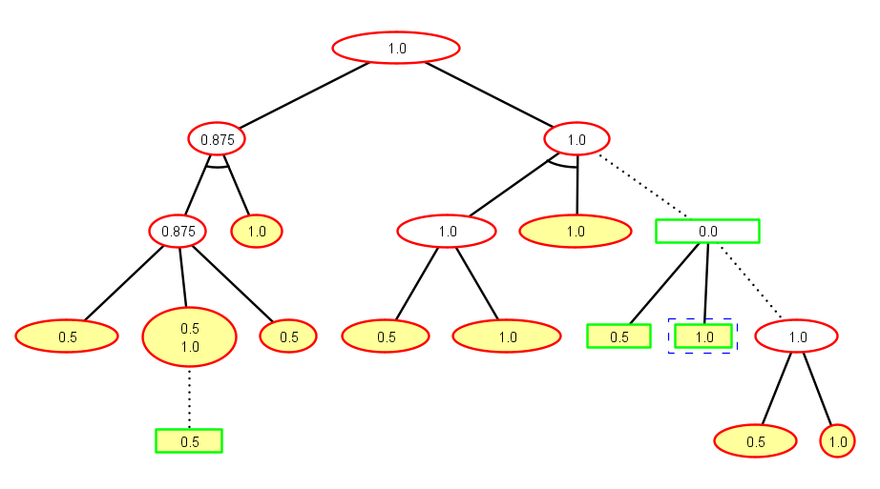
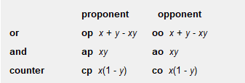
Example Question 6
Part 2
?
?
0.75
1.0
?
?
?
0.0
?
?
1.0
?
?
?
0.5

Slide 48
Example Question 7
Alice wants to send Bob a secret message. To keep the message confidential, she decides to use steganography.
Part 1 [4 marks] Alice ultimately chooses to employ image steganography, but she is concerned that an attacker may use steganalysis methods to uncover her secret message. In the context of image steganography, describe 2 characteristics that can be used for steganalysis.
Part 2 [4 marks] Outline the steps of the digital forensics process and provide a brief explanation of key activities that take place during each step.

Slide 49
Example Question 7
Part 1 [4 marks] Alice ultimately chooses to employ image steganography, but she is concerned that an attacker may use steganalysis methods to uncover her secret message. In the context of image steganography, describe 2 characteristics that can be used for steganalysis.

Slide 50
Example Question 7
Part 1 [4 marks] Alice ultimately chooses to employ image steganography, but she is concerned that an attacker may use steganalysis methods to uncover her secret message. In the context of image steganography, describe 2 characteristics that can be used for steganalysis.
[2 marks] Difference in image size: image steganography can increase/reduce the size of an image to hide data. Thus, comparing the size of an image before and after steganography can help identify the presence of hidden data.
[2 marks] Difference in LSBs of pixel values: image steganography can use the least significant bits (LSBs) of pixel values to hide data, which changes the pixel values. Thus, analyzing LSBs of pixel values before and after steganography can help detect the presence of hidden data.

Slide 51
Example Question 7
Part 2 [4 marks] Outline the steps of the digital forensics process and provide a brief explanation of key activities that take place during each step.

Slide 52
Example Question 7
Part 2 [4 marks] Outline the steps of the digital forensics process and provide a brief explanation of key activities that take place during each step.
[1 mark] Collection:
Gather digital evidence using proper tools and techniques while maintaining a clear chain of custody; Identify sources of data; Secure devices to avoid tampering; Perform necessary decryption of data
[1 mark] Examination:
Search for evidence in the collected data. Use existing tools to assist in examination of data of recovering files of interest from memory
[1 mark] Analysis:
Examine collected digital evidence to identify relevant information, reconstruct events, and uncover hidden data; More in-depth exploration of materials; Attribution, establishing alibis, collecting statements, intents, all happen in this phase; Need to be based off of discovered, potential evidence; Basic description of image analysis, memory analysis.
[1 mark] Reporting:
Findings are documented; Create final reports to be used in legal proceedings

Slide 53
Example Question 8
Alice and Bob want to communicate securely via the internet. For instance, Alice wants to send a message to Bob with the message being encrypted. They have never met in person, nor have they communicated via the internet before.
Part 1 [6 marks] Describe the concept of public key cryptography (PKC) and provide a step-by-step explanation of how PKC can be used to enable secure communication between two parties.
Part 2 [4 marks] Following on from Part 1, suppose a malicious third-party, Eve, is attempting to intercept and read the messages exchanged between Alice and Bob. What a possible attack could Eve carry out to compromise the security of their communication?

Slide 54
Example Question 8
Part 1 [6 marks] Describe the concept of public key cryptography (PKC) and provide a step-by-step explanation of how PKC can be used to enable secure communication between the two parties.

Slide 55
Example Question 8
Part 1 [6 marks] Describe the concept of public key cryptography (PKC) and provide a step-by-step explanation of how PKC can be used to enable secure communication between two parties.
[2 marks] Public key cryptography is a cryptographic system that utilizes a pair of keys for encryption and decryption: a public key and a private key. The public key is freely shared, while the private key remains confidential.

Slide 56
Example Question 8
Part 1 [6 marks] Describe the concept of public key cryptography (PKI) and provide a step-by-step explanation of how PKI can be used to enable secure communication between two parties.
[2 marks] Public key cryptography.
[4 marks]
1. Alice and Bob generate their own public and private key pairs.
2. Alice and Bob exchange their public keys while keeping their private keys secret.
3. To send a secure message to Bob, Alice encrypts the message using Bob's public key.
4. When receiving the message, Bob uses his private key for decryption. For Bob, he encrypts his message using Alice's public key, and Alice decrypts it with her private key.

Slide 57
Example Question 8
Part 2 [4 marks] Following on from Part 1, suppose a malicious third-party, Eve, is attempting to intercept and read the messages exchanged between Alice and Bob. What a possible attack could Eve carry out to compromise the security of their communication?

Slide 58
Example Question 8
Part 2 [4 marks] Following on from Part 1, suppose a malicious third-party, Eve, is attempting to intercept and read the messages exchanged between Alice and Bob. What a possible attack could Eve carry out to compromise the security of their communication? Identify a possible countermeasure that Alice and Bob can employ to protect their messages from being intercepted and tampered with by Eve.
[1 mark] Eve generates two pairs of privates and public keys.
[1 mark] Eve intercepts the public key exchange between Alice and Bob,
[1 mark] Eve substitutes her own public keys for Alice's and Bob’s.
[1 mark] As a result, when Alice and Bob send encrypted messages to each other, they are actually encrypted with Eve's public keys, allowing her to decrypt the messages with her private keys.

Slide 59
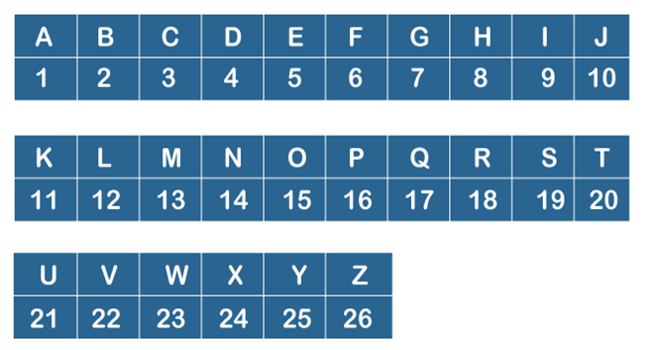
Example Question 9
Part 1 [4 marks] You invent the “FRNZ” cryptographic algorithm, which works on English messages, and all letters are treated as upper cases. FRNZ is implemented by the following steps:
Step 1. A Caesar cipher operates over the plaintext by the rotation number R (a positive R value means a forward rotation by R).
Step 2. The result in step 1 is converted, letter by letter, using the Alphanumeric table found below. For each output character, if it is even, its resulting character is 0 (i.e., even numbers are mapped to 0). If the output character is odd, its resulting character is 1 (i.e., odd numbers are mapped to 1).
Step 3. The result in step 2 is now XOR’d with the key K. If the length of the key is less than the length of the message, the key is padded (on the right) to the length of the message. For example, if the message has length 10, and K=1110, the padded key is 1110111011.
For example, the plaintext “HELLOWORLD”, with the values R=2, K=1110 produces the final result “1010000011”:
“HELLOWORLD” -> “JGNNQYQTNF”
“JGNNQYQTNF” -> “107141417251720146”
“107141417251720146” -> “0100111000”
“0100111000”
“1110111011.” -> “1010000011”

Slide 60
Example Question 9
Part 1 Your Task for this part:
Perform the FRNZ cryptographic algorithm, step by step, using the first 10 characters of your combined first and last names without spaces, e.g., “JOHNNY SMITH” becomes “JOHNNYSMIT”. Also, if your first or last name contains characters that cannot be found in the Alphanumeric table below, these characters will be skipped, e.g., “JOÚHNNY SMIÊTH” becomes “JOHNNYSMIT”.
If your first and last names combined without spaces are less than 10 characters long, pad the end of the combined string with the first characters from the string “LOREMIPSUM” until the final string is 10 characters long. For example, “JOHN DOE” becomes “JOHNDOE”. Then, as this is 7-characters long, pad it with the first 3 characters “LOR”. Thus, the final string becomes, “JOHNDOELOR”.
Use the values R=4, K=1010 in your answer.
[1 mark] successful rotation of R.
[1 mark] successful binary string conversion
[1 mark] correctly padding the key.
[1 mark] successful XOR

Slide 61
Example Question 9
Part 2 [7 marks] Explain the factors that determine the security strength of the FRNZ cryptographic algorithm. What is the impact of changing the values of R and K on the security strength?

Slide 62
Example Question 9
Part 2 [7 marks] Explain the factors that determine the security strength of the FRNZ cryptographic algorithm. What is the impact of changing the values of R and K on the security strength?
.
[2 marks] clearly state that FRNZ mostly relies on K and the mapping between numbers and bit 0/1.
[2 marks] the length of K determines the number of possible combinations for brute force, affecting the overall security. A longer K increases the number of combinations. For example, when K has 4 bits, it has 2^4 options. When K has 10 bits, it has 2^10 options.
[2 marks] one to many mapping of bit 0/1 to letter contributes to security. The actual complexity is 13^10.
[1 mark] either decreasing or increasing R has some marginally effect on overall security: only 26 rotations

Slide 63
Good Luck in all your final exams!!!
Exam Strategy: Prioritizing questions based on difficulty can help manage your time effectively and ensure you tackle the ones you're most confident about first.

