Slide 1
CHESS ELO PREDICTION
Transformer model to predict level of play in chess.

Slide 2
TABLE OF CONTENTS
01
02
03
04
INTRODUCTION
PREPROCESSING
Brief overview of the research
Extracting structured data from PGN
MODELING
RESULTS
Training & Testing Transformer model
Results, Conclusion & Future Scope

Slide 3
01
INTRODUCTION
Predicting player skill level (Elo) using chess game data

Slide 4
WHAT IS ELO?

Slide 5
ELO RATING SYSTEM
Relative skill levels in zero-sum games. (Chess, esports, Tennis, etc.)
Player with the higher Elo rating is more likely to win.
Elo ratings are self-correcting.

Slide 6
PROBLEM?
Outcome-based approach presents limitations when attempting to evaluate performance within a single game.

Slide 7

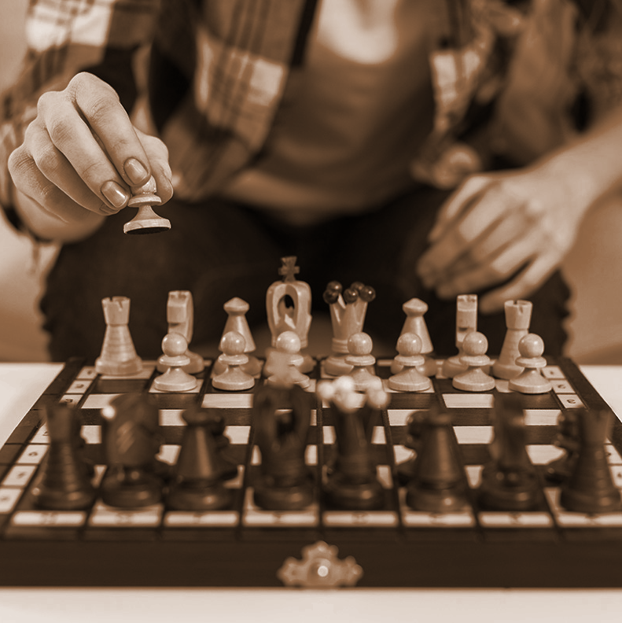
PROBLEM WITH ELO
Inaccurate in predicting the result of any individual games.
Inaccurate initial rating for players.
Not a measure of playing strength.
Unsuitable for comparisons of players across different historical periods.
Notes:
Outcome-based approach presents limitations when attempting to evaluate performance within a single game.

Slide 8
RESEARCH OVERVIEW
Predicting the intrinsic quality or player skill levels in terms of Elo Rating by analyzing their performance in individual games.
Aim:
Can a multi-feature approach accurately predict a chess player's Elo rating from a single game?

Slide 9
02
PREPROCESSING
Extracting structured data and feature engineering.

Slide 10
90,000,000
Dataset of ~90 Million games extraced for the month of Feb 25

Slide 11
DATASET
250 GB
90M
2M
PGN
GAMES
PLAYERS
Unstructured data of games.
Played on Lichess.com in Feburary.
Distinct players who played the games.

Slide 12

CLUSTERING INTO VARIANTS
46%
15%
BLITZ
RAPID
Less than 8 mins
Less than 25 mins
2%
37%
OTHERS
BULLET
Classical, UltraBullet, Unlimited
Less than 3 mins

Slide 13
CLUSTERING INTO VARIANTS
46%
15%
BLITZ
RAPID
Less than 8 mins
Less than 25 mins
2%
37%
OTHERS
BULLET
Classical, UltraBullet, Unlimited
Less than 3 mins

Slide 14
PGN

Slide 15
[Event "Rated bullet game"]
[Site "https://lichess.org/MQNHYI0k"]
[Date "2025.03.16"]
[White "antbeckman"]
[Black "dudelyy"]
[Result "1-0"]
[GameId "MQNHYI0k"]
[UTCDate "2025.03.16"]
[UTCTime "22:16:19"]
[WhiteElo "929"]
[BlackElo "998"]
[WhiteRatingDiff "+102"]
[BlackRatingDiff "-6"]
[Variant "Standard"]
[TimeControl "120+1"]
[ECO "B40"]
[Opening "Sicilian Defense: French Variation, Normal"]
[Termination "Time forfeit"]
1. e4 c5 2. Nf3 e6 3. d4 cxd4 4. Nxd4 Nf6 5. Bb5 a6
METADATA
MOVES

Slide 16
[Event "Rated bullet game"]
[Site "https://lichess.org/MQNHYI0k"]
[Date "2025.03.16"]
[White "antbeckman"]
[Black "dudelyy"]
[Result "1-0"]
[GameId "MQNHYI0k"]
[UTCDate "2025.03.16"]
[UTCTime "22:16:19"]
[WhiteElo "929"]
[BlackElo "998"]
[WhiteRatingDiff "+102"]
[BlackRatingDiff "-6"]
[Variant "Standard"]
[TimeControl "120+1"]
[ECO "B40"]
[Opening "Sicilian Defense: French Variation, Normal"]
[Termination "Time forfeit"]
1. e4 c5 2. Nf3 e6 3. d4 cxd4 4. Nxd4 Nf6 5. Bb5 a6
METADATA
MOVES

Slide 17
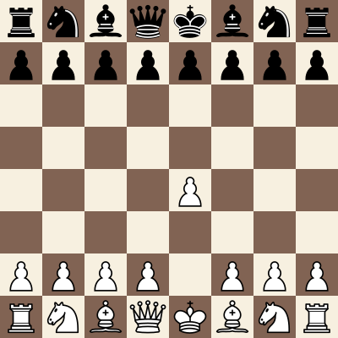
MOVE NOTATION
1. e4 c5 2. Nf3 e6 3. d4 cxd4 4. Nxd4 Nf6 5. Bb5 a6 6. Ba4 Nxe4 7. Qe2 Nf6 8. O-O Be7 9. Bg5 O-O 10. Nc3 h6 11. Bh4 b5 12. Bb3 d5 13. Rfe1 Bb7 14. h3 Nc6 15. Nxc6 Bxc6 16. Rad1 Nd7 17. Bxe7 Qxe7 18. a4 Nc5 19. axb5 axb5

Slide 18
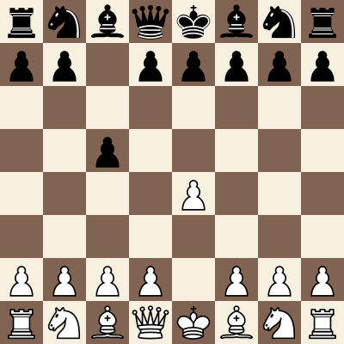
MOVE NOTATION
1. e4 c5 2. Nf3 e6 3. d4 cxd4 4. Nxd4 Nf6 5. Bb5 a6 6. Ba4 Nxe4 7. Qe2 Nf6 8. O-O Be7 9. Bg5 O-O 10. Nc3 h6 11. Bh4 b5 12. Bb3 d5 13. Rfe1 Bb7 14. h3 Nc6 15. Nxc6 Bxc6 16. Rad1 Nd7 17. Bxe7 Qxe7 18. a4 Nc5 19. axb5 axb5

Slide 19
DATA PIPELINE

Slide 20


DATA PIPELINE
BRONZE
GOLD
Raw unstructured Data .pgn file
Aggregated metrics & ML features.
Extract
Transform
Load
SOURCE
SILVER
Compressed .zst file from Lichess Open Database
Parsed game data in relational format (SQLite)

Slide 21
SQLITE TABLES
GAMES
PLAYERS
EVENTS
Game info such as Elo, Result, Moves, TimeControl
Name and Elo rating of players
Name and ID of events

Slide 22
FEATURE ENGG.

Slide 23

ENGINE EVALUATION
~ 6% of games already annotated.
Multiple instances of Stockfish 17
Batches of 5000 games each.
Generate evaluations for each position in each game.

Slide 24
ENGINE CONFIGURATION
 | ENGINE: | Stockfish 17
 | DEPTH: | 14 | THREADS: | 2
 | MAX WORKERS: | 8 | BATCH: | 5000
 | LIMIT STRENGTH: | FALSE | WDL: | TRUE
 | SKILL LEVEL: | 20 (MAX STRENGTH)

Slide 25
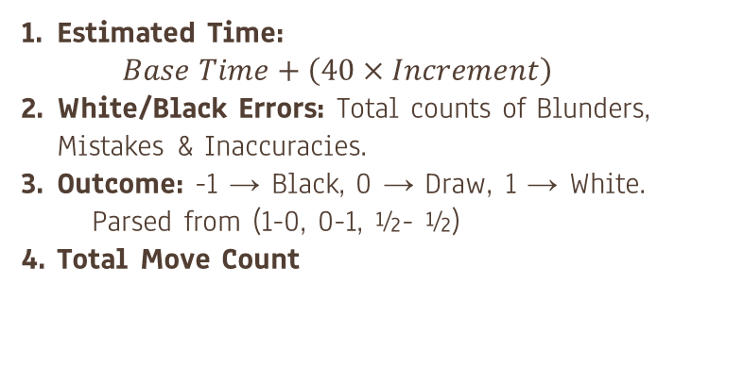
FEATURE ENGINEERING
Game Level
Estimated Time:
$$Base Time+\left(40×Increment\right)$$
White/Black Errors: Total counts of Blunders, Mistakes & Inaccuracies.
Outcome: -1 → Black, 0 → Draw, 1 → White.
Parsed from (1-0, 0-1, ½- ½)
Total Move Count

Slide 26
FEATURE ENGINEERING
Move Level
Centipawn Score: Generated by Engine. Setting mate score to 1000.
W/D/L: Generate by Engine.
Half-move Count: Count of individual moves.
Move: Current Move (d2d3, c3c4, etc.)
Turn: 0 → Black, 1 → White
Fen: Current Board State (rnbqkbnr/pppppppp/8/8/8/8/PPPPPPPP/RNBQKBNR)
Mate Info: Is Check?, Mate in N, Is Checkmate?

Slide 27
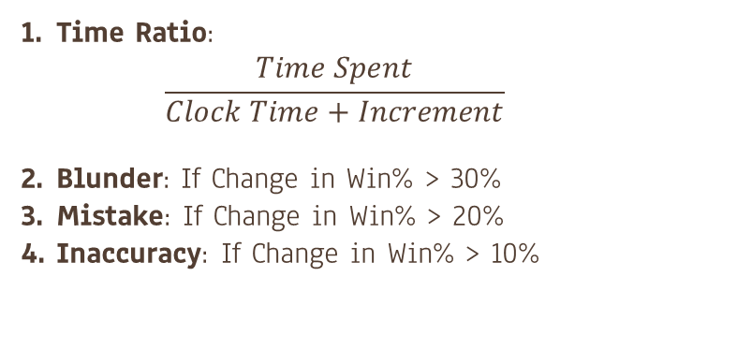
FEATURE ENGINEERING
Calculated Move Level
Time Ratio:
$$\frac{Time Spent}{Clock Time+Increment}$$
Blunder: If Change in Win% > 30%
Mistake: If Change in Win% > 20%
Inaccuracy: If Change in Win% > 10%

Slide 28



NORMALIZATION
ERRORS
!?
EST. TIME
Total Errors $÷$ Total Moves
Est. Time $÷$ Game Thresh.
MOVE COUNT
CP & MATE
Move Count $÷$ Total Moves
Applying tanh to CP & Standard Scaling for Mate

Slide 29
ENCODING
FEN
MOVE
Normalized 70D vector—64 board squares (signed, scaled piece values), 4 castling flags, and 2 en passant coordinates
Normalized 5D vector—[from_file, from_rank, to_file, to_rank, promotion]—with each value scaled between 0 and 1

Slide 30
03
MODELING
Training & Testing Transformer model.

Slide 31
MODEL ARCHITECTURE

Slide 32
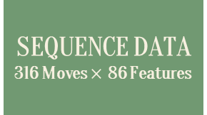
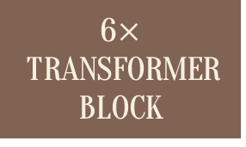
Transformer Block
MULTI-HEAD ATTENTION
6 Heads
LAYER NORMALIZATION
LAYER NORMALIZATION
FEED FORWARD NETWORK
512 Units
SEQUENCE MASK
316 Values
6$×$TRANSFORMER BLOCK
SEQUENCE DATA
316 Moves $×$ 86 Features
DENSE LAYER
Dimensionality = 256
POSITIONAL ENCODING

Slide 33
GAME METADATA
8 Features
DENSE LAYER
128 Units, ReLU
OUTPUT LAYER
2 Units, Linear
ELO PREDICTION
GLOBAL AVERAGE POOLING

Slide 34
04
RESULTS
Results, Conclusion & Future Scope

Slide 35
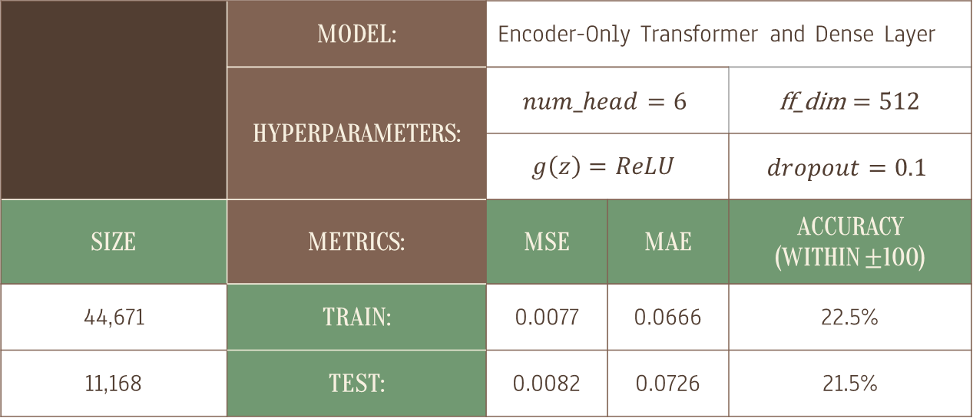
MODEL METRICS
 | MODEL: | Encoder-Only Transformer and Dense Layer
 | HYPERPARAMETERS: | $$num_head=6$$ |  | ff_dim $=512$
 |  | $$g\left(z\right)=ReLU$$ |  | $$dropout=0.1$$
SIZE | METRICS: | MSE | MAE | ACCURACY (WITHIN $±$100)
44,671 | TRAIN: | 0.0077 | 0.0666 | 22.5%
11,168 | TEST: | 0.0082 | 0.0726 | 21.5%

Slide 36
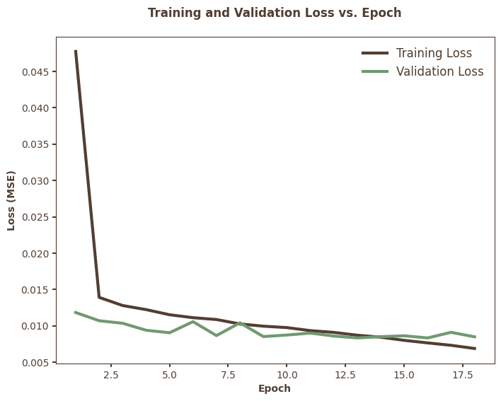
TRAIN AND VALIDATION LOSS
After the initial steep drop, the curve flattens out, suggesting diminishing returns from further training.
Validation loss does not diverge from training loss. This implies that the model generalizes well and is not overfitting the training data.

Slide 37
CONCLUSION
Transformer-based sequence modeling effectively captures chess gameplay patterns but maintains ±200 Elo point accuracy limitations.
Single-game Elo prediction faces inherent challenges as Elo rating is supposed to be a cumulative rating of Player performance.

Slide 38
FUTURE SCOPE
Future improvements require better normalization, deeper contextual features, and additional metadata.
Explore enhanced feature engineering with additional chess context and alternative non-sequential modeling techniques like CNNs

Slide 39
IS EVAL BY TIME ENOUGH?

Slide 40
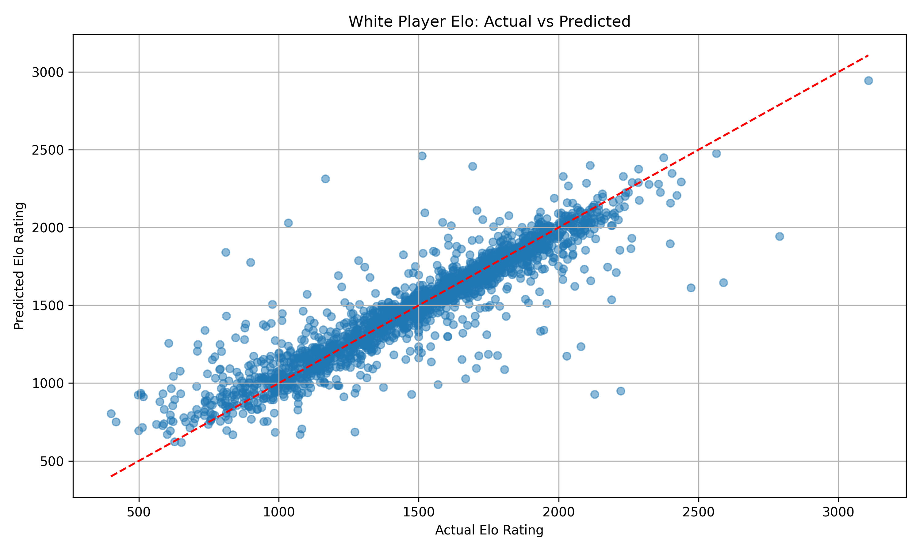
EVAL AND TIME
Model: NN (MLP Regressor)
Features: Elo (Both players), Game Result & Evaluation Time series.
Ran stockfish evaluation on more games.

Slide 41
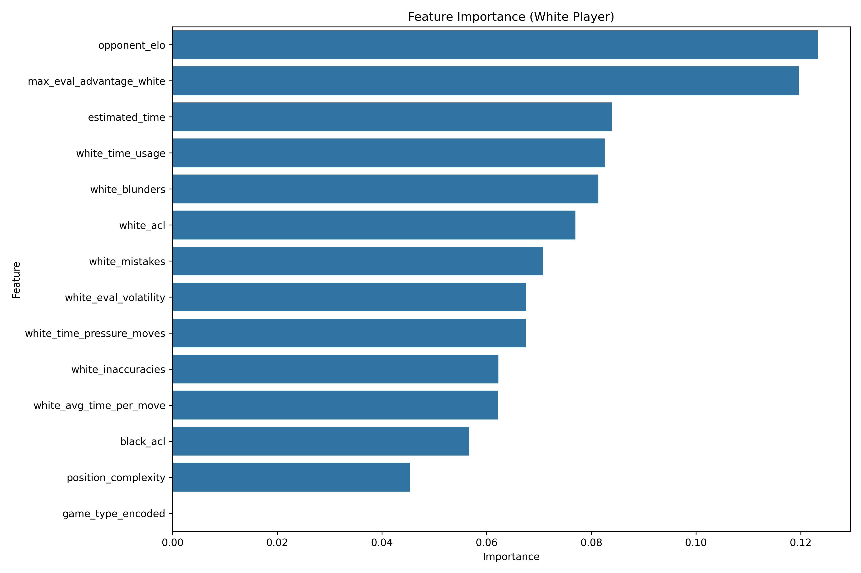
PROBLEM?
Significantly rely on the opponent elo information.
Similar rating due to matchmaking.
Big elo difference ignored.

Slide 42
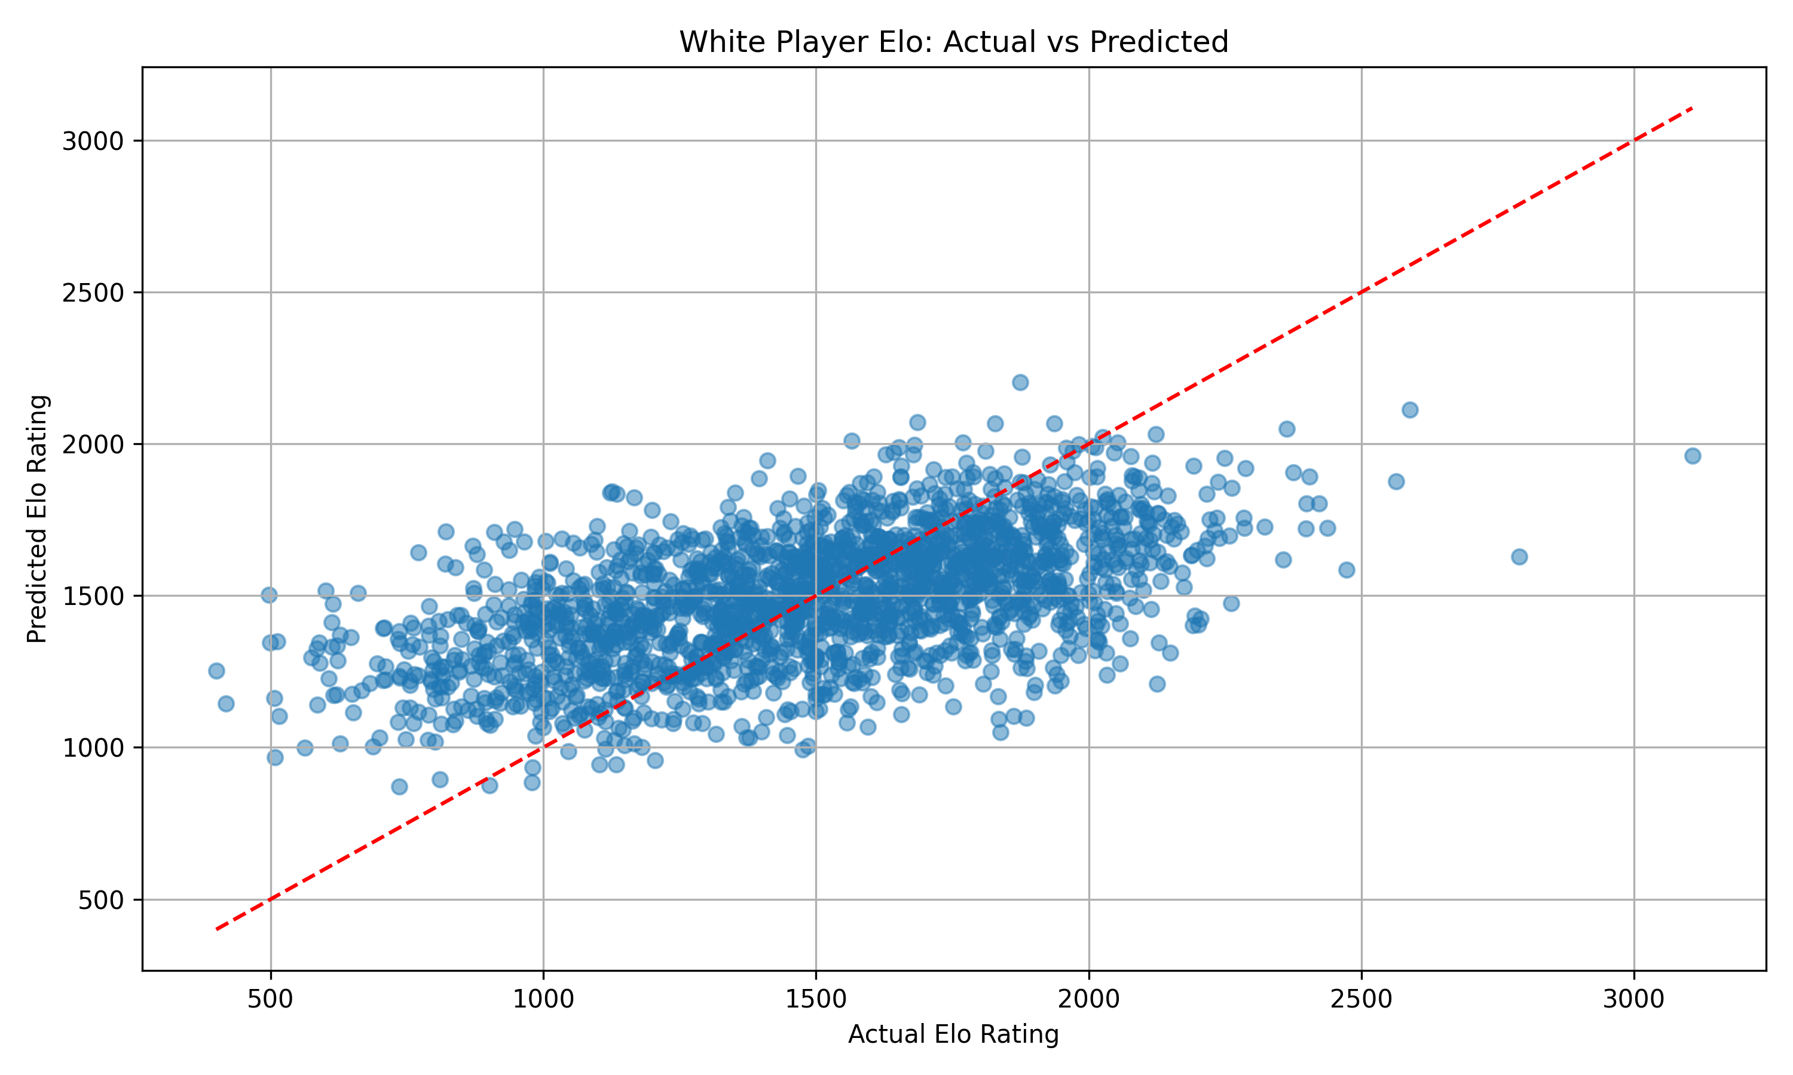
WITHOUT OPP ELO
Significantly poor performance.
Suggests low co-relation between Eval by Time vs Elo
Which is unlikely.
Features need to be engineered better.

Slide 43
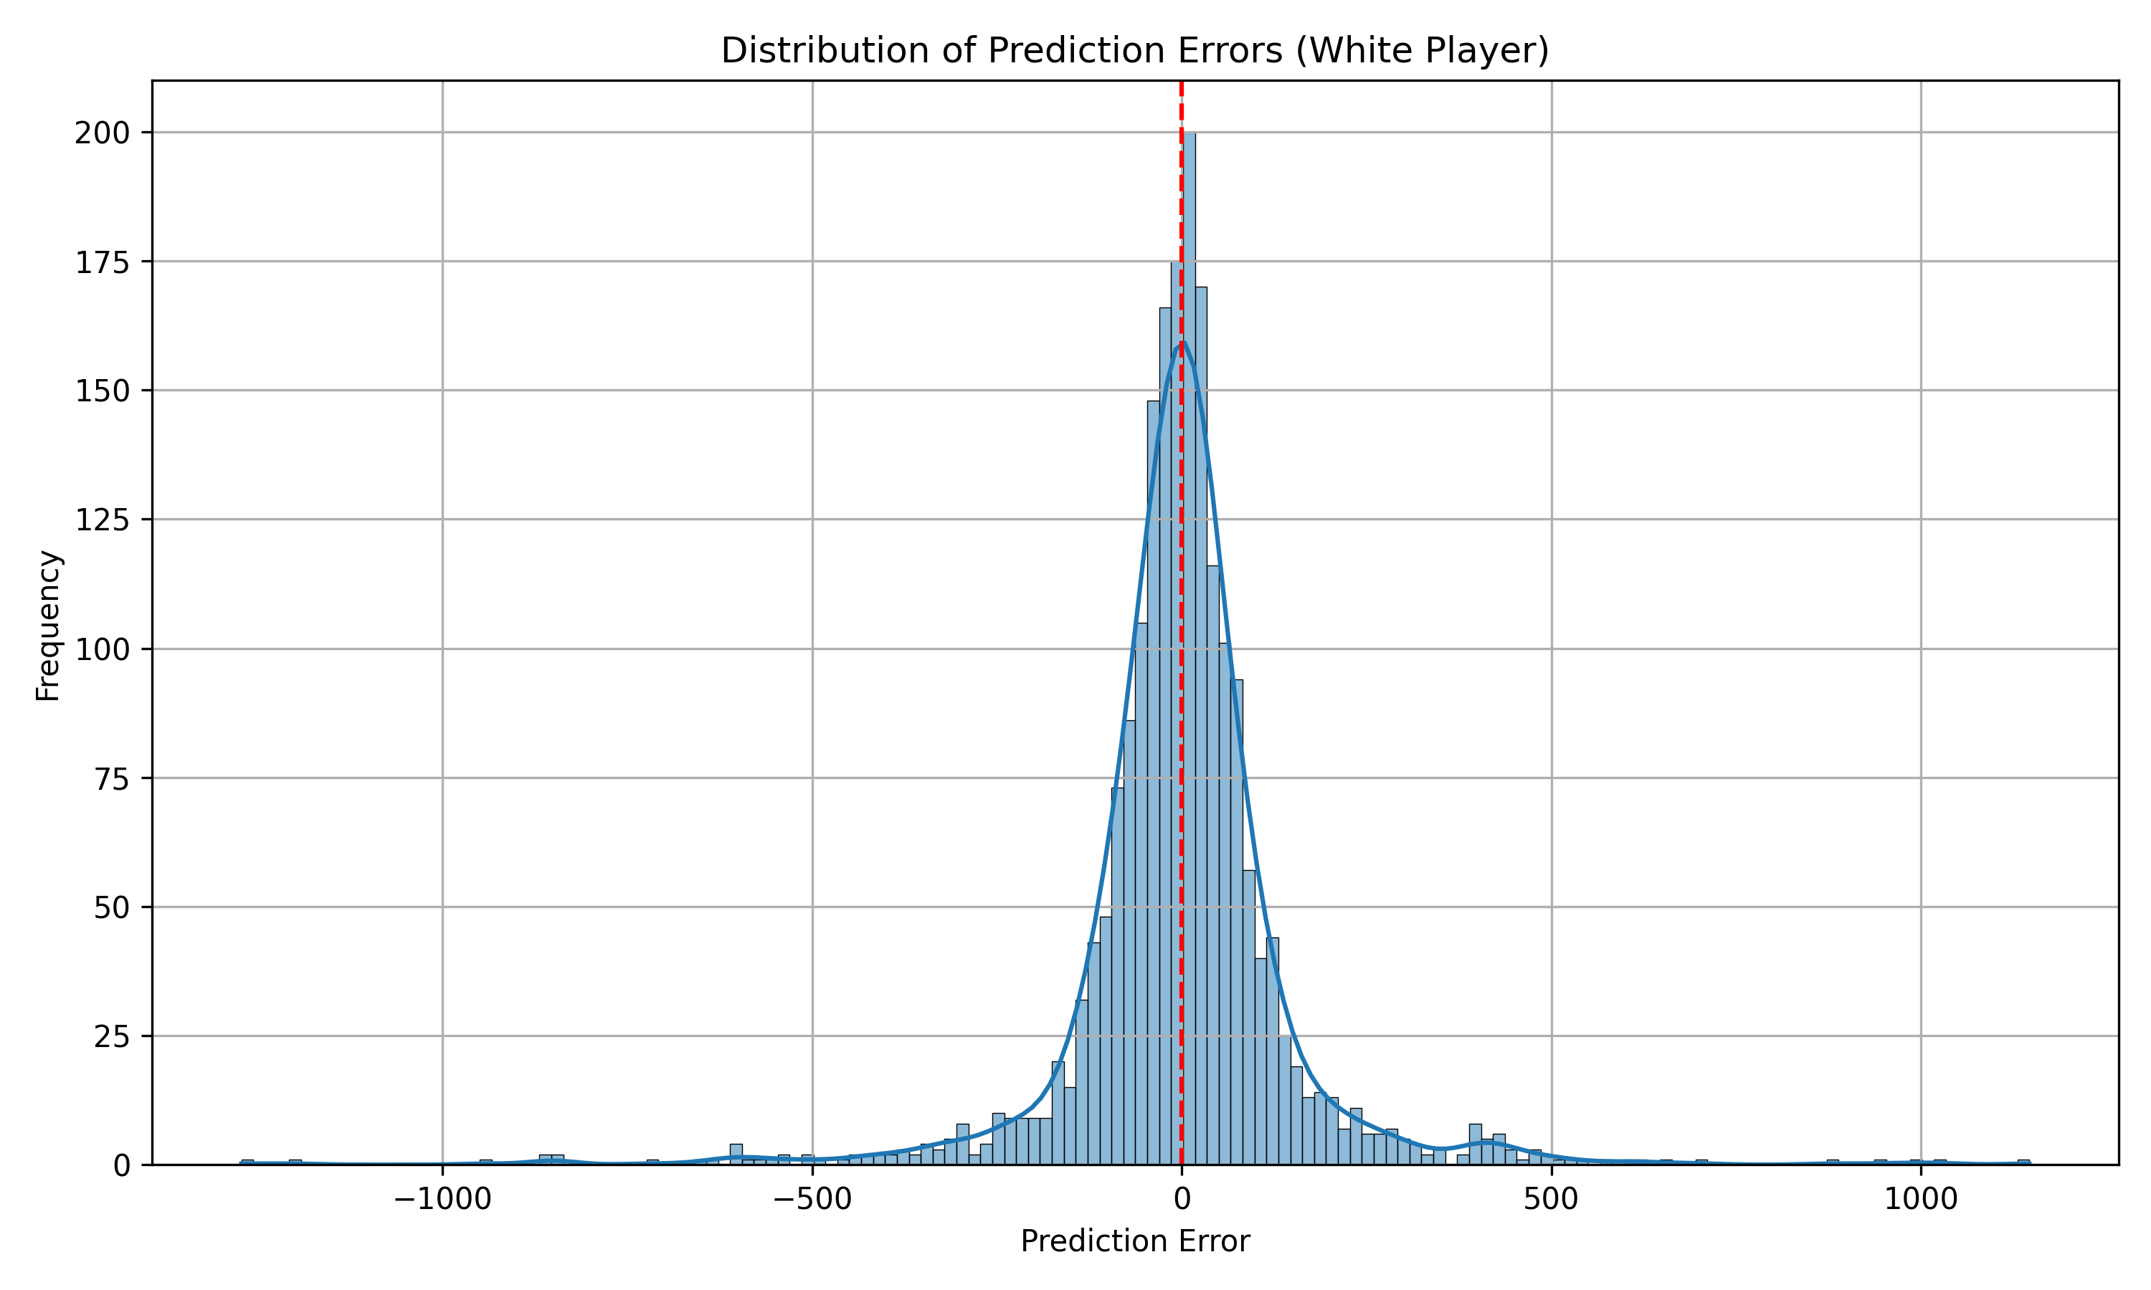
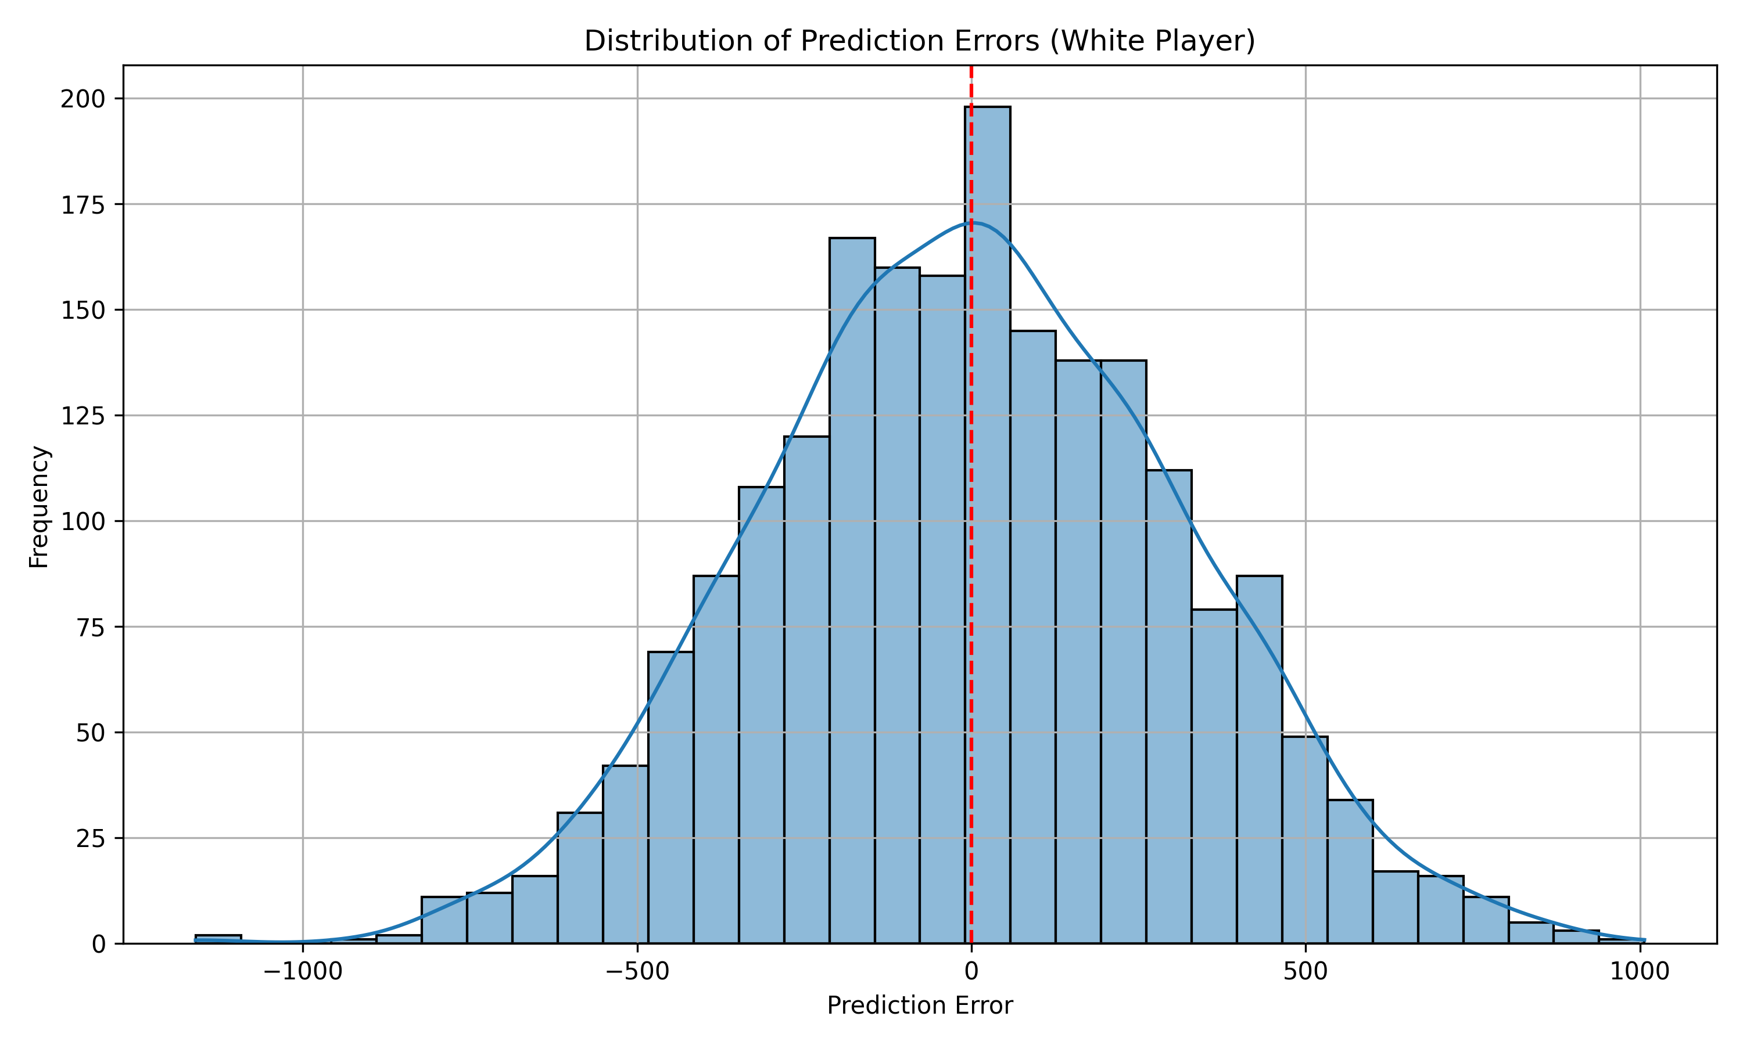
PREDICTION ERRORS
WITH OPP ELO
WITHOUT OPP ELO

Slide 44
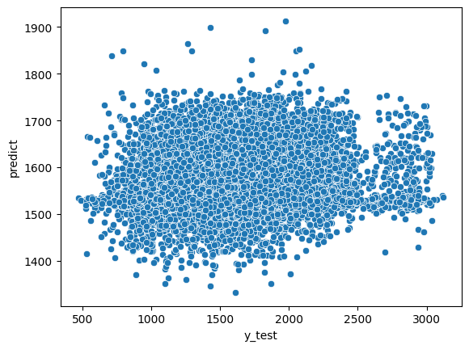
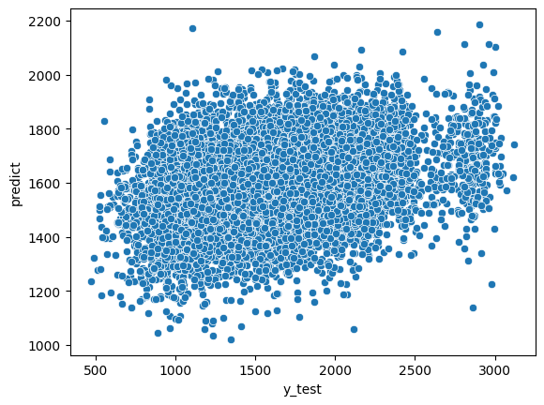
PREDICTING AVG ELO
NEURAL NETWORK
RANDOM FOREST

Slide 45
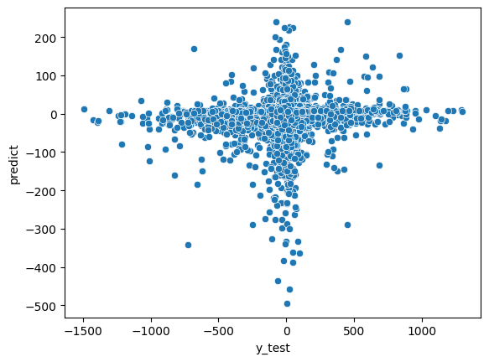
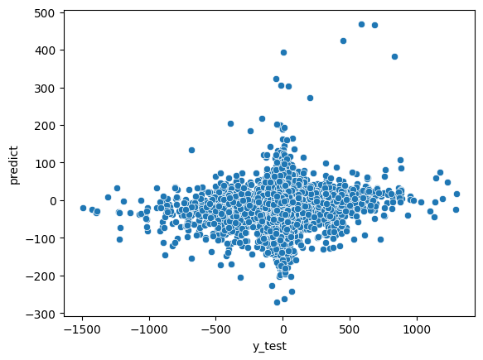
PREDICTING ELO DIFF
NEURAL NETWORK
RANDOM FOREST

Slide 46
IS EVAL BY TIME ENOUGH?

Slide 47
NO!
The models lack context and rely heavily on opponent ratings.

Slide 48
MORE FEATURES
Current approach is naïve.
Transform Scalar aggregates → Tensor representations (e.g., time per move, evaluation deltas)
Explore sequence models (RNN, CNN, Transformers)
Addition of chess principles-based features.

Slide 49

DASHBOARD
Dasboard for visualizing PGN data, created using Streamlit written in Python. Visualizations using Plotly & python-chess

Slide 50




THANKS
DO YOU HAVE ANY QUESTIONS?

