Slide 1

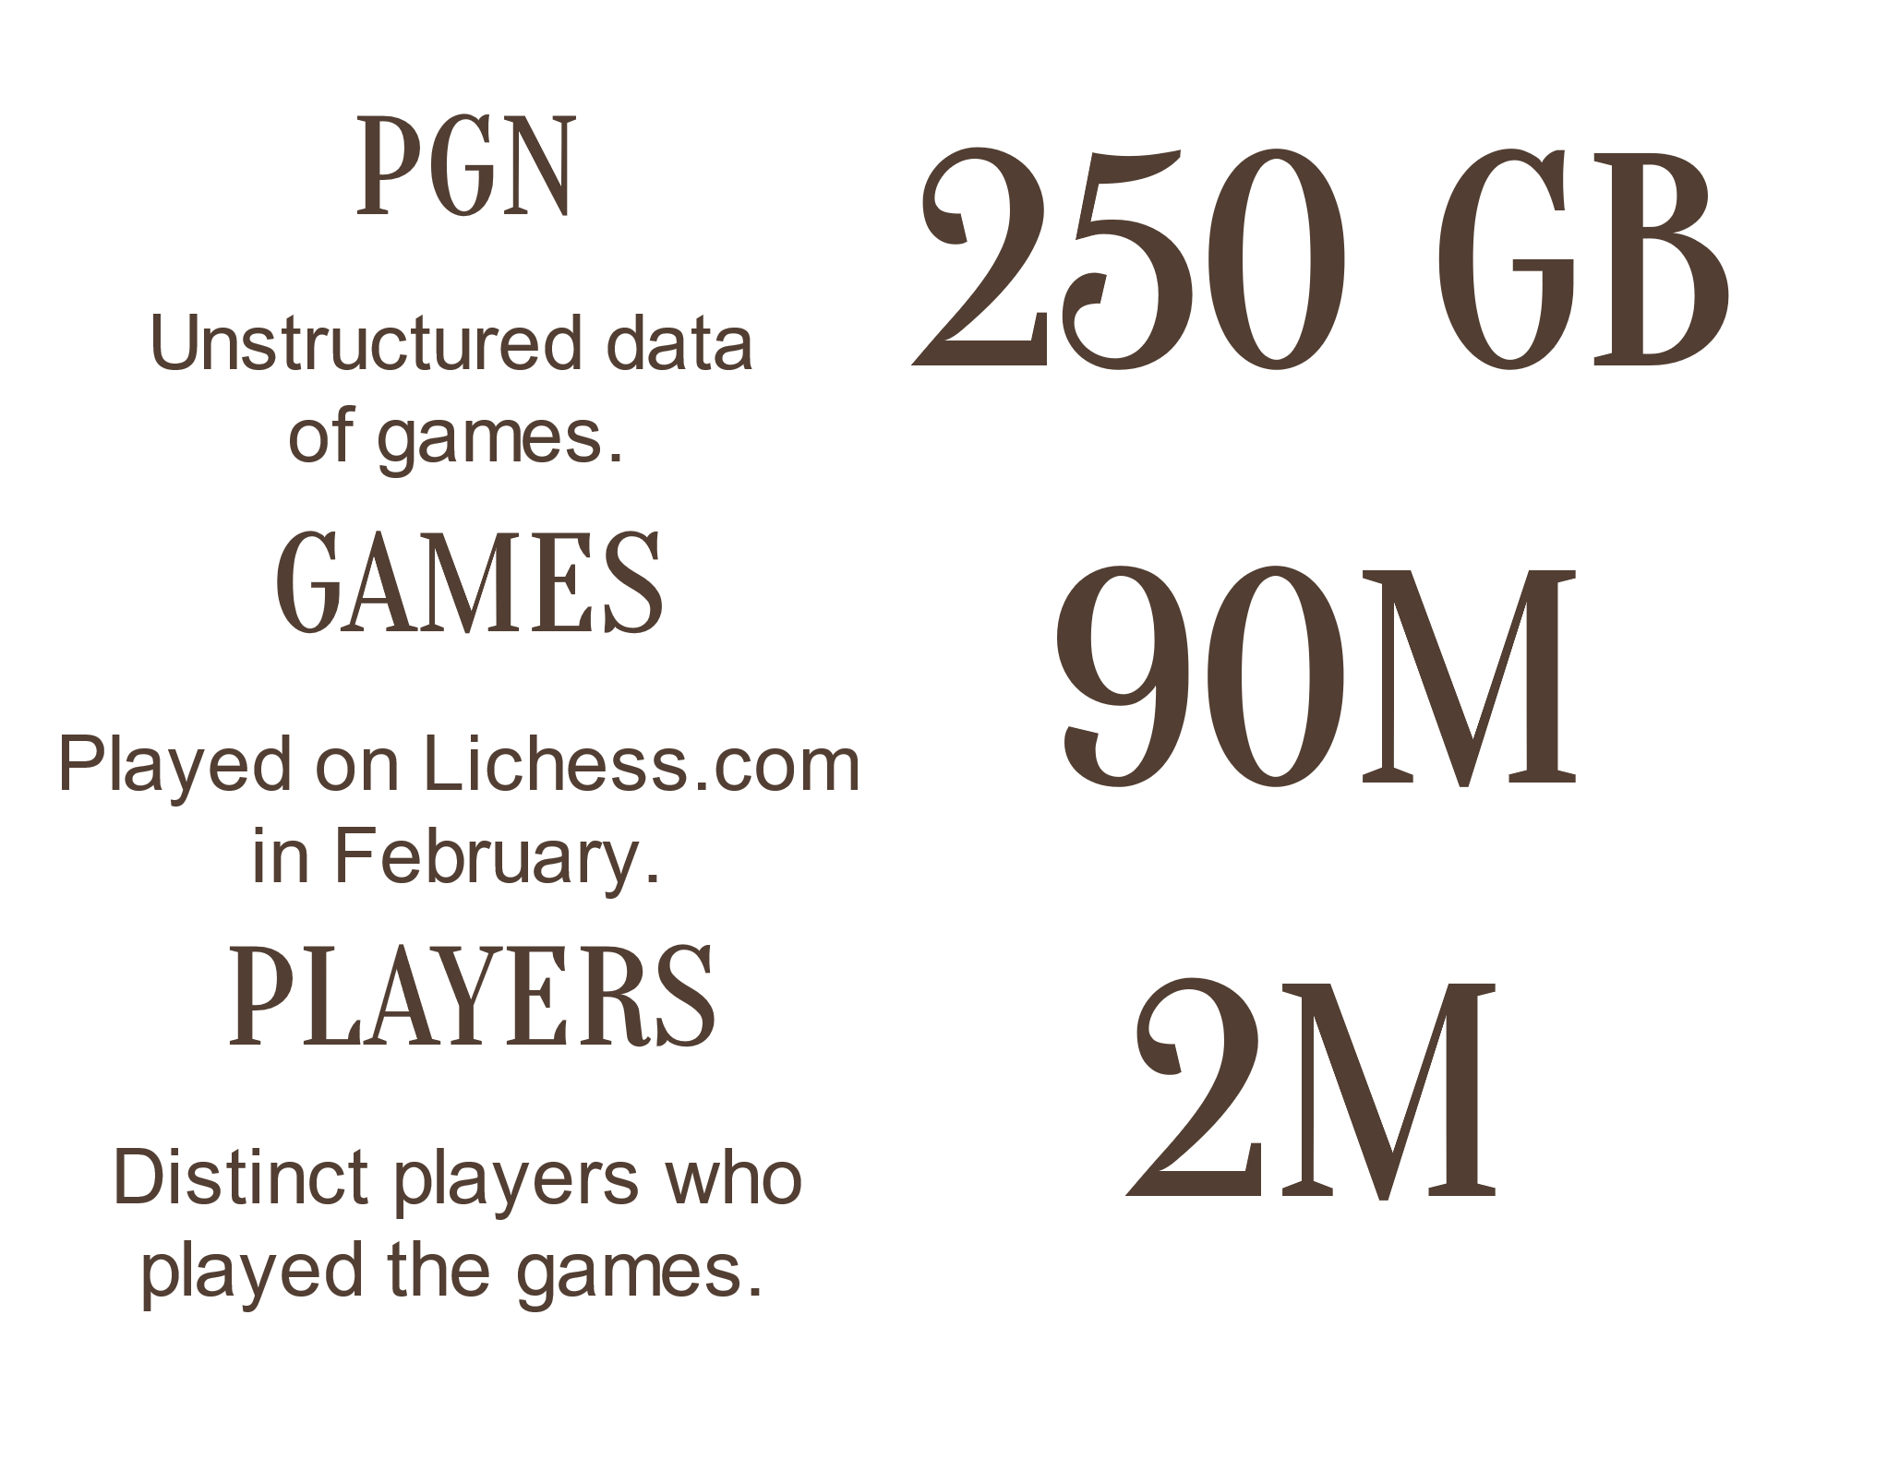
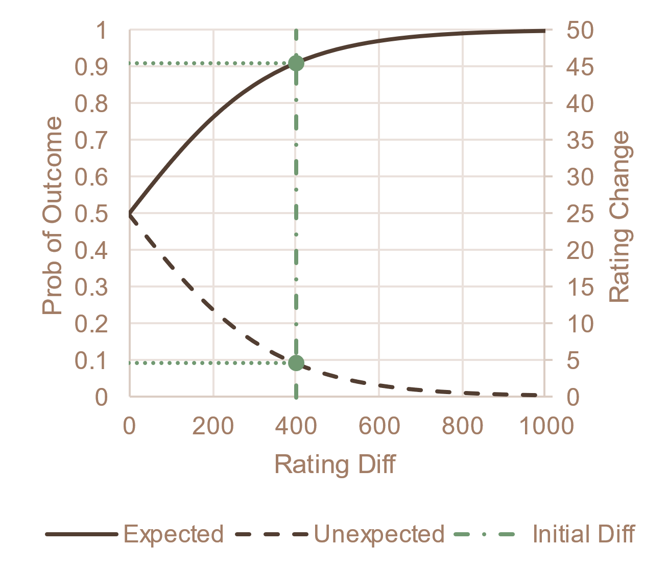
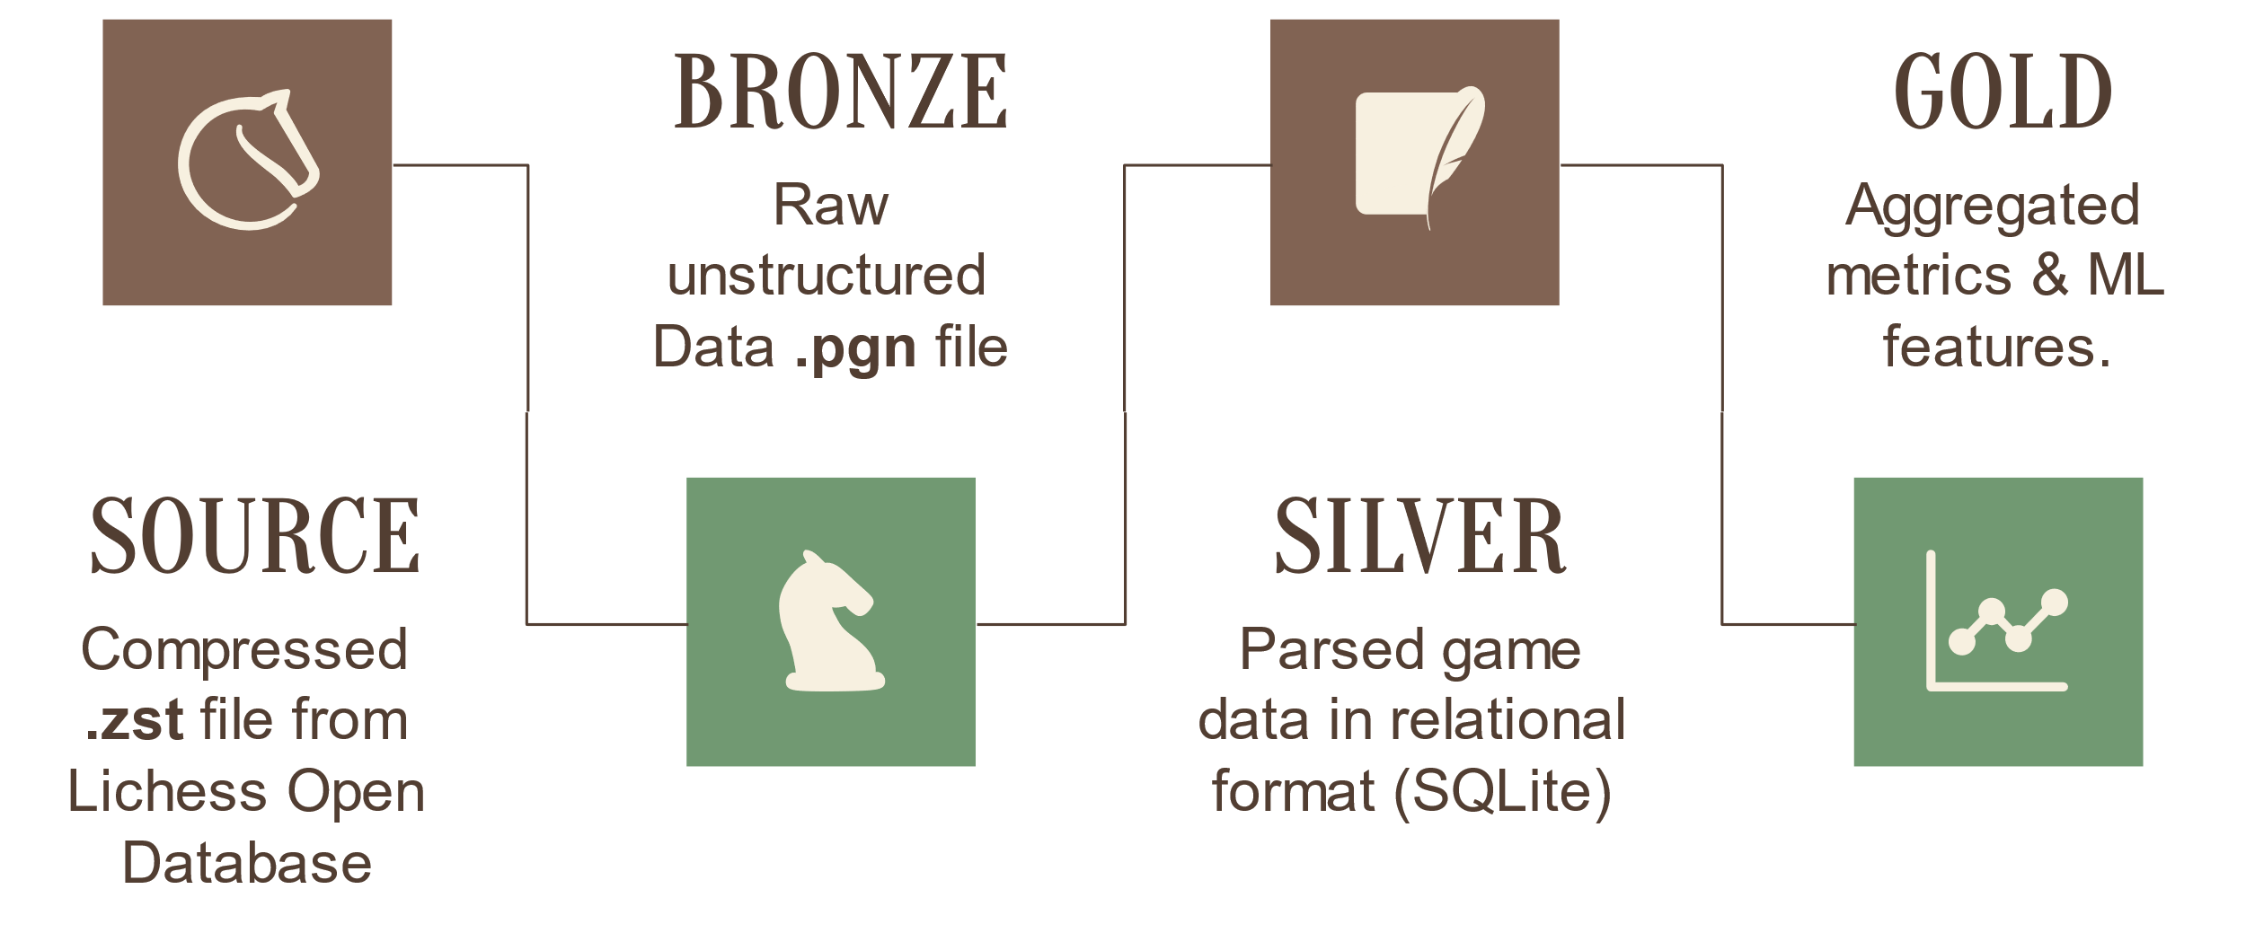
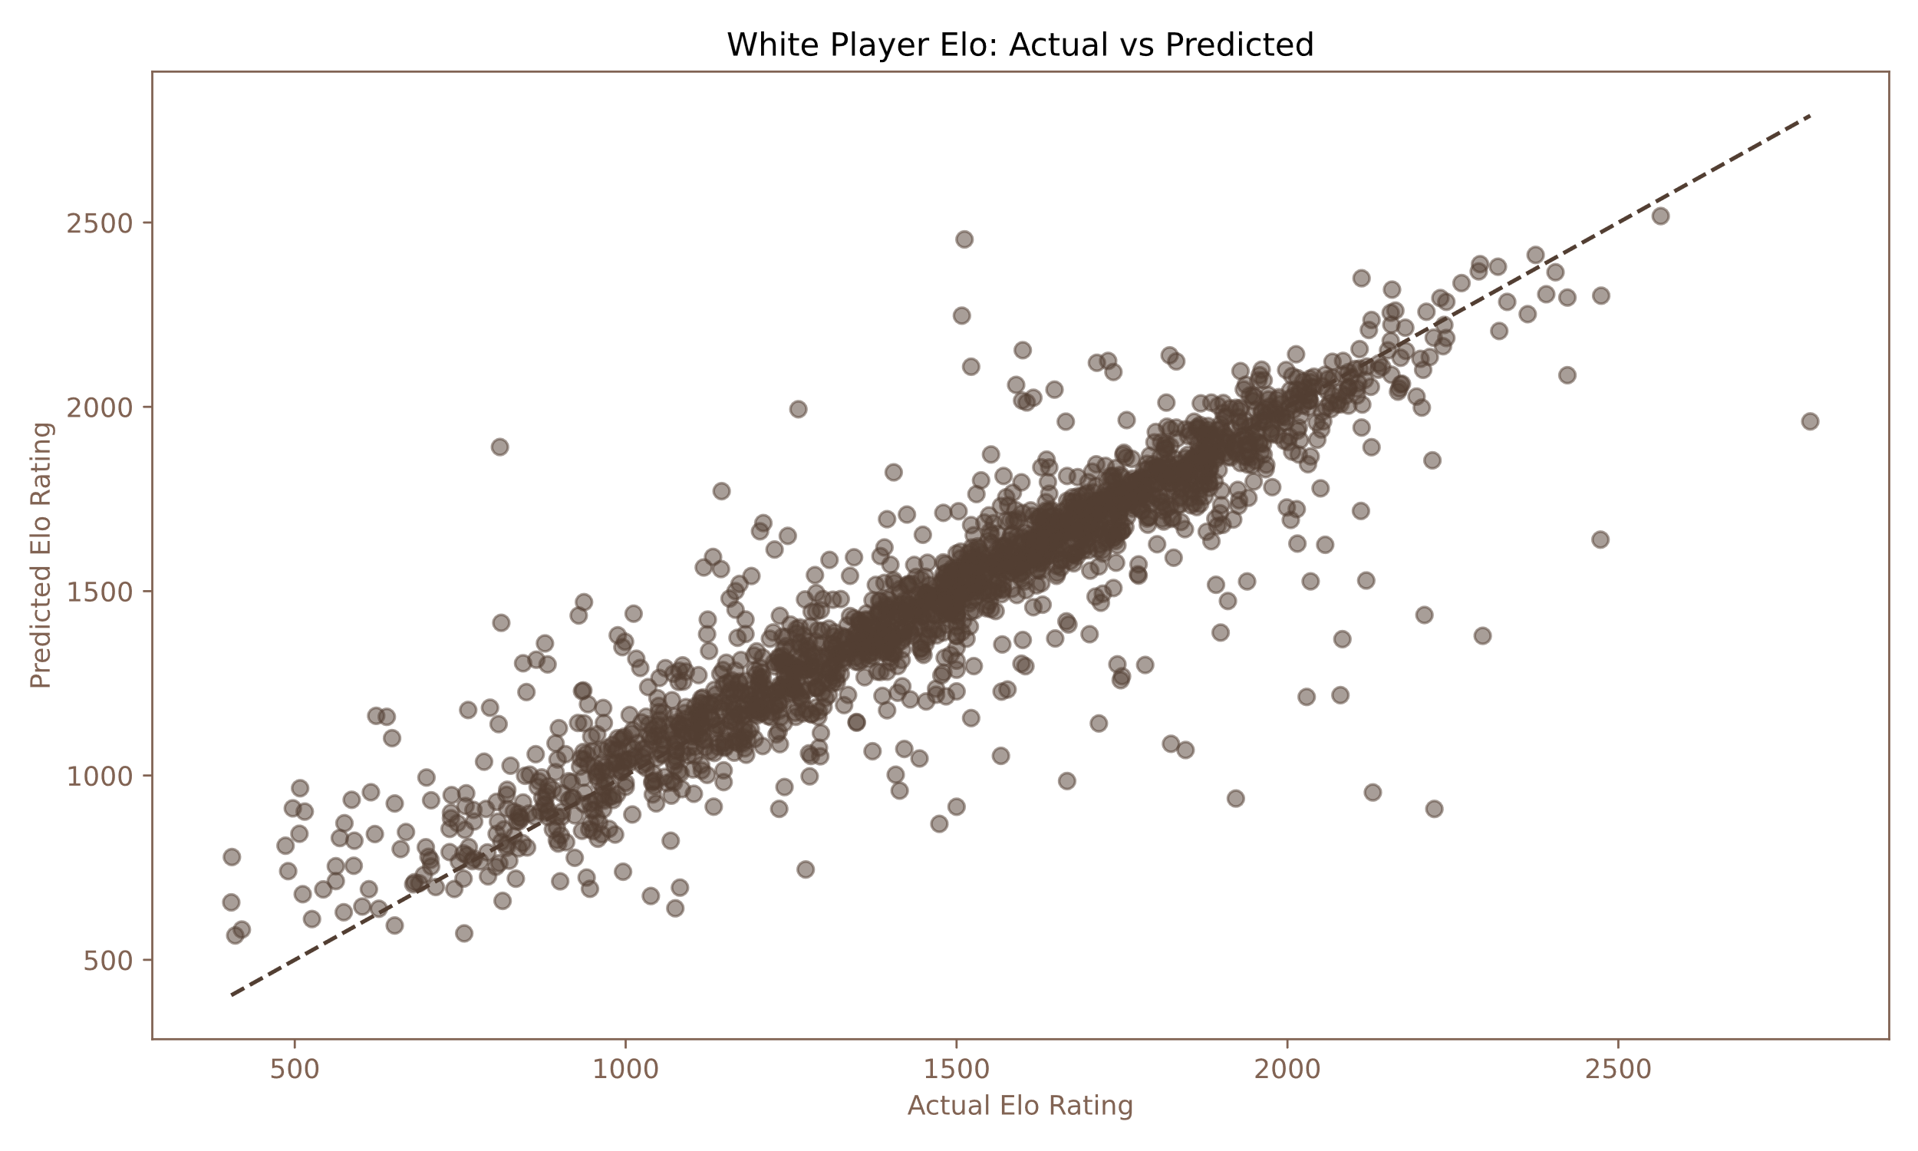
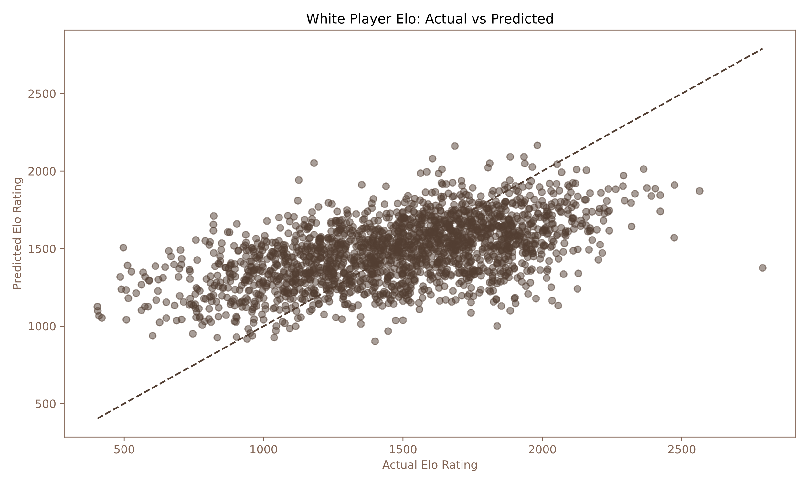
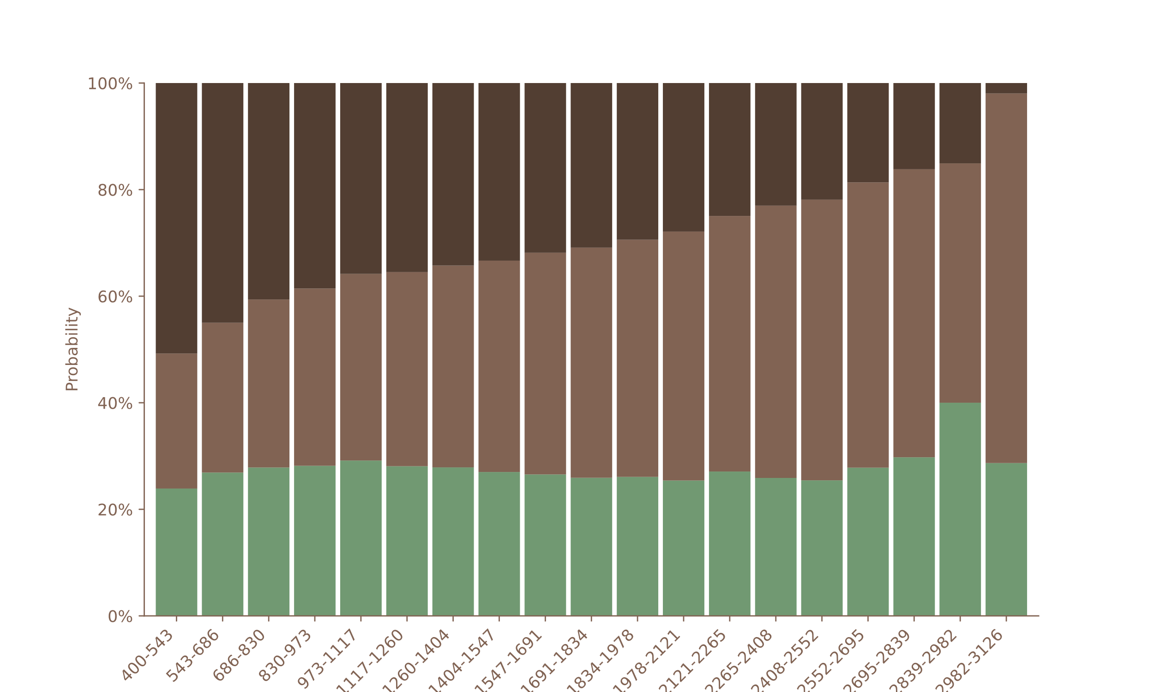
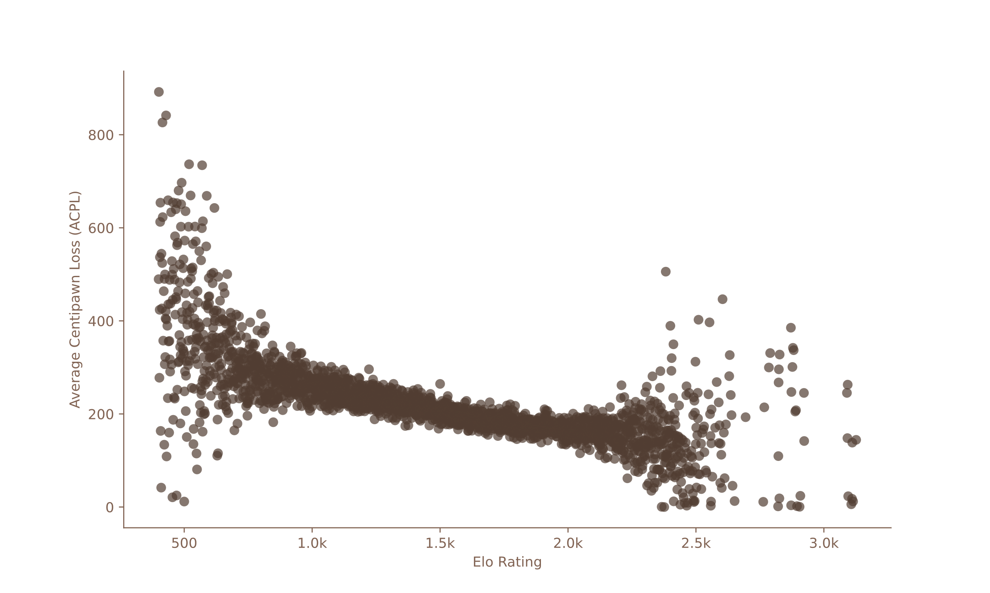
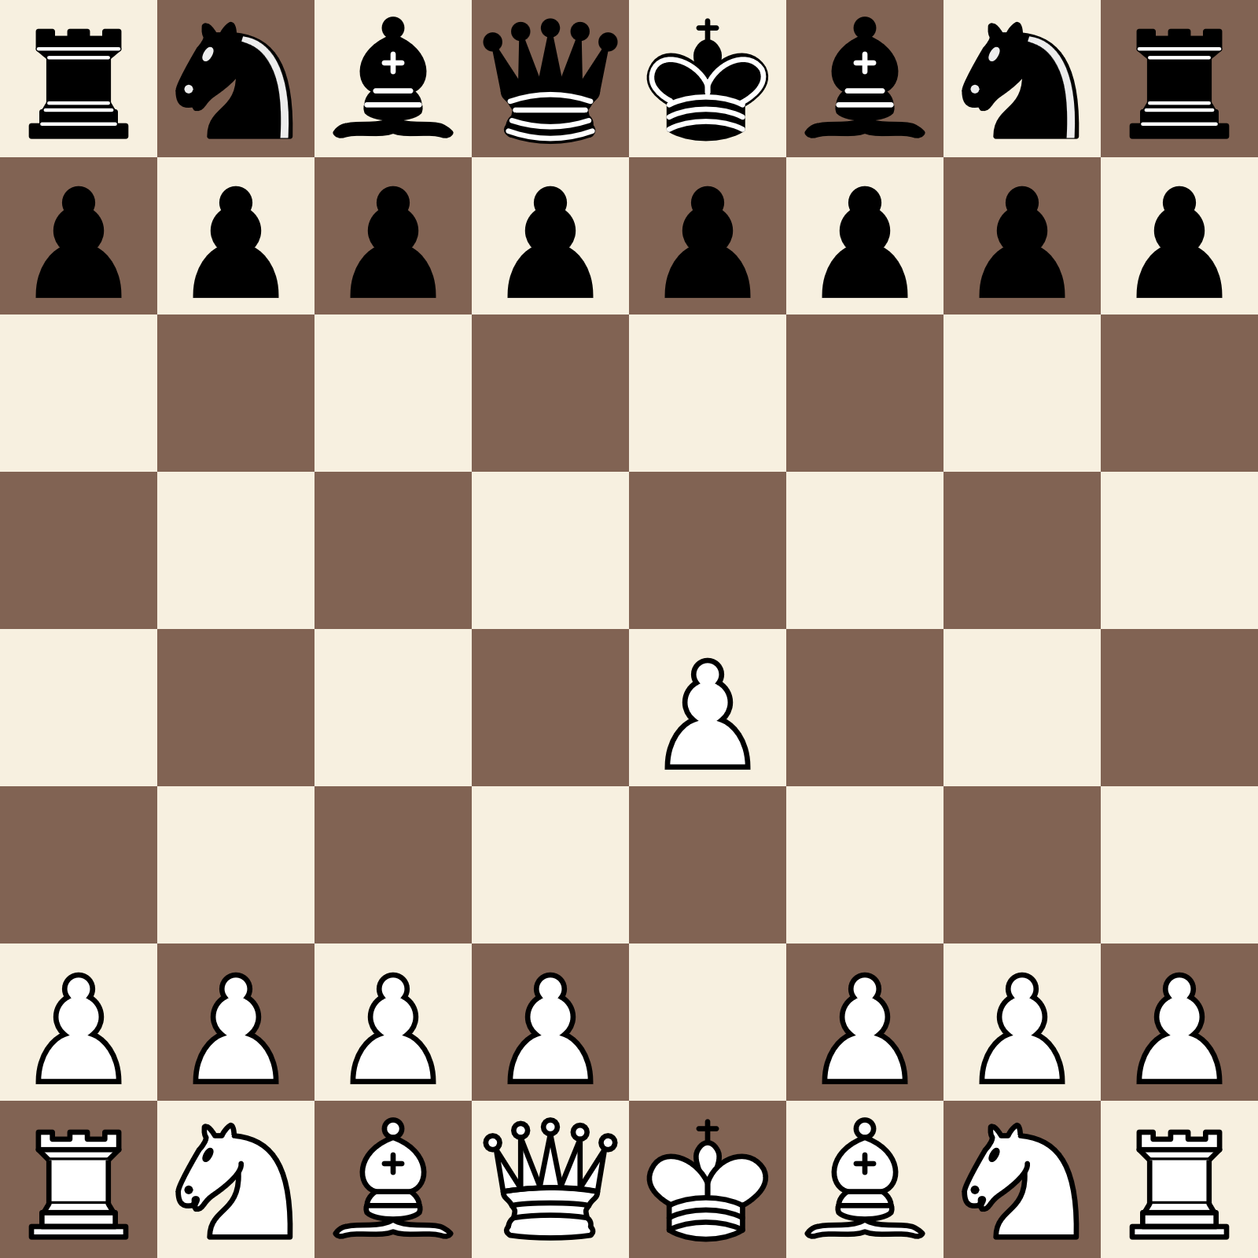

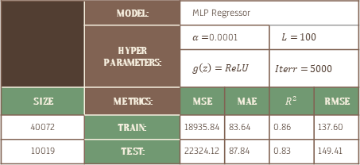
PREDICTING LEVEL OF PLAY IN CHESS
OBJECTIVE
DATA & PIPELINE
MODELLING
Can a multi-feature approach accurately predict the Elo Rating from a single game?
Parallel processing of batches of games.
Engine Evaluation to generate features: Eval, W/D/L, Blunders, Mistakes, Inaccuracies, etc.
Export tensorized features to TFRecords for direct ML training.
 | MODEL: | MLP Regressor
 | HYPER PARAMETERS: | $α=$0.0001 |  | $$L=100$$
 |  | $$g\left(z\right)=ReLU$$ |  | $$Iterr=5000$$
SIZE | METRICS: | MSE | MAE | $$R^{2}$$ | RMSE
40072 | TRAIN: | 18935.84 | 83.64 | 0.86 | 137.60
10019 | TEST: | 22324.12 | 87.84 | 0.83 | 149.41
Outcome-based
Limitations in evaluating solo game.
Inaccurate initial rating.
Doesn’t measure playing strength
Not suitable for cross-era player comparisons
RESULTS
DATA SOURCE
Monthly games from Lichess open Database.
Compressed file of PGN data.
Metadata + Move order seq (SAN).
1. e4 c5 2. Nf3 e6 3. d4 cxd4 4. Nxd4 Nf6 5. Bb5 a6 6. Ba4 Nxe4 7. Qe2 Nf6 8. O-O Be7 9. Bg5 O-O 10. Nc3 h6 11. Bh4 b5 12. Bb3 d5 13. Rfe1 Bb7 14. h3 Nc6 15. Nxc6 Bxc6 16. Rad1 Nd7 17. Bxe7 Qxe7 18. a4 Nc5 19. axb5 axb5
Predicts Elo with an error of ±87.
Relied heavily on opponent’s Elo.
Explore sequential models (RNN, CNN, Transformers)

