Slide 1

Anudip foundation
Batch Code
ANP-C8362
Student Name: Chauhan Vandana Ramdayal Student Id: AF0411629
Batch Code: ANP-C8362
Submitted By, Submitted To,
Chauhan Vandana Ramdayal Siva Kumar Selvam Sir

Slide 2

Analysis of Mobile
The dataset contains detailed information about various mobile phones, including features, prices, and other specifications

Slide 3
Analysis of Mobile
Introduction
To examine mobile phone features, pricing, and trends to uncover insights into brand performance, technological advancements, and user preferences.
Objective:
To analyze mobile phone features, prices, and trends.
Dataset Details:
Information about brands, operating systems, storage, 5G availability, and prices.

Slide 4

Key Analysis Questions
What are the top 5 most expensive and cheapest phones?
What are the trends in pricing across different brands?
Which phones support 5G?
High and low-priced phones based on operating systems (Android/iOS).

Slide 5
Tools and Technologies
Database: MySQL Workbench
Visualization: Power BI and Python (Seaborn, Matplotlib)
Data Source: CSV file with detailed mobile specifications

Slide 6
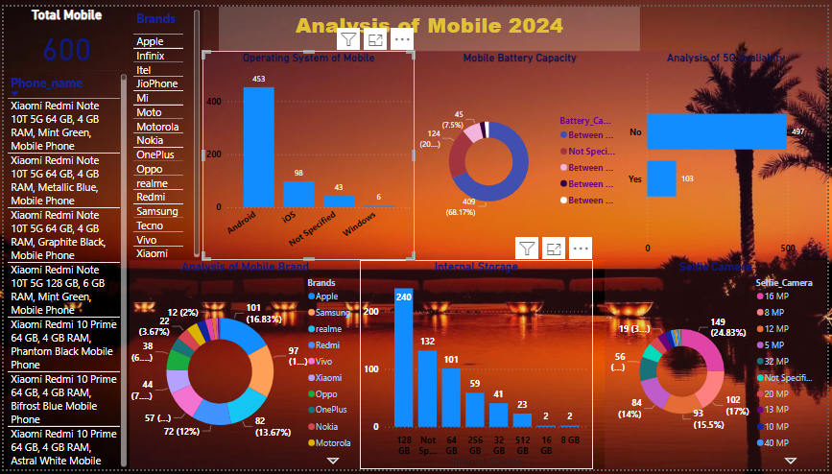
Power BI Visualization

Slide 7
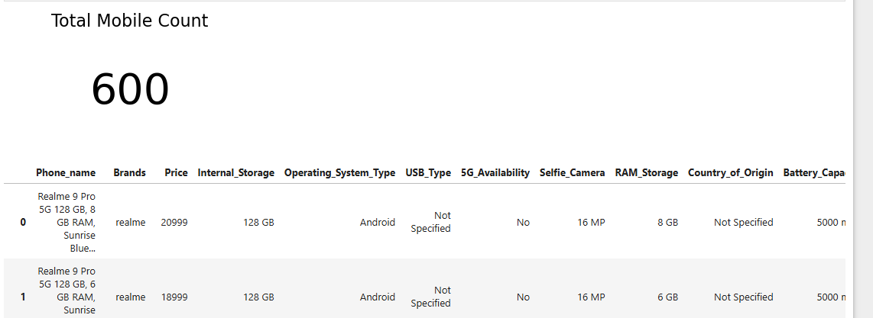
Python Visualization

Slide 8
Thank You

