Slide 1
Skeleton and Compactness. Analysis of Tiger Movement Segmentation Final Project GEOG 275
March/2024
Vanessa Echeverri & Mary Salami
Department of Geography
University of California, Santa Barbara

Slide 2
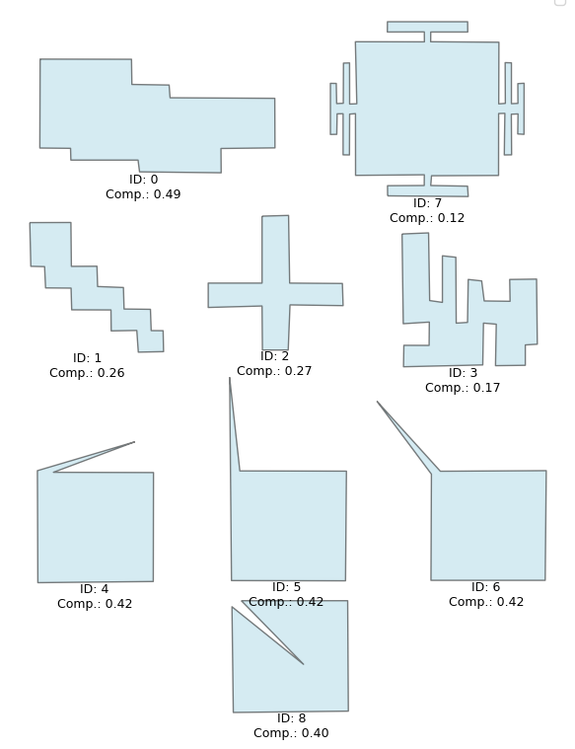
Some Aspects of Compactness Measures
Compare shapes to known simple geometries (square or circle)
Widely used measures of compactness do not account for holes
Neglect boundary irregularities (concavities)
Center is essential in some measures

Slide 3
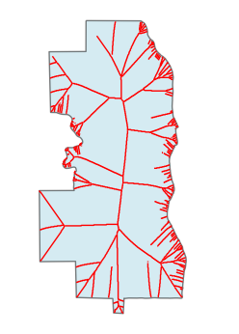
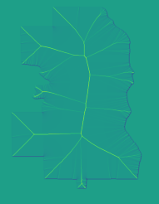
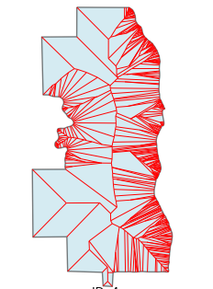
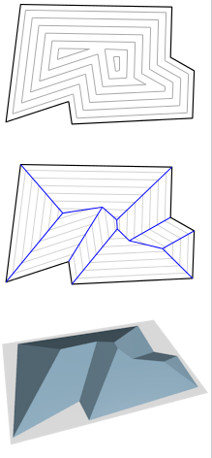
Skeleton
Also known as medial axis
Represents a shape in a simplified form
Captures the topological and geometric properties in a “reduced” version
Lines are formed by a set of points that have more than one closest point from the boundary
Straight skeleton is a particular type. Shrinking process
Notes:
https://en.wikipedia.org/wiki/File:StraightSkeletonDefinition.png

Slide 4
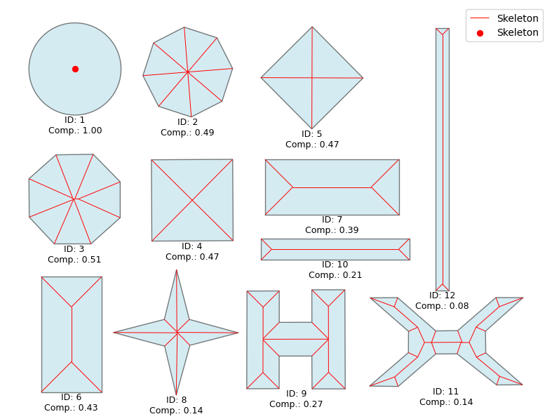
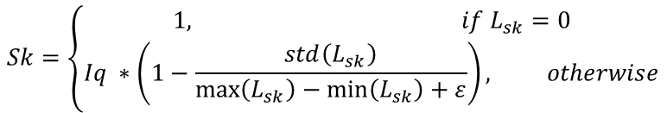

Measure of Compactness
Complement existing measures to capture boundary complexities and holes

Slide 5
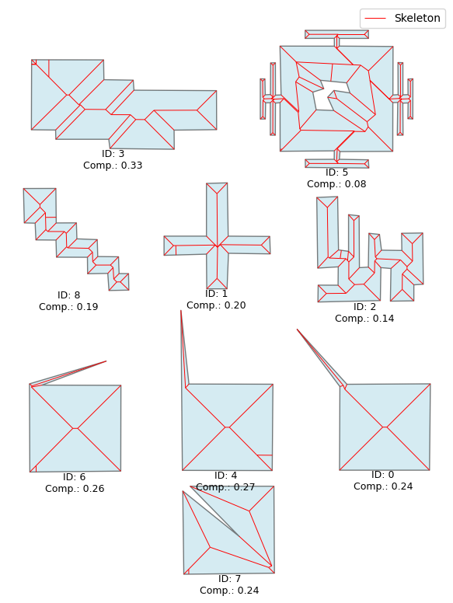
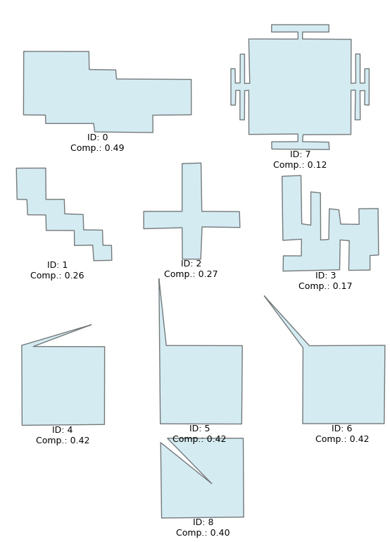
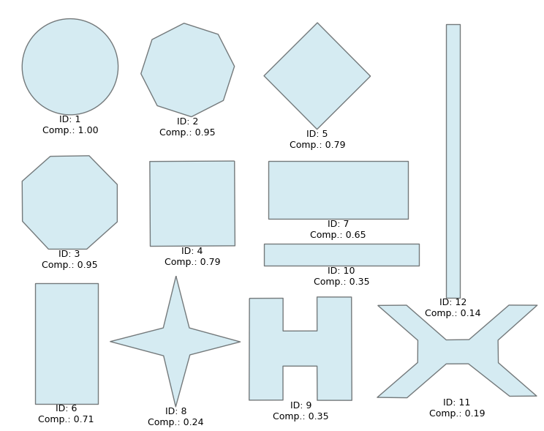
Sk Measure vs. IQ
Sk Measure
Sk Measure
Isoperimetric Quotient
Isoperimetric Quotient

Slide 6
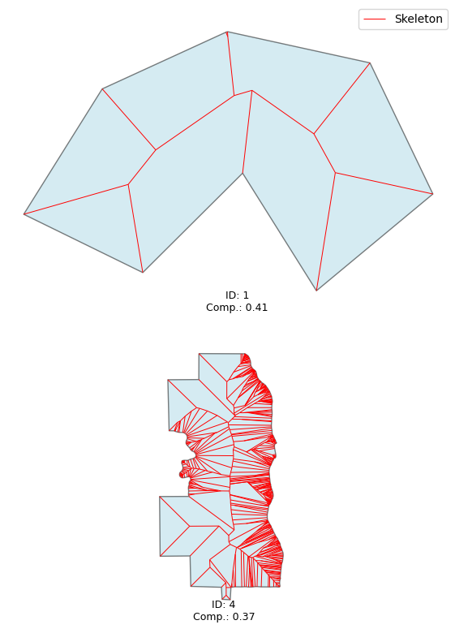
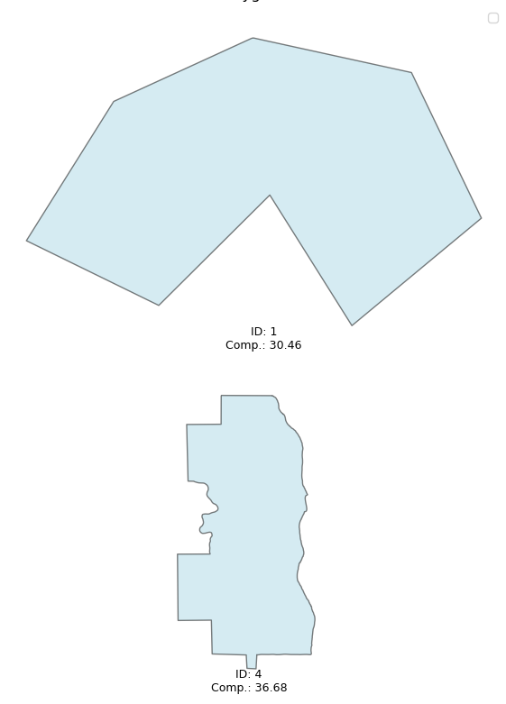
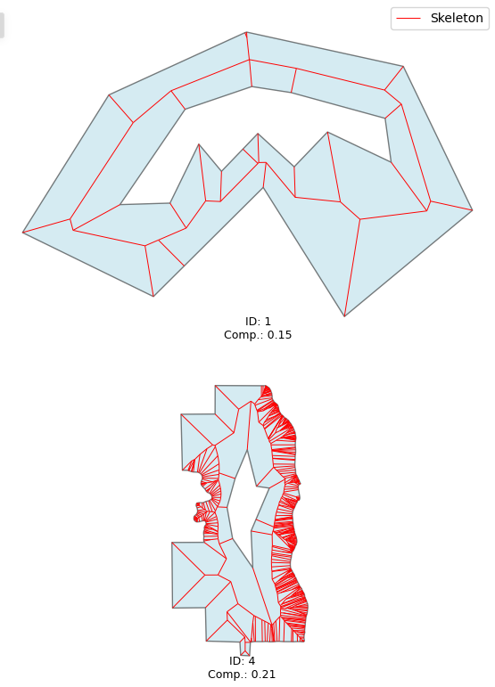
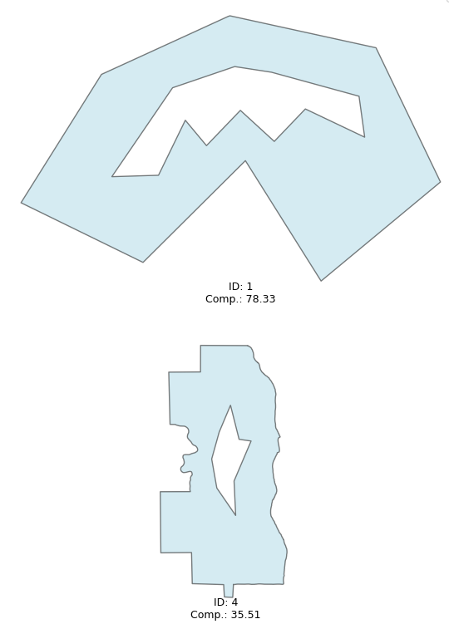
Sk Measure vs. Boyce Clark
Sk Measure
Boyce Clark
Sk Measure
Boyce Clark

Slide 7
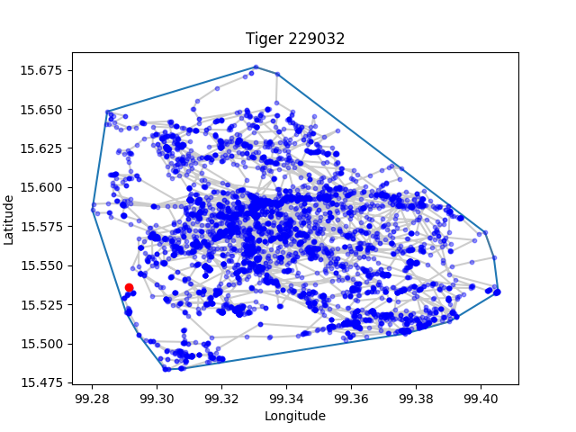
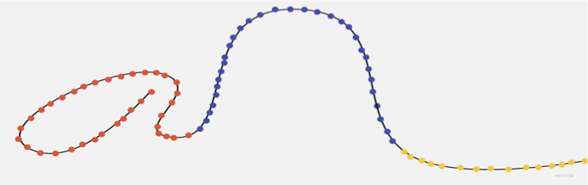
Tiger Trajectory Segmentation
•Trajectory segmentation is dividing a trajectory into segments
•To reduce computational complexity
•Understanding patterns or distinct behavior
Tiger Behavior
Exploring - Patrolling & Searching
Hunting
Research Question
How can compactness measures be used to understand tiger behavioral patterns?
Behavior 1
Behavior 3
Behavior 2
Dodge, S., Weibel, R., & Laube, P. (2009). Exploring movement-similarity analysis of moving objects. SIGSPATIAL Special, 1(3), 11-16

Slide 8
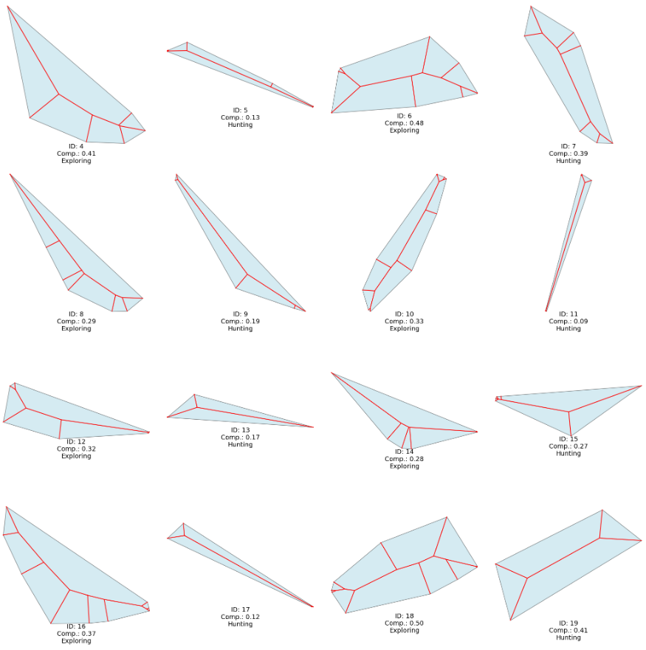
Tiger Data
Data for a single tiger. Behavior captured in a year
Selected 51 days at random
Gathered points for 5 days and sub-partitioned based on known activities
Created convex hulls
Calculated various compactness measures
Assessed prediction of compactness on classification

Slide 9
Compactness and Tiger Behavior
Statistic | Behavior | Sk | Reock | Isoperimetric Quotient | Boyce-Clark
Mean | Exploring | 0.42 | 0.35 | 0.59 | 29.70
 | Hunting | 0.19 | 0.15 | 0.28 | 58.23
Median | Exploring | 0.41 | 0.32 | 0.57 | 28.80
 | Hunting | 0.17 | 0.11 | 0.24 | 56.94
SD | Exploring | 0.09 | 0.14 | 0.14 | 10.65
 | Hunting | 0.14 | 0.12 | 0.21 | 26.04
Min | Exploring | 0.28 | 0.19 | 0.39 | 9.28
 | Hunting | 0.00 | 0.00 | 0.00 | 18.84
Max | Exploring | 0.60 | 0.71 | 0.88 | 45.20
 | Hunting | 0.43 | 0.40 | 0.61 | 125.57

Slide 10
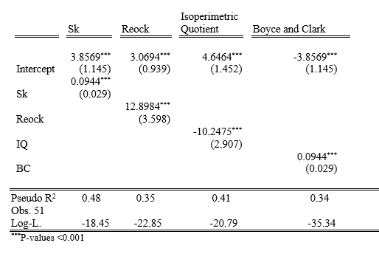
Shape Assessment
Logistic Regression
Assessed prediction of compactness using 85% of training data and 15% for validation.
Model | Accuracy
Sk | 88%
Reock | 75%
Isoperimetric Quotient | 75%
Boyce and Clark | 75%

Slide 11
Conclusions
The skeleton seems to capture complexities present in the boundary
It considers holes
The shape enclosing tiger behavior might contain information to perform segmentation

Slide 12
Thank You!
Mary Salami & Vanessa Echeverri
marysalami@ucsb.edu
vanessa610@ucsb.edu

