Slide 1



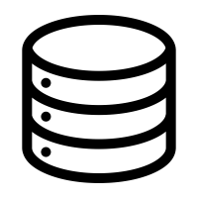


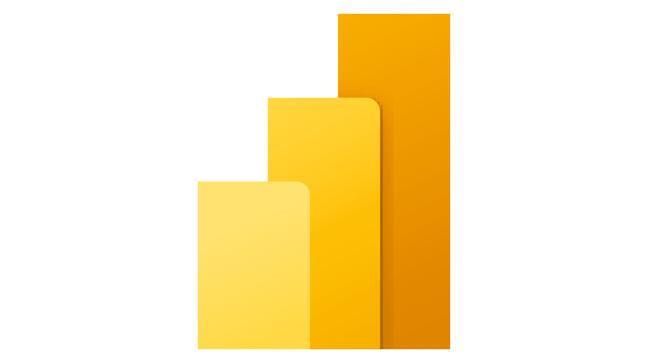

Log Analytics
Azure Monitoring
Logic Apps
Data Management
Data Storage & Transformation
Ingestion Layer
Source Systems
SFTP
Server
Data Storage
Tax_source
Batch
Flow
Fabric One Lake
Archival
Fabric Data Factory
Error Logging
Landing
Raw
Staging
Curated
Datamart
Events
Cleansed Data
Curated Data
Data Processing
Data Processing utilities (EY Cloud Studio)
ETL & Orchestration
Data Quality
Data Visualisation Layer
Error and Restart
Data Processing
Users
Data Transformation
Power BI
Foundational Layer
WOG Azure Active Directory
Azure Key Vault

