Slide 1
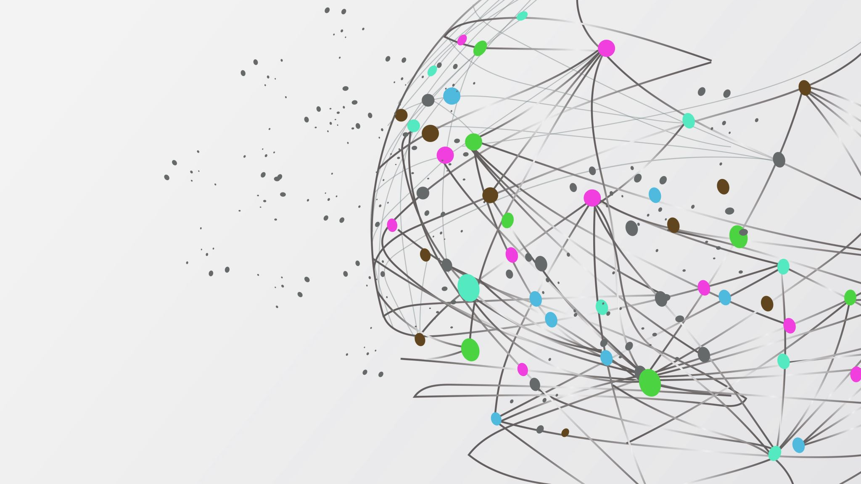
Value Stream Management
Vanessa Espino

Slide 2
VSm
VSM is the business practice of planning, aligning and continually improving the value created during the end-to-end delivery of products and services. Its purpose is to maximize value stream efficiency, reduce time-to-market, enhance product quality and provide greater customer experience.
Value Stream management uses cross-functional teams that break operational silos to give stakeholders visibility and input across business functions, helping them identify bottlenecks and inefficient workflows.

Slide 3
Benefits
The benefits of value stream management include:
Enhanced insights
Operational efficiency
Faster delivery
Improved customer experience

Slide 4
Value stream mapping
Value stream mapping involves charting the path of information, materials and other resources throughout the process of creating and delivering a product. Value stream mapping creates a clear visualization of the sequence of activities required to deliver a product or service.
A value stream map visually represents essential information:
Time spent working and waiting at each step
Labor required for each step
Error rates at each step
Downtime experienced along the value stream
Bottlenecks and process delays at each step

Slide 5
Lead time and processing time
Lead time represents the total elapsed time from the moment a customer places an order or a request enters your system until the moment that order is completely fulfilled and delivered
Processing time refers to the actual time spent actively working on a task or product. This is the value-added time where transformation occurs, where raw materials become finished goods, or where information is actively being processed rather than sitting idle
Whereas the lead time clock starts when the request is made and ends when it is fulfilled, the process time clock only starts when we begin work on the customer request-specifically, it omits the time that the work is in queue, waiting to be processed.

Slide 6
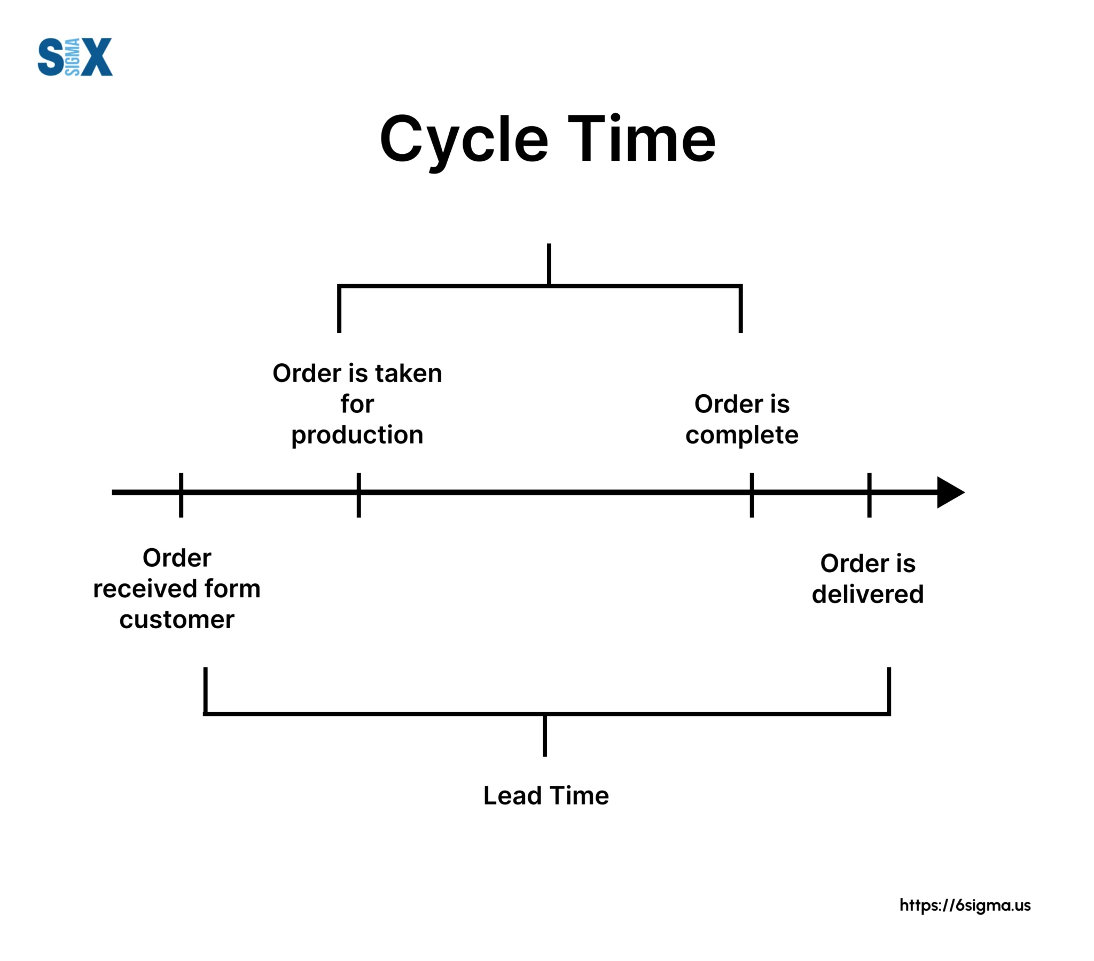

Slide 7
“Many teams and organizations find themselves in situations where deployment lead times months. This is especially common in large, complex organizations that are working with tightly coupled, monolithic systems, often with scarce integration test environments, long test and production environment lead times, high reliance on manual testing, and multiple required approval processes.
When we have long deployment lead times, heroics are required at almost every stage of the value stream. In the DevOps ideal, developers receive fast, constant feedback on their work, enabling them to quickly and independently implement, integrate, and validate their code and have the code deployed into the production environment.
We achieve this by continually checking small code changes into our version control repository, performing automated and exploratory testing against it and deploying it into production.” -The DevOps Handbook

Slide 8
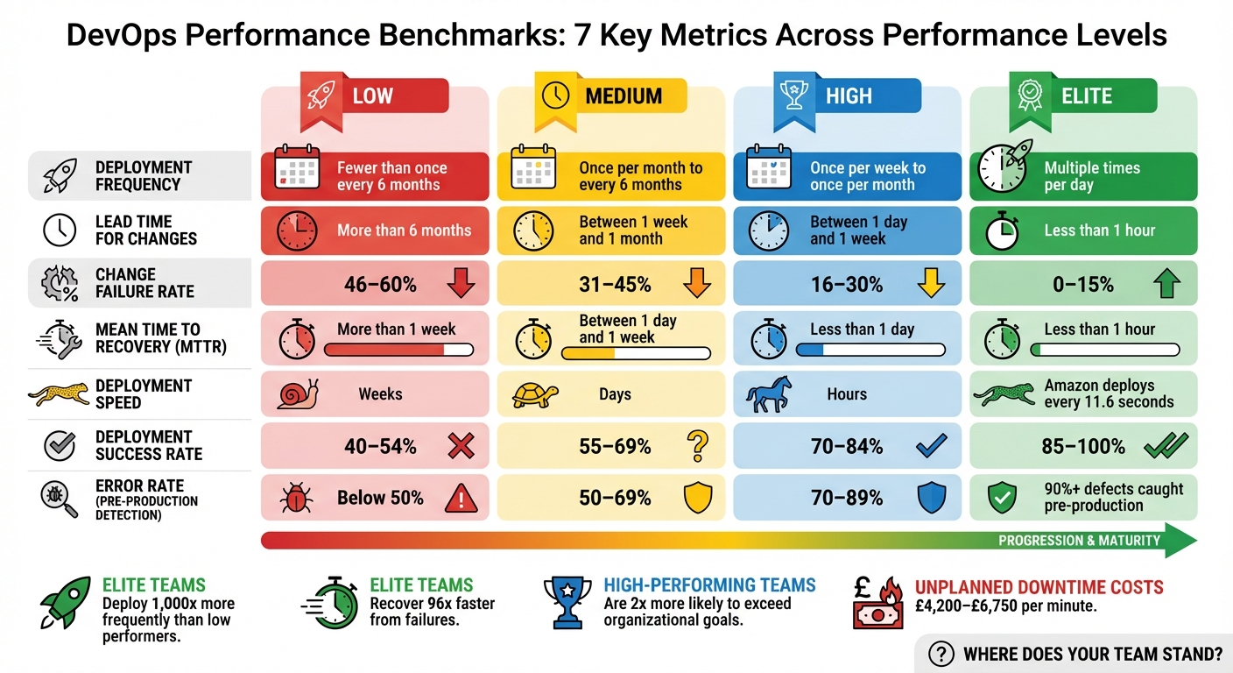
This enables us to have a high degree of confidence that our changes will operate as designed in production and that any problems can be quickly detected and corrected. This is most easily achieved when we have architecture that is modular, well encapsulated, and loosely coupled so that small teams are able to work with high degrees of autonomy, with failures being small and contained, and without causing global disruptions.
In this scenario, our deployment lead time is measured in minutes, or, in the worst case, hours.

Slide 9
There are 2 types of value streams: Operational value streams and development value streams. Operational value streams make up the personnel, workflows, systems and tools needed to deliver a product to a customer.
Modern software development methodologies, such as DevOps, implement many of the same principles of value stream management while combining value streams.
Agile methodologies break down larger projects into smaller phases or sprints. Agile development prioritizes collaboration, continuous improvement and user feedback to make improvements throughout the software development cycle.
Value stream management can work with both methodologies but extends the principles a bit further by incorporating additional teams such as project management teams, marketing teams and customer service teams.

Slide 10
references
https://www.ibm.com/think/topics/value-stream-management
https://lean6sigmahub.com/measure-phase-understanding-the-critical-difference-between-lead-time-and-processing-time/
The DevOps Handbook

