Slide 1
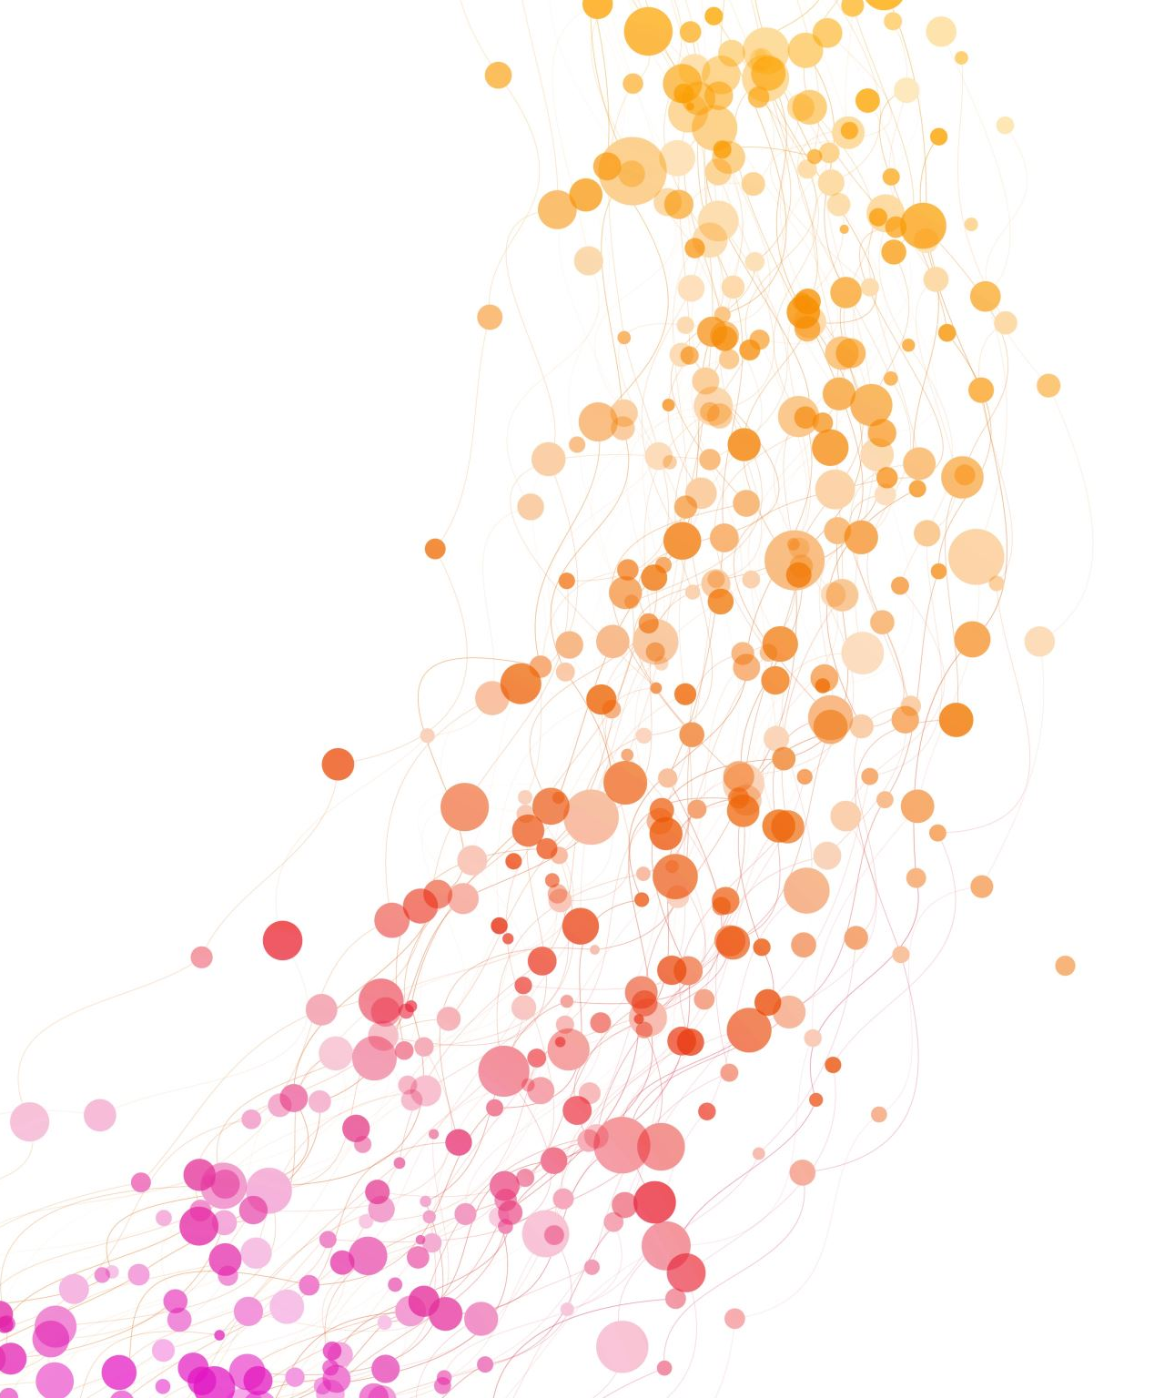
Just Culture
Vanessa Espino
Module 8
CSD 380

Slide 2
In the world of cybersecurity, incidents aren’t just likely- they’re inevitable. Human error, process flaws, technical vulnerabilities… odds are sooner or later something will go wrong.
What distinguishes a resilient organization from a vulnerable one is how it responds.
Punishing those who make mistakes does not prevent the next one, instead a paradigm shift is needed. This is where Just Culture is needed.

Slide 3
What is a “Just Culture”?
Just Culture was originated in high-risk contexts such as aviation and healthcare.
The underlying idea is simple: to encourage people to report problems without fear of automatic punishment.
The goal of Just Culture is to foster transparency, learning, and prevention.
It’s a culture of accountability that distinguishes between honest mistakes and irresponsible behavior without necessarily seeking scapegoats.

Slide 4
Deeply Ingrained Blame Culture and Fear
Often team members fear professional damage, demotion, or firing after a major production outage.
Instead of asking “Who was at fault?” we start with “What went wrong?” to strengthen the system.
In the context of cybersecurity, this approach is still now widely adopted, yet it is essential for building an organization capable of learning from incidents, reducing human error, and proactively addressing threats.

Slide 5
Just Culture teaches that human error is never solely personal but rather stems from latent conditions for error embedded within procedures, technologies, and corporate culture.
Blaming someone without analyzing the context means missing an opportunity to learn and improve.
When you adopt Just Culture, you create more trust, more reporting by making people feel safe reporting vulnerabilities and near-misses. Every incident is a chance to learn and improve.
Cybersecurity is not the responsibility of IT or the SOC alone. Everyone-developers, managers, HR- need to be involved.

Slide 6
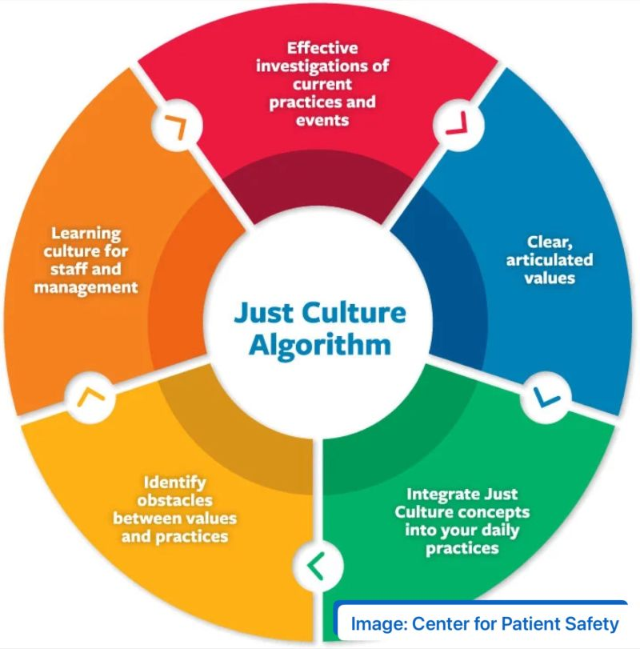

Slide 7
Deda Tech’s approach: Red Button
Deda Tech has transformed Just Culture into a concrete service. Red Button is an intervention and coordination model that goes beyond the technical response.
Red Button does not merely resolve attacks: it analyzes, learns, and helps organizations evolve.
It does not seek culprits, but solutions. It doesn’t just put out fires but builds prevention.

Slide 8
Major Challenges
There are some major barriers to creating a Just Culture.
Blame: When things go wrong, humans have the tendency to want to blame the people involved.
Outcome Bias: Humans allow the outcome of a situation to influence the decision about what an appropriate response is for the people involved.
Lack of Openness: Team members are scared to come forward when mistakes are made, and how it will impact them.

Slide 9
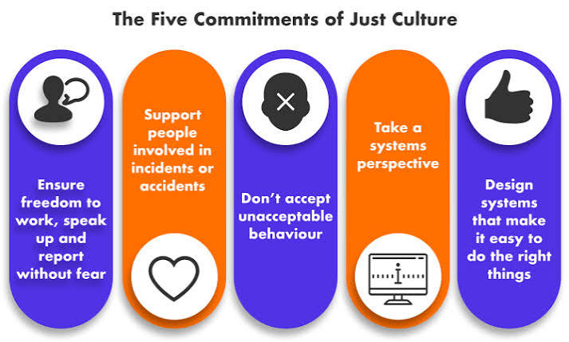

Slide 10
How To Achieve Just Culture
Almost three-quarters of complicated, large-scale change programs fail to reach their goals. This is partly due to employee resistance or not having enough knowledge of tools to execute. As well as:
Encourage Emotional Awareness
Respond Appropriately to Mistakes
Inspire with Vision
Secure Buy-In as Early as Possible
Follow the PIKES Model: Purpose, Integration, Knowledge, Ecosystem, and Self

Slide 11
References:
https://justculture.hqa.ca/overcoming-barriers-to-a-just-culture/
https://www.deda.com/insights/blog/cybersecurity-and-just-culture
https://kbmax.com/engineer-to-order-software-overcoming-the-5-big-barriers-to-adoption/
https://blog.codacy.com/quality-oriented-culture

