Slide 1
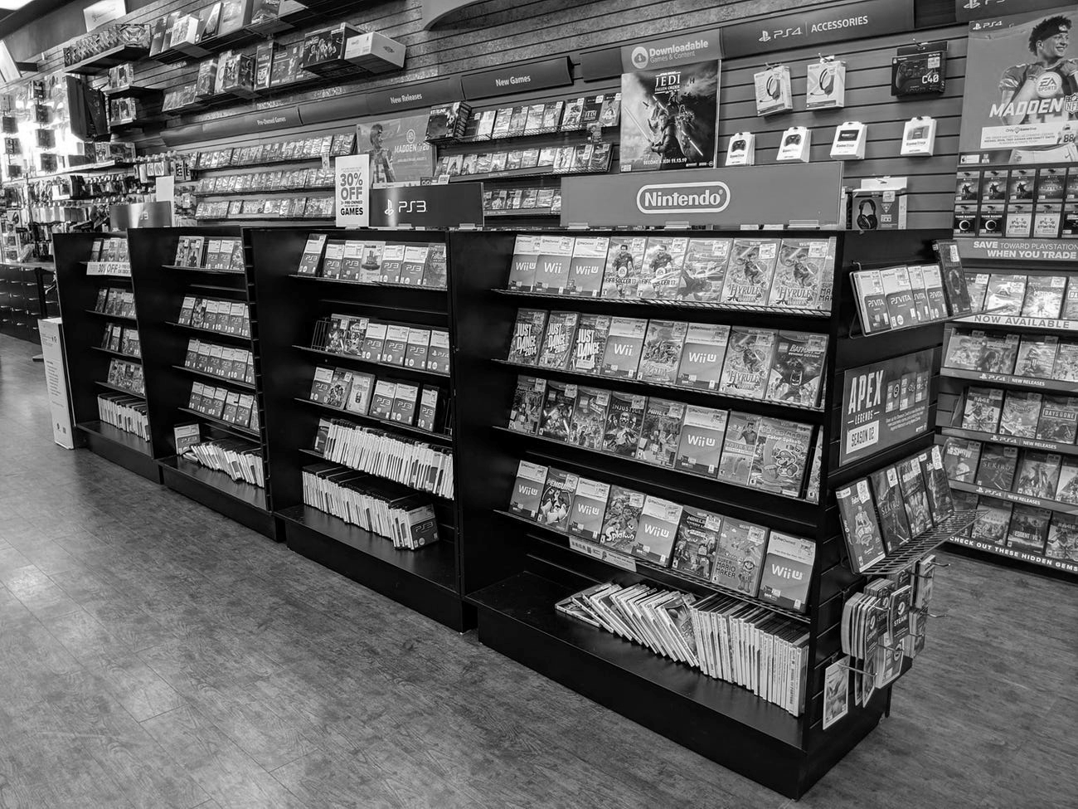
GAMES COMMERCE DATABASE
PROG211 Relational Databases
Eumee Garcia, Vanesa Robledo, Connar Thompson

Slide 2
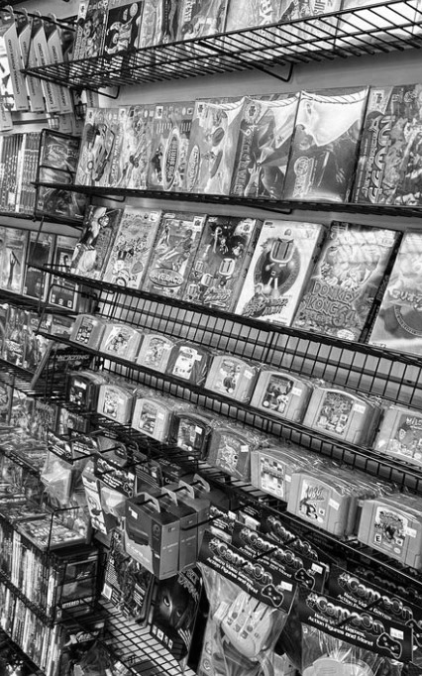
Project Use Case
Manage video game commerce
      Track video games and consoles sold in the business and purchases made by customers
        Manage customers that register with the store
        Manage employees that work at stores

Slide 3
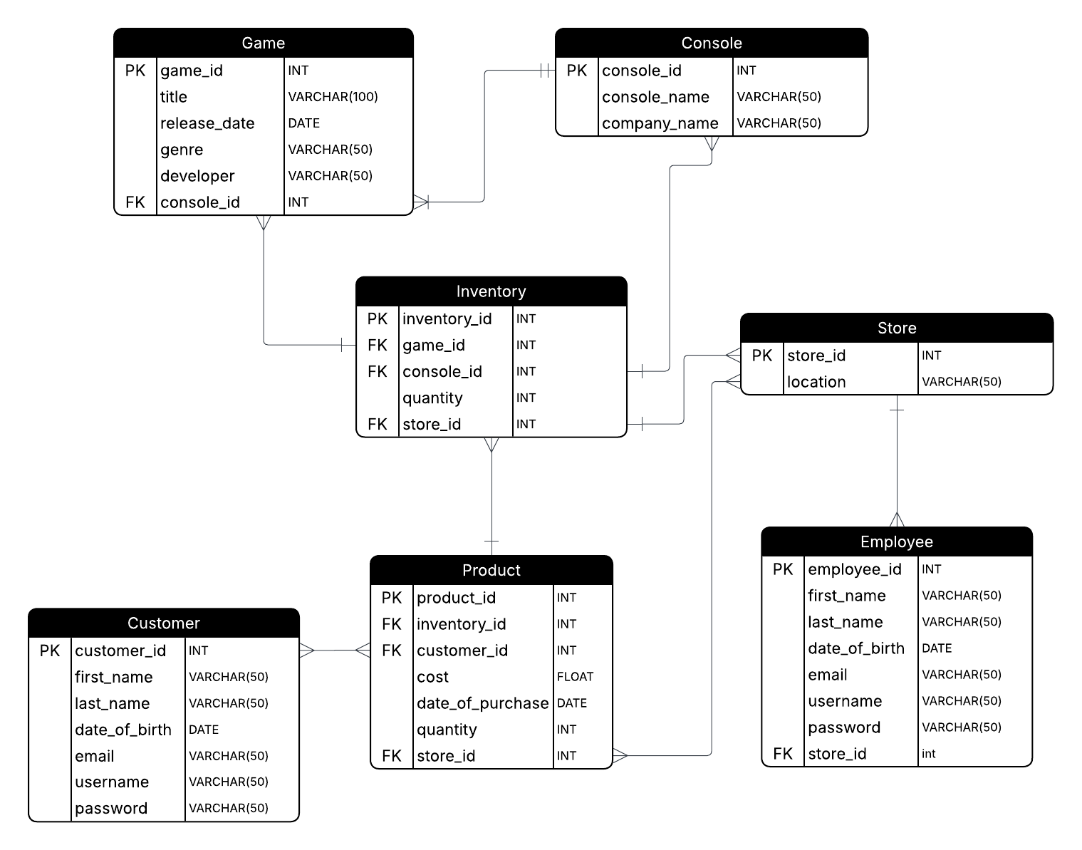
erd

Slide 4
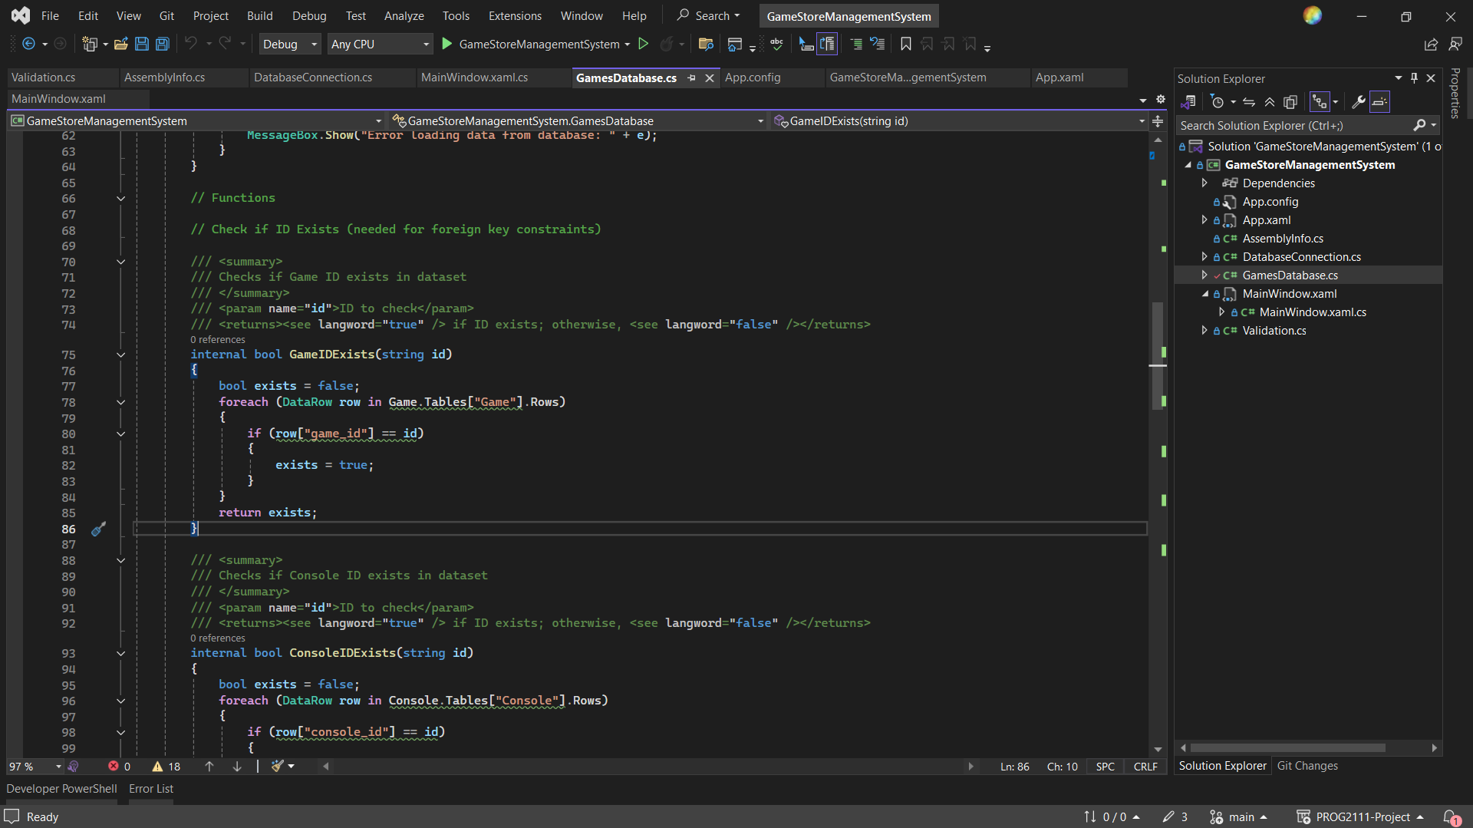
Project demo

Slide 5

CHALLENGES
Representing both video games and consoles in purchases
  Solution: Create inventory entity

Slide 6

THANK YOU

