Slide 1
TE2023 Microcontrollers Computer Architectures and Instructions
Luis Alfonso Maeda Núñez, PhD
Professor

Slide 2
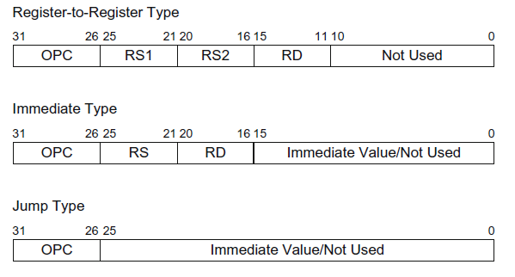
Instruction types
Register-to-register
Format: OPC RS1, RS2, RD
Behavior: Reg[RS1] (OPC) Reg[RS2] -> Reg[RD]
Immediate type
Format: OPC RS, RD, Immediate
Behavior: Reg[RS] (OPC) Immediate -> Reg[RD]
Jump type
Format: OPC Immediate
Behavior: Immediate -> PC

Slide 3
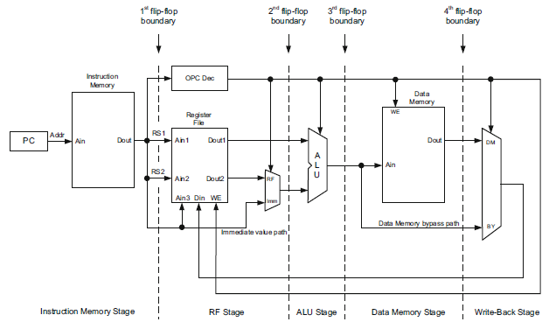
CPU Architecture

Slide 4
ALU Register-Register Instructions
Encoding |  |  |  |  |  | OPC | Op1 | Op2 | Op3 | Operation
0 | 0 | 0 | 0 | 0 | 0 | ADD | RS1 | RS2 | RD | Reg[RS1] + Reg[RS2] -> Reg[RD]
0 | 0 | 0 | 0 | 0 | 1 | SUB | RS1 | RS2 | RD | Reg[RS1] - Reg[RS2] -> Reg[RD]
0 | 0 | 0 | 0 | 1 | 0 | AND | RS1 | RS2 | RD | Reg[RS1] & Reg[RS2] -> Reg[RD]
0 | 0 | 0 | 0 | 1 | 1 | OR | RS1 | RS2 | RD | Reg[RS1] | Reg[RS2] -> Reg[RD]
0 | 0 | 0 | 1 | 0 | 0 | XOR | RS1 | RS2 | RD | Reg[RS1] ^ Reg[RS2] -> Reg[RD]
0 | 0 | 0 | 1 | 0 | 1 | NAND | RS1 | RS2 | RD | ~(Reg[RS1] & Reg[RS2]) -> Reg[RD]
0 | 0 | 0 | 1 | 1 | 0 | NOR | RS1 | RS2 | RD | ~(Reg[RS1] | Reg[RS2]) -> Reg[RD]
0 | 0 | 0 | 1 | 1 | 1 | XNOR | RS1 | RS2 | RD | ~(Reg[RS1] ^ Reg[RS2]) -> Reg[RD]
0 | 0 | 1 | 0 | 0 | 0 | SL | RS1 | RS2 | RD | Reg[RS1] << Reg[RS2] -> Reg[RD]
0 | 0 | 1 | 0 | 0 | 1 | SR | RS1 | RS2 | RD | Reg[RS1] >> Reg[RS2] -> Reg[RD]
0 | 0 | 1 | 0 | 1 | 0 | SGE | RS1 | RS2 | RD | If Reg[RS1] >= Reg[RS2] then 1 -> Reg[RD] else 0 -> Reg[RD]
0 | 0 | 1 | 0 | 1 | 1 | SGT | RS1 | RS2 | RD | If Reg[RS1] > Reg[RS2] then 1 -> Reg[RD] else 0 -> Reg[RD]
0 | 0 | 1 | 1 | 0 | 0 | SLE | RS1 | RS2 | RD | If Reg[RS1] <= Reg[RS2] then 1 -> Reg[RD] else 0 -> Reg[RD]
0 | 0 | 1 | 1 | 0 | 1 | SLT | RS1 | RS2 | RD | If Reg[RS1] < Reg[RS2] then 1 -> Reg[RD] else 0 -> Reg[RD]
0 | 0 | 1 | 1 | 1 | 0 | SEQ | RS1 | RS2 | RD | If Reg[RS1] == Reg[RS2] then 1 -> Reg[RD] else 0 -> Reg[RD]
0 | 0 | 1 | 1 | 1 | 1 | SNE | RS1 | RS2 | RD | If Reg[RS1] != Reg[RS2] then 1 -> Reg[RD] else 0 -> Reg[RD]

Slide 5
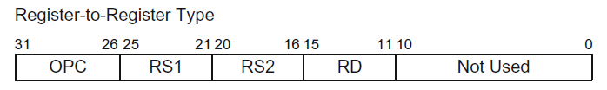




ALU Register-Register Instruction formats

Slide 6
ALU Register-Immediate Instructions
Encoding |  |  |  |  |  | OPC | Op1 | Op2 | Op3 | Operation
0 | 1 | 0 | 0 | 0 | 0 | ADDI | RS | RD | Imm | Reg[RS] + Immediate -> Reg[RD]
0 | 1 | 0 | 0 | 0 | 1 | SUBI | RS | RD | Imm | Reg[RS] - Immediate -> Reg[RD]
0 | 1 | 0 | 0 | 1 | 0 | ANDI | RS | RD | Imm | Reg[RS] & Immediate -> Reg[RD]
0 | 1 | 0 | 0 | 1 | 1 | ORI | RS | RD | Imm | Reg[RS] | Immediate -> Reg[RD]
0 | 1 | 0 | 1 | 0 | 0 | XORI | RS | RD | Imm | Reg[RS] ^ Immediate -> Reg[RD]
0 | 1 | 0 | 1 | 0 | 1 | NANDI | RS | RD | Imm | ~(Reg[RS] & Immediate) -> Reg[RD]
0 | 1 | 0 | 1 | 1 | 0 | NORI | RS | RD | Imm | ~(Reg[RS] | Immediate) -> Reg[RD]
0 | 1 | 0 | 1 | 1 | 1 | XNORI | RS | RD | Imm | ~(Reg[RS] ^ Immediate) -> Reg[RD]
0 | 1 | 1 | 0 | 0 | 0 | SLI | RS | RD | Imm | Reg[RS] << Immediate -> Reg[RD]
0 | 1 | 1 | 0 | 0 | 1 | SRI | RS | RD | Imm | Reg[RS] >> Immediate -> Reg[RD]
0 | 1 | 1 | 0 | 1 | 0 | SGEI | RS | RD | Imm | If Reg[RS] >= Immediate then 1 -> Reg[RD] else 0 -> Reg[RD]
0 | 1 | 1 | 0 | 1 | 1 | SGTI | RS | RD | Imm | If Reg[RS] > Immediate then 1 -> Reg[RD] else 0 -> Reg[RD]
0 | 1 | 1 | 1 | 0 | 0 | SLEI | RS | RD | Imm | If Reg[RS] <= Immediate then 1 -> Reg[RD] else 0 -> Reg[RD]
0 | 1 | 1 | 1 | 0 | 1 | SLTI | RS | RD | Imm | If Reg[RS] < Immediate then 1 -> Reg[RD] else 0 -> Reg[RD]
0 | 1 | 1 | 1 | 1 | 0 | SEQI | RS | RD | Imm | If Reg[RS] == Immediate then 1 -> Reg[RD] else 0 -> Reg[RD]
0 | 1 | 1 | 1 | 1 | 1 | SNEI | RS | RD | Imm | If Reg[RS] != Immediate then 1 -> Reg[RD] else 0 -> Reg[RD]

Slide 7
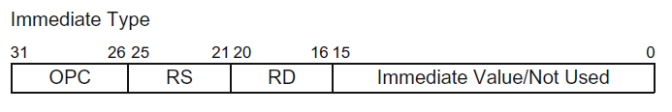


ALU Register-Immediate Instruction formats

Slide 8
Data Movement and Program Control Instructions
Encoding |  |  |  |  |  | OPC | Op1 | Op2 | Op3 | Operation
1 | 0 | 0 | 0 | 0 | 0 | LOAD | RS | RD | Imm | mem{Reg[RS] + Immediate} -> Reg[RD]
1 | 0 | 0 | 0 | 0 | 1 | STORE | RS | RD | Imm | Reg[RS] -> mem{Reg[RD] + Immediate}
1 | 0 | 0 | 0 | 1 | 0 | MOVE | RS | RD |  | Reg[RS] -> Reg[RD]
1 | 0 | 0 | 0 | 1 | 1 | MOVEI | Imm | RD |  | Immediate -> Reg[RD]
1 | 0 | 0 | 1 | 0 | 0 | BRA | RS | RSVal | Imm | If Reg[RS] == RSVal then PC + Immediate -> PC else PC + 2 -> PC
1 | 0 | 0 | 1 | 0 | 1 | JUMP | Imm |  |  | Immediate -> PC
1 | 0 | 0 | 1 | 1 | 0 | JREG | RS |  |  | Reg[RS] -> PC
1 | 0 | 0 | 1 | 1 | 1 | JAL | Imm |  |  | (PC + 2) -> Reg[R14], Immediate -> PC
1 | 0 | 1 | 0 | 0 | 0 | JALR | RS |  |  | (PC + 2) -> Reg[R14], Reg[RS] -> PC
1 | 0 | 1 | 0 | 0 | 1 | RET |  |  |  | Reg[R14] -> PC
1 | 0 | 1 | 0 | 1 | 0 | NOP

Slide 9



Data Movement Instruction formats

Slide 10





Program Control Instruction formats

Slide 11
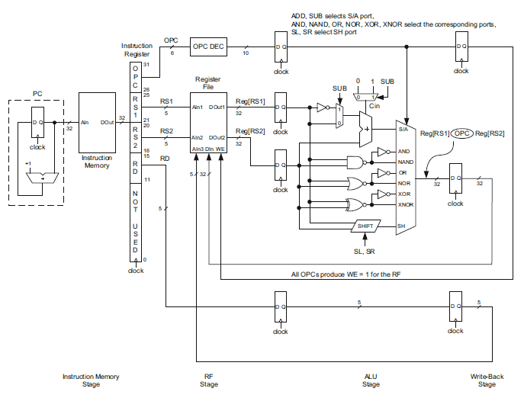
ALU Register-Register CPU Datapath

Slide 12
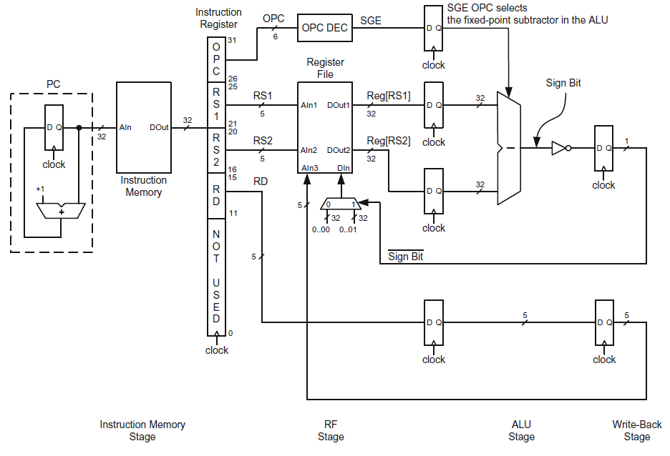
SGE CPU Datapath

Slide 13
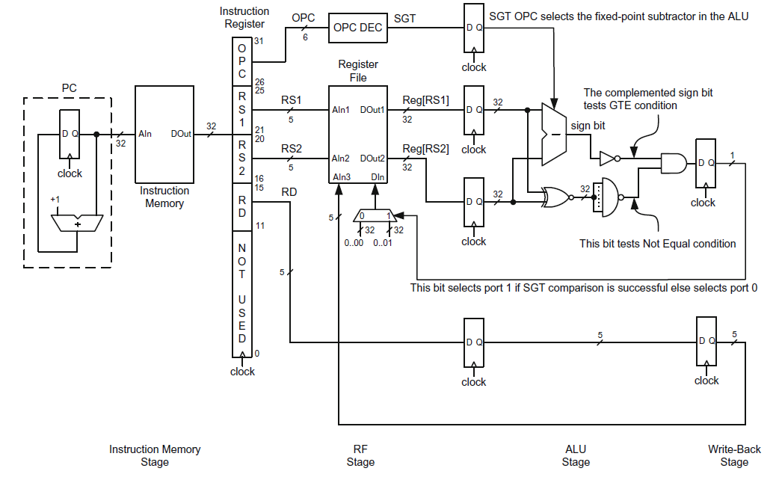
SGT CPU Datapath

Slide 14
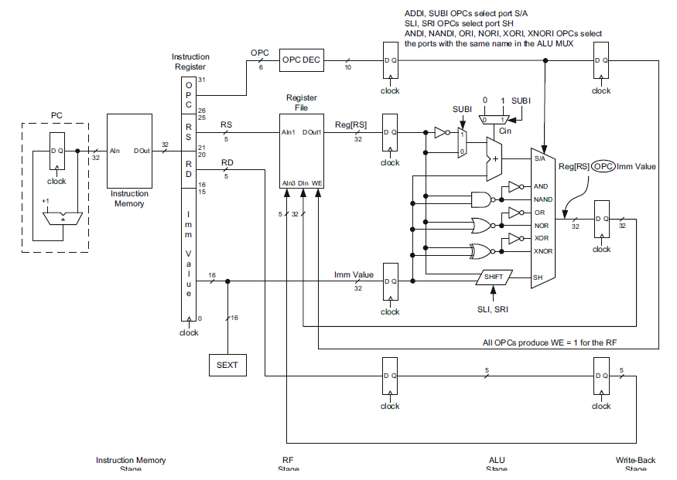
ALU Register-Immediate CPU Datapath

Slide 15
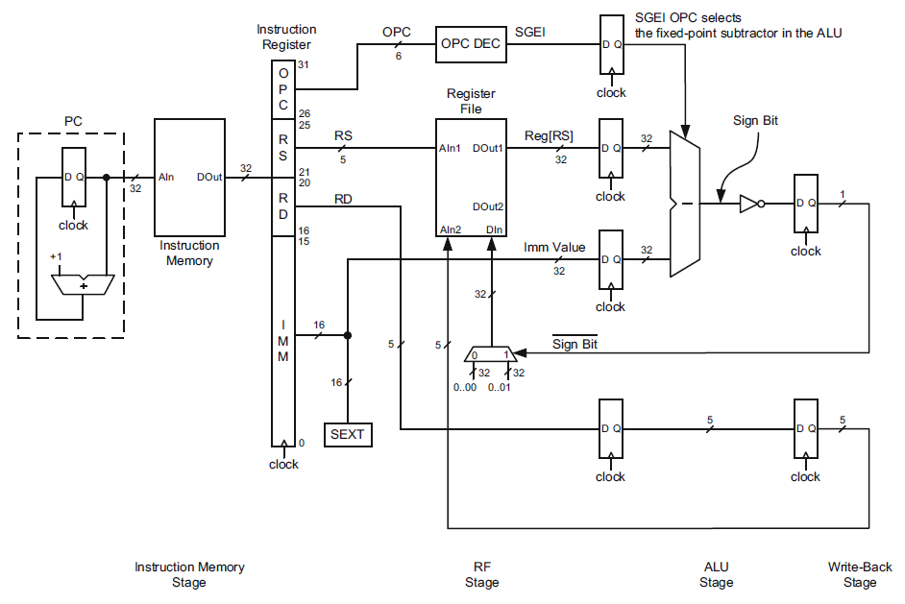
SGEI CPU Datapath

Slide 16
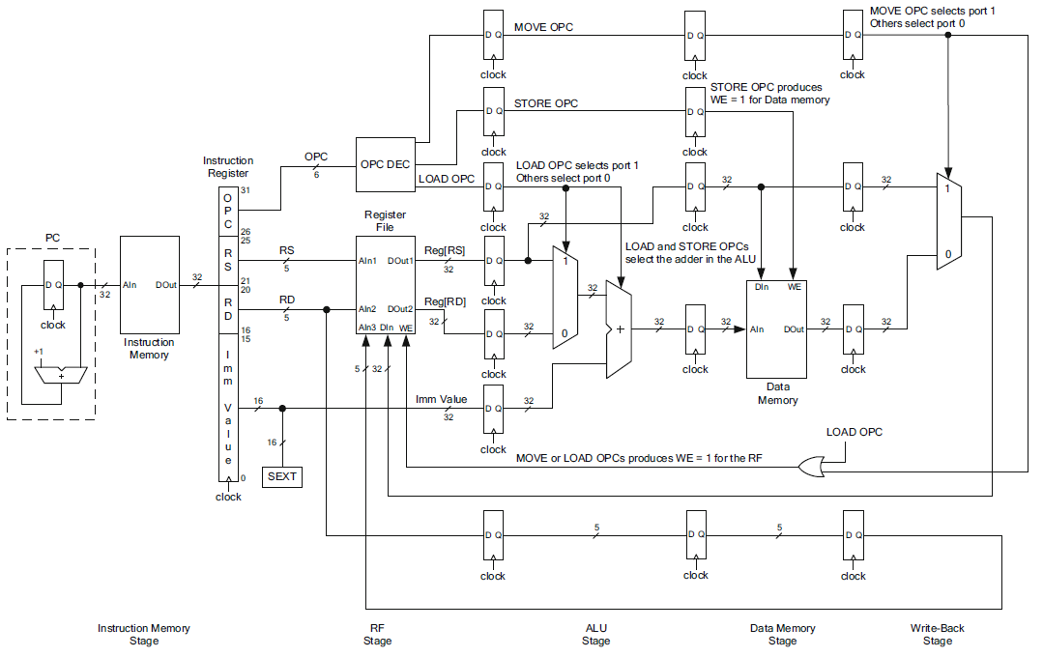
Data Movement CPU Datapath

Slide 17
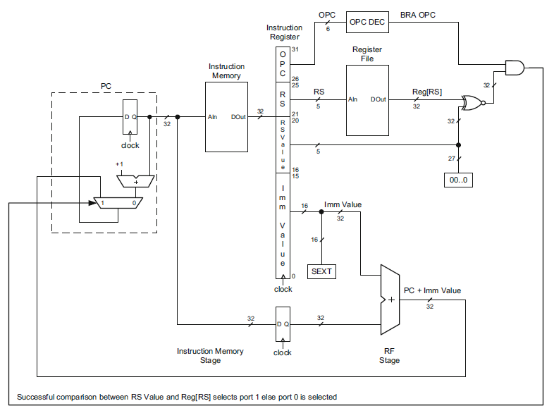
Branch if Equal (BRA) CPU Datapath

Slide 18
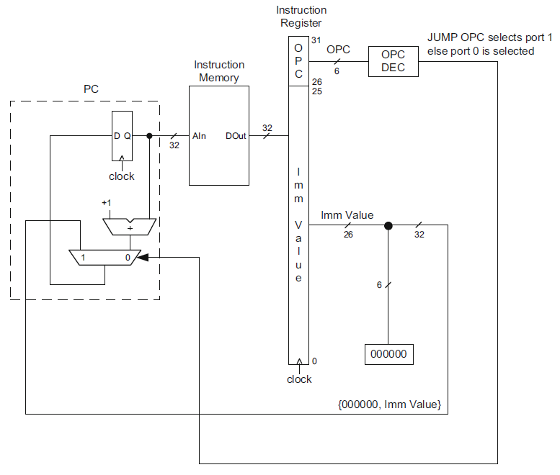
JUMP Instruction CPU Datapath

Slide 19
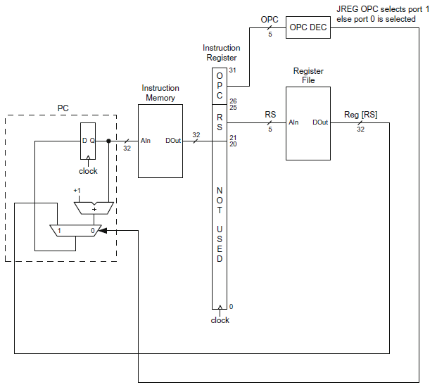
JREG Instruction CPU Datapath

