Slide 1
GradLink
A tool for graduate success by LinkedIn
Product Owner: Vanessa Lam
© 2019 Udacity. All rights reserved.

Slide 2
Background
Why Are We Here?
A personalised service to help graduates to find their passion, get their foot in the door and succeed in the workforce.
The GradLink App. A tool for graduate success by LinkedIn.
© 2019 Udacity. All rights reserved.

Slide 3
Business Case
© 2019 Udacity. All rights reserved.
Notes:
[ALL PARTICIPATION]

Slide 4

Initial Focus
Where are we starting?
“Create economic opportunity for every member of the global workforce”
Our aim is to create an app for LinkedIn that will recommend the best jobs to recent college graduates based on their skills and preferences.
© 2019 Udacity. All rights reserved.

Slide 5
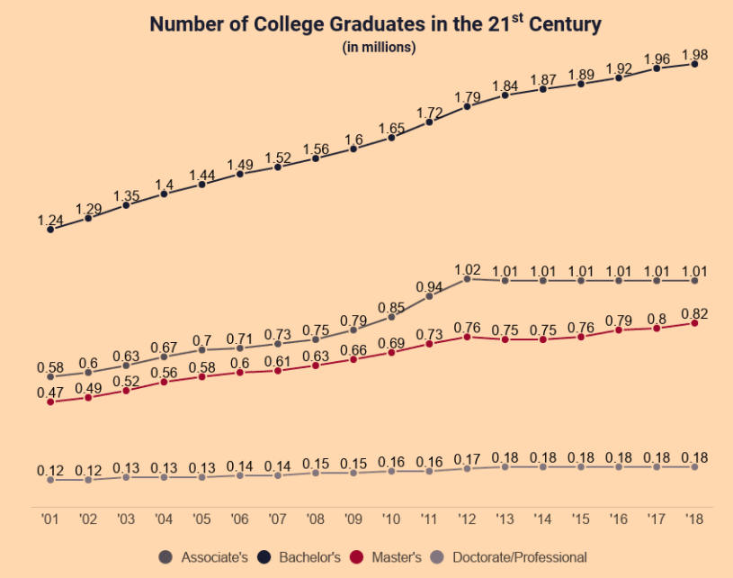
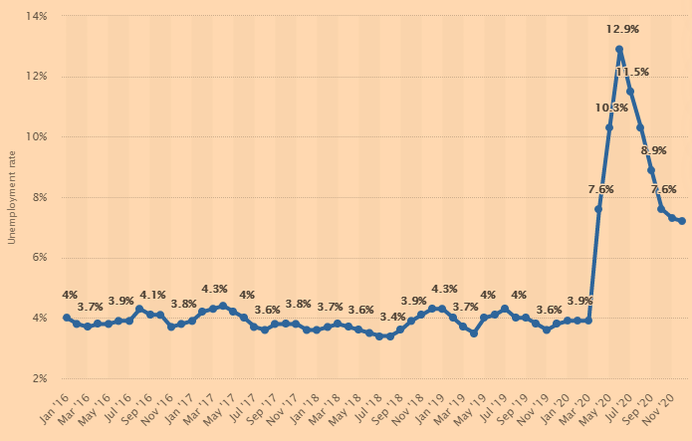
Opportunity
What’s the problem?
Number of college graduates are increasing
19.64 million students currently enrolled ^{[1]}
4 million graduates between 2020 to 2021 ^{[2]}
Annual increasing rate of 2%
Unemployment rates are increasing for graduates
Hovered around 3.9% pre COVID
Spiked to 12.9% and is currently sitting around 7.2% ^{[3]}
Figure 1: Number of College Graduates in the 21st Century. https://educationdata.org/number-of-college-graduates
Figure 2: Unemployment rate of recent graduates 2016-2020. https://www.statista.com/statistics/633660/unemployment-rate-of-recent-graduates-in-the-us/
© 2019 Udacity. All rights reserved.

Slide 6
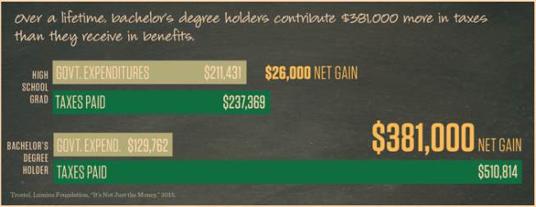
Opportunity
What’s the problem?
One third of US workers are not satisfied with their jobs ^{[4]}
Job mismatch effects job satisfaction ^{[5]}
Graduates add value to the economy
Graduates pay more tax ^{[6]}
‘The Graduate Effect’- For every 1000 graduates hired, 120 jobs are created ^{[7]}
Figure 3: Taxes contributed by Bachelors degree holder versus high school graduates. https://www.aplu.org/projects-and-initiatives/college-costs-tuition-and-financial-aid/publicuvalues/societal-benefits.html#11
“Create economic opportunity for every member of the global workforce”

Slide 7
Proposal
What’s Our Solution?
Our GradLink App is the intelligent solution to matching up graduates with employment opportunities that fall in line with their career goals.
Personalised profile synced with LinkedIn
Customise your career path
Free for LinkedIn Premium; Freemium for general public
Key Features:
Resume Upload
Email updates
Upskill recommendations
© 2019 Udacity. All rights reserved.

Slide 8
Total Addressable Market in the US
What’s our revenue opportunity?
328 million people in the US
4 million graduates
37% of US adults are on LinkedIn
1.48 million graduates are on LinkedIn
39% of users subscribe to LinkedIn Premium
$29.99/month subscription fee
(1.48 million graduates on LinkedIn x 39% of users subscribe to LinkedIn Premium) x $29.99/ month subscription fee x 12 months
TAM = $207 million/year

Slide 9
Return On Investment
What can we do?
Estimation of initial development costs: $520k
2 x Mobile developer (iOS and Android), 2 x Backend developer, Designer, Business Analyst
8 months (1240 business hours) x $70/hr developer rate x 6 staff = $520,800
Estimation of marketing & distribution costs: $383k
Marketing: $50,000 for initial lift off (PR outreach, ads, SEO, marketing agency, influencer)
Distribution for 500,000 installs. US Cost per install is $0.44 for iOS, $0.86 for Android. (46% iOS): 230,000 x $0.44 = $101,200, (54% Android): 270,000 x $0.86 = $232,200
Estimation of revenue: $207 million
(1.48 million graduates on LinkedIn x 39% of users subscribe to LinkedIn Premium) x $29.99/ month subscription fee x 12 months = $207 million/year
Costs | Impact | ROI
$904k | + $207 million | 228%
© 2019 Udacity. All rights reserved.

Slide 10
Measurement
How will we know if we’re successful?
Business
Conversion to premium subscription
Churn rate
Average revenue per user
Product
# of users
Average # of sessions per active user
Average time users spent on user profile
# of jobs attained per user
Quality
App rating in app stores
Support contact rate
Online reviews
Development
On time delivery
Test coverage
© 2019 Udacity. All rights reserved.

Slide 11
Competitors
© 2019 Udacity. All rights reserved.
Notes:
[ALL PARTICIPATION]

Slide 12
Traditional Job Search
E.G. Indeed, CareerBuilder, ZipRecruiter, Monster, Glassdoor
Revenue
Indeed - $2.97 billion
CareerBuilder – $714 million
ZipRecruiter - $418.1 million
Monster- $666.9 million
Glassdoor - $177.5 million
Targets people looking for employment
Traditional job search engine
Database with company testimonials and salary insight
- Contributed by the public
Resume upload
- Recruiters to review
Employers post hiring events
‘It’s clear that Indeed favours quantity over quality.’ Aaron Michel, 2016, https://www.linkedin.com/pulse/truth-indeed-how-fails-users-aaron-michel/
© 2019 Udacity. All rights reserved.

Slide 13



Graduate Job Search
E.G. Graduateland, CollegeGrad, After College
Target niche is graduates and students
Job search engine
Resume upload
Job matching and headhunting services
Start ups
Revenue
Graduateland - $7million – 1 million users
CollegeGrad - $1 million
After College - $1.6 million – 5 million users
© 2019 Udacity. All rights reserved.

Slide 14
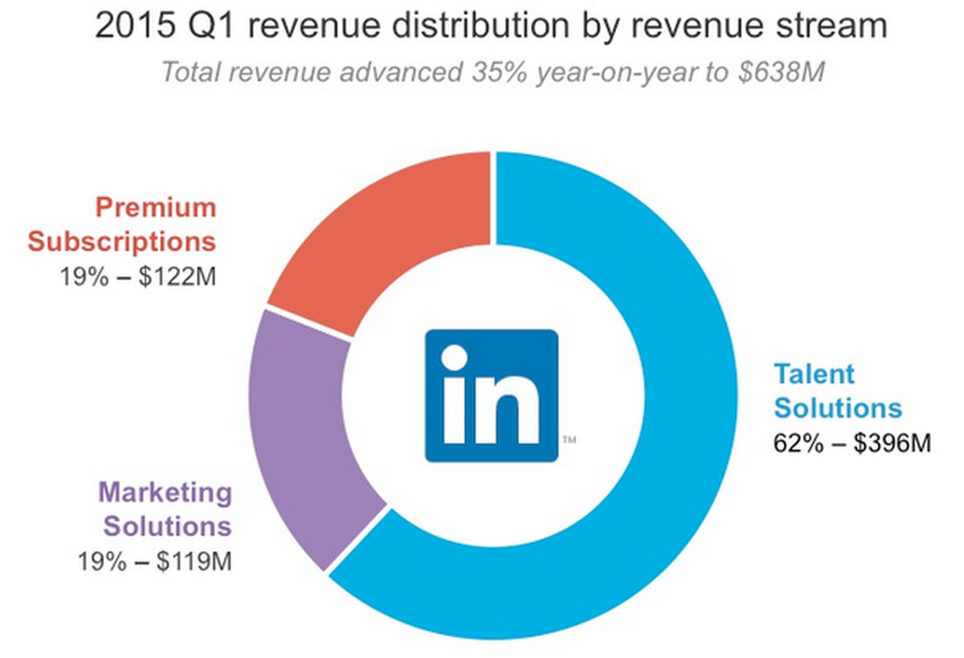
Our Advantages
Why are we better?
LinkedIn is established as a ‘professional social networking site’
740 million users
LinkedIn already offers Talent Solutions
3 people are hired through LinkedIn every minute.
LinkedIn has access to a broad network of companies and recruiters
87% of recruiters and 55 million companies listed on the site
Figure 4:2015 Q1 Revenue distribution by revenue stream. https://www.fool.com/investing/general/2015/05/20/this-company-has-the-best-business-model-in-social.aspx
© 2019 Udacity. All rights reserved.

Slide 15
Roadmap and Vision
© 2019 Udacity. All rights reserved.
Notes:
[ALL PARTICIPATION]

Slide 16
Roadmap Pillars
Where do we go from here?
GradLink aims to kickstart the careers of students and graduates and set them up for success.
Point students in the right direction by helping them define their career path
Match graduates to employers and start their professional career
© 2019 Udacity. All rights reserved.

Slide 17

Career mapping
Define your career path
Self-assessment
Knowledge, skills, abilities, accomplishments and interests
Individualized career map
Build out your career map short term, medium term and long-term goals
Exploring other opportunities
Based off past experiences, interests and motivation.
© 2019 Udacity. All rights reserved.

Slide 18

Job Match
Match graduates to employers and help start their professional career
Listing page with recommended jobs
Allows students to browse for roles
Ability to save listings for later
Saved jobs with email updates
Quick apply feature with resume upload
Preloaded resume that lets you save time applying
© 2019 Udacity. All rights reserved.

Slide 19

Where do we go from here?
Widening the scope
Enhance functionalities
Based off customer feedback
Leverage use of Artificial Intelligence
Better targeted job recommendations
Build the platform for synergies
Offer career mapping for more users
Establish a mentoring service
Connect students and graduates to mentors
© 2019 Udacity. All rights reserved.

Slide 20
Partnerships

Slide 21
Partnerships
Create value for our users
Establish partnetship programs with customized services
Content creators, e.g. mentors, coaches
Universities and colleges, e.g. Harvard
Recruitment services
Certification programs
Educational programs, e.g. Kaplan, Udacity
Develop detection program for job and skill gap
e.g. LinkedIn research with universities and employers.
© 2019 Udacity. All rights reserved.

Slide 22
Sources
Statista, https://www.statista.com/statistics/183995/us-college-enrollment-and-projections-in-public-and-private-institutions/
EDUCATIONDATA. ORG, https://educationdata.org/number-of-college-graduates#:~:text=4%20million%20or%2018%25%20of,have%20increased%2015%25%20since%202010.
Statista, https://www.statista.com/statistics/633660/unemployment-rate-of-recent-graduates-in-the-us/
What to Become, https://whattobecome.com/blog/job-satisfaction-statistics/
National Research Institute for Labour and Social Protection, https://seaopenresearch.eu/Journals/articles/SPAS_15_9.pdf
Association of Public & Land-grand Universities, https://www.aplu.org/projects-and-initiatives/college-costs-tuition-and-financial-aid/publicuvalues/societal-benefits.html#11
Universities Australia, https://www.universitiesaustralia.edu.au/media-item/the-graduate-effect-having-more-graduates-grows-jobs-and-wages/
Business Strategy Hub, https://bstrategyhub.com/linkedin-business-model-how-does-linkedin-make-money/

