Slide 1
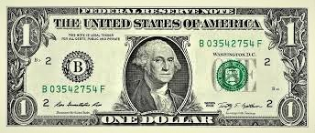

Slide 2
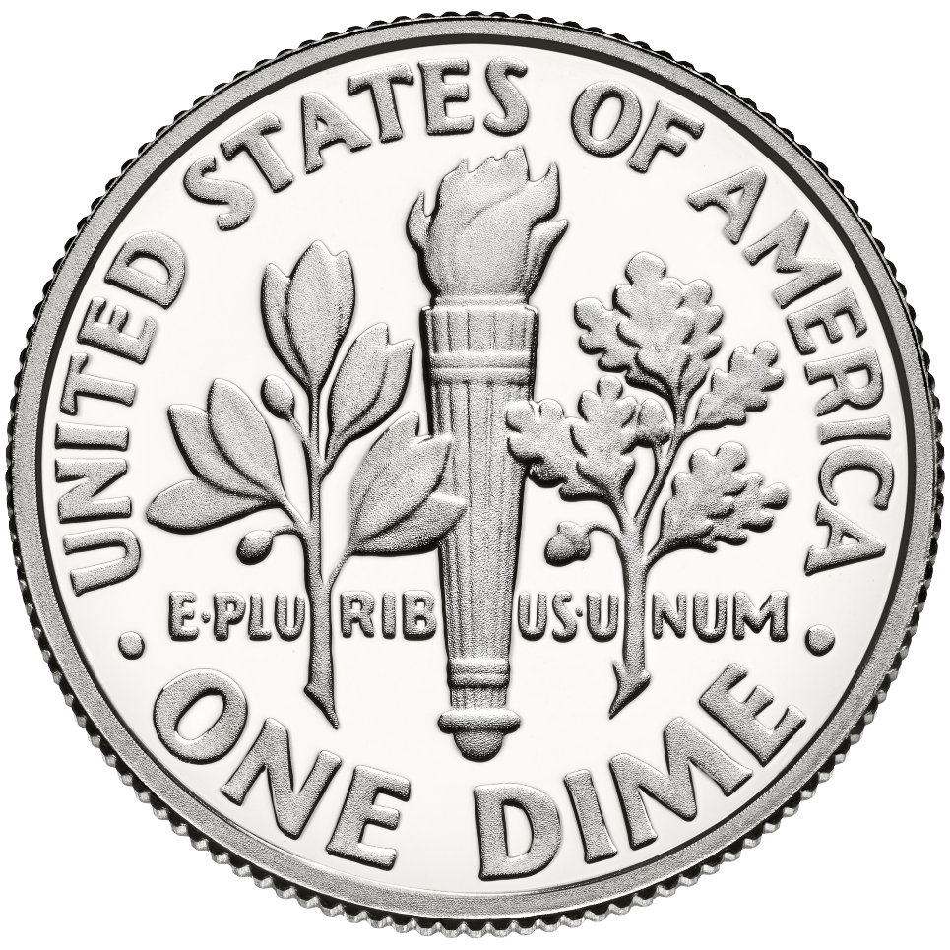

Slide 3
X

Slide 4
X

Slide 5
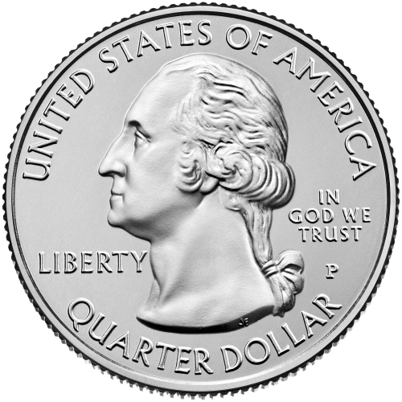

Slide 6
X

Slide 7


