Slide 1
House Price Prediction Model For King County

Slide 2
Business overview.
The real estate industry is a complex business that is pushed by various factors that affect house prices.
Due to these factors, giving a valuation to a property is a challenging task.
The project aims to explore King County house data set and factor in some of the factors provided, which will help to derive a model that will help to predict the price of a house.
Overall the model will help buyers and sellers to identify factors that will increase the price of the house.

Slide 3
Objectives
Determining the relationship between the square footage of the house and the sale price of the houses.
Examine the relationship between the overall grade of the house and the sale price of the houses.
Explore the relationship between the year built and the sale price of the houses.
Investigate the relationship between the number of bedrooms and the sale price of the houses.

Slide 4
Sources of data set.
The data came from house sale prices in King County, Washington between the year (2014 to 2015.)
The data had 18,678 showing the number of house sold and 21 features.

Slide 5
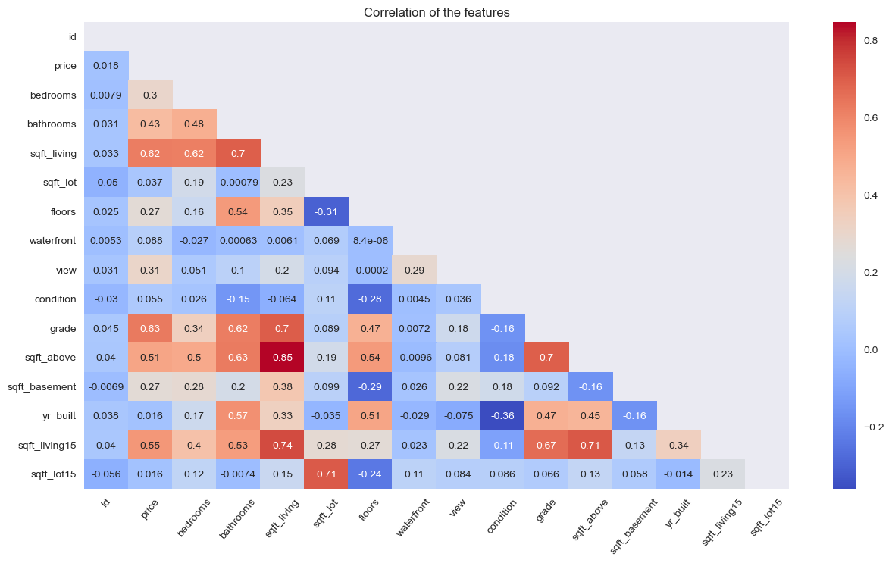
Explanatory Data Analysis

Slide 6
Models
First Model
Second Model
Baseline
Analysed how the size of living space affected price.
Living space size could only predict the price with a 36.8% accuracy.
Made updates to the data but there was no improvement in the accuracy.
Living space and Bedrooms
We checked how related the two features are to price.
This still did not give us a good value for prediction.
It could only account for 38.1% accuracy.

Slide 7
Models
Third Model
Fourth Model
Grades
We checked if grade could have any influence.
It had a small effect on the price.
It had a 40% accuracy thus a little better than the previous models.
Combined features.
We combined this features to identify their effect.
This proved to be better as it has a 56.8% accuracy.
However, it did not meet the target.

Slide 8
Conclusion
We can conclude that there is a strong linear relationship between price and square foot living and square foot above.
We can conclude that as the grade of the house increases, its price also increases and this will determine the selling price of the house.
We can conclude that the number of bedrooms has a weak positive correlation with the house price

Slide 9
Recommendations
Build houses that have a high-grade rating.
Target houses with a big living square footage.
The bedrooms are also a factor in the price so they can look for buildings with at least 4 bedrooms

Slide 10
THANK YOU
If you have any questions, please reach out at Vanessa Mwangi: vanessamwangi82@gmail.com

