Slide 1
Every Bin, Every Time
wAPMT COACHING | STOW
First Face Fix and the ROBOTSS rules: two habits that stop amnesty at the source
Notes:
Hi everyone, and thanks for taking a few minutes with me. This one is for our stow team. Today we're focusing on amnesty, and on two simple habits that make a real difference to it: First Face Fix, and the ROBOTSS bin etiquette rules. Let's get into it.

Slide 2



What is amnesty?
An item that should be in a stowed pod bin, but is not physically there.
It belongs in a stowed bin
Stowed to prime and not picked yet
It isn't physically there
It fell, or ended up at the station or on the floor
It puts the customer at risk
A virtual overage that can cause a pick short
Notes:
So, what is amnesty? Amnesty is an item that should be in a stowed pod bin, but isn't physically there. It was stowed to prime and hasn't been picked yet, but it fell out, or ended up at the station or on the floor. The system still thinks it's in the bin. That creates a defect in our inventory, and it can lead to a pick short, which puts our customer at risk.

Slide 3


Where amnesty comes from
Floor amnesty
Items that fall from pods onto the AR floor while pods travel
Station amnesty
Items left behind at the station when the pod leaves
Poor bin etiquette is the #1 cause of amnesty.
Good bin etiquette is something every one of us controls.
Notes:
Amnesty shows up in two places. Floor amnesty is when items fall out of pods onto the robotics floor. Station amnesty is when items are left behind at the station. Both have the same root cause. Poor bin etiquette is the number one cause of amnesty, and the good news is that bin etiquette is completely in our hands.

Slide 4

Amnesty or problem solve?
AMNESTY
NOT AMNESTY
Not picked yet
Belongs in a stowed pod bin
Fell out or is missing from that bin
Already picked
Belongs in a tote, rebin location or chute
Fell or was put in the wrong place
→ Send to amnesty
→ Outbound problem solve
Putting picked items into amnesty over-inflates wAPMT and hides the real outbound problem.
Notes:
Here's the key distinction. Amnesty is only for items that haven't been picked yet: they belong in a stowed pod bin, and they're not in it. Those go to amnesty. But if you find an item that has already been picked, one that should be in a tote, at a rebin location or in a chute, and it fell or was put in the wrong place, that is not amnesty. That's an outbound problem solve item. Putting picked items into amnesty over-inflates our wAPMT, and it hides the real outbound problem that needs fixing.

Slide 5
First Face Fix
PART 1
One minute. The first pod face. Every shift start and after every break.
Notes:
Let's start with part one: First Face Fix, or F F F.

Slide 6


What is First Face Fix?
1
minute to fix the first pod face
When
At shift start and after every break
What
The first pod face that arrives at your station
Who
All Stow and ICQA associates
Notes:
First Face Fix is a standard process to fix the bin etiquette of the very first pod face that arrives at your station. It takes just one minute. You do it at the start of your shift, and again after every break. It applies to all Stow and ICQA associates.

Slide 7
How to do FFF in 4 steps
1
Get ready
Log in, choose your process path, check your station
2
Work top to bottom
Start at the top of the face and follow the stow snake
3
Fix every bin
Bring each bin up to the ROBOTSS rules
4
Start your process
After 1 minute, or once the face meets ROBOTSS
Notes:
Here's how to do it in four steps. One: enter your station, log in, choose your process path, and make sure your station is ready. Two: when the first pod face arrives, work from the top to the bottom, just like the stow snake. Three: fix every bin so it meets the ROBOTSS rules, which we'll cover in a moment. Four: start your assigned process after one minute, or as soon as the face meets ROBOTSS.

Slide 8





During FFF, do NOT
Scan
any articles in totes or bins
Move
articles to a different bin
Remove
any articles from bins
FFF is only about organizing what is already in each bin.
Notes:
There are three things you must not do before or during First Face Fix. Don't scan any articles in totes or bins. Don't move articles to a different bin. And don't remove any articles from bins. First Face Fix is only about organizing what's already in each bin, so the inventory stays exactly where the system expects it.

Slide 9

Then keep fixing as you go
Leave every bin better than you found it.
Whenever your hands are in a bin, fix its etiquette.
15
FFF audits per shift
90%+
daily compliance target
Audited by ICQA, Ops and L&D, with feedback on the spot
Notes:
First Face Fix gets your shift off to a clean start, but it doesn't stop there. Whenever your hands are in a bin, fix its etiquette as you go. If every one of us leaves each bin a little better than we found it, units won't fall out as the pod moves. We check First Face Fix with at least fifteen audits per shift, and our target is ninety percent compliance or better, with feedback given to you right away.

Slide 10
Bin Etiquette: ROBOTSS
PART 2
Seven rules for every bin you touch, in Stow, Pick and ICQA.
Notes:
Now for part two: the rules you use during First Face Fix and every time you touch a bin. They're called ROBOTSS.

Slide 11
Seven rules, one word
R
O
B
O
T
S
S
Right bin size
No overhang
Blocking
Over-stuffing
Titles out
Stacking
Similar items
Why it matters: pickers find items faster, bins hold more, and nothing falls out when the pod moves.
Notes:
ROBOTSS stands for seven rules. R, right bin size. O, no overhang. B, blocking. O, overstuffing. T, titles out. S, stacking. And S, similar items. Follow them and pickers find items faster, bins hold more, and nothing falls out when the pod moves. Let's go through them one by one.

Slide 12
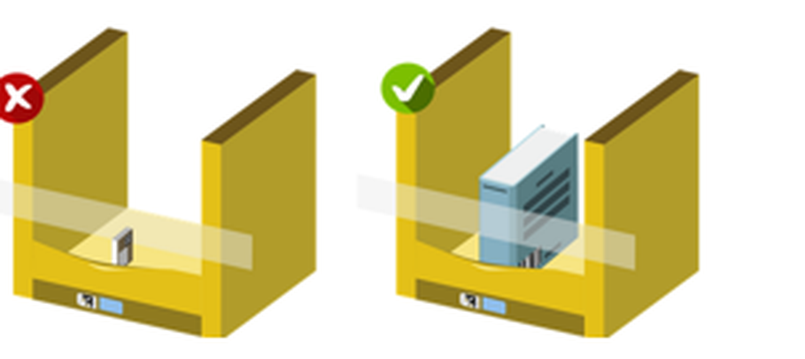
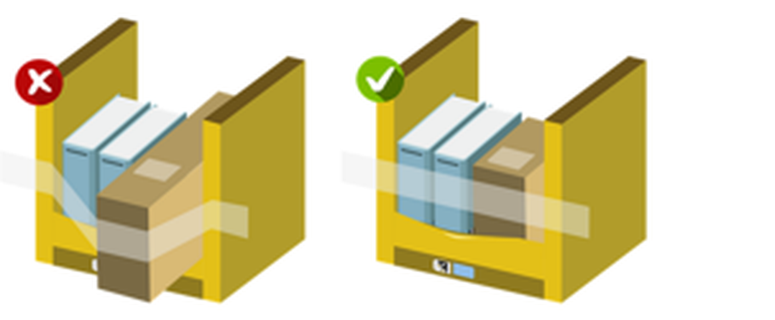
R + O: size it right
R
Right bin size
O
No overhang
Use the smallest bin that fits
Place items by length first
Every item must fit fully inside the bin
Overhang causes drive obstructions and pod crashes
Notes:
R is for right bin size. Always stow into the smallest bin the item fits in, and place it by its length first. The first O is no overhang. Every item must fit completely inside the bin. Anything hanging out can catch, causing drive obstructions and even pod crashes, and that's how items end up on the floor.

Slide 13
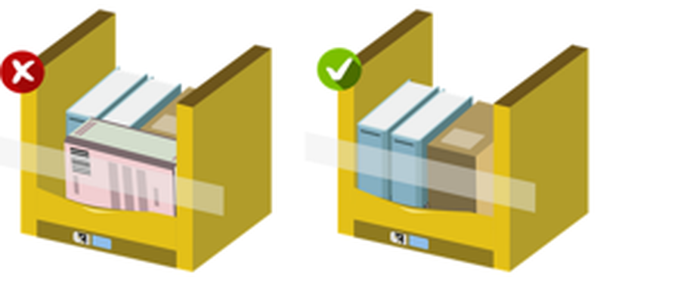
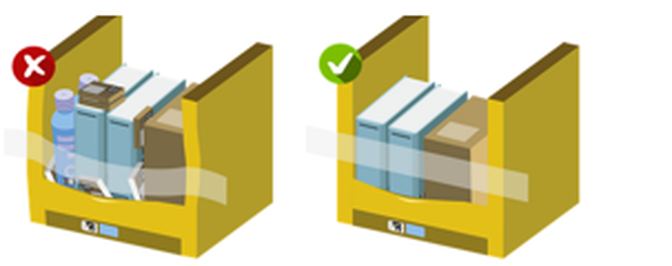
B + O: keep items safe
B
Blocking
O
Overstuffing
Never hide small items behind larger ones
Stand flat items upright so they can't slip between the bands
Don't overfill the bin
Forcing items in damages customer products
Notes:
B is for blocking. Never put a large item in front of a small one, because the picker won't see it. Stand flat items upright so they can't slide out between the retention bands. The second O is overstuffing. Don't overfill a bin. Forcing items in damages customer products, and an overstuffed bin is the one most likely to spill.

Slide 14
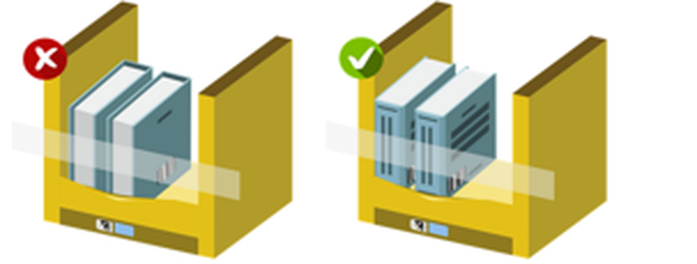
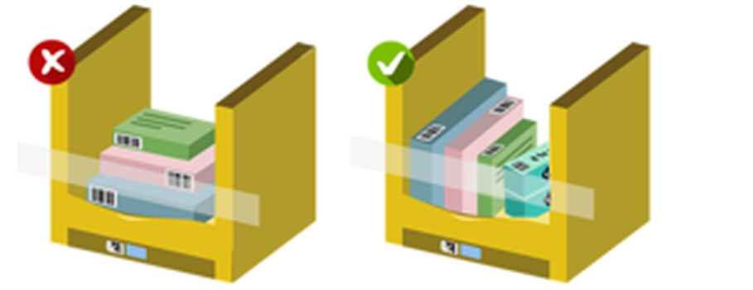
T + S: easy to find
T
Titles out
S
Stacking
Book and DVD spines face outward
So pickers can find them fast
Same ASIN only, with two flat sides
Keep stacks below the retention bands
Notes:
T is for titles out. Books and DVDs go in with the spine facing outward, so pickers can find them straight away. The first S is stacking. Only stack items of the same ASIN, only when they have at least two flat surfaces, and always keep them below the retention bands.

Slide 15
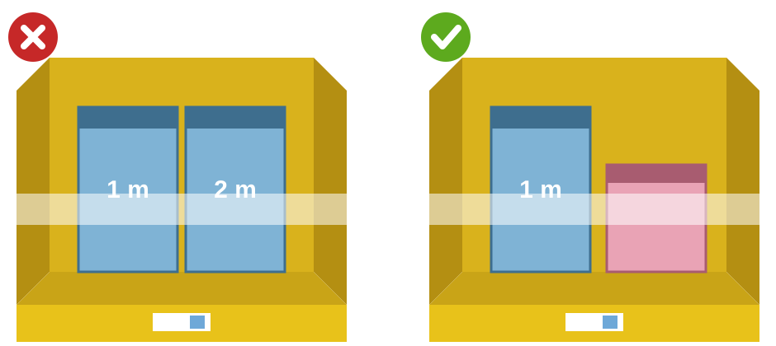
S: similar items
Never put look-alike items in the same bin
Use the cross method for similar items
The system won't always flag them on screen
Notes:
The last S is similar items. Never put items that look alike, or have similar names, in the same bin, like these two cables that only differ by length. Use the cross method for similar items instead, because the system won't always warn you on screen, and the picker could grab the wrong one.

Slide 16




Your shift, bin by bin
Shift start and after breaks
1-minute First Face Fix
Every bin you touch
Apply ROBOTSS
All shift long
Fix as you go
Goal: fewer units falling, lower wAPMT, happier customers.
Notes:
So here's your shift, bin by bin. At shift start and after every break, do your one-minute First Face Fix. On every bin you touch, apply ROBOTSS. And all shift long, fix as you go. Do these three things consistently and fewer units will fall, our wAPMT will come down, and our customers get what they ordered.

Slide 17

Learn and be curious
Small fixes. Big impact.
Rate this video
Notes:
Small fixes make a big impact. Thanks for watching, and thanks for looking after every bin, every time. If you have any questions, speak to your Process Guide, your Area Manager, or the ICQA team. And please take a second to rate this video.

