Slide 1
Every Bin, Every Time
wAPMT COACHING | STOW & PICK
What counts as amnesty, First Face Fix and the ROBOTSS rules
Notes:
Hi everyone, and thanks for taking a few minutes with me. This one is for all of us, stowers and pickers. We'll cover what really counts as amnesty, and what doesn't, then First Face Fix and the ROBOTSS bin etiquette rules, plus one habit just for pickers. Let's get into it.

Slide 2



What is amnesty?
An item that should be in a stowed pod bin, but is not physically there.
It belongs in a stowed bin
Stowed to prime and not picked yet
It isn't physically there
It fell, or ended up at the station or on the floor
It puts the customer at risk
A virtual overage that can cause a pick short
Notes:
So, what is amnesty? Amnesty is an item that should be in a stowed pod bin, but isn't physically there. It was stowed to prime and hasn't been picked yet, but it fell out, or ended up at the station or on the floor. The system still thinks it's in the bin. That creates a defect in our inventory, and it can lead to a pick short, which puts our customer at risk.

Slide 3


Where amnesty comes from
Floor amnesty
Items that fall from pods onto the AR floor while pods travel
Station amnesty
Items left behind at the station when the pod leaves
Poor bin etiquette is the #1 cause of amnesty.
Good bin etiquette is something every one of us controls.
Notes:
Amnesty shows up in two places. Floor amnesty is when items fall out of pods onto the robotics floor. Station amnesty is when items are left behind at the station. Both have the same root cause. Poor bin etiquette is the number one cause of amnesty, and the good news is that bin etiquette is completely in our hands.

Slide 4


Amnesty or problem solve?
AMNESTY
NOT AMNESTY
NOT AMNESTY
Stowed, not picked yet
Belongs in a stowed pod bin
Fell out or is missing from that bin
Not stowed yet
Still belongs in a stow tote or cart
Fell or was left before it was stowed
Already picked
Belongs in a tote, rebin location or chute
Fell or was put in the wrong place
Send to amnesty
Inbound problem solve
Outbound problem solve
Only stowed, not-yet-picked items are amnesty. Anything else just inflates wAPMT.
Notes:
Here's the key distinction. Amnesty is only for items that have been stowed into a pod bin and haven't been picked yet. If one of those isn't in its bin, it goes to amnesty. If you find an item that hasn't been stowed yet, one that still belongs in a stow tote or cart, that's not amnesty. Take it to inbound problem solve. And if you find an item that has already been picked, one that belongs in a tote, at a rebin location or in a chute, that's not amnesty either. Take it to outbound problem solve. Putting these items into amnesty over-inflates our wAPMT and hides the real problem that needs fixing.

Slide 5
Two questions to ask
You find an item out of place
NO
Has it been stowed yet?
YES
Has it already been picked?
Not stowed yet
Inbound problem solve
Stowed, not picked yet
Amnesty
Already picked
Outbound problem solve
Notes:
So when you find an item out of place, ask yourself two questions. First: has it been stowed yet? If not, it's inbound problem solve. If it has, ask: has it already been picked? If not, it's amnesty. If it has, it's outbound problem solve.

Slide 6
First Face Fix
PART 1
One minute. The first pod face. Every shift start and after every break.
Notes:
Let's start with part one: First Face Fix, or F F F. This part is for our stow and ICQA associates. Pickers, stay with us, because the ROBOTSS rules in part two are for you too.

Slide 7


What is First Face Fix?
1
minute to fix the first pod face
When
At shift start and after every break
What
The first pod face that arrives at your station
Who
All Stow and ICQA associates
Notes:
First Face Fix is a standard process to fix the bin etiquette of the very first pod face that arrives at your station. It takes just one minute. You do it at the start of your shift, and again after every break. It applies to all Stow and ICQA associates.

Slide 8
How to do FFF in 4 steps
1
Get ready
Log in, choose your process path, check your station
2
Work top to bottom
Start at the top of the face and follow the stow snake
3
Fix every bin
Bring each bin up to the ROBOTSS rules
4
Start your process
After 1 minute, or once the face meets ROBOTSS
Notes:
Here's how to do it in four steps. One: enter your station, log in, choose your process path, and make sure your station is ready. Two: when the first pod face arrives, work from the top to the bottom, just like the stow snake. Three: fix every bin so it meets the ROBOTSS rules, which we'll cover in a moment. Four: start your assigned process after one minute, or as soon as the face meets ROBOTSS.

Slide 9
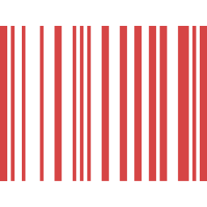




During FFF, do NOT
Scan
any articles in totes or bins
Move
articles to a different bin
Remove
any articles from bins
FFF is only about organizing what is already in each bin.
Notes:
There are three things you must not do before or during First Face Fix. Don't scan any articles in totes or bins. Don't move articles to a different bin. And don't remove any articles from bins. First Face Fix is only about organizing what's already in each bin, so the inventory stays exactly where the system expects it.

Slide 10

Then keep fixing as you go
Leave every bin better than you found it.
Whenever your hands are in a bin, fix its etiquette.
15
FFF audits per shift
90%+
daily compliance target
Audited by ICQA, Ops and L&D, with feedback on the spot
Notes:
First Face Fix gets your shift off to a clean start, but it doesn't stop there. Whenever your hands are in a bin, fix its etiquette as you go. If every one of us leaves each bin a little better than we found it, units won't fall out as the pod moves. We check First Face Fix with at least fifteen audits per shift, and our target is ninety percent compliance or better, with feedback given to you right away.

Slide 11
Bin Etiquette: ROBOTSS
PART 2
Seven rules for every bin you touch, in Stow, Pick and ICQA.
Notes:
Now for part two: the rules you use during First Face Fix and every time you touch a bin. They're called ROBOTSS.

Slide 12
Seven rules, one word
R
O
B
O
T
S
S
Right bin size
No overhang
Blocking
Over-stuffing
Titles out
Stacking
Similar items
Why it matters: pickers find items faster, bins hold more, and nothing falls out when the pod moves.
Notes:
ROBOTSS stands for seven rules. R, right bin size. O, no overhang. B, blocking. O, overstuffing. T, titles out. S, stacking. And S, similar items. Follow them and pickers find items faster, bins hold more, and nothing falls out when the pod moves. Let's go through them one by one.

Slide 13
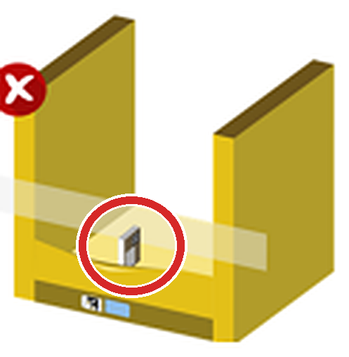
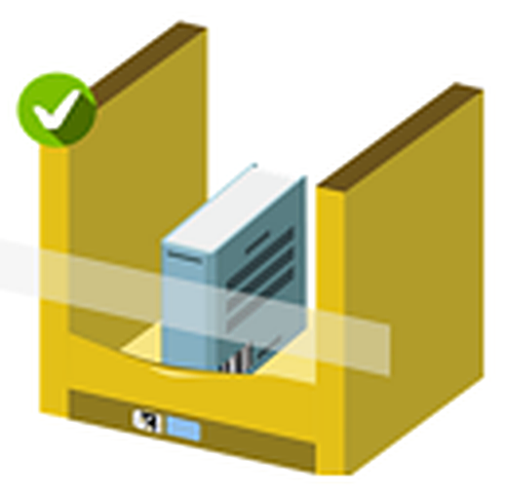
R: Right bin size
WRONG: A tiny item in a big bin wastes space
RIGHT: The item suits the size of the bin
Use the smallest bin possible, and place items by length first.
Notes:
R is for right bin size. On the left, a tiny item sits alone in a big bin. That wastes space, and small items get lost. On the right, the item suits the size of the bin. Always stow into the smallest bin the item fits in, and place it by its length first.

Slide 14
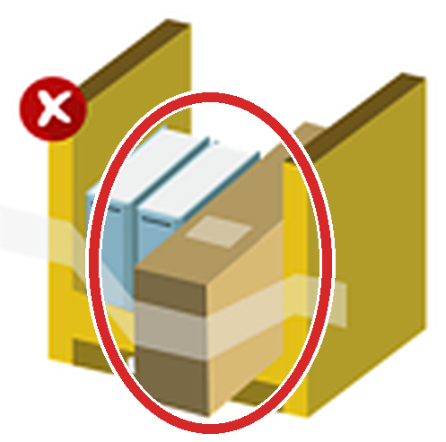

O: No overhang
WRONG: The box sticks out past the bin edge
RIGHT: Everything sits fully inside the bin
All items must fit inside the bin. Overhang causes drive obstructions and pod crashes.
Notes:
The first O is no overhang. On the left, the box sticks out past the edge of the bin. On the right, everything sits fully inside. Anything hanging out can catch as the pod moves, causing drive obstructions and even pod crashes, and that's how items end up on the floor.

Slide 15

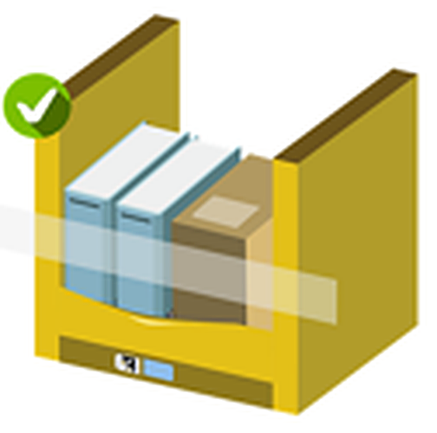
B: Blocking
WRONG: A flat item in front hides the items behind it
RIGHT: Every item is visible from the front
Never block small items with larger ones. Stand flat items upright.
Notes:
B is for blocking. On the left, a flat item lying across the front hides everything behind it, so the picker can't see what they need. On the right, every item is visible from the front. Never put a large item in front of a small one, and stand flat items upright so they can't slide out between the retention bands.

Slide 16

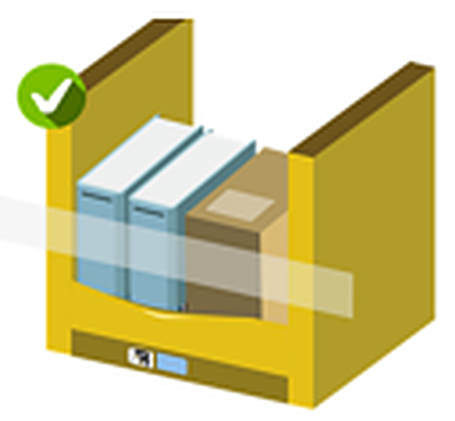
O: Overstuffing
WRONG: Items forced in, the bin is bulging
RIGHT: Items fit with room to pick
Don't overfill bins. Forcing items in damages customer products.
Notes:
The second O is overstuffing. On the left, items have been forced in and the bin is bulging. On the right, everything fits with room to pick. Forcing items in damages customer products, and an overstuffed bin is the one most likely to spill.

Slide 17
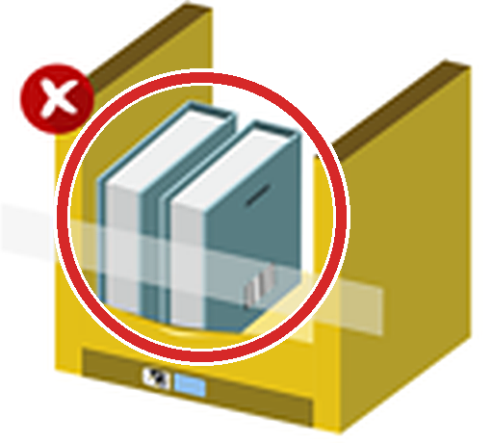
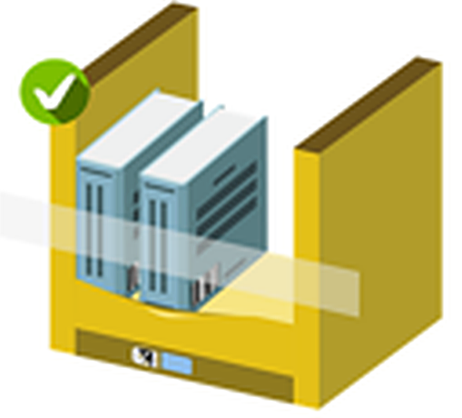
T: Titles out
WRONG: Spines face in, so titles can't be read
RIGHT: Spines face out, titles easy to read
Books and DVDs go in with the spine facing out.
Notes:
T is for titles out. On the left, the spines face inward, so the picker can't read the titles. On the right, the spines face out and the titles are easy to read. Always stow books and DVDs spine out, so pickers can find them straight away.

Slide 18


S: Stacking
WRONG: Different items stacked on top of each other
RIGHT: Items stand side by side, below the bands
Only stack the same ASIN, with two flat sides, and stay below the bands.
Notes:
The first S is stacking. On the left, different items are piled on top of each other. On the right, they stand side by side, below the bands. Only stack items of the same ASIN, only when they have at least two flat surfaces, and always keep them below the retention bands.

Slide 19
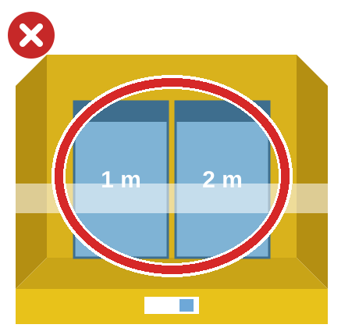
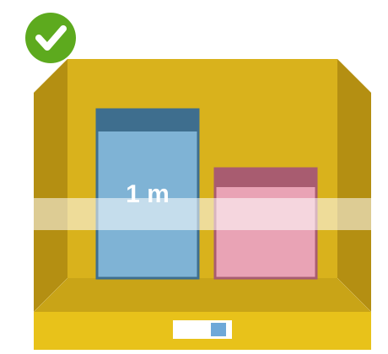
S: Similar items
WRONG: Two look-alike items share one bin
RIGHT: Look-alikes are kept in different bins
Use the cross method. The system won't always flag similar items on screen.
Notes:
The last S is similar items. On the left, two cables that look almost the same, one meter and two meters, are in the same bin, so the picker could easily grab the wrong one. On the right, the look-alikes are kept in different bins. Use the cross method for similar items, because the system won't always warn you on screen.

Slide 20

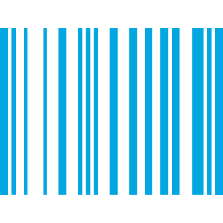
For pickers: one item at a time
1
item in your hands at a time
Take one item
Pick a single item, using both hands
Scan it once
One item, one scan
Place it in your tote
Before you reach back into the bin
Notes:
And one more habit, just for our pickers: one piece flow. Handle one item at a time, with both hands. Take one item, scan it once, and place it in your tote before you reach back into the bin. With Pod Release Optimization, the pod can leave while you're still handling items, and anything left behind becomes station amnesty.

Slide 21




Bin by bin, every shift
Stow and ICQA, at shift start
1-minute First Face Fix
Every bin you touch
ROBOTSS, fix as you go
Found an item?
Amnesty or problem solve?
Goal: an accurate wAPMT, fewer units falling, happier customers.
Notes:
So here's the recap. Stowers and ICQA: at shift start and after every break, do your one-minute First Face Fix. Everyone: on every bin you touch, apply ROBOTSS and fix as you go. Pickers: one item at a time. And when you find an item out of place, ask the two questions before you call it amnesty. That keeps our wAPMT accurate, stops units falling, and gets our customers what they ordered.

Slide 22

Learn and be curious
Small fixes. Big impact.
Rate this video
Notes:
Small fixes make a big impact. Thanks for watching, and thanks for looking after every bin, every time. If you have any questions, speak to your Process Guide, your Area Manager, or the ICQA team. And please take a second to rate this video.

