Slide 1

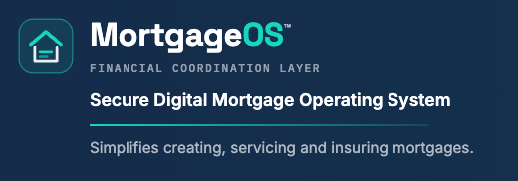
Service a residential mortgage for thirty years. Prove every dollar on the XRP Ledger.
XRPL Grants proposal · $200,000 over 12 months · September 10, 2026
High Tech Mortgage, Inc. · Sacramento, California · Metro Manila, Philippines · v2.0.0 live on Testnet

Slide 2
The problem is the thirty years after closing, not the closing
2
• A mortgage is a thirty-year credit asset. The legal note, the servicing books, the cash flows and the evidence trail must stay consistent across tax changes, servicing transfers and audits.
• Escrow mistakes, misapplied payments and late tax disbursements are the most common servicing failures and the most expensive to remediate.
• Property taxes change every year without warning; the servicer must still pay the bill in full and on time (12 CFR 1024.17(k)) and recover through the annual analysis.
• Incumbent servicing systems cost $10 to $30 per loan per month and expose no evidence an examiner can verify independently.
What a servicer does every month
• credit the payment as of the day received
• remit P&I to the bank that owns the note
• reserve tax and hazard insurance
• remit FHA mortgage insurance to HUD
• pay county and carrier on statutory dates
• analyse escrow once a year, send statements
• file Form 1098
High Tech Mortgage, Inc. · MortgageOS™ servicing layer v2.0.0 · XRPL Grants proposal · September 10, 2026 · github.com/vanfwilson/xrpl-mortgage-tokenizing-htm

Slide 3
What we built: MortgageOS™ servicing layer v2.0.0 (open source, MIT)
3
Paper in
Servicing engine
XRP Ledger
Evidence
• 23-page closing package printed, scanned, OCR'd
• canonical loan record
• every figure tied out to the cent; the run stops on any disagreement
• receipt-date application
• 12 CFR 1024.17 aggregate analysis with exact (f)(2)-(f)(4) options
• advance-first disbursement
• statements, cases, transfers, Form 1098
• R01-R31 as code, one named test each
• exact-cent issued-USD legs, signed once, journaled, never re-signed
• one NFToken loan-record handle (hash + opaque id)
• TokenEscrow date lock on every verified bill
• 2-of-3 signer lists, key drills
• bank receipt-file contract, three-way match
• append-only hash-chained event log
• examiner evidence pack with SHA-256 manifest
• cost model per loan-year
High Tech Mortgage, Inc. · MortgageOS™ servicing layer v2.0.0 · XRPL Grants proposal · September 10, 2026 · github.com/vanfwilson/xrpl-mortgage-tokenizing-htm

Slide 4
What the ledger does, and what it does not do
4
Does
Does not
• fingerprints the loan file: NFToken URI = {v, loan, sha256, ptr}, nothing else
• records every settlement leg to the cent with a six-key memo and no personal data
• locks each verified impound bill until its statutory date; an early release fails on the ledger itself
• proves servicing hand-offs and key-management drills
• decide what the borrower owes: the servicer's books in the bank's custodial accounts are authoritative
• replace the Note, Deed of Trust, lien, county record or custodial accounts
• tokenize the note, sell interests in loans, or raise capital
• prove legal compliance, payee receipt, document validity or custody by itself
High Tech Mortgage, Inc. · MortgageOS™ servicing layer v2.0.0 · XRPL Grants proposal · September 10, 2026 · github.com/vanfwilson/xrpl-mortgage-tokenizing-htm

Slide 5
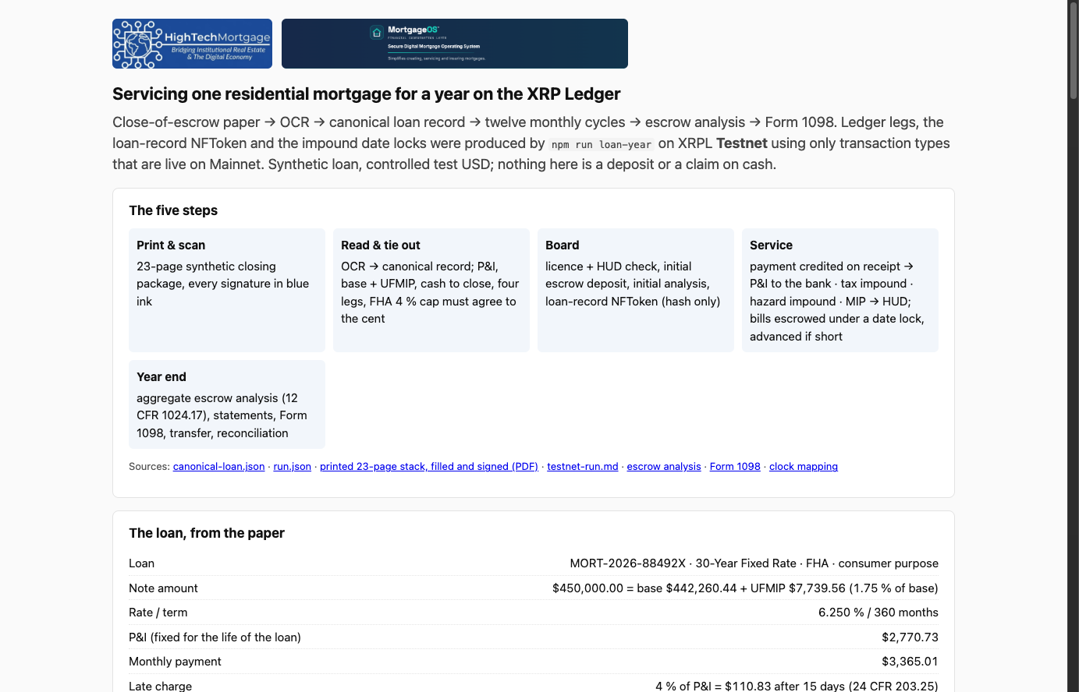
Live proof on XRPL Testnet: run-mtvzvtnk, September 10, 2026
5
Proof | Result
Ledger transactions | 108
Settlement legs journaled validated | 75 of 75
Impound escrows finished on date | 3
Early finish attempt | refused: tecNO_PERMISSION
1-of-3 signature on a 2-of-3 list | refused: tefBAD_QUORUM
2-of-3 signatures | tesSUCCESS
Master key after disable | refused: tefMASTER_DISABLED
Bank = subledger = ledger | 75 matched, 0 unmatched
Business-event chain | 19 events, verified
Only transaction types live on Mainnet: Payment, NFTokenMint/Offer/Accept, EscrowCreate/Finish/Cancel, AccountSet, TrustSet, SetRegularKey, SignerListSet.
vanfwilson.github.io/xrpl-mortgage-tokenizing-htm/demo (reads Testnet in the browser)
High Tech Mortgage, Inc. · MortgageOS™ servicing layer v2.0.0 · XRPL Grants proposal · September 10, 2026 · github.com/vanfwilson/xrpl-mortgage-tokenizing-htm

Slide 6
The annual escrow analysis, to the cent (fixture: FHA 30-year, $450,000, Idaho)
6
Figure | Value
Note = base + financed UFMIP | $450,000.00 = $442,260.44 + $7,739.56
P&I, fixed for the life of the loan | $2,770.73
Tax impound (Ada County, Dec 20 / Jun 20) | $285.00 / month
Hazard impound (renewal Sep 1) | $125.00 / month
FHA MIP (0.50 % of base, 78.98 % LTV) | $184.28 / month
Monthly payment | $3,365.01
Late charge (4 % of P&I, 24 CFR 203.25) | $110.83
• Initial deposit at closing: $1,230.50 (tax $855.35, hazard $375.15). Year-one analysis: shortage $479.50; option elected: do nothing (1024.17(f)(3)).
• December tax bill $1,710.00 exceeded the impound: servicer advanced $284.65 so the county was paid on time (1024.17(k)); the escrow released on the ledger only on Dec 20.
• Year-two analysis: monthly escrow rises from $410.00 to $449.96; shortage spread over 12 months; annual statement delivered within 30 days with evidence.
• A surplus of $50 or more would be refunded within 30 days; under $50 credited. California pays 2 % interest on impounds (Civ. Code 2954.8).
High Tech Mortgage, Inc. · MortgageOS™ servicing layer v2.0.0 · XRPL Grants proposal · September 10, 2026 · github.com/vanfwilson/xrpl-mortgage-tokenizing-htm

Slide 7
Regulation as code: 31 controls, one named test each, 127 offline tests
7
Rule | What the code enforces | Tests
RESPA 12 CFR 1024.17 | aggregate method, one-sixth cushion, surplus / shortage / deficiency options, timely disbursement, initial and annual statements | R01-R10
1024.33, .35-.41 | transfer notices and 60-day grace, notice of error, information requests, force-placed insurance, records, early intervention, loss mitigation | R11-R15
Regulation Z 1026.36(c), .41, .39, .3(a) | receipt-date credit, periodic statement content, ownership-transfer notice, consumer purpose | R16-R19
FHA 24 CFR 203.25, HUD ML 2023-05, 4000.1 | late charge cap 4 %, UFMIP and MIP on the base loan, custodial accounts | R20-R22
California Civ. Code 2954.8, 2954.85; Idaho 63-903 | 2 % impound interest, loss-draft account, tax calendar (Idaho interest rule gated as unverified) | R23-R25
Licensing, vendor oversight, GLBA | boarding refuses without a current authority; no operator keys; no PII on the ledger | R26-R28
IRS | Form 1098 boxes from receipt-dated interest, 1099-INT threshold, 1099-A/C hand-offs | R29-R31
Every control appears in the examiner evidence pack's control map with the test names that carry it. npm test runs them all offline in seconds.
High Tech Mortgage, Inc. · MortgageOS™ servicing layer v2.0.0 · XRPL Grants proposal · September 10, 2026 · github.com/vanfwilson/xrpl-mortgage-tokenizing-htm

Slide 8
Settlement safety: sign once, journal first, never re-sign
8
• Each leg is autofilled and signed once; the signed blob, its hash and a fingerprint are persisted under (company, loan, run, leg) before submission.
• On a timeout the transport looks the hash up on the ledger and submits the identical blob only if unknown. A restart returns the validated job without signing or submitting (proven on Testnet after a database reopen).
• Reusing a key for a different transaction is refused. A failed engine result is journaled and blocks silent replay.
• Degraded mode is a written contract: servicing never blocks on the ledger; the bank's books stay authoritative; legs stay 'prepared' and resume safely.
Evidence an examiner can open
• bank receipt-file contract: bank_ref, posted_on, loan_ref, direction, amount; strict parse, one dollars-to-cents path
• three-way match bank = subledger = ledger by reference; one cent off is a break, never absorbed
• append-only, hash-chained business-event log (UPDATE and DELETE rejected by trigger)
• npm run evidence: control map, every leg with explorer link, statements, tax forms, reconciliation, chain head, SHA-256 manifest
High Tech Mortgage, Inc. · MortgageOS™ servicing layer v2.0.0 · XRPL Grants proposal · September 10, 2026 · github.com/vanfwilson/xrpl-mortgage-tokenizing-htm

Slide 9
What a loan-year costs on the ledger
9
Production footprint per loan-year | Value
Transactions (6 legs x 12 months + boarding + escrows) | 81
Fees burned (10 drops each) | 810 drops
Owner reserve parked (refundable) | 0.8 XRP
All-in per loan-month at $2 / XRP | $0.13
All-in per loan-month at $5 / XRP | $0.33
Loans | Tx / month | Hours (batched) | Reserve XRP
1,000 | 6,333 | 0.14 | 800
10,000 | 63,333 | 1.4 | 8,000
100,000 | 633,333 | 14.1 | 80,000
• Fees are negligible at any plausible price; the only material line is the refundable reserve, and it stays under the $0.50 floor of the price band even at $5 per XRP.
• Priced as an evidence and settlement add-on at $0.50 to $1.50 per loan per month on top of the servicing fee. Incumbent platforms charge $10 to $30 per loan per month.
High Tech Mortgage, Inc. · MortgageOS™ servicing layer v2.0.0 · XRPL Grants proposal · September 10, 2026 · github.com/vanfwilson/xrpl-mortgage-tokenizing-htm

Slide 10
Who we are and how we operate
10
• High Tech Mortgage, Inc.: licensed California mortgage broker (DFPI and DRE), Sacramento, with an operations centre in Manila.
• Loans: standard Fannie Mae uniform-instrument, fixed-rate, 30-year residential, funded and owned by banks under contract.
• No capital raising, no investors, no interests in loans sold. The note is not tokenized.
• The Manila team executes servicing tasks under dual control and never holds signing keys.
Model A: servicer of record
HTM services its own clients' loans under its California licences through a servicing entity kept separate from the brokerage.
Model B: bank's servicing contractor
A lending bank is the official servicer and keeps banking compliance and liability; HTM runs servicing operations and the technology. Several banks have asked for exactly this.
High Tech Mortgage, Inc. · MortgageOS™ servicing layer v2.0.0 · XRPL Grants proposal · September 10, 2026 · github.com/vanfwilson/xrpl-mortgage-tokenizing-htm

Slide 11
Twelve-month milestones
11
ID | Months | Milestone | Evidence
M1 | 1-2 | Counsel memos (CA residential carve-outs, Idaho, custodial asset); first bank servicing contract or LOI; key-management runbook | memos, LOI, runbook
M2 | 2-4 | Live custodial statements via the receipt-file contract; daily three-way reconciliation; live tax-bill source behind an operator verification gate | reconciliation reports, verified-bill trail
M3 | 4-7 | Full 1024.35-.41 case workflows with SLA evidence; statement PDFs with delivery evidence; dual-control task queue for Manila | fixtures, golden PDFs, queue log
M4 | 6-9 | Production key management (HSM, 2-of-3, rotation drills); settlement-asset decision with RLUSD / institutional teams; Mainnet dry-run criteria | drill logs, decision record
M5 | 8-10 | Controlled pilot on real, redacted loan files with the contracting bank; Form 1098 season dry run; evidence packs to the bank's examiner | pilot report, examiner feedback
M6 | 9-11 | Second-jurisdiction abstraction: legal layer separated from the engine, mapped for the Manila operation | jurisdiction matrix
M7 | 11-12 | Independent security review; public technical paper; refreshed demo; Mainnet go/no-go | review notes, paper, video
High Tech Mortgage, Inc. · MortgageOS™ servicing layer v2.0.0 · XRPL Grants proposal · September 10, 2026 · github.com/vanfwilson/xrpl-mortgage-tokenizing-htm

Slide 12
Budget $200,000 and grant-period targets
12
Workstream | Amount
XRPL settlement and evidence engineering | $60,000
Servicing and data engineering (bank receipts, tax-bill source, cases, PDFs, queue) | $50,000
Security and independent technical review | $25,000
Legal and regulatory | $25,000
Document and AI ingestion | $15,000
Pilot infrastructure and testing | $15,000
Developer docs and open-source components | $7,000
Contingency | $3,000
By month 12 | Target
Boarded loan records (test and pilot) | 50
Ledger transactions | 5,000
Servicing events | 1,200
Counterparties engaged | 4
Reconciliation accuracy vs benchmark | 99 %+
Funding gates: build and integration (M1-M3) 30 %, $60,000; usage and pilot (M4-M7) 70 %, $140,000. Checkpoints at months 4, 7, 10 and 12.
High Tech Mortgage, Inc. · MortgageOS™ servicing layer v2.0.0 · XRPL Grants proposal · September 10, 2026 · github.com/vanfwilson/xrpl-mortgage-tokenizing-htm

Slide 13
What is not yet true, stated plainly
13
• No bank has signed a servicing contract yet; the operating assumptions are ours.
• No production stablecoin can be escrowed today (RLUSD issuers do not allow trust-line locking); the settlement asset is an open decision. The code refuses to build an escrow when the issuer flag is off.
• California residential consumer-protection carve-outs and the Idaho servicing posture go to counsel before a live loan; the Idaho escrow-interest rule is gated as unverified in the engine.
• Tax and hazard bills in the published runs come from a fixture; production needs a live bill source behind an operator verification gate (M2).
• Documents are synthetic; production ingest hashes the custodian-held eNote, not a scan.
• No borrower portal or operator web UI yet: the product surface is the command line and the evidence pack.
High Tech Mortgage, Inc. · MortgageOS™ servicing layer v2.0.0 · XRPL Grants proposal · September 10, 2026 · github.com/vanfwilson/xrpl-mortgage-tokenizing-htm

Slide 14
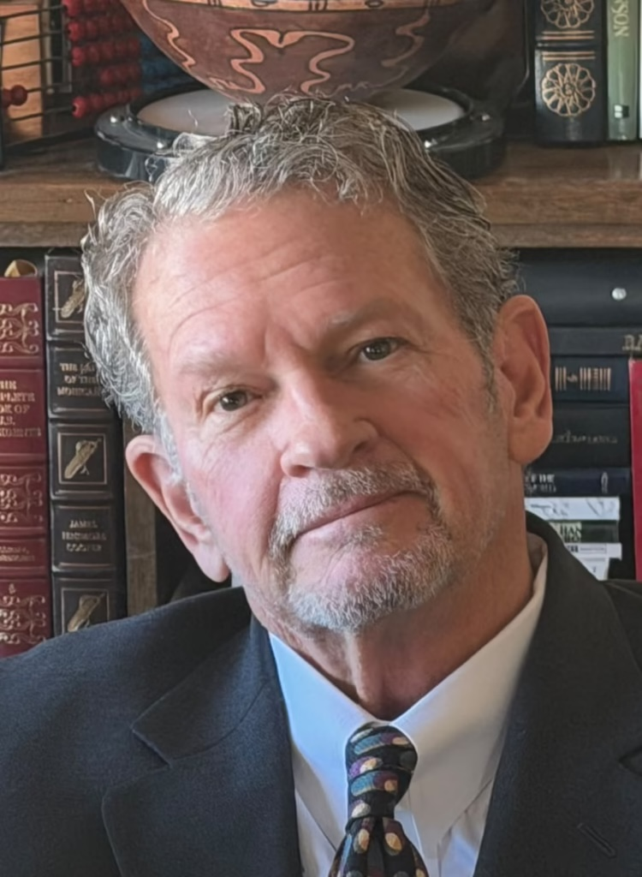



Team (as published at hightechmortgage.com/about)
14
Rich Young
Dr Van Wilson
Trish Wilson
Bill Thompson
Founder, President and Lead Broker
Data Science, AI and Blockchain
Real Estate, Finance and PH Operations
Operations, IT and Business Management
• California DRE Broker's License #01106294
• California Mortgage Broker NMLS #291547
• 30+ years Bay Area real estate and mortgage
• Owns origination, servicing and compliance obligations; licensed principal in both operating models
• 20+ years in data science, mostly in finance; secret clearance while at the U.S. SEC and Fannie Mae
• Fannie Mae: built the ML model forecasting mortgage payments after the COVID payment freeze
• MIT post-graduate degree in data science and AI (2022); CSU Fullerton BS; AWS, Databricks, Blockchain Training Alliance, Microsoft Certified Trainer
• Real-estate investor since 1998, 120+ transactions, $10M+ portfolio; built v2.0 · linkedin.com/in/drvanwilson
• Active licensed US Realtor
• Philippine Real Estate Broker PRC 0024025
• CPA (St. Paul University, BA Accounting); Int'l Certified Financial Consultant; ex-internal auditor, Philippine Airlines
• Leads Manila servicing operations under dual control; accounting review
• ITIL v4; Six Sigma Quality; CompTIA A+; TOPCIT
• Practical Project Mgmt; URAC; FranklinCovey Mgmt
• Ateneo Graduate School of Business; CSU Dominguez Hills
• Operations, infrastructure and process discipline; dual-control task queue
High Tech Mortgage, Inc. · MortgageOS™ servicing layer v2.0.0 · XRPL Grants proposal · September 10, 2026 · github.com/vanfwilson/xrpl-mortgage-tokenizing-htm

Slide 15
The ask
15
$200,000 of milestone-gated funding over 12 months for the plan on slides 11 and 12.
• Introductions to banks that outsource servicing operations, and to the RLUSD / institutional team on the custodial-asset question.
• Everything stays open source: the canonical loan schema, the regulatory control map and its tests, the memo and receipt-file contracts, the evidence-pack format, the cost model.
• Repository: github.com/vanfwilson/xrpl-mortgage-tokenizing-htm · Live demo: vanfwilson.github.io/xrpl-mortgage-tokenizing-htm/demo · Proposal: docs/grant-proposal-2026-09-10.pdf
High Tech Mortgage, Inc. · 730 I Street, Sacramento, CA 95814 · 19F Marco Polo Ortigas, Pasig City, Metro Manila · info@hightechmortgage.com
High Tech Mortgage, Inc. · MortgageOS™ servicing layer v2.0.0 · XRPL Grants proposal · September 10, 2026 · github.com/vanfwilson/xrpl-mortgage-tokenizing-htm

