Slide 1


Tokenize the note. Service it for thirty years. Prove every payment on the XRP Ledger.
XRPL Grants proposal · $200,000 over 12 months · September 11, 2026
High Tech Mortgage, Inc. · Sacramento, California · Metro Manila, Philippines · v3.1 live on Testnet

Slide 2
The problem is the thirty years after closing, not the closing
2
• A mortgage is a thirty-year credit asset. The legal note, the servicing books, the cash flows and the evidence trail must stay consistent across tax changes, servicing transfers and audits.
• Escrow mistakes, misapplied payments and late tax disbursements are the most common servicing failures and the most expensive to remediate.
• Property taxes change every year without warning; the servicer must still pay the bill in full and on time (12 CFR 1024.17(k)) and recover through the annual analysis.
• Incumbent servicing systems cost $10 to $30 per loan per month and expose no evidence an examiner can verify independently.
What a servicer does every month
• credit the payment as of the day received
• remit P&I to the bank that owns the note
• reserve tax and hazard insurance
• pay county and carrier on statutory dates
• analyse escrow once a year, send statements
• keep the books and the evidence in agreement
High Tech Mortgage, Inc. · MortgageOS™ tokenization + servicing layer v3.1 · XRPL Grants proposal · September 11, 2026 · github.com/vanfwilson/xrpl-mortgage-tokenizing-htm

Slide 3
What we built: MortgageOS™ tokenization + servicing layer v3.1 (open source, MIT)
3
The note asset
Guarded accounts
The payment rail
System of record
• one Multi-Purpose Token issuance per loan: the note's digital twin
• supply = face value in cents, held by the lender for 30 years
• CanEscrow + CanTransfer + CanLock + RequireAuth; never clawback
• XLS-89d metadata: fixed terms, manifest hash, IPFS CID slot
• DepositAuth on the issuer, the lender and the impound account
• DepositPreauth for the borrower and the counterparties
• only authorized institutions can hold the asset
• issuer can place a holding on hold and release it
• fixed P&I and impound legs as TokenEscrow of a settlement MPT
• FinishAfter = due date; destination finishes
• split + regulatory markers in the memo
• each validated finish = on-chain proof of payment
• PostgreSQL: loans, issuances, 360-row schedule, every tx with state
• outstanding principal in the books, never on the ledger
• audit log of every failed broadcast and timeout
• audit sweep re-reads every payment proof from the ledger
High Tech Mortgage, Inc. · MortgageOS™ tokenization + servicing layer v3.1 · XRPL Grants proposal · September 11, 2026 · github.com/vanfwilson/xrpl-mortgage-tokenizing-htm

Slide 4
What the ledger does, and what it does not do
4
Does
Does not
• holds one note asset per loan with the lending institution at face value: the right to the fixed P&I cash flow, transferable only between authorized institutions
• settles every fixed P&I and impound leg to the cent under a date lock, with the split in the memo and no personal data; each validated finish is a proof of payment
• refuses payments from anyone not pre-authorized; can place a holding on hold for a dispute
• keeps every transaction, proof, error code and timeout in an audit trail an examiner can open
• decide what the borrower owes: outstanding principal and the escrow analysis are the servicer's books
• replace the Note, Deed of Trust, lien, county record or custodial accounts
• sell the asset to the public or raise capital; the borrower's consumer obligation is untouched by anything the lender does with it
• prove legal compliance, payee receipt, document validity or custody by itself
High Tech Mortgage, Inc. · MortgageOS™ tokenization + servicing layer v3.1 · XRPL Grants proposal · September 11, 2026 · github.com/vanfwilson/xrpl-mortgage-tokenizing-htm

Slide 5
Live proof on XRPL Testnet: v3 verification run, September 11, 2026
5
• Phase 1: DepositAuth and Preauth set and read back; the note asset minted with CanEscrow, CanTransfer, CanLock, RequireAuth and no CanClawback, its metadata carrying the fixed terms; the lender authorized and delivered 45,000,000 units (face value); ledger issuance id equals the database row.
• Phase 2: a strict fixed-rate schedule (identical P&I for 360 periods) written to PostgreSQL; P&I ($2,844.31, to the lender) and impound ($655.21) legs escrowed with the split in the memo; both finished on the due date with tesSUCCESS; books reduced by $406.81 while the on-ledger face value stayed 45,000,000; asset hold placed and released.
• Audit sweep: both finish transactions re-read from the ledger, validated tesSUCCESS, ledger index stamped on the payment rows.
• Phase 3: a forced ledger error (tecPATH_PARTIAL) and a forced network timeout both caught, written to the audit log with the raw code and full envelope, engine exits cleanly.
Proof | Result
MPT issuances (note asset + settlement) | 2
Note held by lender at face value | 45,000,000 units
Escrow legs finished on date | 2 of 2, tesSUCCESS
Payment proofs re-verified on-ledger | 2 of 2
Asset hold, release | tesSUCCESS, tesSUCCESS
Books after month 1 | $449,593.19 (off-ledger)
Forced errors triaged | tecPATH_PARTIAL, timeout
Pending transactions after run | 0
Only amendments live on Mainnet: MPTokensV1, TokenEscrow, DepositAuth, DepositPreauth. Evidence: docs/evidence/v3/. Hook firewall proven on Xahau: hooks/evidence/.
High Tech Mortgage, Inc. · MortgageOS™ tokenization + servicing layer v3.1 · XRPL Grants proposal · September 11, 2026 · github.com/vanfwilson/xrpl-mortgage-tokenizing-htm

Slide 6
One month of servicing, to the cent (fixture: 30-year fixed, $450,000 at 6.5 %)
6
Figure | Value
Note face value = token supply, constant | $450,000.00 = 45,000,000 units
P&I, identical every month | $2,844.31
Month-1 interest / principal | $2,437.50 / $406.81
Tax impound (1/12 of $6,062.50) | $505.21 / month
Hazard impound (1/12 of $1,800.00) | $150.00 / month
Monthly payment | $3,499.52
Outstanding after month 1 (books only) | $449,593.19
• Strict 30-year fixed framework: the payment is rounded up to the cent and every period is identical; the schedule builder refuses anything else.
• RESPA 12 CFR 1024.17: impounds are one-twelfth of the last actual annual bill; a bill above what was collected is advanced by the servicer and recovered at the next analysis.
• The borrower escrows both legs; each escrow cannot be finished before its due date on the ledger itself, and each validated finish is the proof of payment.
• The note asset never changes: amortization is a servicing figure in the books, so a holder's position is exactly what the ledger says it is.
High Tech Mortgage, Inc. · MortgageOS™ tokenization + servicing layer v3.1 · XRPL Grants proposal · September 11, 2026 · github.com/vanfwilson/xrpl-mortgage-tokenizing-htm

Slide 7
Regulation as code: what v3 enforces today and what is ported next
7
Rule | v3.0 today | Ported from v2 during M2–M3
RESPA 12 CFR 1024.17 | rolling 1/12 impound collection, servicer advance on shortfall, date-locked disbursement, markers in every memo | aggregate analysis with one-sixth cushion, surplus / shortage / deficiency options, initial and annual statements
1024.33, .35-.41 | payment proofs and audit trail as the evidence base; asset hold for disputes | transfer notices and 60-day grace, notice of error, information requests, force-placed insurance, early intervention, loss mitigation
Regulation Z 1026.36(c), .41 | receipt-dated settlement events | periodic statement content, ownership-transfer notice
Licensing, GLBA | no PII on the ledger; no operator keys | boarding gate on a current servicing authority
IRS | interest per period in the schedule and memo | Form 1098, 1099-INT
The v2 control map (R01–R31, 127 named tests) is archived on main and is the porting roadmap, not a v3 feature. v3 is graded by a live suite that ends in a reconciliation sweep and prints a single pass string only when every phase passed.
High Tech Mortgage, Inc. · MortgageOS™ tokenization + servicing layer v3.1 · XRPL Grants proposal · September 11, 2026 · github.com/vanfwilson/xrpl-mortgage-tokenizing-htm

Slide 8
Settlement safety: one submit path, every failure in the audit log
8
• Every transaction goes through one function: autofill and sign once, record it Pending with its hash and full envelope, submit, record Confirmed or Failed with the ledger result.
• tec / tef / tem codes and network timeouts are triaged, never crash the loop, and are written to the audit log with the raw code and the envelope for review.
• Postgres is authoritative for servicing; the ledger is evidence. The audit sweep re-reads every payment proof from the ledger and checks the lender still holds the note at face value; a miss is an incident, not a silent state.
• The code refuses Mainnet endpoints. All runs are on the public Testnet with a self-issued test USD.
Evidence an examiner can open
• mortgageos.ledger_transactions: hash, type, account, state, result code, ledger index, parsed memo, envelope, meta
• mortgageos.escrow_legs: owner, destination, units, FinishAfter, create and finish hashes, proof ledger index and verification time
• mortgageos.audit_log: phase, error code, error text, envelope, timestamp
• mortgageos.loans: outstanding principal, the number the ledger is reconciled to
High Tech Mortgage, Inc. · MortgageOS™ tokenization + servicing layer v3.1 · XRPL Grants proposal · September 11, 2026 · github.com/vanfwilson/xrpl-mortgage-tokenizing-htm

Slide 9
What a loan-year costs on the ledger
9
Production footprint per loan-year (v3) | Value
Transactions (4 per month + boarding) | about 55
Fees burned (10 drops each) | about 550 drops
Owner reserve parked (2 MPToken objects, refundable) | about 0.4 XRP
Escrow reserve | transient, released on finish
All-in per loan-month at $5 / XRP | under $0.20
• Fees are negligible at any plausible price; the only material line is the refundable reserve.
• Priced as an evidence and settlement add-on at $0.50 to $1.50 per loan per month on top of the servicing fee. Incumbent platforms charge $10 to $30 per loan per month.
High Tech Mortgage, Inc. · MortgageOS™ tokenization + servicing layer v3.1 · XRPL Grants proposal · September 11, 2026 · github.com/vanfwilson/xrpl-mortgage-tokenizing-htm

Slide 10
Who we are and how we operate
10
• High Tech Mortgage, Inc.: licensed California mortgage broker (DFPI and DRE), Sacramento, with an operations centre in Manila.
• Loans: standard Fannie Mae uniform-instrument, fixed-rate, 30-year residential, funded and owned by banks under contract.
• No capital raising and no sale of interests to the public. The note asset moves only between authorized institutions; the borrower's obligation is untouched by it.
• The Manila team executes servicing tasks under dual control and never holds signing keys.
Model A: servicer of record
HTM services its own clients' loans under its California licences through a servicing entity kept separate from the brokerage.
Model B: bank's servicing contractor
A lending bank is the official servicer and keeps banking compliance and liability; HTM runs servicing operations and the technology. Several banks have asked for exactly this.
High Tech Mortgage, Inc. · MortgageOS™ tokenization + servicing layer v3.1 · XRPL Grants proposal · September 11, 2026 · github.com/vanfwilson/xrpl-mortgage-tokenizing-htm

Slide 11
Twelve-month milestones
11
ID | Months | Milestone | Evidence
M1 | 1-2 | Counsel memos (CA residential carve-outs, Idaho, custodial asset); first bank servicing contract or LOI; key-management runbook | memos, LOI, runbook
M2 | 2-4 | Port the v2 aggregate analysis and statements onto the v3 core; live tax-bill source behind an operator verification gate; IPFS pinning with the CID verified in the record | ported tests, verified-bill trail, CID checks
M3 | 4-7 | Live custodial statements and three-way reconciliation; 1024.35-.41 case workflows with SLA evidence; dual-control task queue for Manila | reconciliation reports, fixtures, queue log
M4 | 6-9 | Production key management (HSM, 2-of-3, rotation drills); settlement-asset decision with RLUSD / institutional teams; Mainnet dry-run criteria | drill logs, decision record
M5 | 8-10 | Controlled pilot on real, redacted loan files with the contracting bank; Form 1098 season dry run; evidence packs to the bank's examiner | pilot report, examiner feedback
M6 | 9-11 | Second-jurisdiction abstraction: legal layer separated from the engine, mapped for the Manila operation | jurisdiction matrix
M7 | 11-12 | Independent security review; public technical paper; refreshed demo; Mainnet go/no-go | review notes, paper, video
High Tech Mortgage, Inc. · MortgageOS™ tokenization + servicing layer v3.1 · XRPL Grants proposal · September 11, 2026 · github.com/vanfwilson/xrpl-mortgage-tokenizing-htm

Slide 12
Budget $200,000 and grant-period targets
12
Workstream | Amount
XRPL settlement and evidence engineering | $60,000
Servicing and data engineering (porting v2 controls, bank receipts, tax-bill source, cases, PDFs, queue) | $50,000
Security and independent technical review | $25,000
Legal and regulatory | $25,000
Document and AI ingestion (scanner port, IPFS manifest pinning) | $15,000
Pilot infrastructure and testing | $15,000
Developer docs and open-source components | $7,000
Contingency | $3,000
By month 12 | Target
Boarded loan records (test and pilot) | 50
Ledger transactions | 5,000
Servicing events | 1,200
Counterparties engaged | 4
Reconciliation accuracy vs benchmark | 99 %+
Funding gates: build and integration (M1-M3) 30 %, $60,000; usage and pilot (M4-M7) 70 %, $140,000. Checkpoints at months 4, 7, 10 and 12.
High Tech Mortgage, Inc. · MortgageOS™ tokenization + servicing layer v3.1 · XRPL Grants proposal · September 11, 2026 · github.com/vanfwilson/xrpl-mortgage-tokenizing-htm

Slide 13
What is not yet true, stated plainly
13
• No bank has signed a servicing contract yet; the operating assumptions are ours.
• Counsel has not yet characterized the note asset (UCC 3/9 negotiability and perfection, eNote / ESIGN / UETA / MERS, securities); until then it stays RequireAuth with only the originating lender authorized.
• XLS-65 / XLS-66 are on Devnet only; vault deposit and collateral use are a readiness study (M6), not a feature. Funding 30-year notes with short-term liabilities is the bank's asset-liability decision.
• No production stablecoin can be escrowed today (RLUSD issuers do not allow trust-line locking); the settlement asset is a self-issued test USD MPT and an open decision.
• California residential consumer-protection carve-outs and the Idaho servicing posture go to counsel before a live loan.
• Tax and hazard bills in the runs are fixture values; production needs a live bill source behind an operator verification gate (M2).
• The loan manifest is hashed into the record but not yet pinned to IPFS; the CID slot is an operator step until a pinning service is on file (M2).
• v3 does not yet include the v2 statements, aggregate analysis with cushion, case workflows or Form 1098; they are archived on main and ported in M2–M3.
• No borrower portal or operator web UI yet: the product surface is the command line and the database.
High Tech Mortgage, Inc. · MortgageOS™ tokenization + servicing layer v3.1 · XRPL Grants proposal · September 11, 2026 · github.com/vanfwilson/xrpl-mortgage-tokenizing-htm

Slide 14
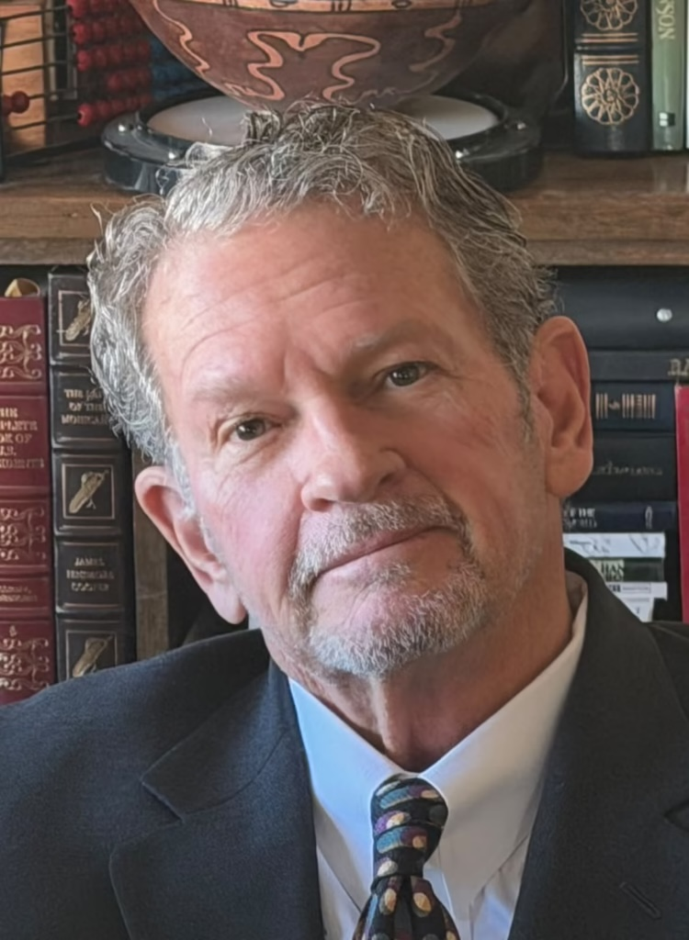



Team (as published at hightechmortgage.com/about)
14
Rich Young
Dr Van Wilson
Trish Wilson
Bill Thompson
Founder, President and Lead Broker
Data Science, AI and Blockchain
Real Estate, Finance and PH Operations
Operations, IT and Business Management
• California DRE Broker's License #01106294
• California Mortgage Broker NMLS #291547
• 30+ years Bay Area real estate and mortgage
• Owns origination, servicing and compliance obligations; licensed principal in both operating models
• 20+ years in data science, mostly in finance; secret clearance while at the U.S. SEC and Fannie Mae
• Fannie Mae: built the ML model forecasting mortgage payments after the COVID payment freeze
• MIT post-graduate degree in data science and AI (2022); CSU Fullerton BS; AWS, Databricks, Blockchain Training Alliance, Microsoft Certified Trainer
• Real-estate investor since 1998, 120+ transactions, $10M+ portfolio; built v2.0 and v3.0 · linkedin.com/in/drvanwilson
• Active licensed US Realtor
• Philippine Real Estate Broker PRC 0024025
• CPA (St. Paul University, BA Accounting); Int'l Certified Financial Consultant; ex-internal auditor, Philippine Airlines
• Leads Manila servicing operations under dual control; accounting review
• ITIL v4; Six Sigma Quality; CompTIA A+; TOPCIT
• Practical Project Mgmt; URAC; FranklinCovey Mgmt
• Ateneo Graduate School of Business; CSU Dominguez Hills
• Operations, infrastructure and process discipline; dual-control task queue
High Tech Mortgage, Inc. · MortgageOS™ tokenization + servicing layer v3.1 · XRPL Grants proposal · September 11, 2026 · github.com/vanfwilson/xrpl-mortgage-tokenizing-htm

Slide 15
The ask
15
$200,000 of milestone-gated funding over 12 months for the plan on slides 11 and 12.
• Introductions to banks that outsource servicing operations, and to the RLUSD / institutional team on the custodial-asset question.
• Everything stays open source: the mortgageos schema, the note-asset MPT pattern and metadata, the memo format, the transaction builders, the payment-proof and audit-log contract, the Hook firewall.
• Repository: github.com/vanfwilson/xrpl-mortgage-tokenizing-htm (branch v3) · Evidence: docs/evidence/v3/ · Proposal: docs/grant-proposal-2026-09-11.pdf
High Tech Mortgage, Inc. · 730 I Street, Sacramento, CA 95814 · 19F Marco Polo Ortigas, Pasig City, Metro Manila · info@hightechmortgage.com
High Tech Mortgage, Inc. · MortgageOS™ tokenization + servicing layer v3.1 · XRPL Grants proposal · September 11, 2026 · github.com/vanfwilson/xrpl-mortgage-tokenizing-htm

