Slide 1


NEXT GEN EMPLOYABILITY PROGRAM
CREATING A FUTURE-READY WORKFORCE
Student Name :
Vangala Deepthi
Student ID :
College Name :
22WJ1A05Y6
Gurunanak Institutions Technical Campus

Slide 2
CAPSTONE PROJECT SHOWCASE
Project Title
Smart Food Ordering System
Abstract | Problem Statement | Project Overview | Proposed Solution | Technology Used | Modelling & Results | Conclusion | Q&A

Slide 3
Abstract
1
Project Name : Smart Food Ordering System
2
Purpose: A web-based platform that allows users to browse restaurants
3
The project aims to develop a robust and user-friendly system that enhances operational efficiency and customer satisfaction in various industries, including food delivery, e-commerce, and retail.
4
This system integrates features such as real-time inventory tracking, secure payment gateways, and order management to provide a seamless user experience.

Slide 4


Problem Statement
In today's fast-paced world, ordering food through traditional methods like phone calls and walk-ins is inefficient and time-consuming. Customers face long wait times, miscommunication, and lack of real-time order tracking.

Slide 5

Project Overview
Smart Food Ordering System is a full-stack web application designed to simplify online food ordering. It allows users to browse restaurants, explore menus, add items to a cart, and place orders seamlessly. The app ensures secure authentication, efficient order management, and a user-friendly experience.

Slide 6
Proposed Solution
To address the challenges outlined in the problem statement, we propose the development of a Zomato-like online food ordering system with a well-structured frontend, backend, and database. The system will be designed to provide a seamless experience for users, restaurant owners, and delivery agents.
This proposed solution aims to create a highly functional, scalable, and secure food ordering system like Zomato, catering to both customers and restaurant owners.

Slide 7
Technology used
Technology Stack Used in Quick-Bites
Frontend: React.js, React Router, Bootstrap – For building a responsive and dynamic user interface.
Backend: Node.js, Express.js – For handling server-side logic and API requests.
Database: MongoDB Atlas – A cloud-based NoSQL database for storing user, restaurant, and order data.

Slide 8
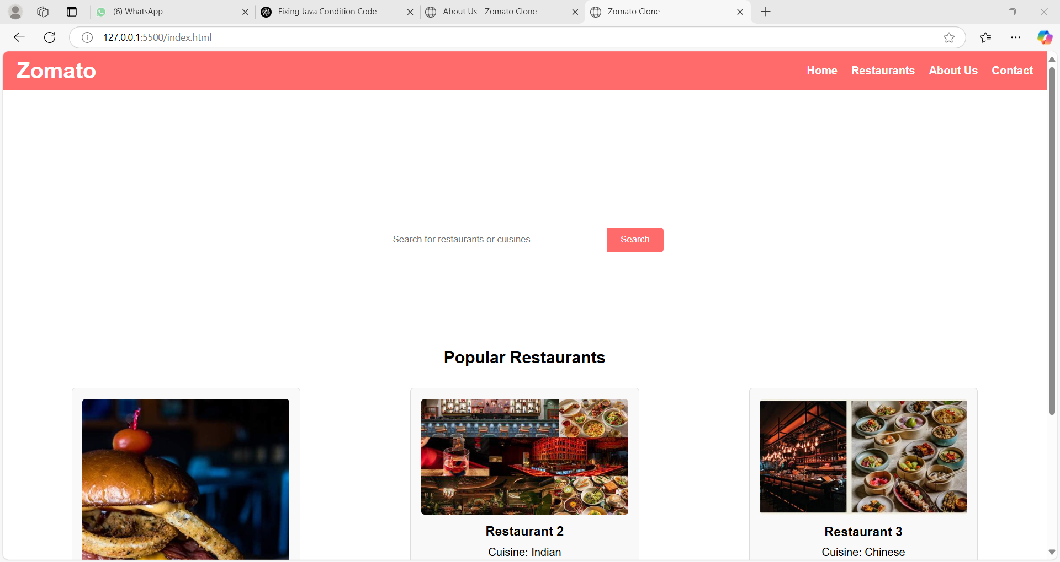
Modelling & Result
HOME

Slide 9
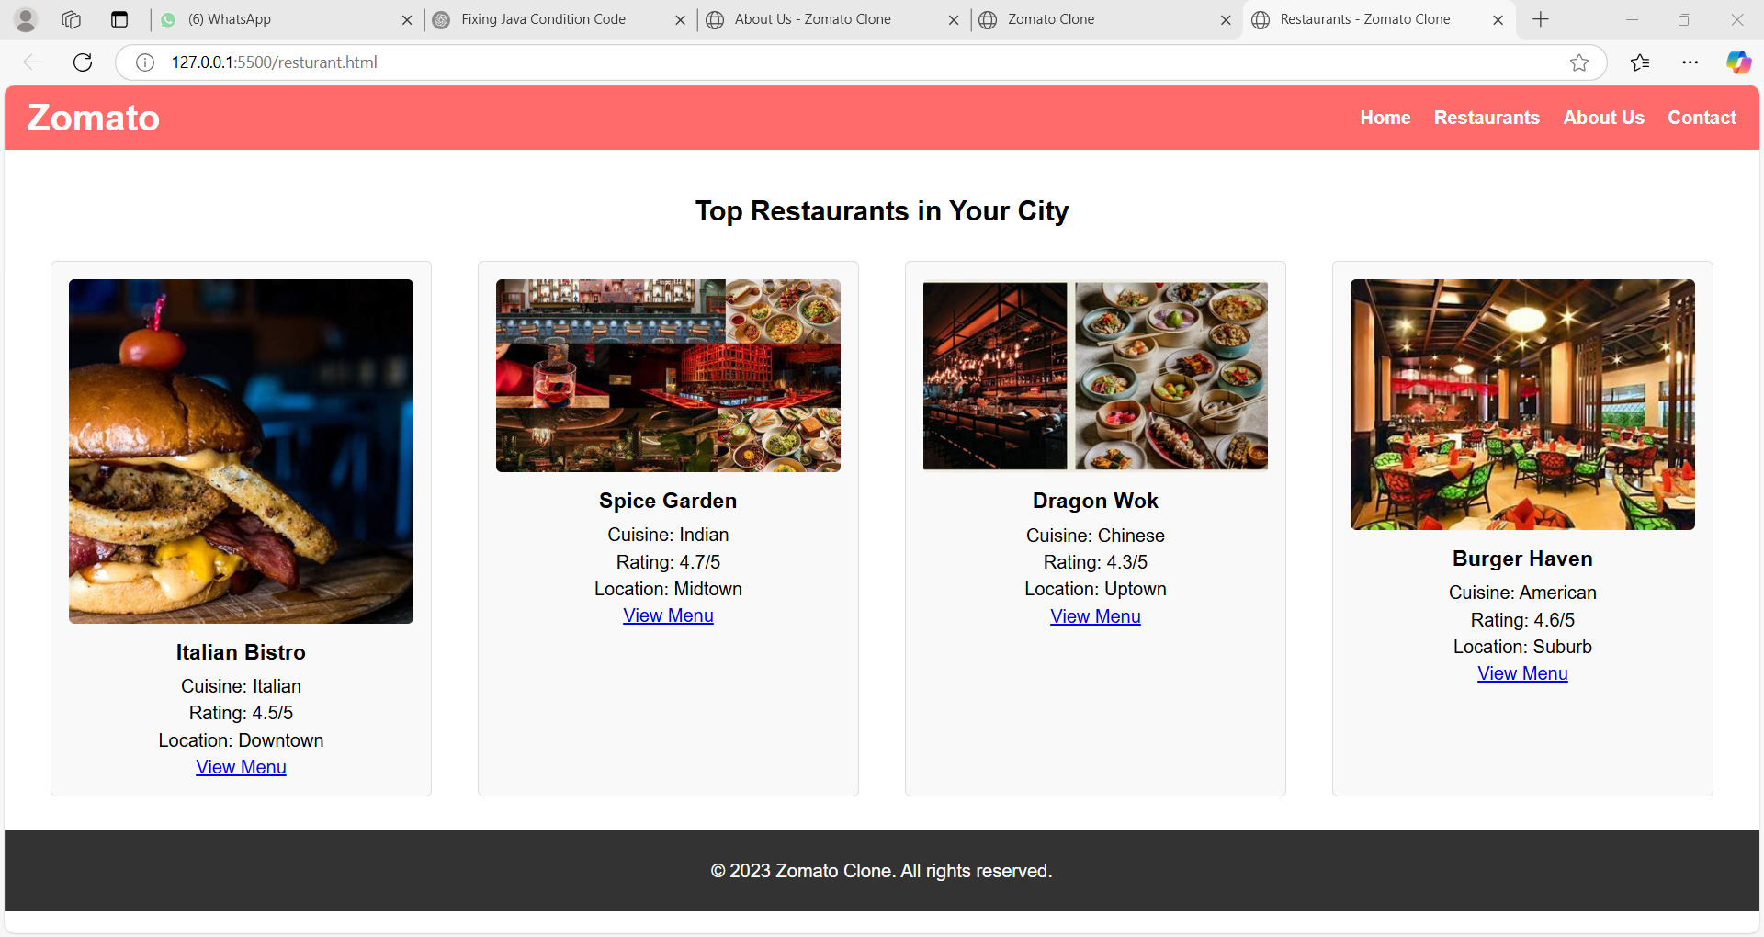
Modelling & Result
RESTURANTS

Slide 10
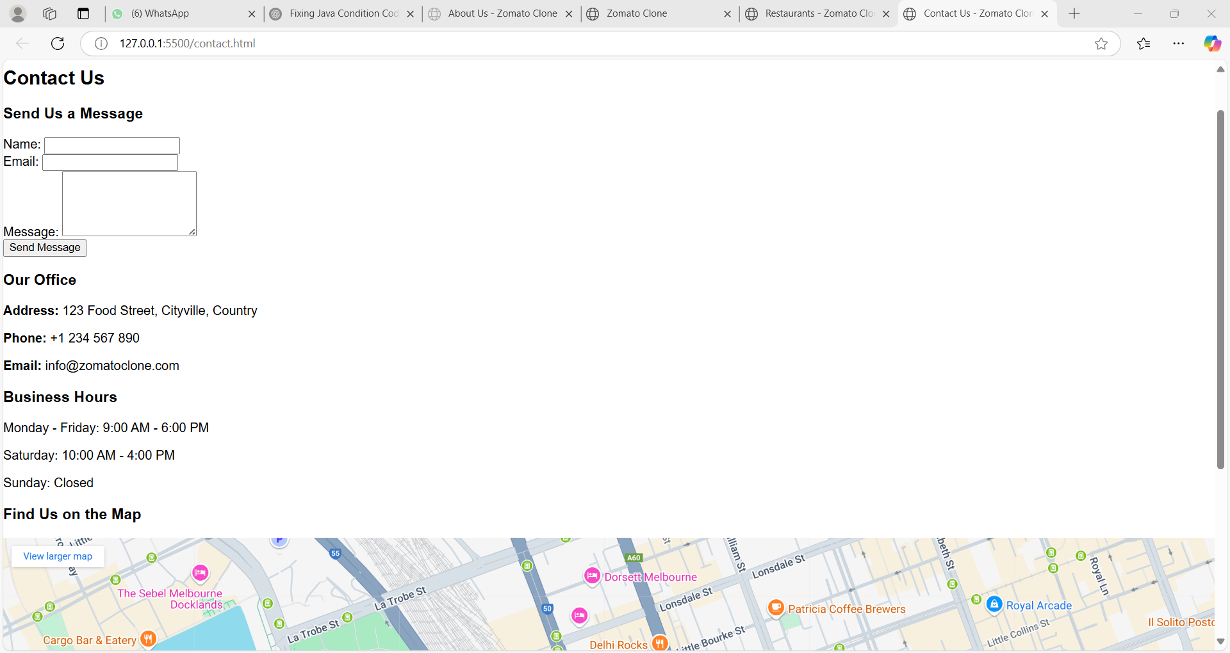
Modelling & Result

Slide 11

Conclusion
The Zomato-like food ordering system enhances convenience, efficiency, and security for users, restaurants, and delivery agents. With features like real-time tracking, secure payments, and user feedback, it ensures a seamless experience. Future improvements could include AI recommendations and advanced delivery methods, making it a scalable and tech-driven solution for modern food delivery.

Slide 12


Notes:
Thank You !!

