Slide 1
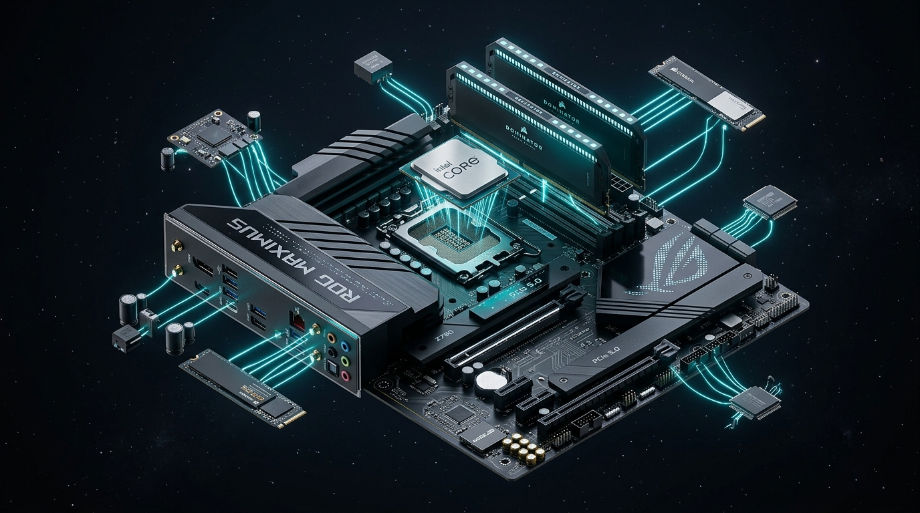
Computer System Architecture
Core Hardware, Storage Hierarchies & Modern Multiprocessing
Operating Systems — System Architecture & Execution Foundations
👤
V. Ram Charan
Act I Lead — Core Hardware & System Bus
👤
Vedhanth
Act II Lead — Memory & Storage Hierarchy
👤
Lochan
Act III Lead — Multiprocessing & Modern Architectures
"The operating system is the software most intimately involved with computer hardware."
Notes:
=== PRESENTER SCRIPT ===
1. WHAT TO SAY (Spoken Script):
Good morning everyone. I’ll be explaining the core hardware of a computer system. Together with Vedhanth and Lochan, we will walk you through how hardware components communicate, how memory hierarchies optimize speed and capacity, and how modern multiprocessing systems scale concurrent execution.
2. KEY ARCHITECTURAL CONCEPT:
Computer system architecture establishes the hardware foundation for operating system process management, memory allocation, and I/O handling.
3. TRANSITION TO NEXT SLIDE:
Let us begin with Slide 2 by examining the three fundamental hardware pillars: the CPU, main memory, and I/O devices.
4. PRESENTATION CUE:
Stand center, introduce team members, gesture to the presenter cards.

Slide 2
ACT I: CORE HARDWARE
PRESENTER: V. RAM CHARAN
02 / 15
The Three Fundamental Hardware Pillars
The CPU, Main Memory & I/O Devices Powering Computation
The CPU (Processor)
Main Memory (RAM)
I/O Devices
Fetch, Decode, Execute
Active Program Workspace
Peripherals & External Bridge
• Responsible for fetching, decoding, and executing instructions.
• Contains Arithmetic Logic Unit (ALU), Control Unit (CU), and high-speed registers.
• Coordinates calculations and directs binary program flow.
• Stores the data and programs that are currently being used.
• The only large storage medium directly accessible and executable by the CPU.
• Volatile working area holding active instructions.
• Helps the computer communicate with the outside world.
• Includes storage drives, displays, input devices, and network cards.
• Managed by dedicated hardware device controllers.
Hardware Core: The CPU executes instructions, Main Memory provides active storage, and I/O Devices bridge external communication.
Notes:
=== PRESENTER SCRIPT ===
1. WHAT TO SAY (Spoken Script):
Good morning everyone. I’ll be explaining the core hardware of a computer system. A computer system mainly consists of three parts: the CPU, main memory, and I/O devices. The CPU is responsible for fetching, decoding, and executing instructions. Main memory stores the data and programs that are currently being used, while I/O devices help the computer communicate with the outside world.
2. KEY ARCHITECTURAL CONCEPT:
The CPU, RAM, and I/O form the triad of computer architecture; the CPU cannot run code that is not first loaded into main memory.
3. TRANSITION TO NEXT SLIDE:
Now let's examine how these three components communicate with each other over the system bus.
4. PRESENTATION CUE:
Point to the 3 distinct cards highlighting CPU, Main Memory, and I/O Devices.

Slide 3
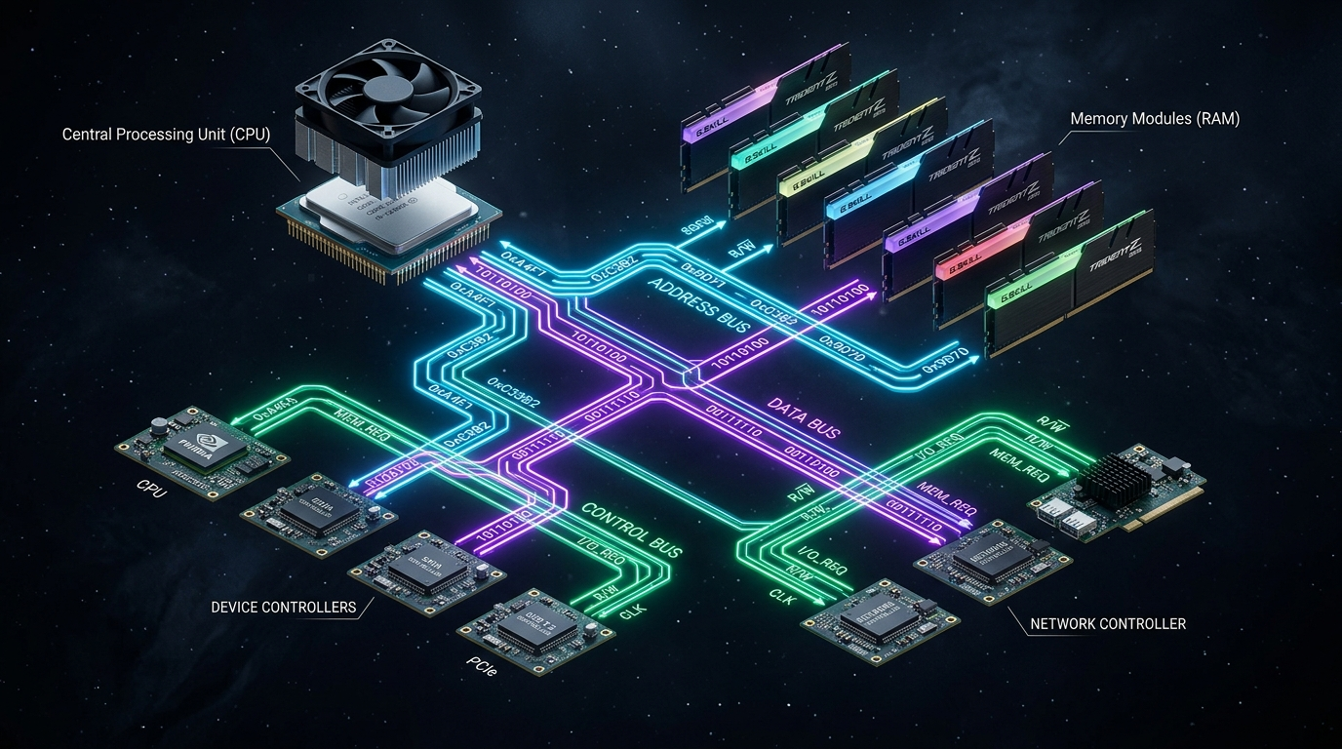
ACT I: CORE HARDWARE
PRESENTER: V. RAM CHARAN
03 / 15
The System Bus Architecture
Three Specialized High-Speed Communication Channels
1. Address Bus
Tells WHERE the data should go by carrying memory addresses and I/O port targets (Unidirectional from CPU/DMA).
2. Data Bus
Carries the ACTUAL DATA and binary instructions between CPU, memory, and controllers (Bidirectional).
3. Control Bus
Carries CONTROL SIGNALS and timing clocks — Read/Write commands, Interrupt requests, and ACKs (Bidirectional).
System Bus Synchronization: These three buses work synchronously to coordinate all instruction fetching, operand reads, and device data transfers.
Notes:
=== PRESENTER SCRIPT ===
1. WHAT TO SAY (Spoken Script):
These components communicate through a system bus, which has three parts: the address bus, which tells where the data should go; the data bus, which carries the actual data; and the control bus, which carries control signals.
2. KEY ARCHITECTURAL CONCEPT:
The system bus connects CPU, memory, and I/O controllers; bus width determines addressable memory limits and throughput bandwidth.
3. TRANSITION TO NEXT SLIDE:
Next, let's look at two critical concepts in hardware communication: Interrupts and DMA.
4. PRESENTATION CUE:
Trace the Address, Data, and Control lines on the diagram.

Slide 4
ACT I: CORE HARDWARE
PRESENTER: V. RAM CHARAN
04 / 15
Hardware Communication: Interrupts & DMA
Asynchronous Event Signaling & High-Speed Memory Transfers
Interrupt Mechanism (Event Signaling)
Direct Memory Access (DMA)
• CPU Attention: Allow devices to get the CPU’s attention when they need it.
• Eliminates Polling: Eliminates constant CPU polling loops, freeing execution time.
• Vector Lookup: CPU pushes state and branches immediately to the Interrupt Service Routine (ISR).
• Context Restoration: Automatically restores user execution context upon completion.
• Direct RAM Transfer: Allows devices to transfer data directly to memory without making the CPU handle every piece of data.
• High-Speed Channel: Essential for disk controllers, NVMe SSDs, and Gigabit network interfaces.
• Block Efficiency: Emits only 1 interrupt per entire block rather than 1 per byte.
• CPU Offload: CPU computes freely in parallel while memory transfers complete.
Communication Synergy: Interrupts signal events asynchronously; DMA offloads bulk data transfers to prevent CPU bottlenecks.
Notes:
=== PRESENTER SCRIPT ===
1. WHAT TO SAY (Spoken Script):
Two important concepts are interrupts and DMA. Interrupts allow devices to get the CPU’s attention when they need it. DMA allows devices to transfer data directly to memory without making the CPU handle every piece of data.
2. KEY ARCHITECTURAL CONCEPT:
Interrupts eliminate busy-wait polling overhead; DMA offloads byte-by-byte data transfer from the CPU.
3. TRANSITION TO NEXT SLIDE:
Let us summarize how core hardware components integrate before moving to memory hierarchy.
4. PRESENTATION CUE:
Contrast the event-driven signal flow of interrupts with the high-throughput block stream of DMA.

Slide 5
ACT I: CORE HARDWARE
PRESENTER: V. RAM CHARAN
05 / 15
Act I Summary: Core Hardware Integration
Cohesive Operation Across Processor, Memory, Bus & Controllers
1. Triad Hardware Organization
2. Tri-Bus Highway
3. Efficient Signaling
The CPU fetches, decodes, and executes. Main memory holds active programs. I/O devices bridge communication with the outside world.
The Address Bus tells where data goes, the Data Bus carries actual data, and the Control Bus delivers read/write synchronization.
Interrupts allow devices to alert the CPU on demand, while DMA streams bulk data directly to memory without CPU overhead.
Act Handover: To Vedhanth for Act II
Next: Vedhanth will cover the Memory and Storage Hierarchy, Locality of Reference, Volatility, and OS Caching Techniques.
Core Hardware Integration: CPUs, Memory, and I/O work synchronously via buses, utilizing interrupts and DMA for efficient data transfer.
Notes:
=== PRESENTER SCRIPT ===
1. WHAT TO SAY (Spoken Script):
That’s the basic idea of how the hardware components communicate. Now I’ll hand it over to explain memory and storage hierarchy.
2. KEY ARCHITECTURAL CONCEPT:
Hardware components form a tightly synchronized system coordinated by the system bus, interrupts, and DMA.
3. TRANSITION TO NEXT SLIDE:
Pass presentation to Vedhanth for Act II.
4. PRESENTATION CUE:
Hand over clicker to Vedhanth.

Slide 6
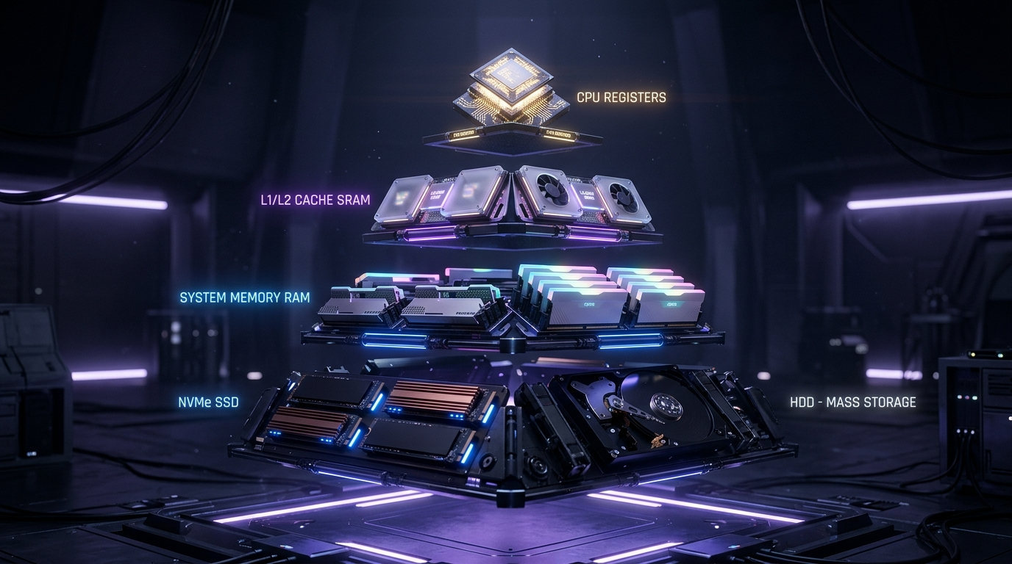
ACT II: MEMORY & STORAGE
PRESENTER: VEDHANTH
06 / 15
Balancing Speed, Cost, and Capacity
Memory and Storage Hierarchy Overview
The Fundamental Trade-off
Faster memory is usually smaller and more expensive, while slower memory can provide much larger capacity.
High-Speed Tier (Top of Pyramid)
Registers and CPU caches provide sub-nanosecond access speeds to keep the execution pipeline fed.
High-Capacity Tier (Bottom of Pyramid)
Main memory and secondary storage (SSDs/HDDs) provide gigabytes to terabytes of storage at low cost per bit.
The Trade-off: Faster memory is smaller and expensive; slower storage is large and economical. The hierarchy balances both.
Notes:
=== PRESENTER SCRIPT ===
1. WHAT TO SAY (Spoken Script):
Now I’ll explain memory and storage hierarchy. Computers use different types of memory because faster memory is usually smaller and more expensive, while slower memory can provide much larger capacity.
2. KEY ARCHITECTURAL CONCEPT:
Trade-off between access latency, cost per bit, and storage capacity across the memory hierarchy.
3. TRANSITION TO NEXT SLIDE:
Let us examine each tier of the hierarchy from internal registers down to secondary storage.
4. PRESENTATION CUE:
Trace the pyramid from top (Registers/Cache) to bottom (RAM/SSD).

Slide 7
ACT II: MEMORY & STORAGE
PRESENTER: VEDHANTH
07 / 15
The Hierarchy Tiers
From Internal CPU Registers Down to Secondary Mass Storage
1. Registers
2. Cache (SRAM)
3. RAM (DRAM)
4. Secondary Storage
Fastest & Smallest
Speed: < 1 ns | Cap: Bytes
High-Speed Buffer
Speed: 1 – 10 ns | Cap: Megabytes
Primary Workspace
Speed: 50 – 100 ns | Cap: Gigabytes
Mass Storage
Speed: 10 μs – 10 ms | Cap: Terabytes
The fastest and smallest storage inside the CPU holding immediate operands.
High-speed SRAM buffering active data and frequent instructions.
Main workspace for running programs and active operating system buffers.
SSDs and hard disks for massive capacity, retaining data permanently.
Latency Spectrum: Registers (<1ns) → Cache (1-10ns) → RAM (~100ns) → Secondary SSD/HDD (~10ms).
Notes:
=== PRESENTER SCRIPT ===
1. WHAT TO SAY (Spoken Script):
The hierarchy starts with registers, which are the fastest and smallest, followed by cache, RAM, and finally secondary storage such as SSDs and hard disks.
2. KEY ARCHITECTURAL CONCEPT:
Step-by-step characteristics of Registers, Cache (SRAM), Main Memory (DRAM), and Secondary Storage (NVM/Disks).
3. TRANSITION TO NEXT SLIDE:
Next, why does caching work so effectively? Let's look at the Locality of Reference.
4. PRESENTATION CUE:
Point to the 4 columns from fastest (Registers) to largest (Secondary Storage).

Slide 8
ACT II: MEMORY & STORAGE
PRESENTER: VEDHANTH
08 / 15
Locality of Reference
Temporal and Spatial Behavioral Principles
Temporal Locality (Locality in Time)
Spatial Locality (Locality in Space)
• Core Rule: Data used recently is likely to be used again soon.
• Program Examples: Loop counters, repeated subroutine calls, stack frame pointers.
• Caching Impact: Keeping recently referenced memory blocks in fast cache produces high hit rates (>90%).
• Core Rule: Data near recently used data is likely to be needed next.
• Program Examples: Sequential instruction streams, contiguous array element traversals.
• Caching Impact: Fetching complete cache lines (64 bytes) rather than single words drastically cuts memory stalls.
Locality Axiom: Cache succeeds because programs exhibit strong temporal (time) and spatial (space) locality.
Notes:
=== PRESENTER SCRIPT ===
1. WHAT TO SAY (Spoken Script):
Cache is important because programs usually show locality of reference. Temporal locality means that data used recently is likely to be used again soon. Spatial locality means that data near recently used data is likely to be needed next.
2. KEY ARCHITECTURAL CONCEPT:
Temporal locality (reuse in time) and Spatial locality (adjacency in space) are the core reasons caching succeeds.
3. TRANSITION TO NEXT SLIDE:
Now let's examine the difference between volatile and non-volatile storage.
4. PRESENTATION CUE:
Highlight the contrast between loop re-execution (Temporal) and sequential array scans (Spatial).

Slide 9
ACT II: MEMORY & STORAGE
PRESENTER: VEDHANTH
09 / 15
Memory Volatility
Volatile Working Storage vs. Non-Volatile Permanent Retention
Volatile Memory (RAM & Caches)
Non-Volatile Storage (SSDs & Hard Disks)
• Power Dependent: RAM is volatile, meaning it loses its contents when power is turned off.
• Physical Implementation: Uses capacitor charges (DRAM) or transistor latches (SRAM).
• System Role: High-speed temporary workspace for running processes and active kernel buffers.
• Power Independent: SSDs and hard disks are non-volatile, so they retain data even without power.
• Physical Implementation: Uses NAND flash floating gates or magnetic platters.
• System Role: Long-term permanent storage preserving operating system files, applications, and user data.
Volatility Distinction: Volatile RAM provides rapid runtime execution; Non-Volatile SSDs/HDDs guarantee permanent data persistence.
Notes:
=== PRESENTER SCRIPT ===
1. WHAT TO SAY (Spoken Script):
RAM is volatile, meaning it loses its contents when power is turned off. SSDs and hard disks are non-volatile, so they retain data even without power.
2. KEY ARCHITECTURAL CONCEPT:
Volatile working RAM vs Non-volatile secondary storage (SSDs/HDDs) and the role of permanent file storage.
3. TRANSITION TO NEXT SLIDE:
Next, how does the Operating System manage this entire storage hierarchy efficiently?
4. PRESENTATION CUE:
Emphasize that volatile RAM provides execution speed while non-volatile SSDs provide data permanence.

Slide 10
ACT II: MEMORY & STORAGE
PRESENTER: VEDHANTH
10 / 15
OS Memory Management
Software Strategies for Maximizing Storage Hierarchy Performance
1. Paging
2. Buffering
Divides memory into fixed-size pages and maps virtual addresses to physical RAM frames, swapping inactive pages to disk.
Temporarily holds data in memory during device transfers to bridge speed mismatches between CPU and slower I/O peripherals.
3. Disk Caching
4. Prefetching
Maintains copies of frequently accessed file system blocks in RAM to avoid slow physical disk read operations.
Anticipates future memory and file requests based on spatial locality, loading data into cache/RAM before requested.
OS Hierarchy Management: Techniques Used: Paging, buffering, disk caching, and prefetching.
Notes:
=== PRESENTER SCRIPT ===
1. WHAT TO SAY (Spoken Script):
The OS uses techniques such as paging, buffering, disk caching, and prefetching to use this hierarchy efficiently. Now Lochan will take over to discuss multiprocessing.
2. KEY ARCHITECTURAL CONCEPT:
Operating system storage management techniques: Paging, Buffering, Disk Caching, and Prefetching.
3. TRANSITION TO NEXT SLIDE:
I will now pass the presentation to Lochan, who will explain multiprocessing, modern multicore systems, and OS challenges.
4. PRESENTATION CUE:
Hand over clicker to Lochan.

Slide 11
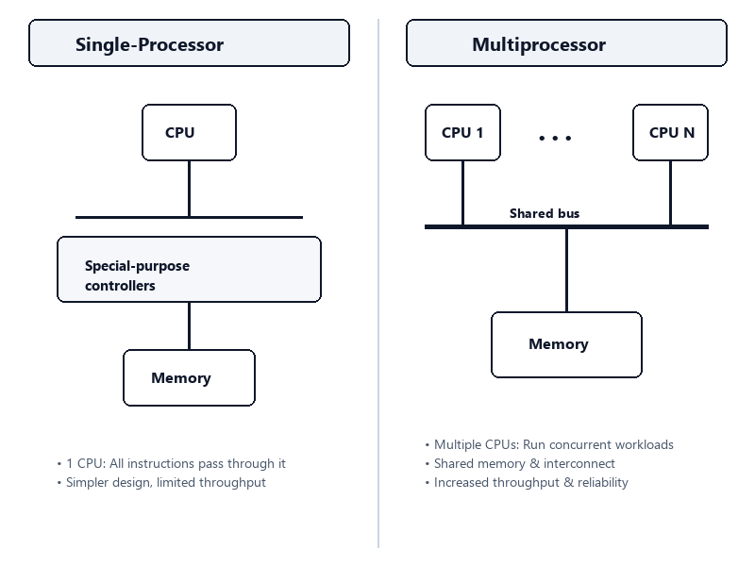
ACT III: MULTIPROCESSING
PRESENTER: LOCHAN
11 / 15
Single-Processor vs. Multiprocessor Systems
Architectural Scaling from Single Execution Streams to Parallel Computing
Single-Processor Systems
• One CPU handles all instructions.
• Simpler hardware design, but limited computational throughput.
• Concurrency is simulated purely via OS time-slicing.
Multiprocessor Systems
• Multiple CPUs share the bus, clock, and memory.
• Runs concurrent workloads to increase speed and reliability.
• Provides higher throughput and graceful degradation (fault tolerance).
Architectural Shift: Multiprocessor systems use multiple CPUs sharing bus and memory to run tasks simultaneously.
Notes:
=== PRESENTER SCRIPT ===
1. WHAT TO SAY (Spoken Script):
Thank you. Moving into modern architectures, we look at multiprocessing. Unlike older systems with a single CPU, multiprocessor systems use multiple CPUs sharing the same bus and memory to run tasks simultaneously.
2. KEY ARCHITECTURAL CONCEPT:
Single-processor serial execution vs multiprocessor concurrent hardware execution.
3. TRANSITION TO NEXT SLIDE:
Let us examine the two primary multiprocessing architectural approaches: SMP and AMP.
4. PRESENTATION CUE:
Point to the single CPU path versus the multiple parallel CPU paths on the diagram.

Slide 12
ACT III: MULTIPROCESSING
PRESENTER: LOCHAN
12 / 15
Multiprocessing Approaches: SMP vs. AMP
Peer Multiprocessing vs. Master-Slave Hierarchical Scheduling
Symmetric Multiprocessing (SMP)
Asymmetric Multiprocessing (AMP)
• Peer Processors: All processors are peers and can execute OS and user tasks independently.
• Shared Architecture: Share physical memory and the system bus equally.
• Dominant Model: Used in virtually all modern personal computers and enterprise servers.
• Dynamic Scheduling: Any processor can pick up any ready process from the ready queue.
• Master-Slave Model: A master processor controls the system and assigns specific tasks to slave processors.
• Dedicated Roles: Slaves run specific application code or I/O while the master executes OS kernel code.
• Simplified Coordination: Avoids complex kernel locking contention by centralizing decisions.
• Specialized Systems: Often found in specialized embedded controllers and legacy mainframes.
Multiprocessing Models: SMP treats all processors as equal peers; AMP uses a master processor delegating work to slave processors.
Notes:
=== PRESENTER SCRIPT ===
1. WHAT TO SAY (Spoken Script):
There are two main approaches here: Symmetric, where all processors are equal peers, and Asymmetric, where a master processor delegates work to slave processors.
2. KEY ARCHITECTURAL CONCEPT:
Symmetric (peer-to-peer) vs Asymmetric (master-slave) multiprocessing models and their trade-offs.
3. TRANSITION TO NEXT SLIDE:
Now let's examine modern systems: Multicore chips and Clustered systems.
4. PRESENTATION CUE:
Contrast the decentralized peer model of SMP with the centralized master-slave model of AMP.

Slide 13
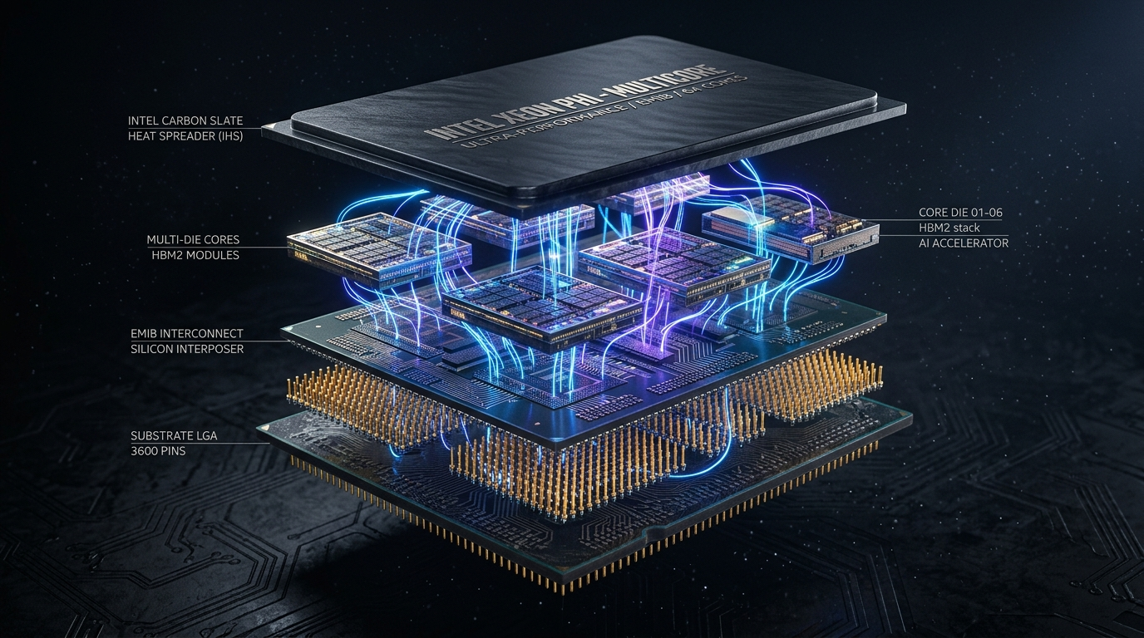
ACT III: MULTIPROCESSING
PRESENTER: LOCHAN
13 / 15
Modern Systems: Multicore & Clustered
On-Chip Scale-Up vs. Networked Scale-Out Architecture
Multicore Processors (Scale-Up)
• Multiple processing cores placed on a single physical chip for ultra-fast communication.
• On-chip communication is significantly faster and uses far less energy than inter-chip buses.
• Each core features private L1/L2 caches and shares an on-die L3 cache.
Clustered Systems (Scale-Out)
• Multiple independent computers connected over a network to share immense workloads.
• Nodes share a common Storage Area Network (SAN) for unified data access.
• Provides high availability and fault tolerance — if one machine fails, others take over.
Modern Architectural Spectrum: Multicore puts multiple cores on one chip; Clustered systems network independent computers together.
Notes:
=== PRESENTER SCRIPT ===
1. WHAT TO SAY (Spoken Script):
Today, this scales up into Multicore processors, where multiple cores live on one chip, and Clustered systems, where whole independent computers network together to act as one.
2. KEY ARCHITECTURAL CONCEPT:
Multicore processors (on-chip parallelism) and Clustered systems (distributed high-availability nodes).
3. TRANSITION TO NEXT SLIDE:
However, multiprocessing creates significant challenges for the operating system. Let's look at those challenges.
4. PRESENTATION CUE:
Contrast on-chip multicore scaling with distributed networked cluster scaling.

Slide 14
ACT III: MULTIPROCESSING
PRESENTER: LOCHAN
14 / 15
OS Challenges in Multiprocessing
Critical Complexities in Coordinating Concurrent Hardware Execution
1. CPU Scheduling
2. Cache Coherence
Deciding which core runs which process to maximize throughput, minimize latency, and maintain processor cache affinity.
Ensuring that when one CPU modifies data in its private cache, all other cores with copies of that memory address are kept updated.
3. Load Balancing
4. Synchronization
Ensuring no single CPU sits idle while another is overwhelmed by evenly distributing ready threads across all cores.
Using mutexes, spinlocks, and semaphores to protect shared kernel data structures and prevent race conditions.
Operating System Burden: The OS must handle complex challenges like CPU scheduling, cache coherence, and load balancing.
Notes:
=== PRESENTER SCRIPT ===
1. WHAT TO SAY (Spoken Script):
While this hardware is powerful, it forces the operating system to work harder. The OS must handle complex challenges like CPU scheduling, cache coherence, and load balancing to keep everything running smoothly.
2. KEY ARCHITECTURAL CONCEPT:
Four major OS multiprocessing challenges: Scheduling, Cache Coherence, Load Balancing, and Synchronization.
3. TRANSITION TO NEXT SLIDE:
Now let's bring our entire presentation together into our final synthesis and key takeaways.
4. PRESENTATION CUE:
Review each of the four challenges and explain why hardware parallelism demands sophisticated OS coordination.

Slide 15
SYNTHESIS & CONCLUSION
PRESENTER: V. RAM CHARAN · VEDHANTH · LOCHAN
15 / 15
Complete Architecture & Key Takeaways
Hardware Foundations, Storage Hierarchies & Modern Multiprocessing
1. Hardware Foundations
2. Storage Hierarchy
3. Locality & Memory
4. Multiprocessing
CPU, RAM, and I/O linked via Address, Data, and Control buses with Interrupts and DMA for efficient operation.
Balancing speed and capacity from fast volatile Registers/Cache/RAM down to non-volatile SSDs and hard disks.
Leveraging Temporal and Spatial locality through OS paging, buffering, disk caching, and prefetching.
Scaling computation through SMP, AMP, Multicore on-chip processors, and Clustered networked systems.
★
OS Coordination: The critical software that manages all this complex hardware—coordinating scheduling, cache coherence, load balancing, and synchronization.
V. Ram Charan
Vedhanth
Lochan
Act I: Core Hardware (Slides 1–5)
Act II: Memory & Storage Hierarchy (Slides 6–10)
Act III: Multiprocessing & Modern Systems (Slides 11–15)
Notes:
=== PRESENTER SCRIPT ===
1. WHAT TO SAY (Spoken Script):
To summarize our complete presentation: Ram Charan walked us through the core hardware and 3-part system bus; Vedhanth explained the storage hierarchy, locality of reference, and OS caching optimizations; and Lochan covered multiprocessing architectures, SMP vs AMP, multicore, clustering, and OS coordination challenges. On behalf of Ram Charan, Vedhanth, and Lochan, thank you for your attention. We are now open for questions.
2. KEY ARCHITECTURAL CONCEPT:
Comprehensive architectural synthesis covering core hardware, system bus, storage hierarchy, locality, multiprocessing, and OS coordination.
3. TRANSITION TO NEXT SLIDE:
End of presentation — open floor for Q&A.
4. PRESENTATION CUE:
All three presenters step forward together, smile, and invite questions from the professor and audience.

