Slide 1
Processing OWL2 ontologies using Thea: An application of logic programming
Vangelis Vassiliadis¹
Jan Wielemaker²
Chris Mungall³
¹ semanticweb.gr
² VU University Amsterdam
³ Lawrence Berkeley National Laboratory

Slide 2
What is Thea
Prolog library for querying and processing OWL2 Ontologies.
OWL2 axioms as Prolog facts based on the OWL functional syntax.
Use of Prolog as an application programming language (host language), rather than as an OWL reasoning engine
Extensions / libraries to support:
  java OWL API
  OWLLink servers
  SWRL
  translation to DLP

Slide 3
Motivation
Sophisticated Ontology engineering environments.
Powerful reasoning servers.
RDF centric tools ‘triple-focus’ not suitable for complex T-Boxes heavily axiomatized.
BUT… need for Easy programmatic access to Ontologies or Knowledge bases.
  Querying
  Scripting operations
  Build applications

Slide 4
Why Prolog?
Declarative features, pattern matching.
  SLD resolution, backward chaining.
Use as a Rule-based system.
Thea uses Prolog as a Host programming language, not as a reasoning system.
SWI-Prolog implementation, semweb package, efficient RDF library

Slide 5
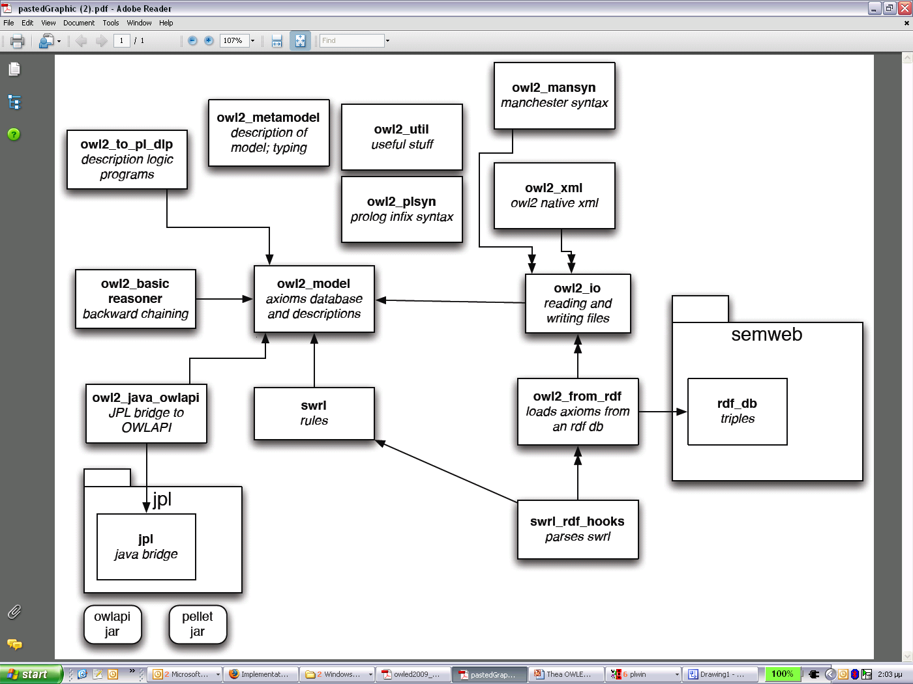
Thea library

Slide 6
Thea library: Model & I/O
Model
  Directly corresponds to the OWL2 structural syntax:
I/O (Parsing – Serialization)
  RDF/XML
  OWL2 XML
  Manchester syntax
  subClassOf(’http://example.org#Human’,’http://example.org#Mammal’).
  OWL2
  EquivalentClasses(forebrain_neuron
  intersectionOf(neuron
  someValuesFrom(partOf forebrain)))
  Prolog
  equivalentClasses([forebrain_neuron,
  intersectionOf([neuron,
  someValuesFrom(partOf, forebrain)])]).

Slide 7
Thea library: Reasoning
Description Logic Programs | equivalentClasses([only_has_part_a, allValuesFrom(has_part, a)]) a(Y):- has_part(X,Y),only_has_part_a(X).
SWRL | ?- prolog_clause_to_swrl_rule((hasUncle(X1,X3):- hasParent(X1,X2),hasBrother(X2,X3)),SWRL),swrl_to_owl_axioms(SWRL,Axiom). X1 = v(1), X3 = v(2), X2 = v(3), SWRL = implies(['_d:hasParent'(v(1), v(3)), '_d:hasBrother'(v(3), v(2))], '_d:hasUncle'(v(1), v(2))), Axiom = [subPropertyOf(propertyChain(['_d:hasParent', '_d:hasBrother']), '_d:hasUncle')].
Backward chaining | subclass1(_X,'http://www.w3.org/2002/07/owl#Thing'). subclass1(X,Y) :- subclassOf(X,intersectionOf(Z)), member(Y,Z).

Slide 8
Thea library: External reasoners
OWLAPI through SWI’s JPL package)
OWLLink (RacerPro):
// Requests
owl_link(URL,[createKB([kb='http://owllink.org/examples/KB_1'],[]),
tell('http://owllink.org/examples/KB_1',
[subClassOf('B','A'),
subClassOf('C','A'),
equivalentClasses(['D','E']),
classAssertion('A','iA'),
subClassOf('C','A')]),
getAllClasses('http://owllink.org/examples/KB_1', getEquivalentClasses('http://owllink.org/examples/KB_1','D'),
getSubClasses('http://owllink.org/examples/KB_1','C'),
…
// Responses
[kb(http://owllink.org/examples/KB_1, []),
syntaxError(Ignored non-valid OWLlink Tell requests: ((ClassAssertion (Class A) (Class iA)))),
setOfClasses([], [owl:Thing, C, B, E, A, D]),
setOfClasses([], [E, D]),
element(SetOfClassSynsets, [], []),]

Slide 9
Applications
Ontology Querying Least common ancestor Count # of class members | common_ancestor(X,Y,A) :- entailed(subClassOf(X,A)), entailed(subClassOf(Y,A)). least_common_ancestor(X,Y,A) :- common_ancestor(X,Y,A), \+ ((common_ancestor(X,Y,A2), A2\=A, entailed(subClassOf(A2,A)))). % --- class(C),aggregate(count,I,classAssertion(C,I),Num).
Ontology Processing Enforce disjointUnion with exceptions | class(Y), setof(X, (subClassOf(X,Y), \+ annotationAssertion(status,X,unvetted) ), Xs), assert_axiom(disjointUnion(Y,Xs))

Slide 10
Comparison with other systems
SPARQL
  No means of updating data
  – Too RDF-centric for querying complex TBoxes
  – Lack of ability to name queries (as in relational views)
  – Lack of aggregate queries
  – Lack of programmability
  But … extensions (SPARQL update)
OPPL:
  Simple, SQL – like
  In Protégé…
  Thea offers a complete programming language.

Slide 11
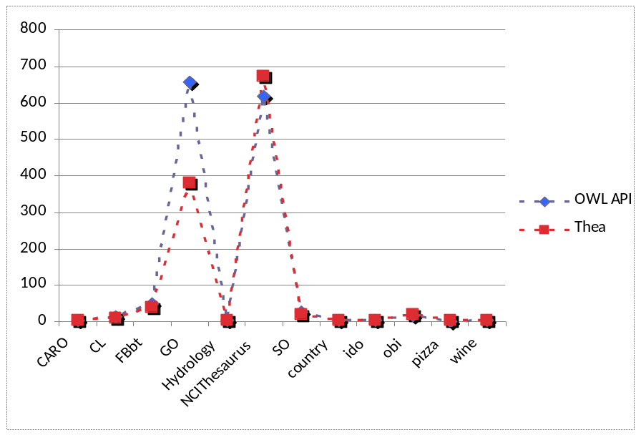
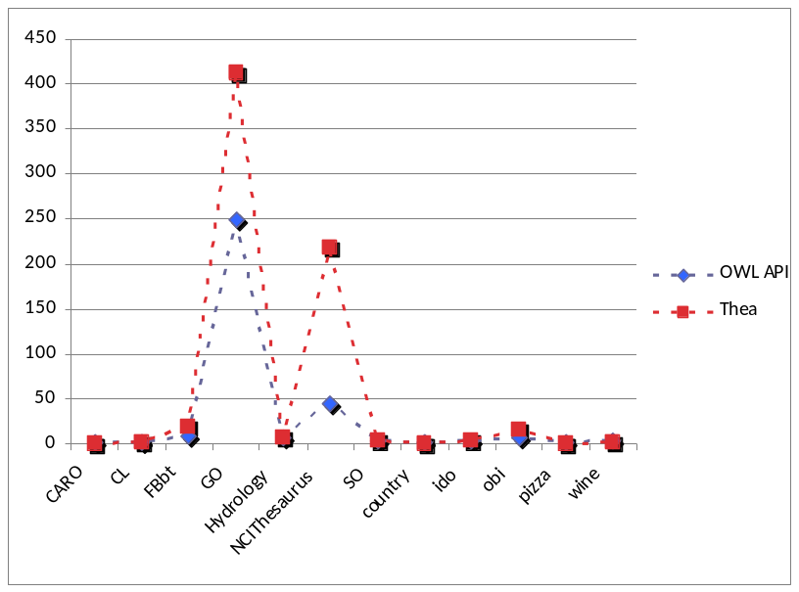
Comparison with OWLAPI
OWLAPI:
  Full featured.
  Mature.
  Java API (OO language)
Thea:
  declarative.
  offers bridge via JPL.
  easy scripting
Memory
usage
Load time
(secs)

Slide 12
Conclusions and Next steps
OWL2 support within Prolog
Full support of OWL2 structural syntax
Easy programmatic access to query and process Ontologies within Prolog.
Import and export to different formats
Modules for external reasoning support
Next Steps
  Portability (other Prolog systems)
  Improvements in efficiency..
  Complete modules (other I/Os, Reasoners etc)
  Use and feedback from the community…

Slide 13
thank you.
http://github.com/vangelisv/thea

