Slide 1

GameStop
SESIS:764 Artificial Intelligence
Group: Leon Tan, Pa Vang, TianXin Shao, Joseph Verbout, & Maxine Thao

Slide 2
What is the Dataset?
1st GameStop Historical Stock Price: From Feb 13th,2002 to Feb 4th, 2021, there are 4779 of records in the dataset. ​
2nd Reddit Comments Datasets: Containing each Reddit post (884,063) from the WSB subreddit mentioning GME over 4/11/2012 ~ 1/31/2021​
Filtered out any blanks, unknown, NA values. Also, removing columns such as dividends and stock splits since GameStop have not reach that financial stage

Slide 3
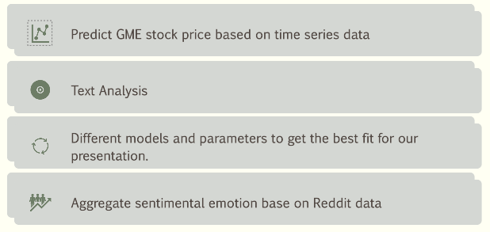
What is the goal?

Slide 4
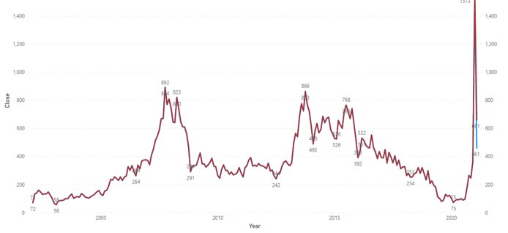
Data Visualization – GME Stock Price
Product A
Product B
Feature 1
Feature 2
Feature 3
Feature 1
Feature 2
Feature 3

Slide 5
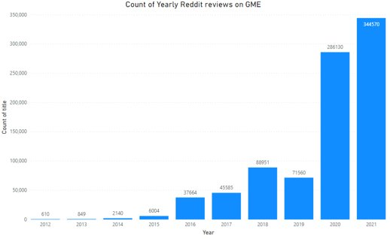
Data Visualization – Count of Reddit reviews on GME

Slide 6
Variables in GME and Reddit Dataset
Index​ | Name​ | Description​ | Type​
1​ | Date​ | The date when the prices were recorded​ | Date​
2​ | Open​ | The stock price at market open​ | Decimal​
3​ | Close​ | The stock price at market close​ | Decimal​
4​ | Low​ | The lowest stock price recorded during the trading period​ | Decimal​
5​ | High​ | The highest stock price recorded during the trading period​ | Decimal​
6​ | Volume​ | The total number of shares traded during the trading period​ | Integer​
7​ | Id​ | The reddit post id​ | Integer​
8​ | Title​ | The title of the Reddit post​ | String​
9​ | Score​ | The score of the reddit post (upvotes – downvotes).​ | Decimal​
10​ | Author​ | Author of the post​ | String​
11​ | author_flair_text​ | Describes is the author has any flair (self-chosen tag)​ | Text​
12​ | removed_by​ | Describes who the post was removed by, if anyone​ | String​
13​ | total_awards​ | The number of awards the post received​ | Integer​
14​ | awarders​ | Who provided the rewards​ | String​
15​ | created_utc​ | The UTC timestamp when the post was created​ | Date​
16​ | num_comments​ | The total number of comments for the post​ | Integer​
Variable from 1st GME Stock Dataset, Variable from 2nd Reddit Review Dataset

Slide 7
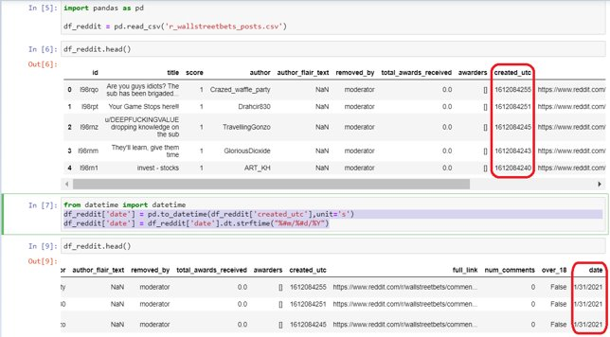
Convert UTC time

Slide 8
Added a New column "Sentiment" on Reddit Data Review
Index​ | Name​ | Description​ | Type​
7​ | Id​ | The Reddit post id​ | Integer​
8​ | Title​ | The title of the Reddit post​ | String​
9​ | Score​ | The score of the reddit post (upvotes – downvotes).​ | Decimal​
10​ | Author​ | Author of the post​ | String​
11​ | author_flair_text​ | Describes is the author has any flair (self-chosen tag)​ | Text​
12​ | removed_by​ | Describes who the post was removed by, if anyone​ | String​
13​ | total_awards​ | The number of awards the post received​ | Integer​
14​ | awarders​ | Who provided the rewards​ | String​
15​ | created_utc​ | The UTC timestamp when the post was created​ | Date​
16​ | num_comments​ | The total number of comments for the post​ | Integer​
17​ | Sentiment​ | The Sentimental of this review​ | Decimal​
Variable from 2nd Reddit Review Dataset​

Slide 9
Variables after Merge two Dataset
Index​ | Name​ | Description​ | Type​
1​ | Date​ | The date when the prices were recorded​ | Date​
2​ | Open​ | The stock price at market open​ | Decimal​
3​ | Close​ | The stock price at market close​ | Decimal​
4​ | Low​ | The lowest stock price recorded during the trading period​ | Decimal​
5​ | High​ | The highest stock price recorded during the trading period​ | Decimal​
6​ | Volume​ | The total number of shares traded during the trading period​ | Integer​
7​ | Sentimental​ | The aggregate sentimental value per day​ | Decimal​
Merge through: GME.Date = Reddit.created_utc​
Sentimental is aggregated value per Day

Slide 10
Text Analysis and Classify
Reddit Review Dataset is un-labelled​
Methods to get sentiment of review:​
Manual Label​
Naive Bayes​
TextBlob​
vaderSentiment​
LSTM

Slide 11
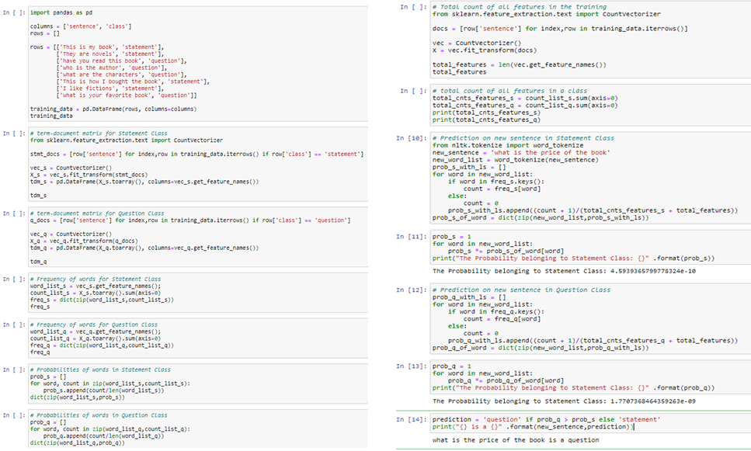
Naïve Bayes Classifier for Text Classification

Slide 12
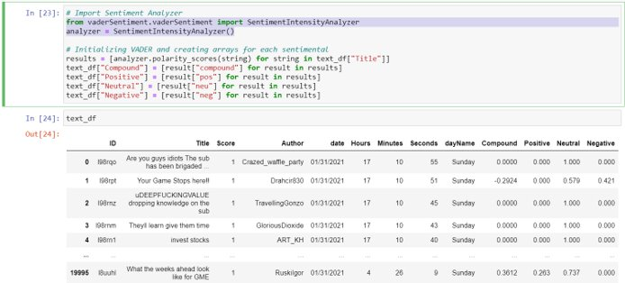
Text Classify Result with SentimentIntensityAnalyzer

Slide 13
Text Classify Compare
Method | Advantage | Disadvantage
Manual Label | Precise | Much effort, may require experts
Naive Bayes (model) | Performs with less time | "Naïve" classifier
TextBlob (library) | Simple obj.sentiment.polarity obj.sentiment.subjectivity | Debatable accuracy
SentimentIntensityAnalyzer (library) | polarity_scores | Debatable accuracy
LSTM (model) | predicting time series | mainly sequential processing over time

Slide 14
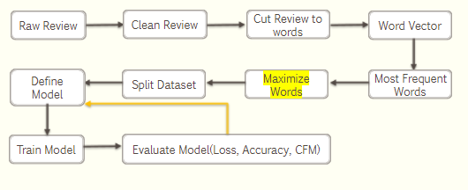
Text Classify with LSTM – But we had no Label?

Slide 15
What we ended up doing
GME Stock Price prediction using LSTM (w/o Reddit review)​
Text mining and natural language processing by analyzing the sentiments​
GME Stock Price prediction using LSTM with the Sentiment of Reddit review​
Hyperparameters of LSTM Optimization​
Metrics of Models (RMSE, Loss, Accuracy)

Slide 16
GME Stock Price prediction using LSTM (w/o Reddit review)
Index​ | Name​ | Description​ | Role​
1​ | Date​ | The date when the prices were recorded​ | Predictor ​
2​ | Open​ | The stock price at market open​ | Response​
3​ | Close​ | The stock price at market close​ | Predictor​
4​ | Low​ | The lowest stock price recorded during the trading period​ | Predictor​
5​ | High​ | The highest stock price recorded during the trading period​ | Predictor​
6​ | Volume​ | The total number of shares traded during the trading period​ | Predictor​
Only need 1st dataset​
Normalization ​
Dataset cross time (2/13/2020 – 2/14/2021), Size (4778), Split into Training and Testing​
Daily Prediction and Metrics: MSE, RMSE​

Slide 17
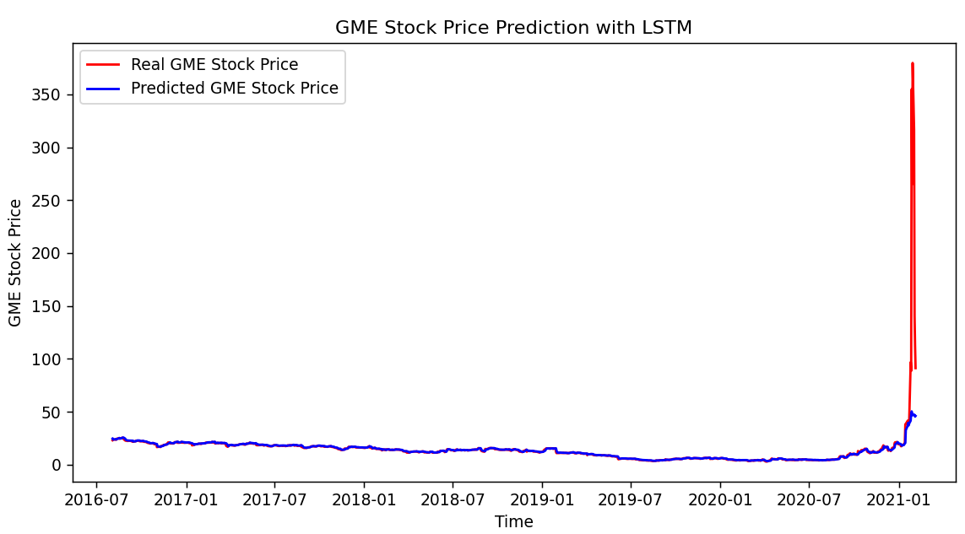
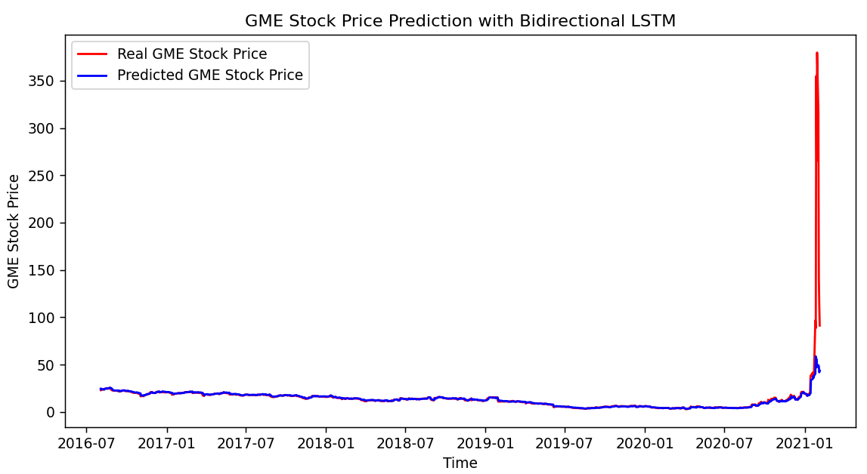
Model summary of GME Stock Price prediction using LSTM (w/o Reddit review)

Slide 18
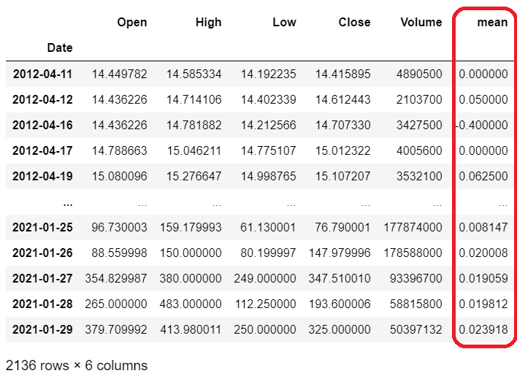
Merged Review Sentiment into 1st Dataset

Slide 19
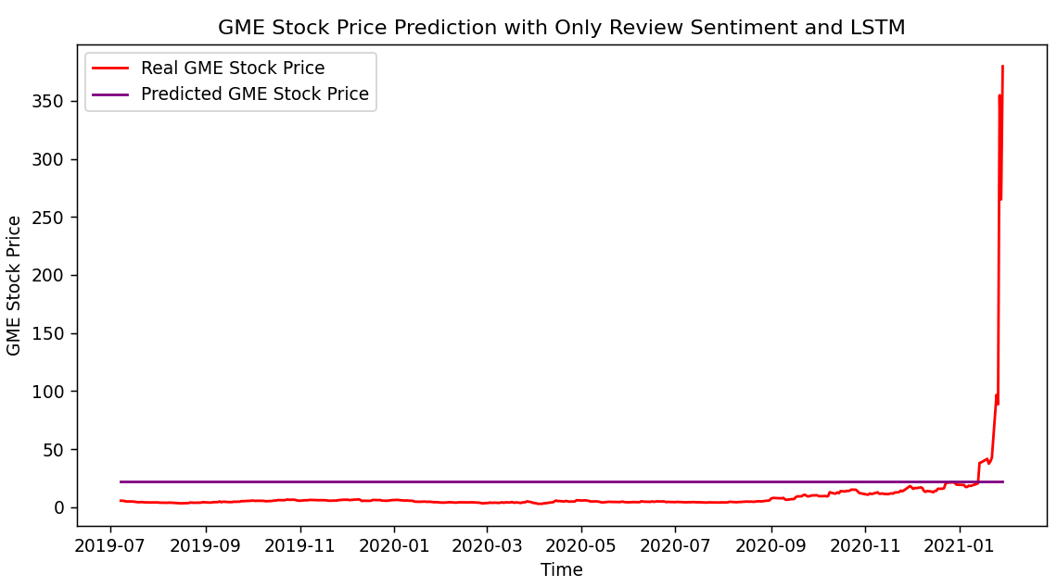
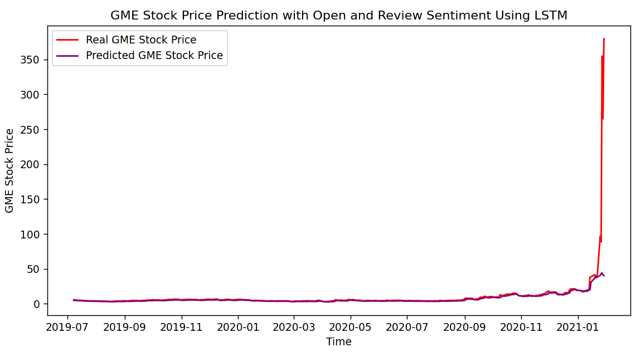
Model summary of GME Stock Price prediction using LSTM (Only Reddit review)

Slide 20
Performance Metrics
Model | MSE | MAE | RMSE
Model 1: Stock Prediction with no Reddit Comments using LSTM | 302.86 | 1.64 | 17.4
Model 2: Stock Prediction with no Reddit Comments using Bidirectional LSTM | 299.27 | 1.65 | 17.3
Model 3: Stock Prediction with only Reddit Comments using LSTM | 1035.37 | 18.24 | 32.18
Model 4: Stock Prediction with Open and Reddit Comments using LSTM | 676.69 | 3.34 | 26.01

Slide 21
Key Findings
Time Series Forecasting using LSTM to predict GME Open Stock Price, we use the first 60-day data to predict the 61st Open price, the predicted price is nearly same as real price, and performance metrics MAE (Mean Absolute Error) is also acceptable (1.64)
Bi-directional LSTM is better than unidirectional LSTM, our model indicated that the metrics MAE decreased from 1.64 to 1.52, but with much more training time.
We cannot say that the Reddit comments have influence on the stock price. From the output of LSTM model on TextBlob Sentimental Analysis on Reddit review comments, the predicted GME stock price nearly keeps unchanged. Really???

Slide 22
More Things To Do In The Future
Increase Dataset size: collect more Reddit review data to combine w/ Stock Dataset- PRAW to scrape reddit data.​
Introduce more predictors(# vars) : Close, High, Low, Dividends, and other factors like: industry policy, news, etc.
Improve the accuracy of Sentimental: Research & learn more on Natural Language processing​ (NLP) to handle Sentimental of Review comments, instead of call directly TextBlob, convert words to vector and use their sentiment- explore more rolling forecast with LSTM

Slide 23
Before you go...
Stock prediction is difficult due to various economic & stock price-related indicators​
Public review comments of Stock is sometimes misleading.

Slide 24
Reference
Sidra Mehtab, Jaydip Sen and Abhishek Dutta, Department of Data Science and Artificial Intelligence, Praxis Business School, Stock Price Prediction Using Machine Learning and LSTM-Based Deep Learning Models​
Serafeim Loukas Jul 10,2020,Time-Series Forecasting: Predicting Stock Prices Using An LSTM Model​
Youtube: Text Classification with TensorFlow Keras NLP Using Embedding and LSTM Recurrent Neural Networks​​
Arjun Rohlfing-Das, , Jul 30, 2020, Sentimental Analysis for Trading with Reddit Text Data

