Slide 1
Domain Object Security (ACLs)

Slide 2
1. Introduction
Authentication will tell you about the user's identity, while Authorization will decide what they have permission to do.
In Spring Security, on one side we have the authorization target, what needs to be protected: Methods, Interfaces, and Web Resources. And also, how they are protected: through layers of authorization, roles, and ACLs.

Slide 3
AUTHORIZATION

Slide 4
The goal allows delegation
Methods: We need to protect API methods from unauthorized people accessing them.
Interface: Normal users should not see links to the Admin management panel, and content that users are not allowed to see.
Web Resources: We reserve the right to allow or deny various HTTP requests based on the URLs and associated HTTP methods.

Slide 5
Authorization models
Authorization based on Authentication, Role, and Permission: These are models that rely on levels of authentication to authorize, from anonymous, to remembered (via cookies, ...) to be completely authentic. Role-based access control (RBAC) is often the default authorization model of Spring Security.
Authorization based on ACL: ACL will control Domain Objects based on each person's access rights based on those Domain Objects.

Slide 6
Spring Security Access Control List
Access Control List (ACL)

Slide 7
Define
Access Control List (ACL) is a list of permissions attached to an object.
An ACL specifies which identities are granted which operations on a given object.
Spring Security Access Control List is a Spring component which supports Domain Object Security.
Spring ACL helps in defining permissions for specific user/role on a single domain object – instead of across the board, at the typical per-operation level.

Slide 8
2. When do we need to use ACL?
Normally, Spring Security will use RBAC by default.

Slide 9
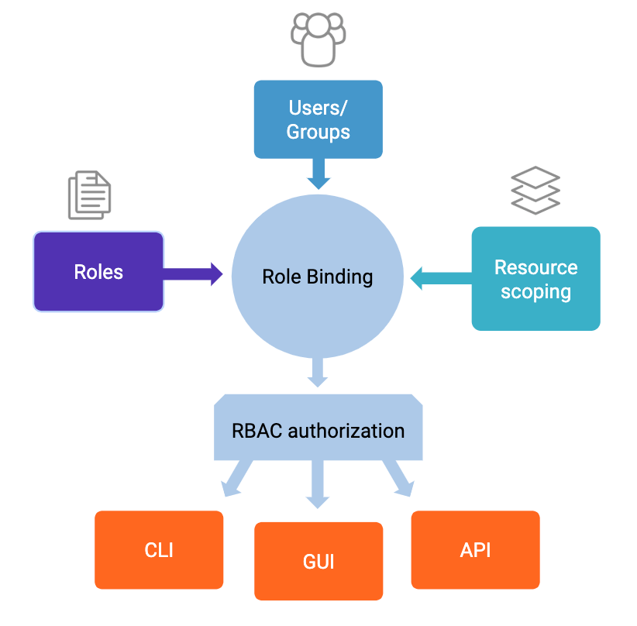

Slide 10
Problem
User 1
Action
Message
Action
User 2
RBAC will solve problems like "Does User1 have permission to edit Messages in general?", but the problem will arise when privacy needs to be guaranteed, users need to be able to access messages but cannot access that message.
ACL can solve that problem and answer the question "Does User1 have permission to edit Message 123?"

Slide 11
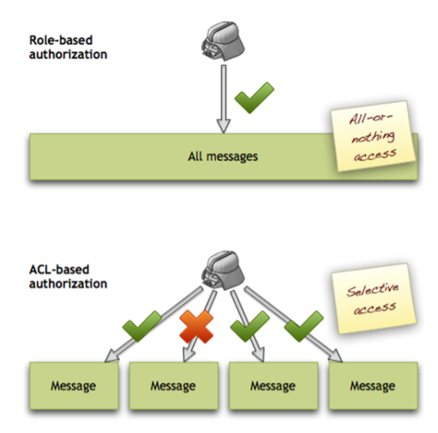

Slide 12
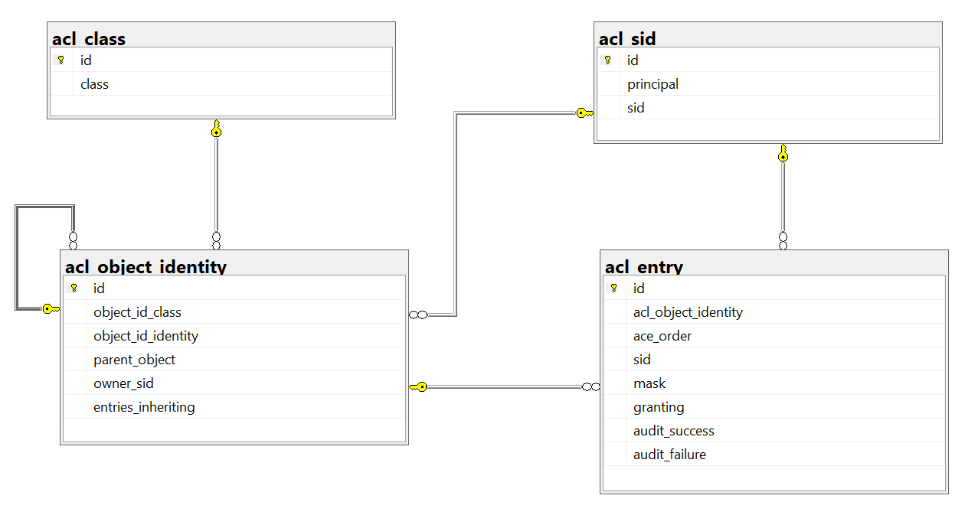
3. ACL Database

Slide 13
Object
Subject
Action
Object
Object
Table ACL_CLASS: contains Domain Object information.
Ex: com.demo.springacl.entities.Message
Table ACL_SID: contains information about a user or a group of users.
Table ACL_OBJECT_IDENTITY: will contain information for each Domain Object one by one.
Table ACL_ENTRY: will store each permission corresponding to each SID for an Object Identity.

Slide 14
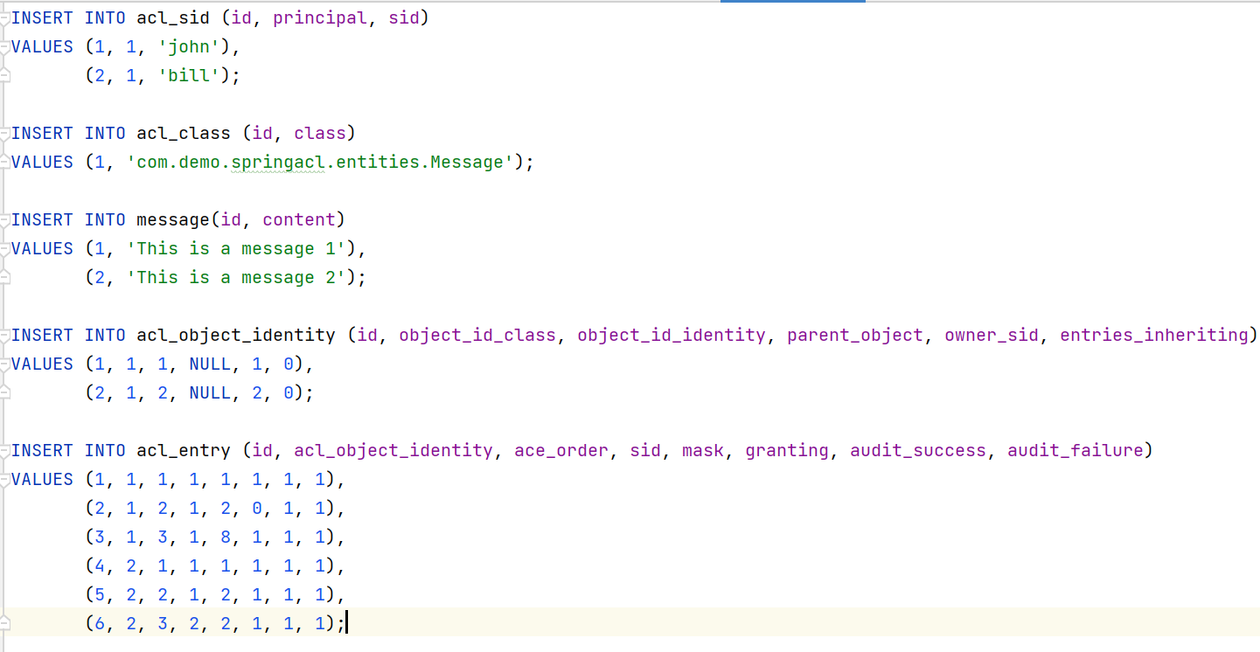
Example data script

Slide 15
Advantages
Fine-Grained Access Control: enables you to define access control rules at the object level.
Hierarchical and Inheritance Support: supports hierarchical structures, allowing parent-child relationships between objects.
Dynamic Access Control: allows you to dynamically modify and manage access control rules during runtime.
Database-Backed Storage: ACL entries are typically stored in a relational database, making it easy to manage and query ACL data.
Integration with Spring Security: integrates with Spring Security, allowing you to use familiar Spring Security constructs like UserDetails and GrantedAuthority for access control.
Audit Logging: supports audit logging, helping you keep track of access control operations.
Multitenancy Support: Spring ACL can be used in multi-tenant applications to enforce access control rules for different tenants' data within a shared system.

Slide 16
Disadvantages
Complexity: Implementing Spring ACL can add complexity to your application. Defining and managing ACL entries for every domain object may require a considerable amount of configuration and code.
Performance Overhead: The database-backed storage for ACL entries may introduce additional performance overhead, especially in applications with high access control request rates.
Database Dependencies: Spring ACL relies on a database to store ACL-related information. This introduces dependencies on the database system.
Maintenance Overhead: As the complexity of your application grows, managing ACL entries, particularly in a dynamic environment, can become challenging.

Slide 17

4. Demo

Slide 18

5. Q&A
Reference:
https://docs.spring.io/spring-security/reference/servlet/authorization/acls.html
https://www.baeldung.com/spring-security-acl
https://viblo.asia/p/mo-hinh-phan-quyen-acl-trong-spring-security-maGK7G1eKj2
https://www.youtube.com/watch?v=GTln3jc5_eg

Slide 19


