Slide 1


Package managers
Installing, updating & reproducing of software tools made easy
Python: Pip, Conda
R: Conda (?), Packrat and now: Renv

Slide 2

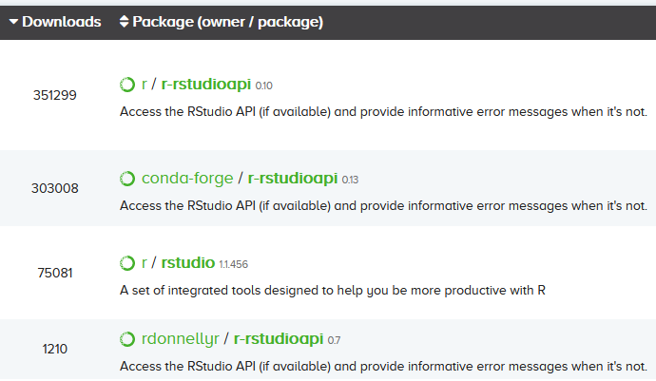
Conda
Command line tool
set up complete working environments in 3 commands:
conda create myenv package1 package2 package3
conda activate myenv
[activate IDE]
Always had issues with R
Python2 and R couldn’t be in the same env
r and conda-forge channel packages not always compatible
r channel R and Rstudio outdated.

Slide 3
Renv
Expectations: can recommend it, but no perfect replacement
What is Renv?
R package managing R package on a Project-basis
So it requires a preinstalled R (and Rstudio)
Can then register the R version
Works 100% within R(studio)
Workflow:
Install packages as normal (install.package(), install.github(), etc.)
Use renv’s save and load commands to store the packages (you actually use)
Environment is stored in JSON format, can be put under version control.

Slide 4
When is it more easy to use Renv?
When collaborating
When running multiple projects
When the R system library on your server is a mess
old R version
multiple R versions
Match packages & versions with 1 command after a git pull
Switch libraries inside Rstudio when switching projects
Renv symlinks system library packages of the right R version into your project library

Slide 5
Installing latest Rstudio (non sudo user)
Post presentation notes:
After installing Rstudio this way, you no longer need the conda r-channel!
mkdir ~/rstudio; cd ~/rstudio
apt-get download rstudio
debfile=$(ls .); dpkg -x $debfile .; rm $debfile
Add this line to ~/.bashrc:
export PATH="$HOME/usr/lib/rstudio/bin:$PATH" (doesn’t work for some reason?)
alias rstudio="$HOME/rstudio/usr/lib/rstudio/bin/rstudio"
source .bashrc

Slide 6
Installing R & renv
Post presentation notes:
Using this environment you can install further packages in R
Even without renv
Using renv will make your packages reproducible & separated per project
Via conda/mamba:
conda create -n R_4.0 -c conda-forge conda-forge::r-base=4.0.3 r-renv r-boot r-class r-cluster r-codetools r-foreign r-KernSmooth r-lattice r-MASS r-Matrix r-mgcv r-nlme r-nnet r-rpart r-spatial r-survival --yes
R version specific conda environment
Conda settings: conda-forge channel should be higher than the r channel
In case of doubt, run conda config --add channels conda-forge
These packages make up the default R system library

Slide 7
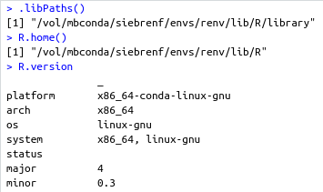
Daily routine
Starting Rstudio
conda activate R_4.0
rstudio
Optional: check everything is working:

Slide 8
So far
Post presentation notes:
Custom Rstudio & R install
Use conda to activate the env with the desired R version
No conflicts with the R system library
At this point you can work in this new environment with or without renv
No more need to install further packages with conda
Packages installed with conda are system packages (and renv)
So no need to mention these in reproducibility reports

Slide 9
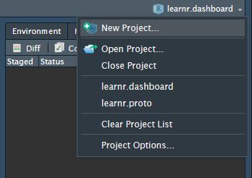
Setting up renv
Start a (new) project
One-time setup command:
renv::init(
project = NULL, # current working dir
settings = list(
r.version = “4.0.3", # specify this R version
vcs.ignore.library = T # don't add libraries to git
),
restart = T # restart the rsession
)
That’s it.

Slide 10
Setting up renv
When you switch project, libraries automatically switch with you.
If you work alone, no further actions are required.
If you are collaborating/publishing, save/load your dependencies with
renv::snapshot() # save
renv::restore() # load
The environment is stored in file renv.lock
Works with CRAN, github, Bioconductor…

