Slide 1
ONLINE TRAIN TICKETING SYSTEM
Studien group made: Bùi Minh Tuấn 20IT020 Lê Văn Dũng 20IT142 Nguyễn Thanh Hưng 20IT155 Lê Đình Cương 20IT824

Slide 2
TABLE OF CONTENTS
01
02
Determine subject requirements
System analysis and design

Slide 3
01
Determine subject requirements

Slide 4
SYSTEM FUNCTIONAL REQUIREMENTS
USER | MANAGER
Function create account , login. Search function. Ticket selection function. Train selection function. | Function login Add , edit and delete function (Customer information or train information) Management function…

Slide 5
02
System analysis and design

Slide 6
IDENTIFY ACTORS AND USE CASE
USER
MANAGER
Create account or login View website Search Ticket information Make transaction
Login (admin) Manage website activities Update information Add , edit ,delete (Customer or tickes)

Slide 7
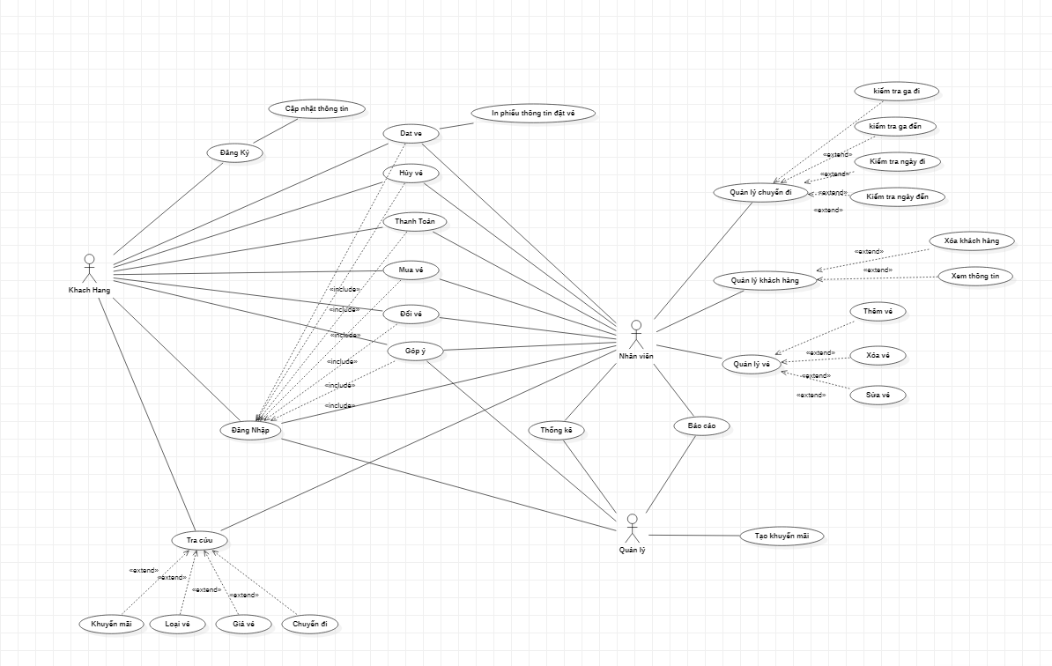
USE-CASE DIAGRAM

Slide 8
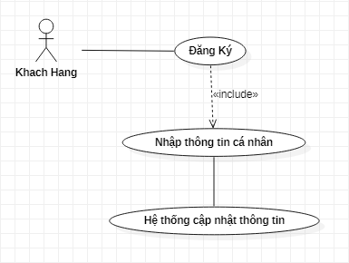
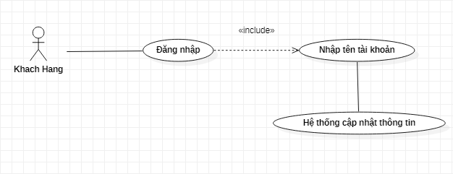
USE-CASE DIAGRAM CREATE ACCOUNT
Description: customers provide full information to register for membership.
USE-CASE DIAGRAM LOGIN
Description:Customers enter their name and password, the system allows login to the system if entered correctly.

Slide 9
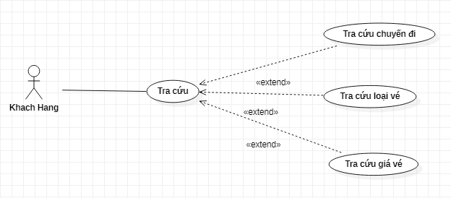
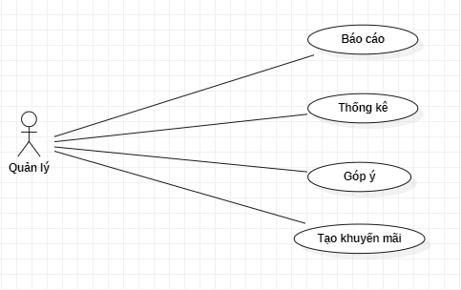
USE-CASE DIAGRAM SEARCH TRAIN
Description: customers looking for products.
USE-CASE DIAGRAM STATISTICS
Description: manage access to reports, statistics, suggestions and use of promotional functions

Slide 10
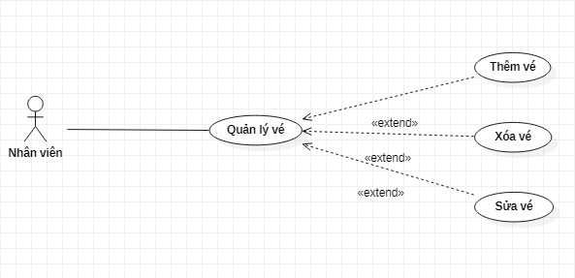
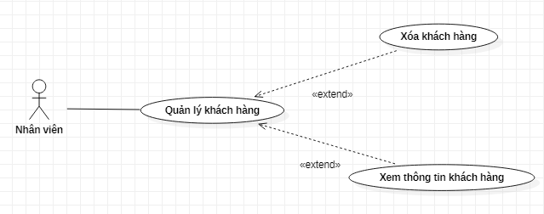
TICKET MANAGEMENT USE-CASE DIAGRAM
Description: view the ticket list, add edit and delete tickets.
CUSTOMER MANAGEMENT USE-CASE DIAGRAM
Description: view customer information and delete customers.

Slide 11
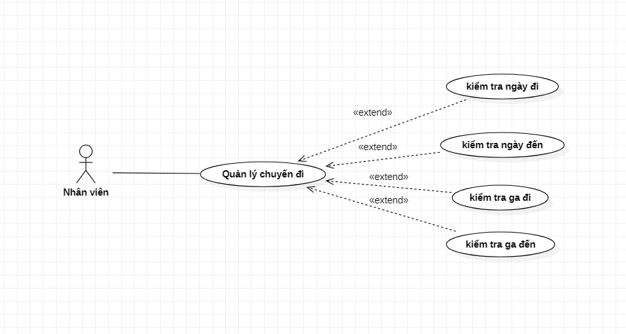
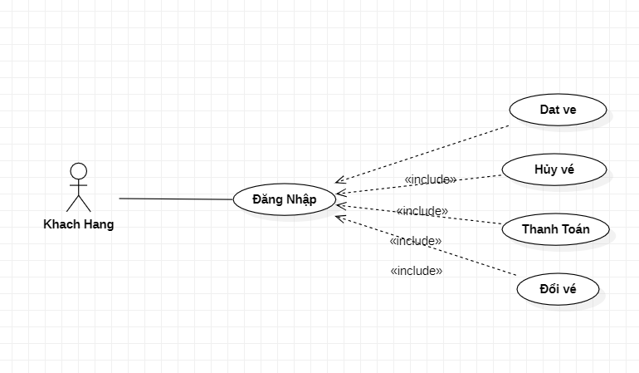
TRAIN MANAGEMENT USE-CASE
Description: View the list of trains, add edit and delete trains.
TICKET BOOKING USE-CASE
Description: Customers choose empty seats or change or return seats.

Slide 12
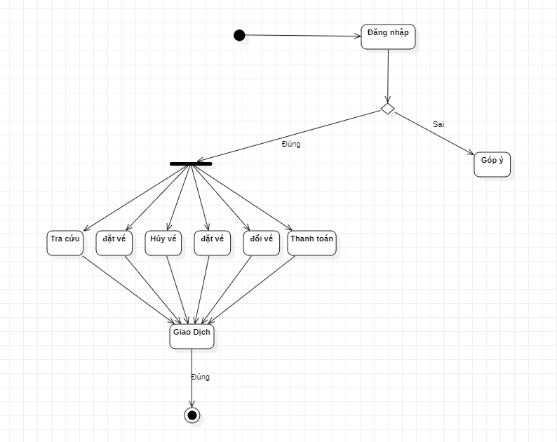
TRADING ACTICITIES
Special operation: Customers log into the system, the system will provide you with options: find a train, choose a seat, book a ticket, pay. After that is the transaction if your account has enough money to pay, otherwise if you log in wrong information or the account is not eligible for payment, the system will send you a notification.

Slide 13
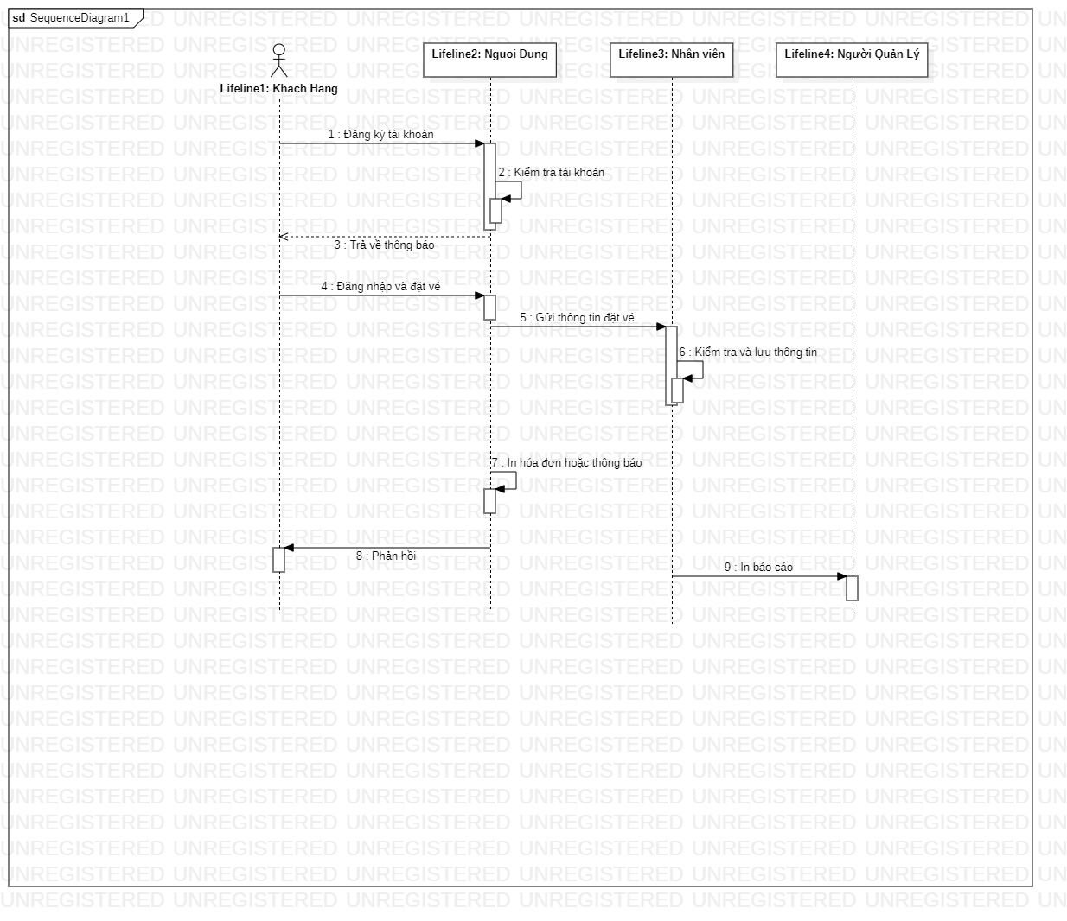
SEQUENCE DIAGRAM
Customers register for an account, the system checks and returns a notification. Then log into the system and proceed to book tickets, the system will send information to the staff and automatically print invoices for customers.

Slide 14
THANKS! FOR WATCHING
Do you have any questions?

