Slide 2
PROJECT REPORT OF Background Digital Communication

Slide 3

Topic 04: Performance Evaluation of 2x2 MIMO - OFDM System with Alamouti STBC and 16 - QAM over Rayleigh Fading Channels
Group 3
Name Phạm Việt Anh Lã Quý Anh Phạm Xuân Hưng Vũ Việt Trung Vũ Nguyên Hiệp | Student code 20238743 20238739 20227815 20238816 20238870

Slide 4
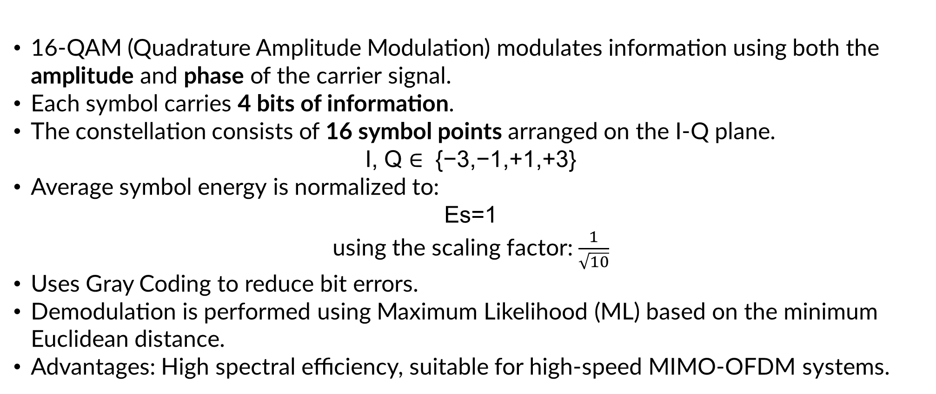
3.2. Quadrature Amplitude Modulation (16-QAM)
16-QAM (Quadrature Amplitude Modulation) modulates information using both the amplitude and phase of the carrier signal.
Each symbol carries 4 bits of information.
The constellation consists of 16 symbol points arranged on the I-Q plane.
I, Q ∈ {−3,−1,+1,+3}
Average symbol energy is normalized to:
Es=1
using the scaling factor: $\frac{1}{\sqrt{10}}$
Uses Gray Coding to reduce bit errors.
Demodulation is performed using Maximum Likelihood (ML) based on the minimum Euclidean distance.
Advantages: High spectral efficiency, suitable for high-speed MIMO-OFDM systems.

Slide 5
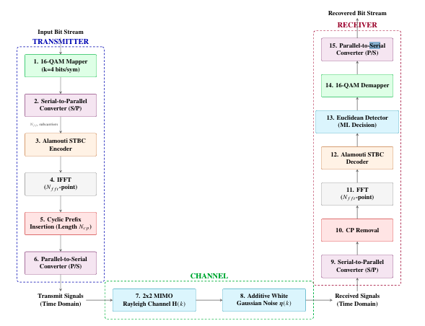

4. System Block Diagram and Operation

Slide 6
4. System Block Diagram and Operation

Slide 13
THANK YOU !

