Slide 1
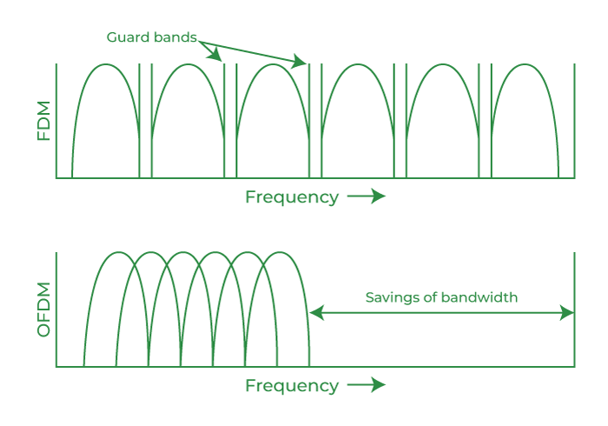
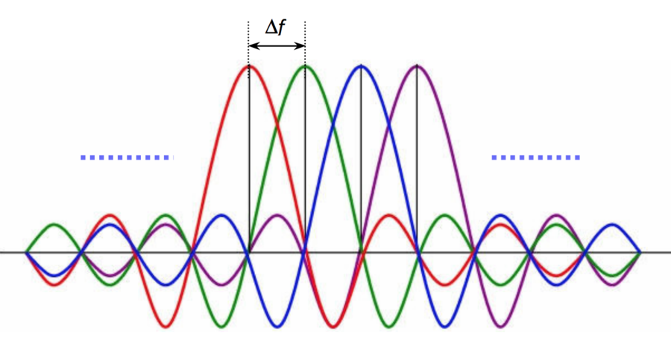
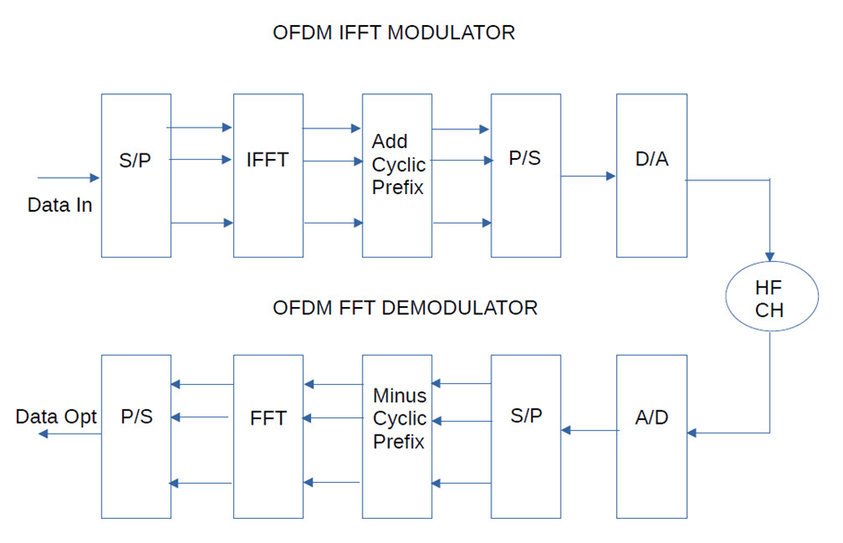
I. OFDM
OFDM (Orthogonal Frequency Division Multiplexing) is a digital modulation technique that splits a single high-speed data stream into multiple lower-speed streams, transmitting them simultaneously over closely spaced, orthogonal (non-interfering) subcarriers.
Roles of IFFT & FFT
Domain Transformation Bridge
Orthogonality Enforcement
Hardware Optimization

Slide 2
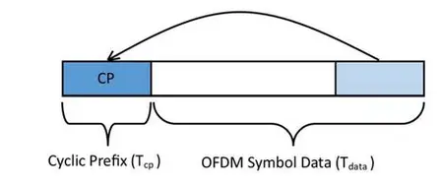
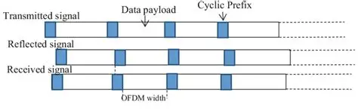
I. OFDM
Cyclic Prefix
CP generation mechanism
A portion of the end of the OFDM symbol is copied and inserted before the symbol itself to create a cyclical guard interval. The length of the guard interval must be greater than the maximum channel delay.
Roles of CP
Inter-Symbol Interference (ISI) suppression
Receiver simplification

Slide 3
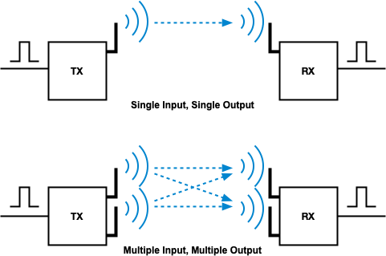
II. MIMO
MIMO is a system that uses multiple antennas at both the transmitter and receiver sides to transmit signals simultaneously.
Objective: Significantly increase data transmission speed and reduce bit error rate (BER) without increasing system power or bandwidth.

Slide 4
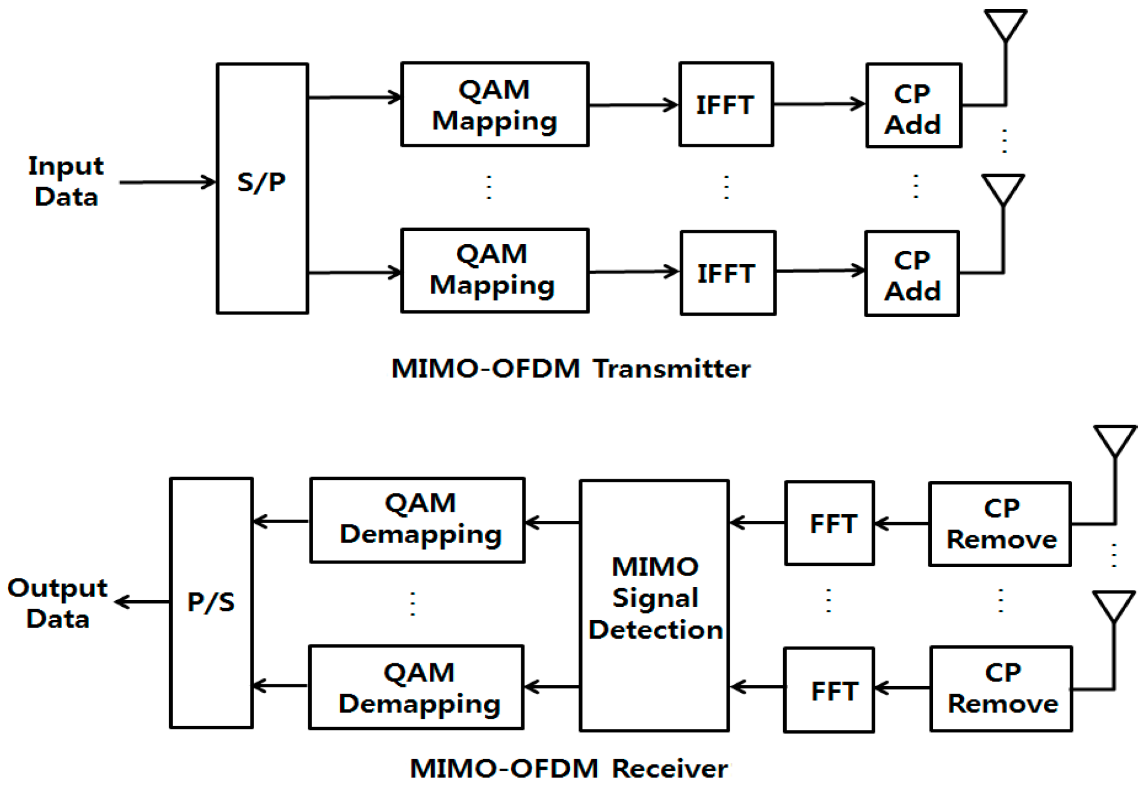
II. MIMO
MIMO-OFDM systerm
MIMO offers speed and reliability, while OFDM helps combat interconnected symbols (ISI) and blurs the filter frequency.
OFDM divides a broadband channel into multiple narrowband subcarriers. In MIMO-OFDM, each subcarrier is affected by flat fading, making signal processing and equalization at the receiver simpler.
Applications: Wi-Fi, 4G LTE, and 5G

