Slide 2
Code & Performance Results

Slide 3

PRESENTATION TITLE
SUBTITLE. SUBTITLE. SUBTITLE.
SUBTITLE. SUBTITLE.

Slide 4
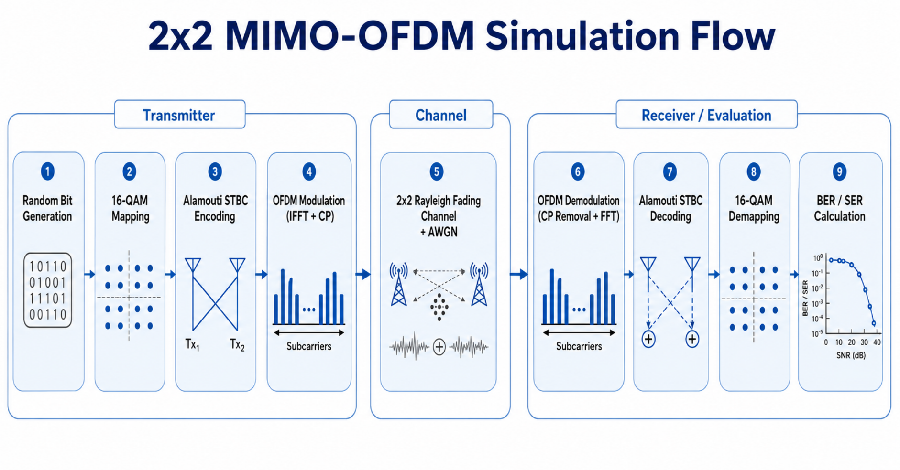
SIMULATION FLOW / CODE STRUCTURE

Slide 5
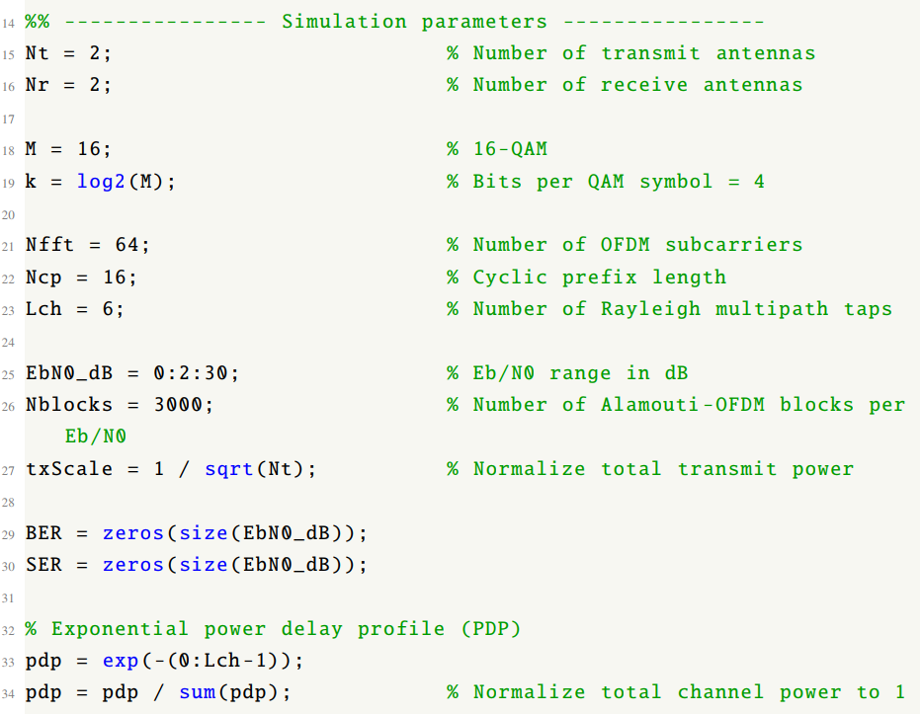
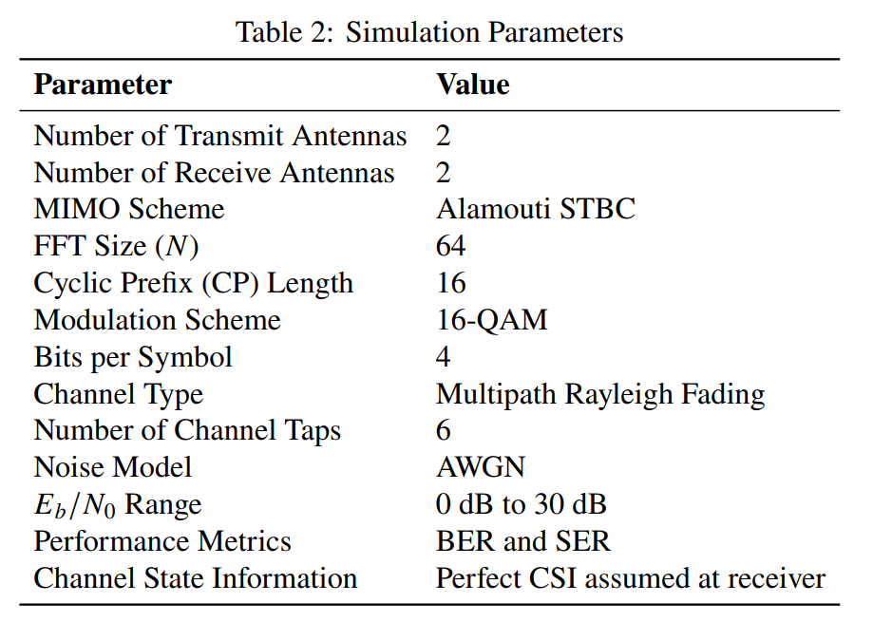
SIMULATION PARAMETERS

Slide 6
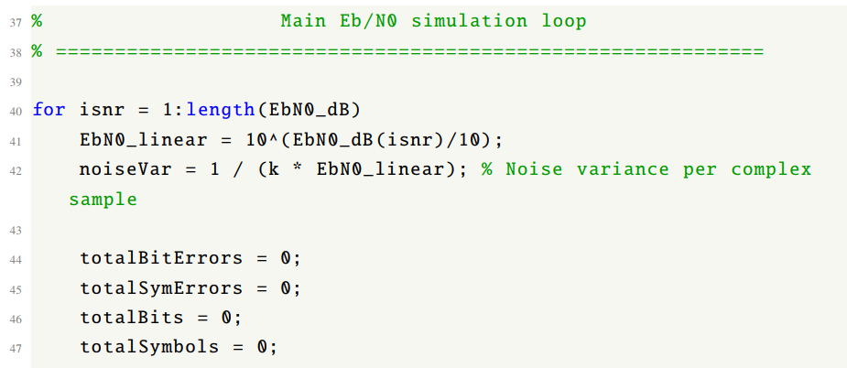
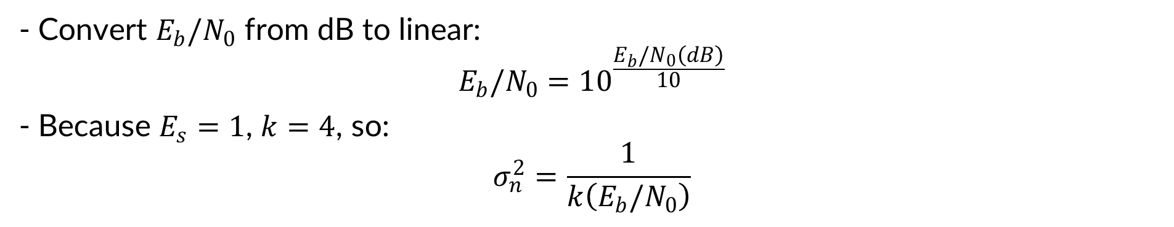
MAIN $E_{b}/N_{0}$ LOOP AND NOISE SETUP
- Convert $E_{b}/N_{0}$ from dB to linear:
$$E_{b}/N_{0}={10}^{\frac{E_{b}/N_{0}\left(dB\right)}{10}}$$
- Because $E_{s}=1$, $k=4$, so:
$$σ_{n}^{2}=\frac{1}{k\left(E_{b}/N_{0}\right)}$$

Slide 7
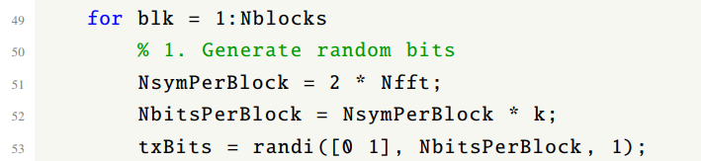
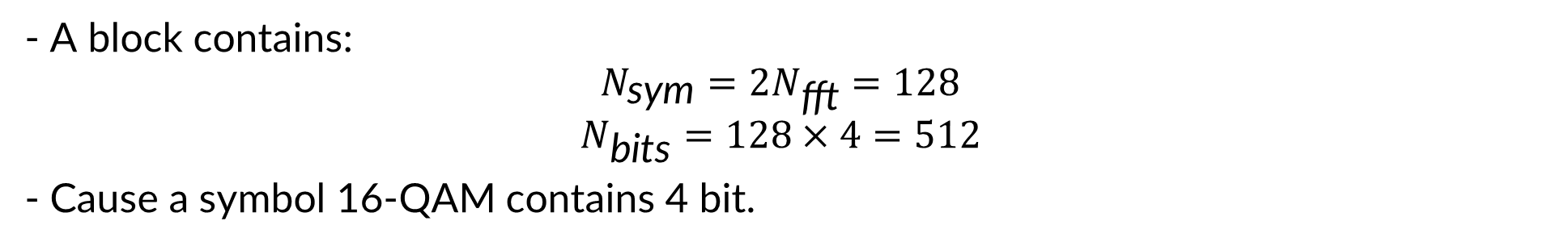
BLOCK LOOP AND RANDOM BIT GENERATION
- A block contains:
$$N_{\text{sym}}=2N_{\text{fft}}=128$$
$$N_{\text{bits}}=128×4=512$$
- Cause a symbol 16-QAM contains 4 bit.

Slide 8
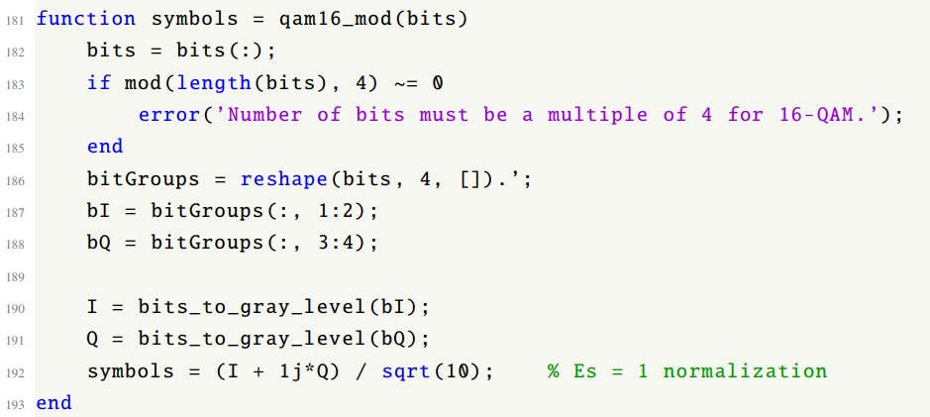
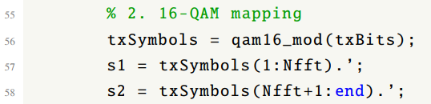
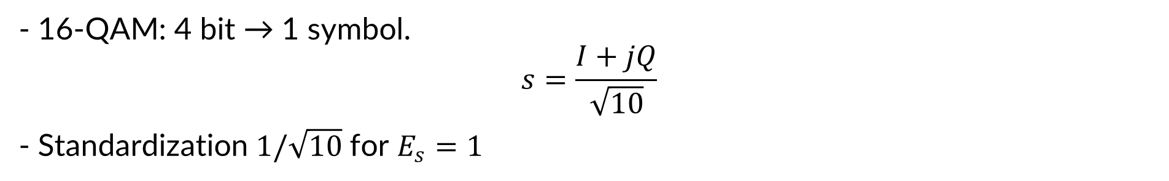
16 – QAM MAPPING
- 16-QAM: 4 bit → 1 symbol.
$$s=\frac{I+jQ}{\sqrt{10}}$$
- Standardization $1/\sqrt{10}$ for $E_{s}=1$

Slide 9
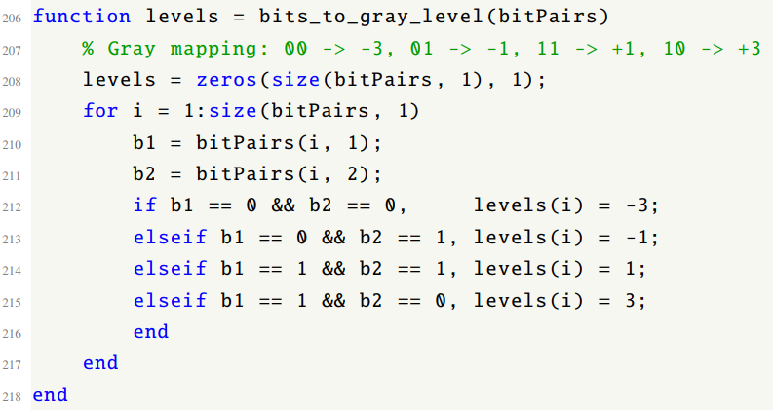
GRAY MAPPING FUNCTION

Slide 10
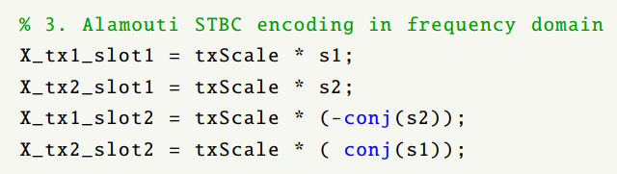
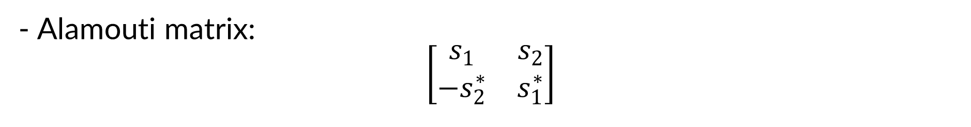
ALAMOUTI STBC ENCODING
- Alamouti matrix:
$$\left[\begin{matrix}s_{1} & s_{2} \\ −s_{2}^{∗} & s_{1}^{∗}\end{matrix}\right]$$

Slide 11
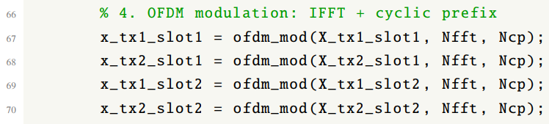
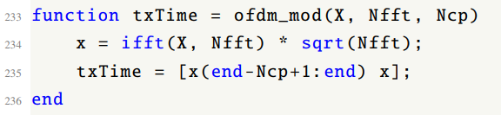
OFDM MODULATION FUNCTION

Slide 12
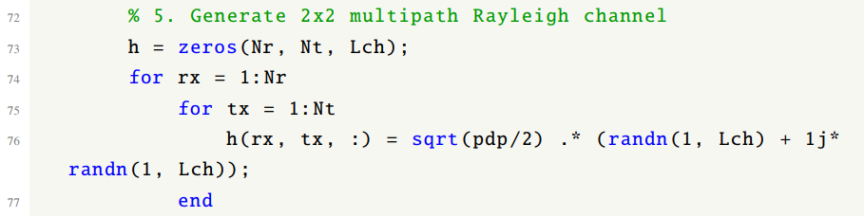
2X2 RAYLEIGH CHANNEL GENERATION
- A 2x2 MIMO system has four channel links: h11​,h12​,h21​,h22​
- Each link has 6 taps. The Rayleigh channel is generated from complex Gaussian random variables.

Slide 13
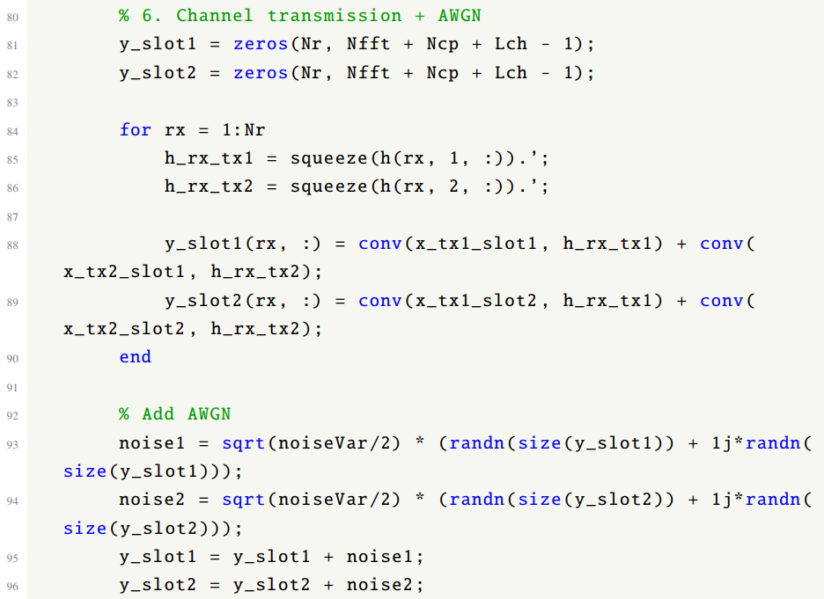
CHANNEL TRANSMITTION AND AWGN
- y=h1​∗x1​+h2​∗x2​+n
- conv() represents signal transmission through a multipath channel. AWGN is added after fading.

Slide 14
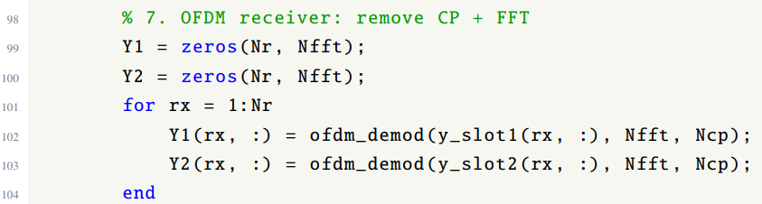

OFDM RECEIVER: CP REMOVAL AND FFT
- The receiver removes the cyclic prefix and then applies FFT to convert the time-domain signal back to the frequency domain.
- After FFT, each subcarrier can be processed separately.

Slide 15
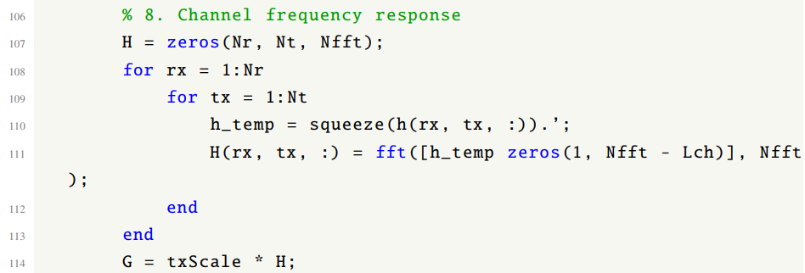
CHANNEL FREQUENCY RESPONSE
- The time-domain channel (h(n)) is converted to the frequency-domain channel response: H(k)=FFT(h(n)) - This is needed for Alamouti decoding on each OFDM subcarrier.

Slide 16
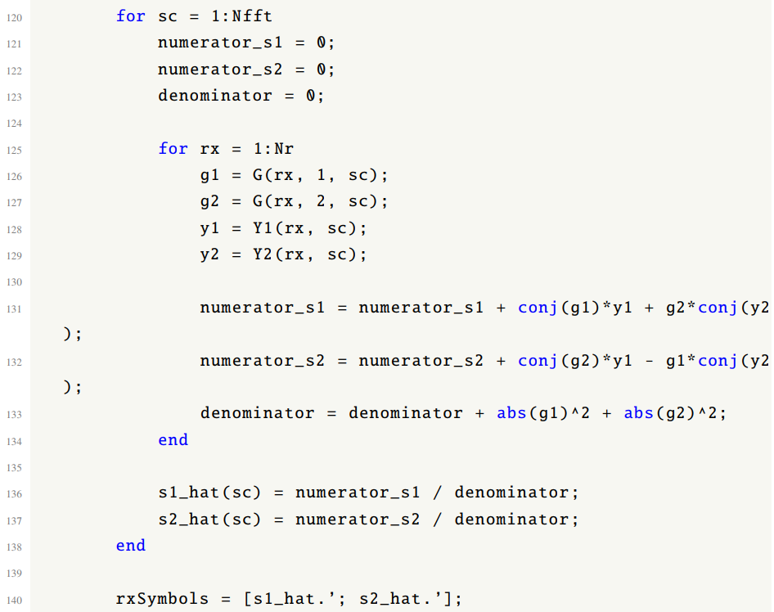
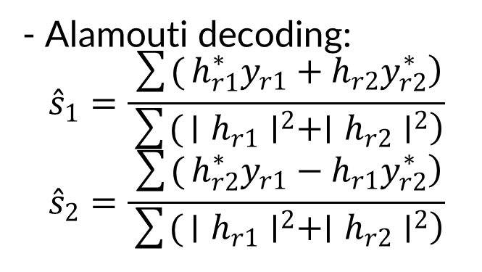
ALAMOUTI STBC DECODING
- Alamouti decoding:
$${\hat{s}}_{1}=\frac{\sum{(}\left.h_{r1}^{∗}y_{r1}+h_{r2}y_{r2}^{∗}\right)}{\sum{(}\left.∣h_{r1}∣^{2}+∣h_{r2}∣^{2}\right)}$$
$${\hat{s}}_{2}=\frac{\sum{(}\left.h_{r2}^{∗}y_{r1}−h_{r1}y_{r2}^{∗}\right)}{\sum{(}\left.∣h_{r1}∣^{2}+∣h_{r2}∣^{2}\right)}$$

Slide 17

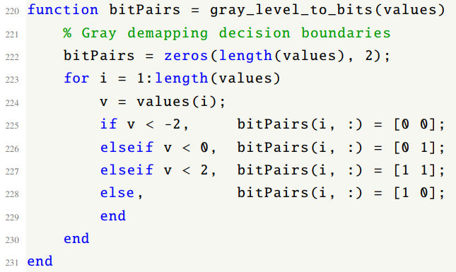

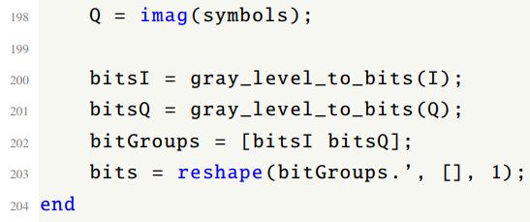
16 – QAM DEMAPPING
- 16-QAM demapping uses decision thresholds (-2, 0, 2). This is equivalent to choosing the nearest constellation point based on Euclidean distance.

Slide 18
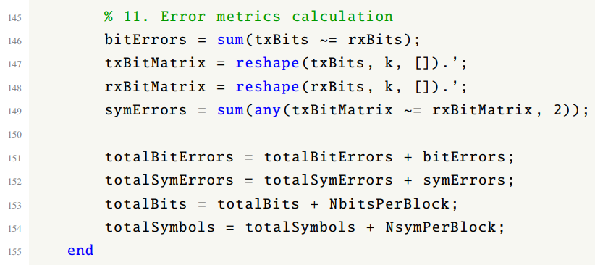
BER AND SER CALCULATION
BER = BIT ERRORS / TOTAL BITS
SER = SYMBOL ERRORS / TOTAL SYMBOLS

Slide 19
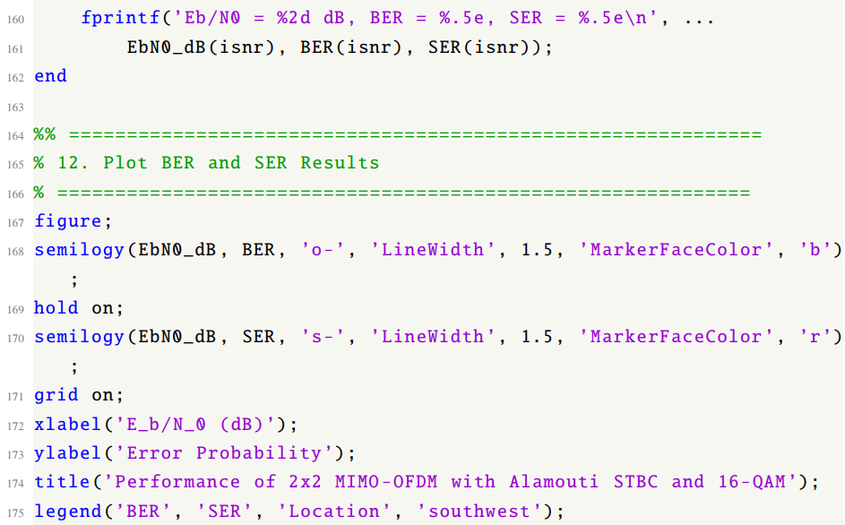
PRINTING AND PLOTTING RESULTS
- Semilogy is used because BER and SER are usually displayed on a logarithmic scale.
- The BER/SER curves decrease as (Eb/N0) increases.

Slide 20
THANK YOU !

