Slide 1
V. EXPERIMENTAL SETUP
2x2 MIMO-OFDM System Simulation
Objective: Evaluate system performance using a MATLAB-based framework.
Channel: Modeled with multipath Rayleigh fading and AWGN.
Tx/Rx Architecture: Integrates 16-QAM, Alamouti STBC, and OFDM modulation/demodulation.
Evaluation: Analyzes Bit Error Rate (BER) and Symbol Error Rate (SER) across various SNR values.

Slide 2
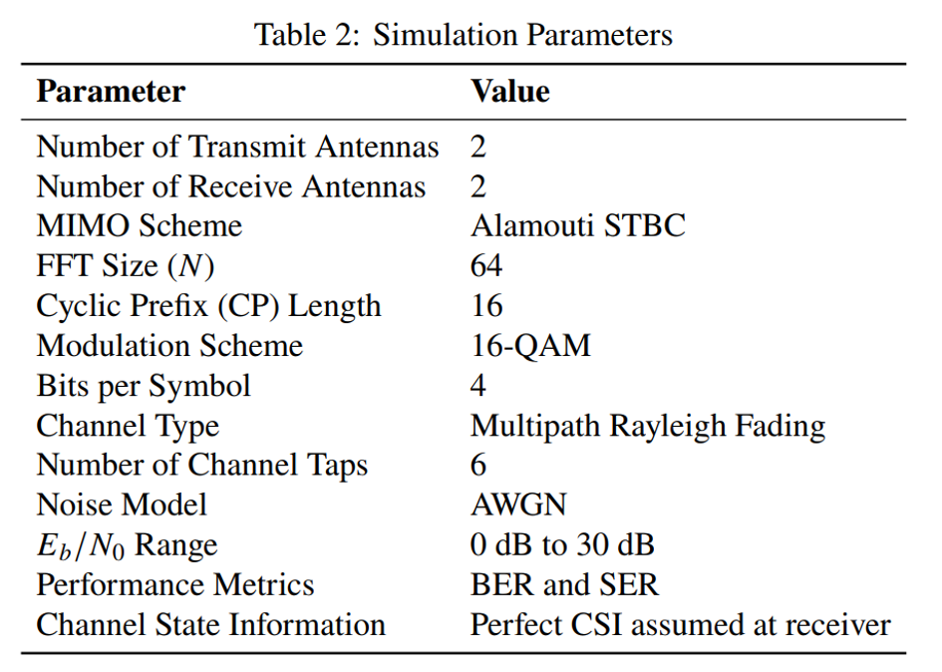
V. EXPERIMENTAL SETUP
5.1 Simulation Parameters

Slide 3
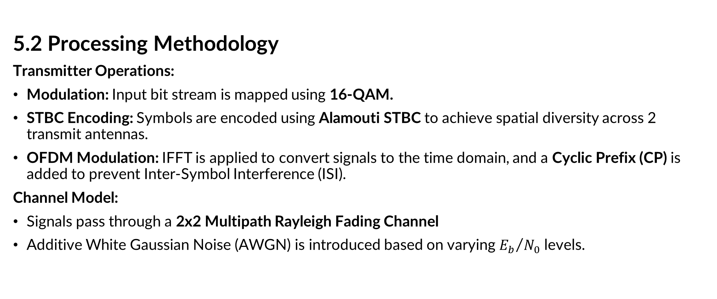
V. EXPERIMENTAL SETUP
5.2 Processing Methodology
Transmitter Operations:
Modulation: Input bit stream is mapped using 16-QAM.
STBC Encoding: Symbols are encoded using Alamouti STBC to achieve spatial diversity across 2 transmit antennas.
OFDM Modulation: IFFT is applied to convert signals to the time domain, and a Cyclic Prefix (CP) is added to prevent Inter-Symbol Interference (ISI).
Channel Model:
Signals pass through a 2x2 Multipath Rayleigh Fading Channel
Additive White Gaussian Noise (AWGN) is introduced based on varying ${E_{b}}/{N_{0}}$ levels.

Slide 4
V. EXPERIMENTAL SETUP
5.2 Processing Methodology
Receiver Operations:
OFDM Demodulation: CP is removed and FFT is applied to return to the frequency domain.
STBC Decoding: Received signals are combined using Alamouti decoding, assuming Perfect Channel State Information (CSI).
Demodulation: Estimated symbols are demapped back into binary bits using 16-QAM decision boundaries.
Performance Evaluation:
Compare recovered data with the original input.
Calculate and analyze Bit Error Rate (BER) and Symbol Error Rate (SER) to evaluate system reliability.

Slide 5
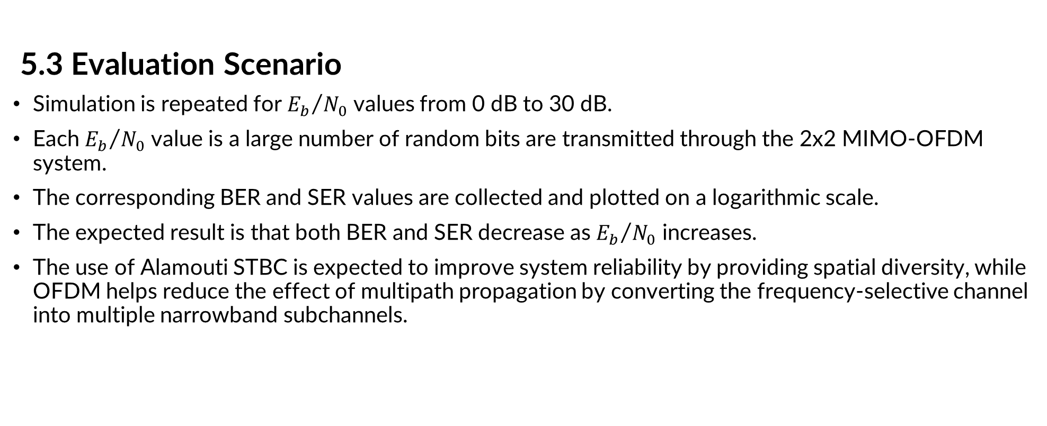
V. EXPERIMENTAL SETUP
5.3 Evaluation Scenario
Simulation is repeated for ${E_{b}}/{N_{0}}$ values from 0 dB to 30 dB.
Each ${E_{b}}/{N_{0}}$ value is a large number of random bits are transmitted through the 2x2 MIMO-OFDM system.
The corresponding BER and SER values are collected and plotted on a logarithmic scale.
The expected result is that both BER and SER decrease as ${E_{b}}/{N_{0}}$ increases.
The use of Alamouti STBC is expected to improve system reliability by providing spatial diversity, while OFDM helps reduce the effect of multipath propagation by converting the frequency-selective channel into multiple narrowband subchannels.

Slide 6
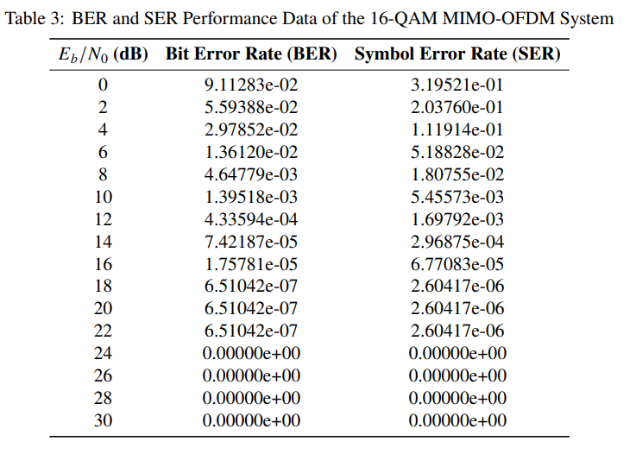

VI.RESULTS AND DISCUSSION
Simulation results
The obtained simulation results illustrate the variations of BER and SER as functions of ${E_{b}}/{N_{0}}$ (dB).

Slide 7
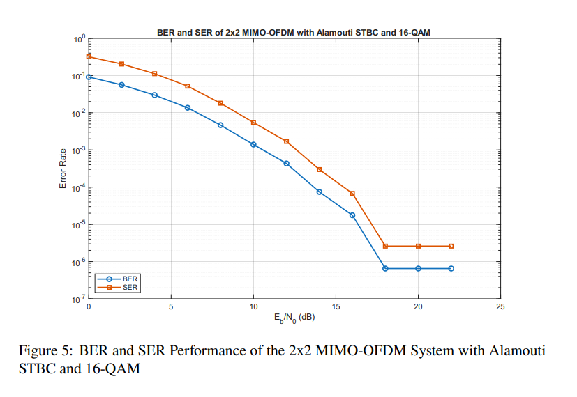
VI.RESULTS AND DISCUSSION
6.1 Simulation results
The corresponding performance curves are plotted in Figure 5.

Slide 8
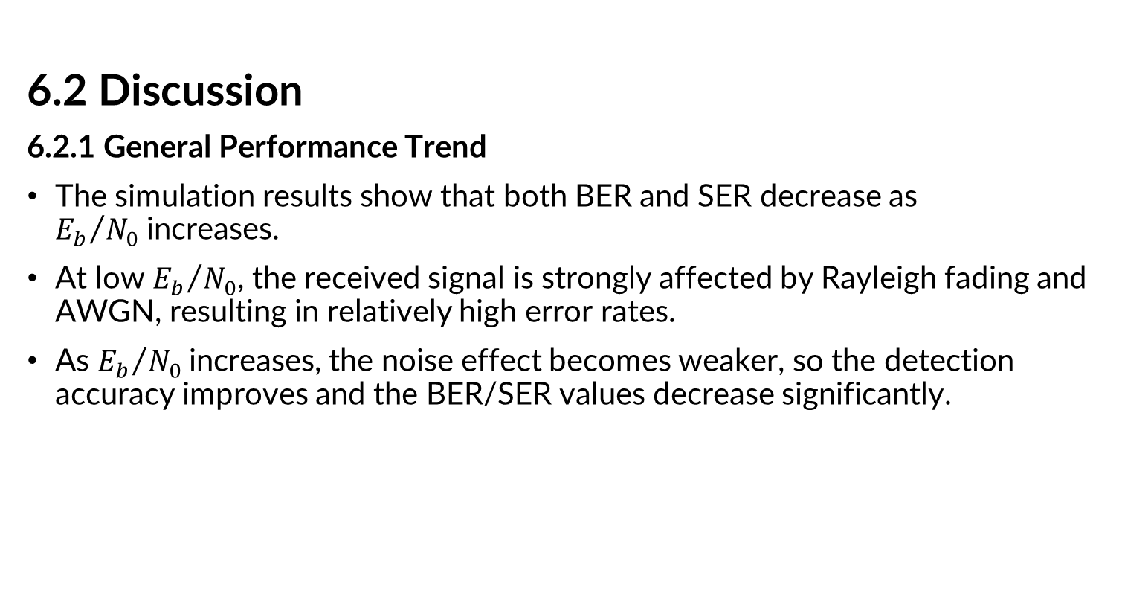
VI. RESULTS AND DISCUSSION
6.2 Discussion
6.2.1 General Performance Trend
The simulation results show that both BER and SER decrease as ${E_{b}}/{N_{0}}$increases.
At low ${E_{b}}/{N_{0}}$, the received signal is strongly affected by Rayleigh fading and AWGN, resulting in relatively high error rates.
As ${E_{b}}/{N_{0}}$increases, the noise effect becomes weaker, so the detection accuracy improves and the BER/SER values decrease significantly.

Slide 9
VI. RESULTS AND DISCUSSION
6.2 Discussion
6.2.2 BER and SER Comparison
The SER values are higher than the BER values because each 16-QAM symbol carriesm 4 bits
A symbol error occurs when at least one bit in the symbol is detected incorrectly.
The use of Gray coding helps reduce the number of bit errors when the received symbol is mistaken for a neighboring constellation point

Slide 10
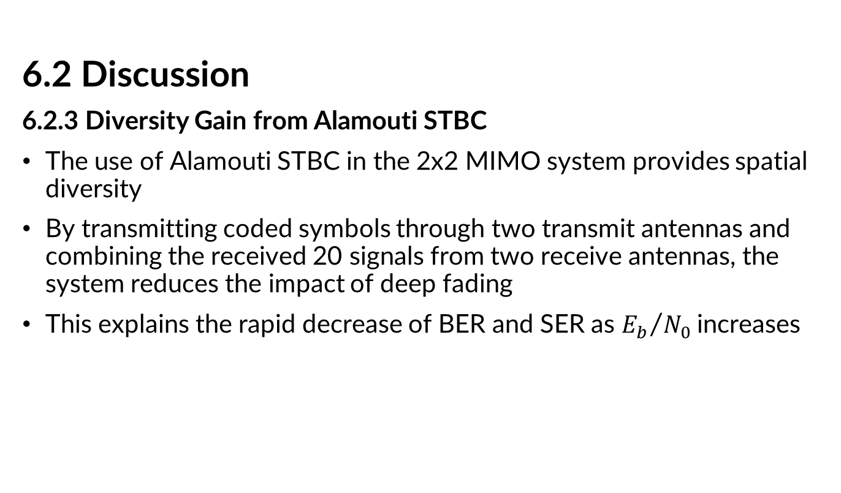
VI. RESULTS AND DISCUSSION
6.2 Discussion
6.2.3 Diversity Gain from Alamouti STBC
The use of Alamouti STBC in the 2x2 MIMO system provides spatial diversity
By transmitting coded symbols through two transmit antennas and combining the received 20 signals from two receive antennas, the system reduces the impact of deep fading
This explains the rapid decrease of BER and SER as ${E_{b}}/{N_{0}}$increases

Slide 11
VI. RESULTS AND DISCUSSION
6.2 Discussion
6.2.4 Effect of OFDM in Multipath Channel
OFDM improves system performance in the multipath Rayleigh channel
The IFFT/FFT structure divides the frequency-selective channel into multiple narrowband subchannels, while the cyclic prefix helps reduce inter-symbol interference
In this simulation, the cyclic prefix length is sufficient for the 6-tap channel, so most ISI effects are mitigated.

Slide 12
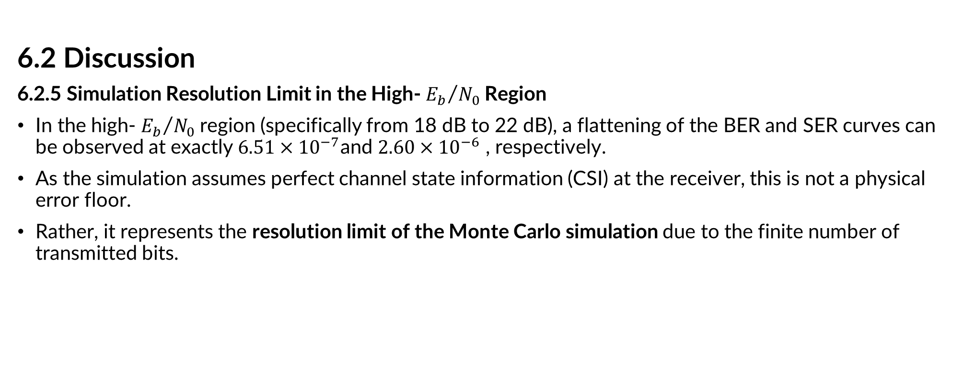
VI. RESULTS AND DISCUSSION
6.2 Discussion
6.2.5 Simulation Resolution Limit in the High- ${E_{b}}/{N_{0}}$Region
In the high- ${E_{b}}/{N_{0}}$region (specifically from 18 dB to 22 dB), a flattening of the BER and SER curves can be observed at exactly $6.51×{10}^{−7}$and $2.60×{10}^{−6}$ , respectively.
As the simulation assumes perfect channel state information (CSI) at the receiver, this is not a physical error floor.
Rather, it represents the resolution limit of the Monte Carlo simulation due to the finite number of transmitted bits.

Slide 13
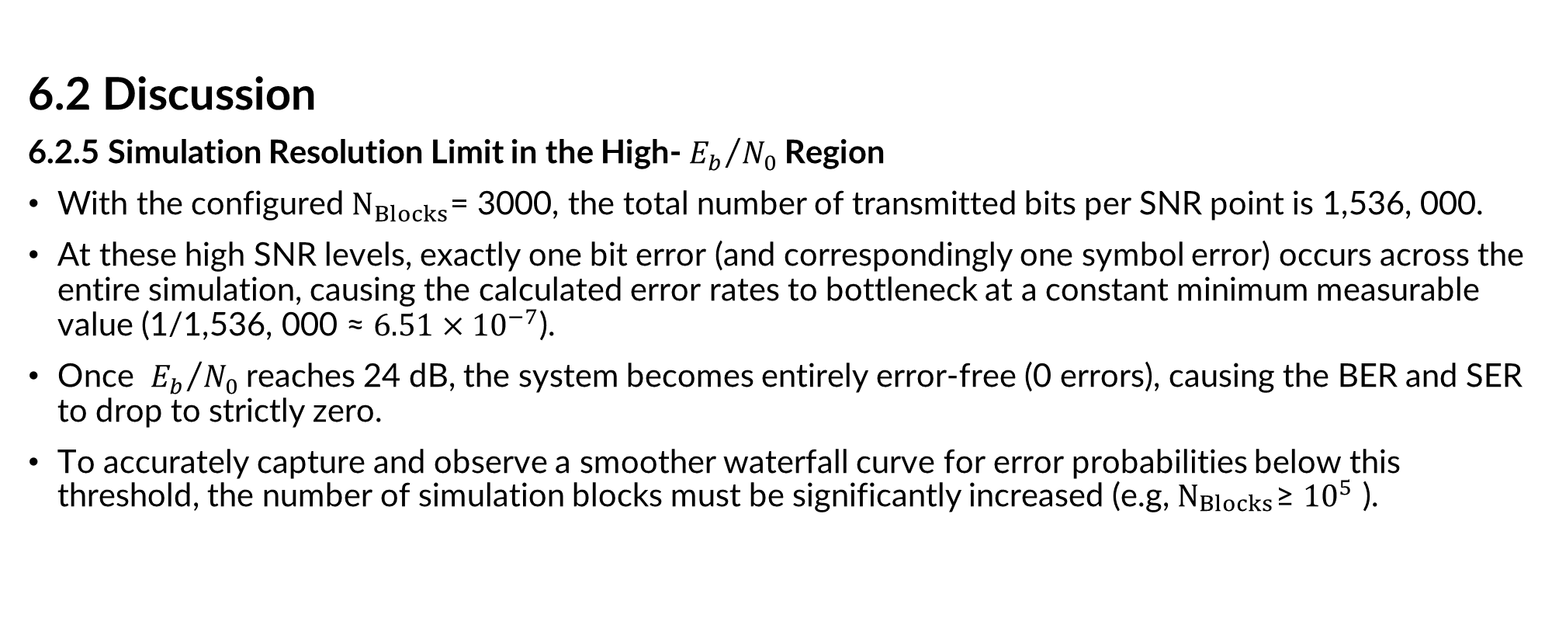
VI. RESULTS AND DISCUSSION
6.2 Discussion
6.2.5 Simulation Resolution Limit in the High- ${E_{b}}/{N_{0}}$Region
With the configured $N_{Blocks}$= 3000, the total number of transmitted bits per SNR point is 1,536, 000.
At these high SNR levels, exactly one bit error (and correspondingly one symbol error) occurs across the entire simulation, causing the calculated error rates to bottleneck at a constant minimum measurable value (1/1,536, 000 ≈ $6.51×{10}^{−7}$).
Once ${E_{b}}/{N_{0}}$reaches 24 dB, the system becomes entirely error-free (0 errors), causing the BER and SER to drop to strictly zero.
To accurately capture and observe a smoother waterfall curve for error probabilities below this threshold, the number of simulation blocks must be significantly increased (e.g, $N_{\begin{aligned}Blocks \\ \end{aligned}}$≥ ${10}^{5}$ ).

Slide 14
VI. RESULTS AND DISCUSSION
6.2 Discussion
6.2.6 Overall Evaluation
Overall, the results confirm that the 2x2 MIMO-OFDM system using Alamouti STBC and 16-QAM achieves good performance over a multipath Rayleigh fading channel.
The performance improvement mainly comes from the diversity gain of STBC and the ability of OFDM to handle multipath propagation.

