Slide 1
Journey to your best program Dao Vo
Participant : Nguyen Van Hung

Slide 2
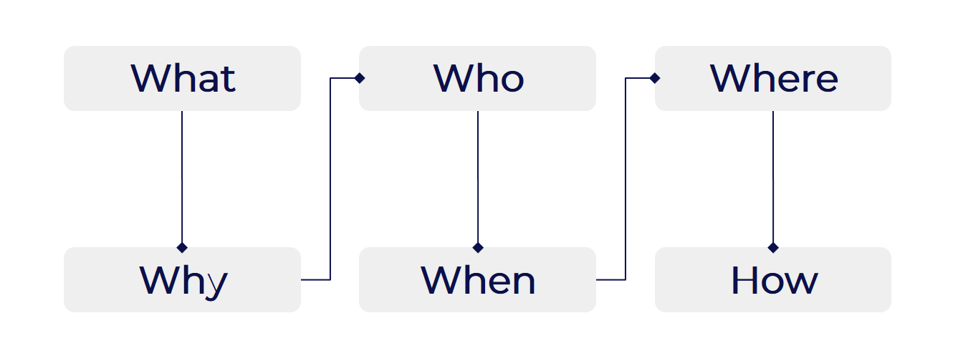
Main content of the presentation
Presetation model
01
02
03
04
Topdown appoach
Learning how to learn and learn fast
Autonomy at work
Smart question and how to apply it on your daily basis/work

Slide 3
WHOA!!
Real courage is when you know you're licked before you begin, but you begin anyway and see it through no matter what ― Harper Lee, To Kill a Mockingbird

Slide 4
Topdown appoach
01

Slide 5
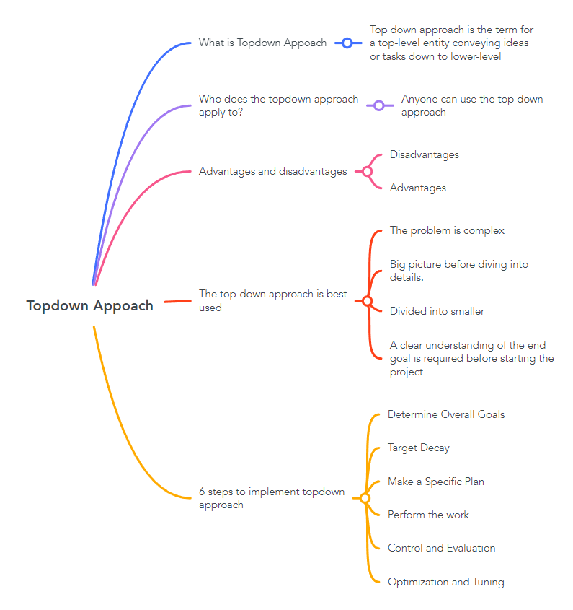
Content
overview

Slide 6
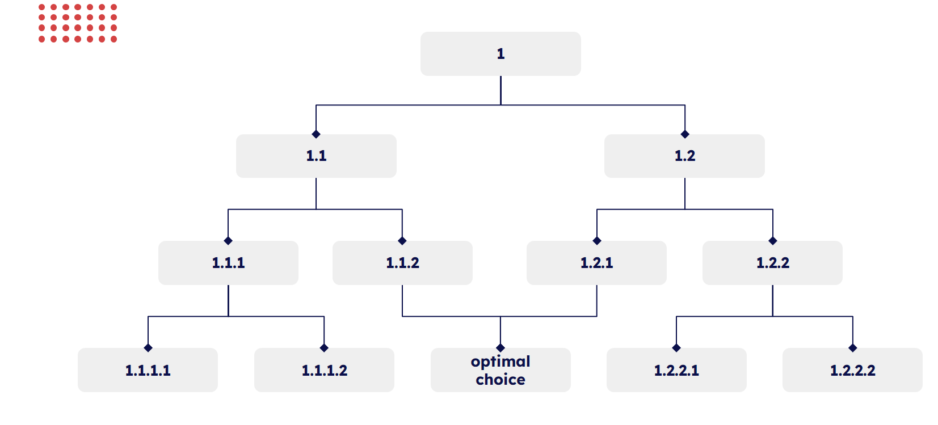
What is the top down approach
Top down approach is the term for a top-level entity conveying ideas or tasks down to lower-level entities to achieve maximum efficiency.
Notes:
Top down approach là thuật ngữ chỉ việc một thực thể ở mức cao nhất truyền đạt các ý tưởng hoặc các công việc xuống cho các thực thể ở mức độ thấp hơn nhằm đạt được hiệu quả tối đa

Slide 7
Advantages and disadvantages
Advantages
Disadvantages
- Easy to understand and implement
Provides clear objectives and expectations
Supports effective allocation of resources
Inflexible to change
Limited to pre-determined solutions
Can lead to missed opportunities or inefficiencies
Can result in lower motivation and participation from lower-level employees

Slide 8
Who does the topdown approach apply to?
Anyone can use the top down approach
Because benefit :
Good organization
High performance
Easy to Manage and Control
Transparency and Understanding
Accurate decisions

Slide 9
The top-down approach is best used
The problem is complex and needs to be broken down into smaller, manageable parts.
There is a need to understand the big picture before diving into details.
A clear understanding of the end goal is required before starting the project.
The solution can be divided into smaller subproblems that can be solved independently.

Slide 10
6 steps to implement topdown approach
Determine Overall Goals
Target Decay
Make a Specific Plan
Ask the question: "What is our main goal?"
Divide the overall goal into smaller components
Identify specific steps to achieve each small component. Schedule time, resources, and set detailed action steps
Perform the work
Control and Evaluation
Optimization and Tuning
Take each specific step according to the plan
Monitor progress, monitor and control work. Evaluate whether each step achieves the set goal and adjust if necessary
Optimize resource usage and deal with any problems that appear. Adjust the plan as necessary based on experience and learning from implementation

Slide 11
Learning how to learn and learn fast
02

Slide 12
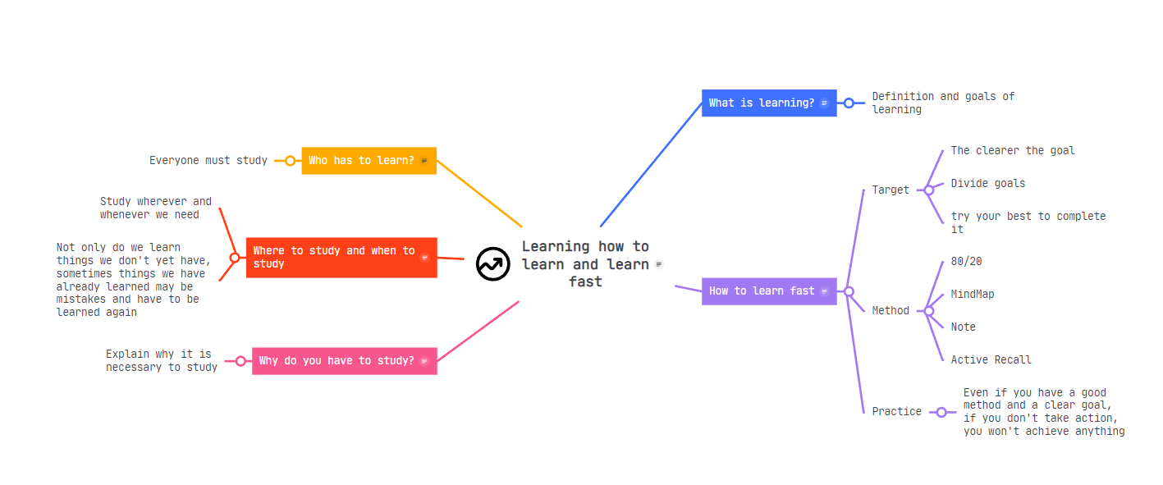
Content overview

Slide 13
What is learning?
Learning is the process of acquiring new understanding, knowledge, behaviour, skills, values, attitudes and interests.
The human learning process starts from birth to death and learning has no limits
“An uneducated person is a person without knowledge, an uneducated person is a stupid person” -Chinese self-cultivation book-
Purpose:
- Improve knowledge, learn to develop yourself, to make life better, to leave value for life
- Learn to fulfill your duty to society, learn to help people
Notes:
Top down approach là thuật ngữ chỉ việc một thực thể ở mức cao nhất truyền đạt các ý tưởng hoặc các công việc xuống cho các thực thể ở mức độ thấp hơn nhằm đạt được hiệu quả tối đa

Slide 14
Why do you have to study?
It not only helps people develop knowledge and skills but also expands vision, creates opportunities, improves quality of life and contributes to society.
Learning helps us become better people.There is no best, only better, always improve to make yourself better every day
Studying is not something you have to do, but if you don't study you will become stupid. Study to better understand the world around you . Anyone at any age must be eager to learn. Once they lose the spirit of learning, they are as good as dead
Notes:
Top down approach là thuật ngữ chỉ việc một thực thể ở mức cao nhất truyền đạt các ý tưởng hoặc các công việc xuống cho các thực thể ở mức độ thấp hơn nhằm đạt được hiệu quả tối đa

Slide 15

Who has to learn?
Everyone must study
It doesn't matter whether you're rich or poor or status

Slide 16
Where to study and when to study
Study wherever and whenever we need. A person who is eager to learn must know how to create a desire to learn when looking at things around them. Only then can learning be enhanced and the true nature of learning.
Not only do we learn things we don't yet have, sometimes things we have already learned may be mistakes and have to be learned again

Slide 17
How to learn fast
Target
Method
Practice
Define clear and detailed performance goals
Use optimal methods for learning that can be flexibly used in different ways
Even if the goal is accurate and the method is great, if you don't practice, the result will be zero

Slide 18
1h 30m run
1500m
4 days a week
Target
The clearer the goal, the simpler the implementation becomes
Divide goals into short-term goals to complete
Once you have set a goal, try your best to complete it
Example learn run :
unless the weather is extreme
regardless of route
Increase 200m per week after 18 weeks of participating in 5km running

Slide 19
Method
80/20
MindMap
Focus on important tasks and manage your time
BUSINESS
Use mindmap to clarify ideas
Note
Active Recall
Annotate important things to remember
Actively recall and review old knowledge

Slide 20
80/20
Determine the optimal time to study during the day, then create and organize your study according to the list
4:30 a.m – 6 a.m : Study theory
2:00 p.m – 4:30 p.m : Study natural subjects
7:45 p.m – 10:30 p.m : Study subjects that require calculation or do not require much memorization
Focus on the important tasks first and try to complete them Eliminates phone-specific interference factors

Slide 21
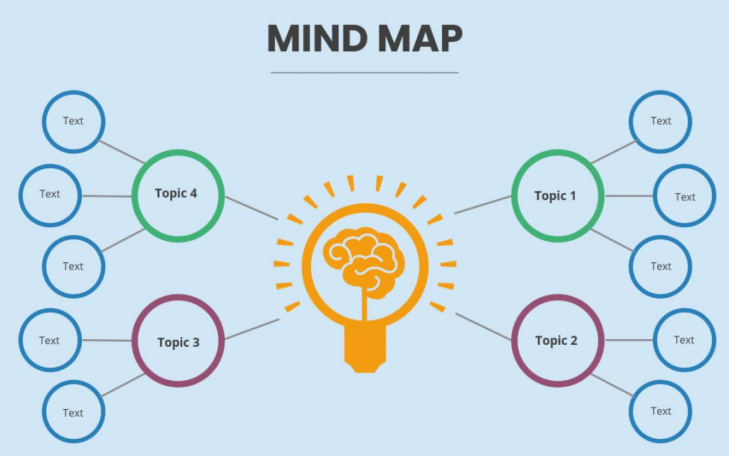
MindMap
The right brain is more inclined towards abstract thinking, perceiving images and colors. The left brain has strengths in logical thinking, remembering numbers, analyzing...
-Use mind maps to create an overview of the knowledge you are learning
-Use colors and images to make the mind map vivid and memorable
-Connecting main ideas helps you better understand how concepts are related
Use xmind to draw the diagram

Slide 22
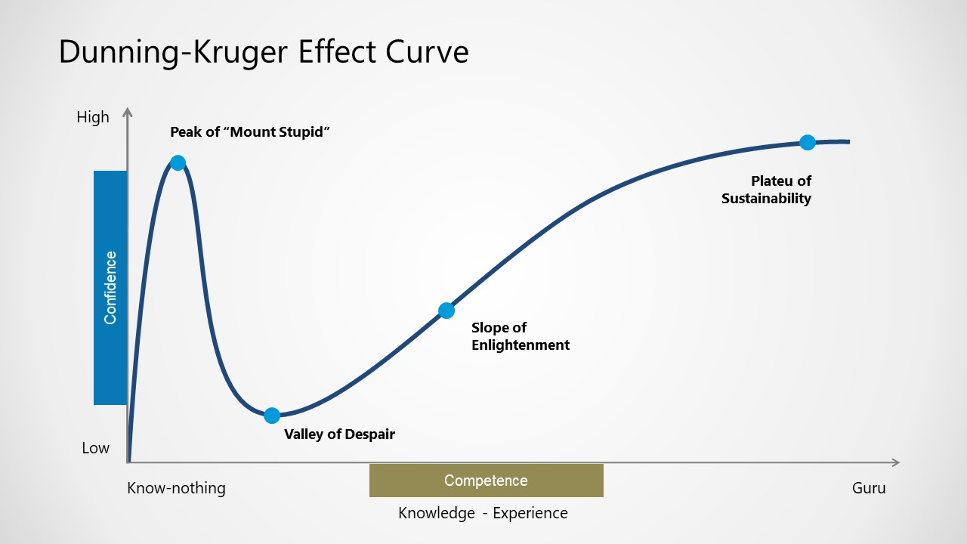
Active Recall
Stage 1 – You “Know Nothing”
Stage 2 – You reach “Peak of Stupidity”
Stage 3 – Falling into the “Valley of Despair”
Stage 4 – You begin to climb the “Slope of Enlightenment”
Stage 5 – Become an expert and stay on the “Plateau of Sustainability”

Slide 23
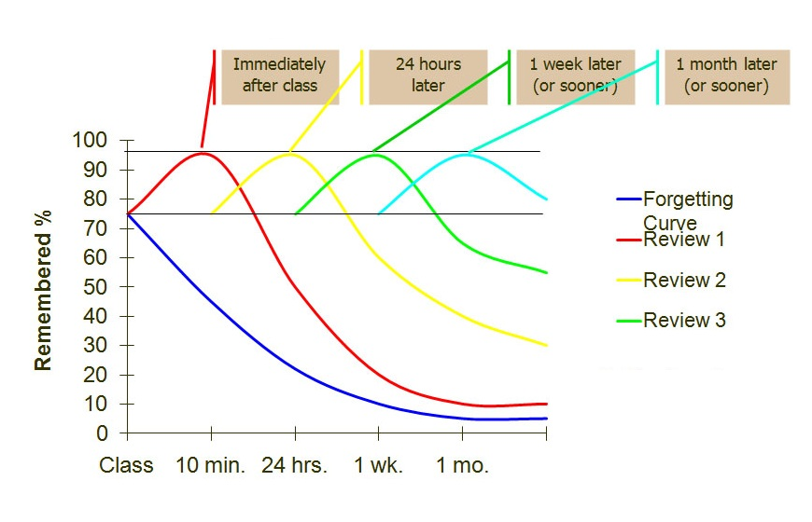
Spaced Repetition
Active Recall
Review at the exact times that knowledge is gradually being forgotten.

Slide 24
Practice
Even if you have a good method and a clear goal, if you don't take action, you won't achieve anything
Create a daily study habit and do it continuously
10,000 hours is the magic number of greatness -Malcolm Gladwell-

Slide 25
Autonomy at work
03

Slide 26
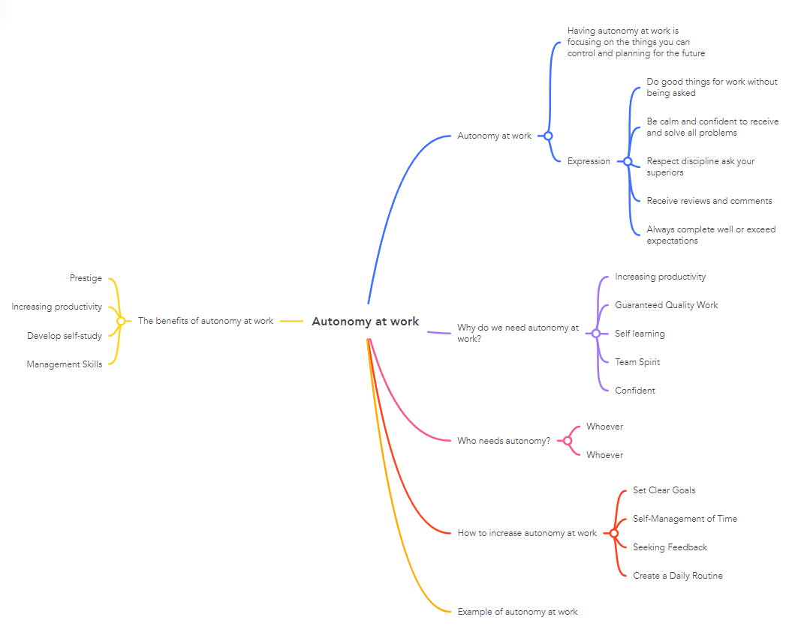
Content overview

Slide 27
Autonomy at work
Having autonomy at work is focusing on the things you can control and planning for the future. In other words, when you are a proactive person, you can complete assigned tasks well and work without being asked.
Expression :
-Do good things for work without being asked
-Be calm and confident to receive and solve all problems
-Respect discipline ask your superiors
-Receive reviews and comments
-Always complete well or exceed expectations

Slide 28
Why do we need autonomy at work?
 | DESCRIPTION
Increasing productivity | Working autonomously means being able to manage your own time, prioritize work and solve problems more flexibly
Guaranteed Quality Work | Focus on the quality of your work, set high standards for yourself, and spend time and effort to ensure the job is completed properly.
Self learning | Promote continuous learning and personal development
Team Spirit | Inspire teammates and create a positive work environment
Confident | Can self-manage and make decisions, thereby improving confidence

Slide 29
Who needs autonomy?
Whoever
Especially at word
Anyone needs to have self-control because this is a good personality that makes people become more perfect
Having autonomy at work helps us get things done and be appreciated

Slide 30

How to increase autonomy at work
Set Clear Goals
Self-Management of Time
Developing Personal Leadership Skills
Seeking Feedback
Create a Daily Routine

Slide 31
Example of autonomy at work
Planning - Plan work, determine deadlines and identify specific steps to achieve goals
Prioritize Work- Focus on the tasks that are important and have the greatest impact on the final results
Learn Essential Knowledge and Skills- Independently research and learn to grasp necessary information
Asking for advice and feedback- Ask for advice and feedback from your superiors
Solving the Problem of Self-Independence- resolve it yourself before discussing it
Check and Evaluate Progress- Regularly check work progress and evaluate

Slide 32
The benefits of autonomy at work
Prestige
Increasing productivity
Develop self-study
Management Skills

Slide 33
Smart question and how to apply it on your daily basis/work
04

Slide 34
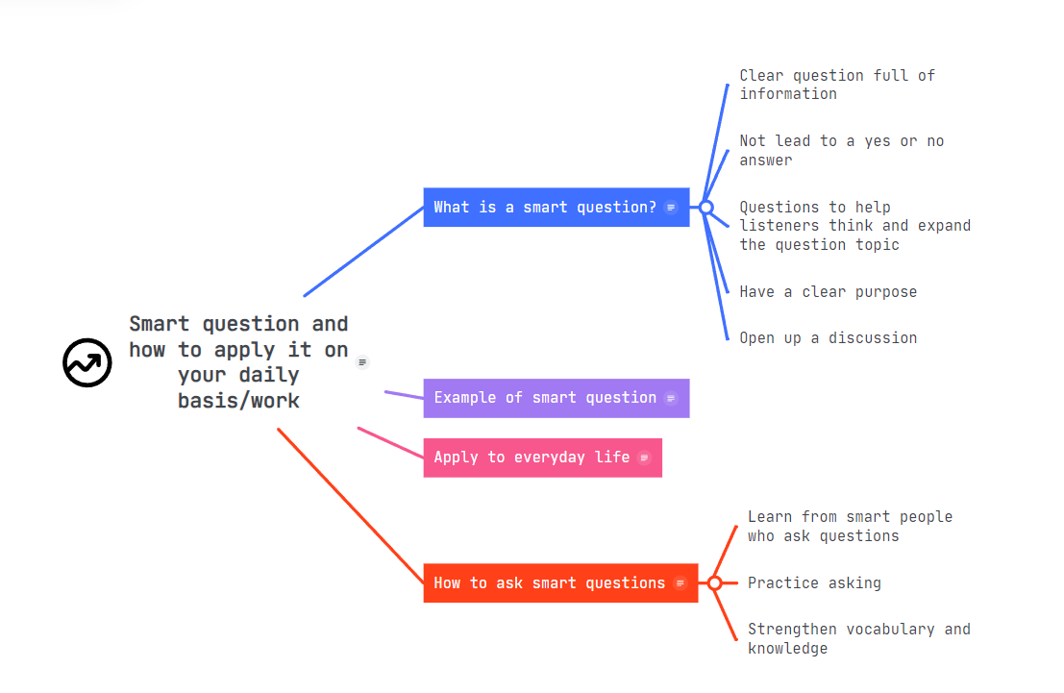
Content overview

Slide 35
“Tis not every question that deserves an answer.”
-Thomas Fuller-
“Quality questions create a quality life.”
-Tonny Robbins-

Slide 36
What is a smart question?
Clear question full of information
Not lead to a yes or no answer
Questions to help listeners think and expand the question topic
Have a clear purpose
Open up a discussion

Slide 37
Example of smart question
Shouldn't be "Can you check my homework for me?“ Instead, you can ask "I am A in class B, I have submitted assignment C to you, I hope you can evaluate and give feedback on the results of my assignment."
Questions create discussion topics: are you rich, what do you think being rich is like?

Slide 38
Apply to everyday life
Personally, when I receive information from sources such as books or newspapers, I always question why something happened like that.
Sometimes it's a short but continuous question to get to the root of the problem For example : why did I get a bad score: because I didn't have enough knowledge Why is there not enough knowledge: because there is too little review Why do I review so little? I want to play
From there, recognize the causes and nature of things and evaluate them
When learning new knowledge, you can also ask smart questions to expand in many directions or link different areas of knowledge together.

Slide 39
How to ask smart questions
Learn from smart people who ask questions
Practice asking questions with friends and they will answer you to see if the question is smart or not
Strengthen vocabulary and knowledge

Slide 40


