Slide 1
E-Commerce Onboard
From
Kalaivani Muralidhara

Slide 2
Agenda
Overall view of the presentation
Key facts of the Supplier Data from the car manufacturers
Deliverable 1: Data Preprocessing of .json to MasterExcel
Deliverable 2/3 :Data Normalisation from preprocessed data.
Mapping the Supplier data to the customers target data
Examples of Mapping
Future incorporation to the Target from Supplier
Deliverable 4
Take away

Slide 3
Overall view
The e-shop commerce shop who are focussed on car business have their pre-defined data structure in their application which is termed as «Target»
The Target has various features(car model) ,attributes(mileage and consumption rate) and records which are primary interest for their business.
The car manufacturers whose primary focus is supplying the cars have their own data structure which is termed as «Supplier».
The Supplier have information on the physical structure of the cars along with consumption rate and unique ID for each model of the car.
Goal: Transform the supplier data into target dataset.

Slide 4
Key facts of Supplier data
The Supplier data consists of following Attributes and Records :
1.Further the AttributeNames has various components
which are crucial from the e-commere business such as :
2.These attributes and records are key
facts to be incorporated into the target
prospective
For eg: BodyTypeText describes the
model and km –» mileage.
Supplier Dataset
ID
Maketext
TypeName
TypeNameFull
ModelText
ModelTypeText
AttributeNames
Attribute Values
Entity ID
AttributeNames
BodyColorText
BodyTypeText
City
ConsumptionTotalText
Km

Slide 5
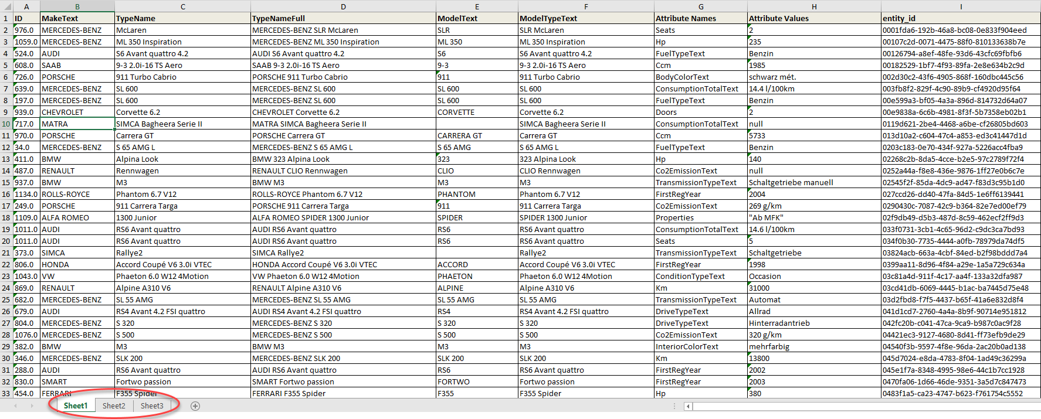
Deliverables (1/4)
An excel speadsheet with 3 tabs (work sheets) showing the results of following
Sheet1: Data pre-processing of the supplier_car data set
Sheet2: Data normalization of the input preprocessed (Sheet1) supplier car data set
Sheet3: Data integration of a new data set with target data schema from the normalized data (Sheet2)
The snapshot of each of above mentioned sheets are provided for reference.

Slide 6
Mapping Supplier to Target (1/3)
From the target view they look forward to the data that satisfy their business needs.
The target requirements are:
1. The data which could give these information seems to be
viable to the customers. So I concentrated on these
elements which could be deduced from the suppliers
data of «Attributes Names» and «Attribute Values».
2. The «ConsumptionTotalText» from the suppliers can be
deduced to Mileage _specifications.
carType
Model_Specifications
Condition
Currency
Drive
City/Country
Make
Mileage_specifications

Slide 7
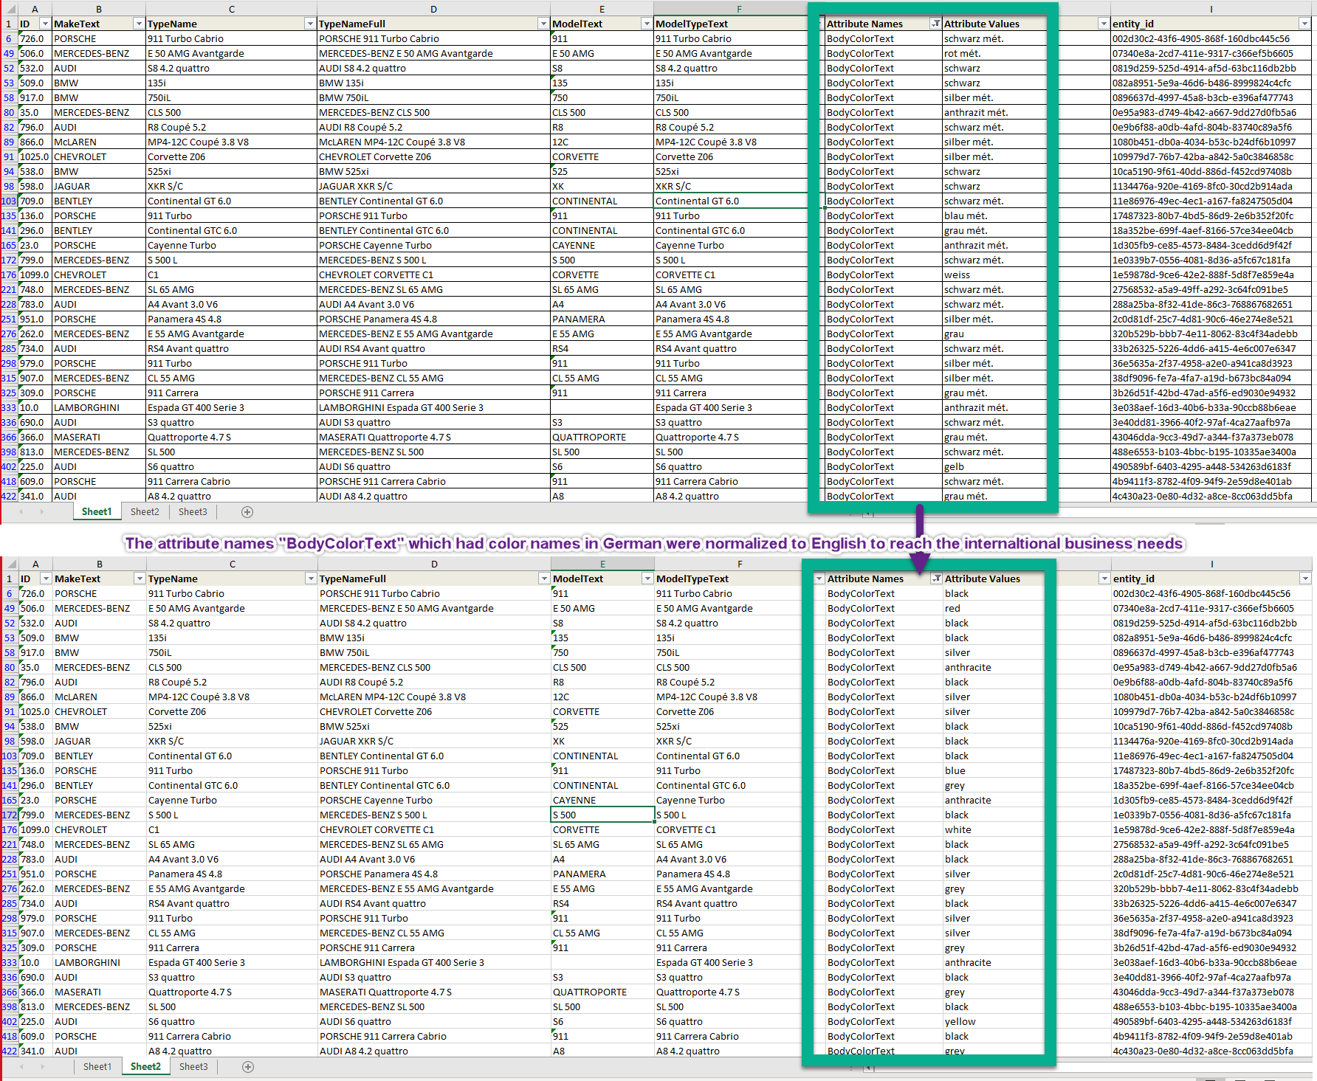
Deliverables (2/4)

Slide 8
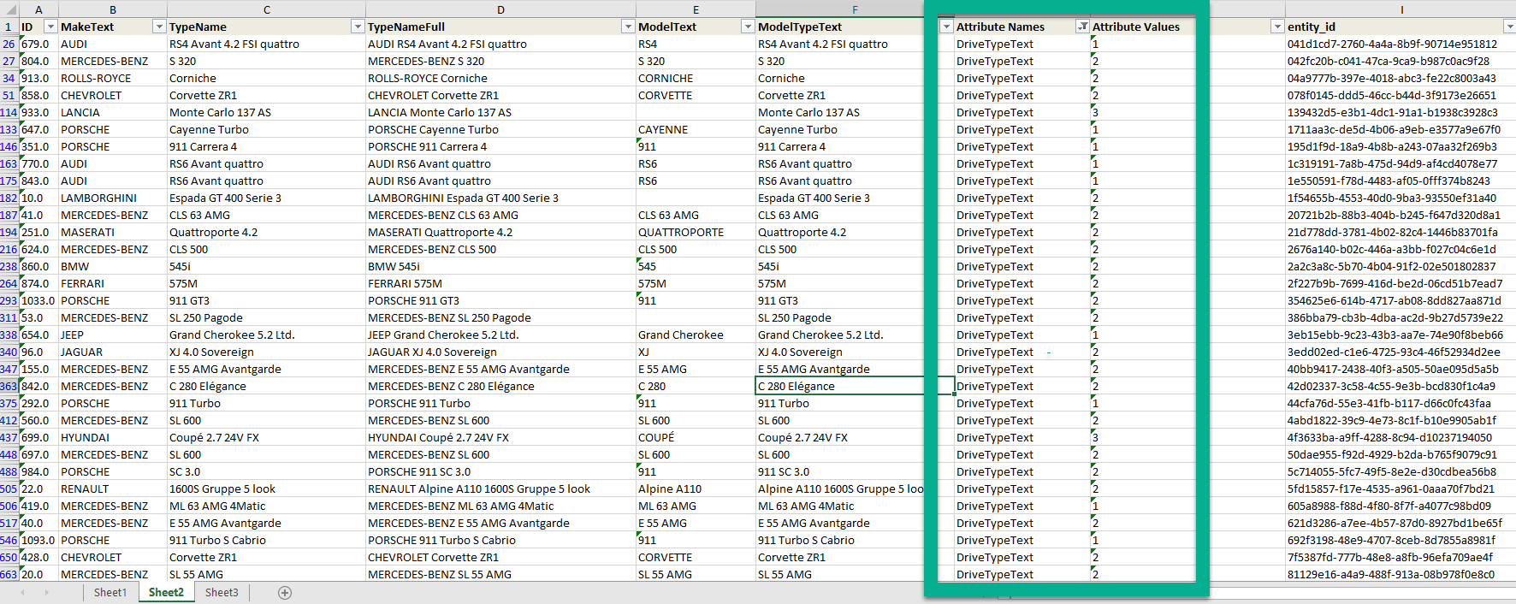
Deliverables (3/4)
There is possibility to normalise many features from the attribute names by mapping it to the integer values and one can do data analysis by pulling the normalized data

Slide 9
Mapping Supplier to Target (2/3)
1. The make from the target was linked from the «MakeText» of the Supplier. Eg:Mercedes-Benz.
2.The «model» and «model_variant» were mapped from the modelText and modelTypeText.Eg: SLR and Mclaren.
3.The «ConsumptionTotalText» could be deduced to «mileage» and «mileage unit».Eg:14.6 l/100km.
4.Depending on the customer requirements in future, a number of specifications could be added to the target data from the suppliers.

Slide 10
Mapping Supplier to Target (3/3)
There is a potential to fill in the data as in when the demand increases and order from the suppliers well in advance.
Example: You have an attribute with BodyColor and when there is a sudden increase of a particular color trending among the users the customers could have that feature from the suppliers which I have deduced from the supplier data.
Similarly the consumption rate or Registered Year holds good for the car craze.

Slide 11
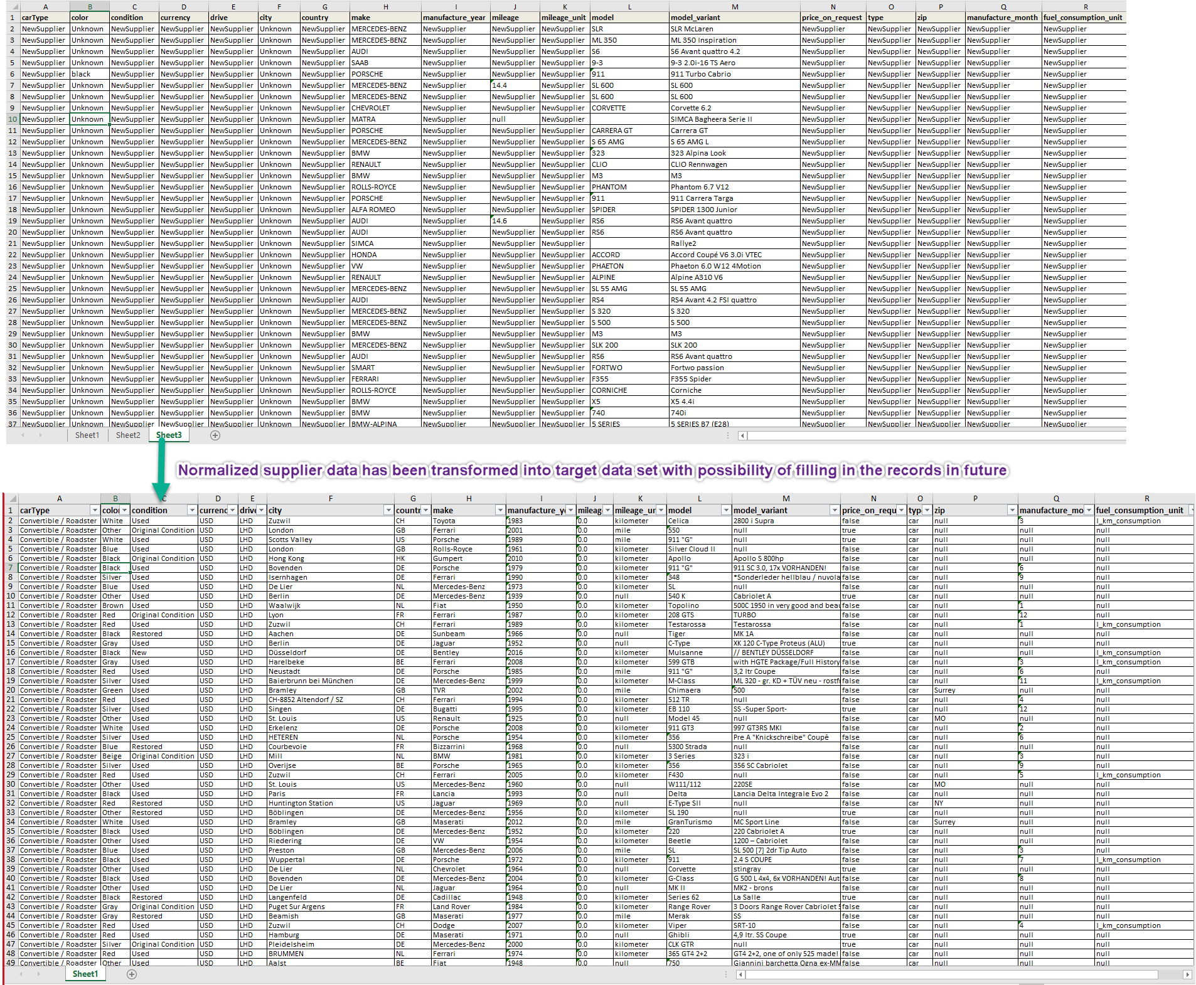
Deliverables (4/4)
The supplier_car data has been transformed into a new data set called target data schema which reflects the original customer data set.
The different attribute and record could be ordered from the suppliers when in demand.

Slide 12
Take Away
The customers have the potential to increase their business needs by meeting their demand from the data I provide.
The ID and entity ID from the suppliers could make them get their required specifications in ease.
Depending on the trend in the market they could place their orders from the suppliers by mapping their requirement data

