Slide 1
AIR PURE INNOVATIONS
AQI – AIR QUALITY INDEX ANALYSIS
By Vani Rampatnam Data Analyst

Slide 2
AIR PURE INNOVATIONS
A startup born out of the air quality crisis in India.
with 14 cities ranking among the world’s top 20 most polluted urban centers.
The company is in the early stages of product development and is unsure whether there is a strong, sustained demand for its air purifier product.
Before committing to production and R&D, they need answers for some critical questions.
Data Analyst, to assist in gathering insights for strategic decisions.

Slide 3
CRITICAL QUESTIONS
1. What pollutants or particles should their air purifier target?
2. What are the most essential features that should be incorporated into the air purifier?
3. Which cities have the highest demand for air purifiers, and what is the market size in these regions?
4. How can R&D be aligned with localized pollution patterns?
Approached Data Analyst, to assist in gathering insights for strategic decisions.

Slide 4
Data Analysis – 2022 to 2025
Analysed their data
Cleaned Data using ETL
Built Data Models
Did Primary and Secondary Analysis
Came out with the Answers for their critical Questions
Built An Easy and Understandable Dashboard for Stakeholders.

Slide 5
Database - Tables
AQI (2022 TO 2025) - Daily air quality monitoring data across major cities and towns in India
IDSP - Disease surveillance data under the Integrated Disease Surveillance Programme
VAHAN - Detailed vehicle registration data across Indian states
POPULATION_PROJECTION – Official population projections for Indian states
BRAND_FEATURE : Extra Table with Latest Brands and their Features.
POLLUTION_POLICIES : Government policies to curb the pollution in metro cities
DIM_DATE – Dates between ( 01.01.2022 to 31.12.2025)
STATE_BRIDGE : Connects all the tables together.

Slide 6
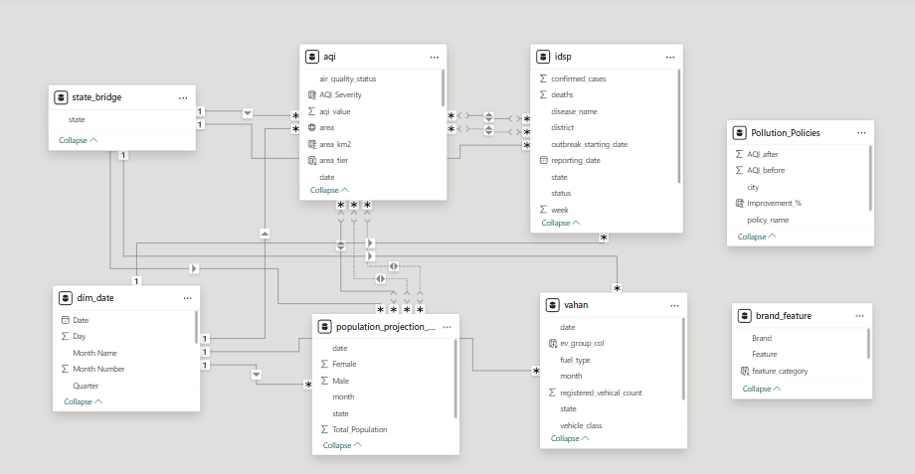
Data Model

Slide 7
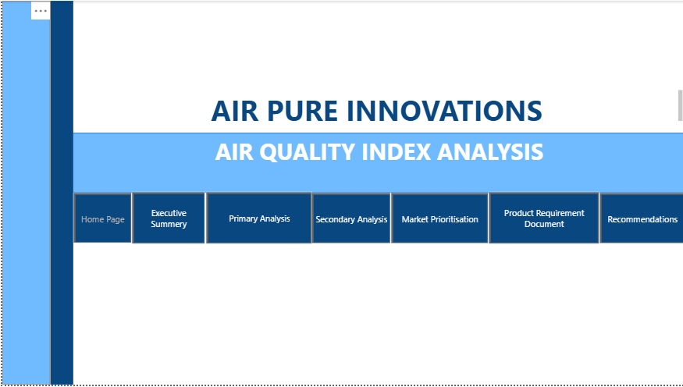

Slide 8
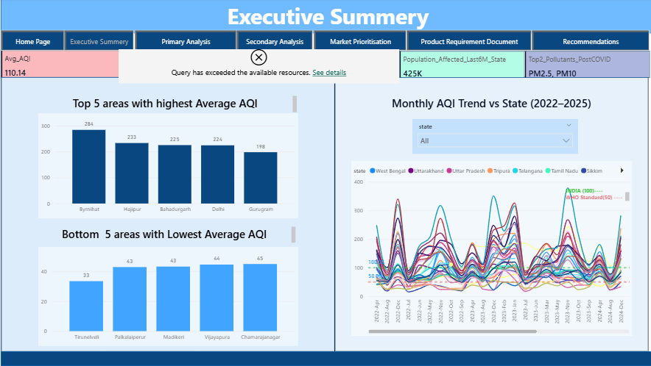

Slide 9
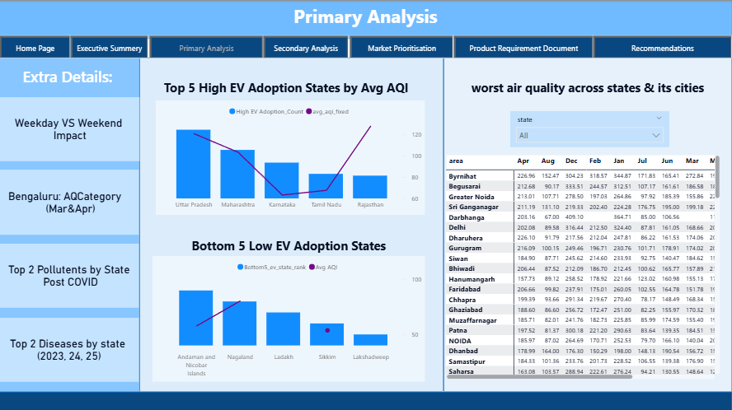

Slide 10
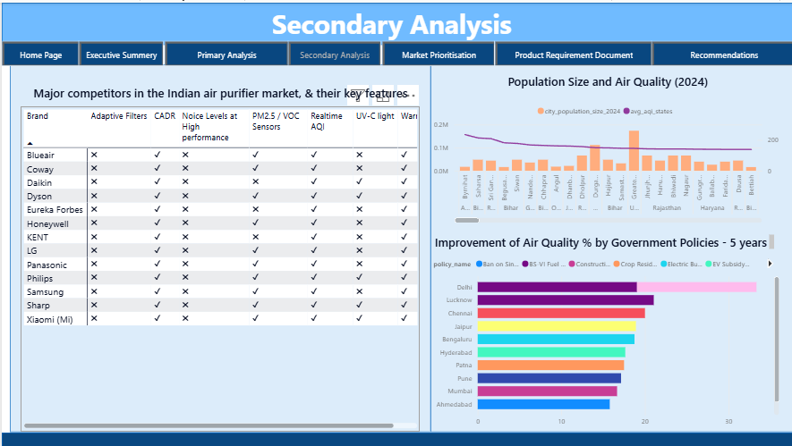

Slide 11
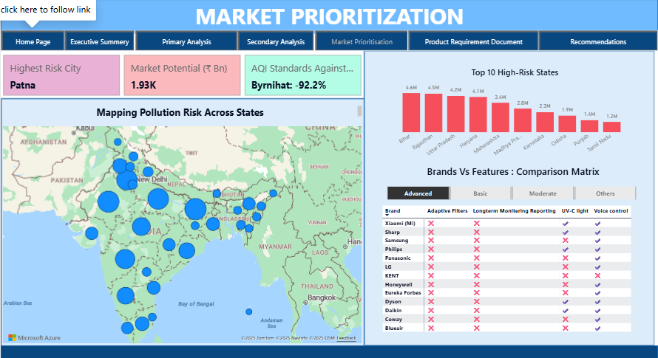

Slide 12
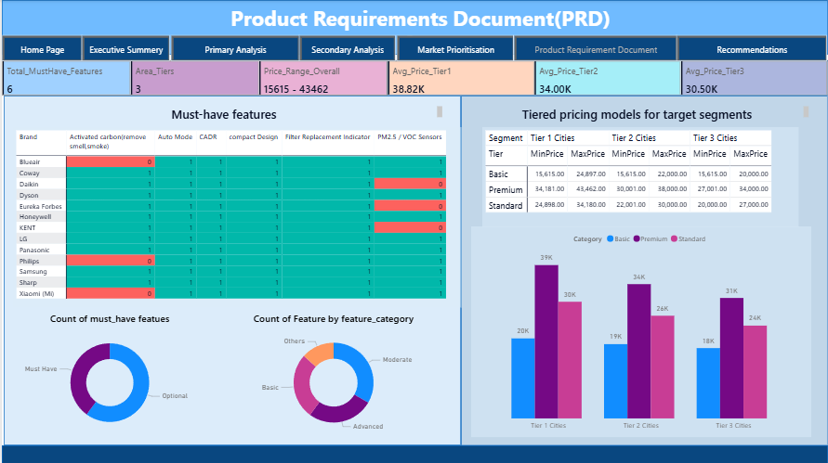

Slide 13
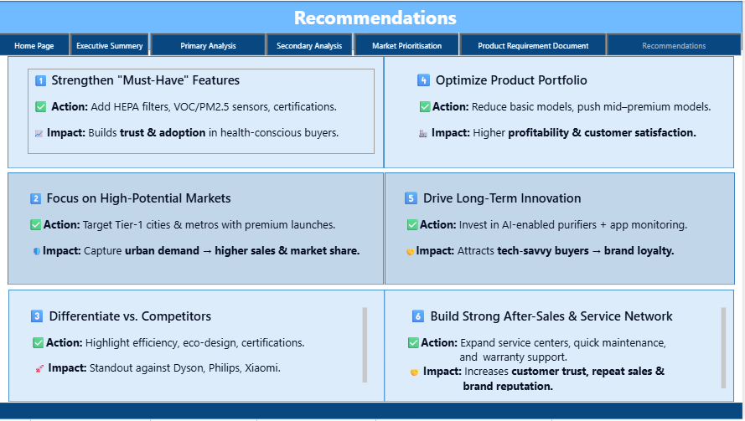

Slide 14
THANK YOU
ADAVAL PATEL SIR
&
HEMANAND VADIVEL SIR
By Vani Rampatnam Data Analyst

