Slide 1


DESIGN AND IMPLEMENTATION OF ONLINE AUCTION SYSTEM WITH REAL TIME BIDDING
CSA0504
DATABASE MANAGEMENT SYSTEM FOR CLOUD NATIVE
Guided By
Dr. S Pandiaraj
Dr .J Velmurgan
Presented By
S. Tharunika Shri(192421244)
M. Tharani(192472375)

Slide 2
INTRODUCTION
Overview of the project:
An online platform where sellers list products for auction and buyers place bids.
Real-time bidding ensures transparency and fair competition.
System automatically declares the winner at auction end.
Problem Statement:
Manual auctions are time-consuming and prone to errors.
Lack of transparency in traditional auction systems.
Difficulty in handling multiple users and products at once.
Purpose of the Project:
To provide a secure and automated online auction system.
To enable real-time bidding with instant updates.
To simplify auction management for sellers, buyers, and admin.

Slide 3
ABSTRACT
This project is about creating an online auction system where users can buy and sell items through real-time bidding.
It allows users to register, log in, and participate in live auctions easily.
The system shows instant updates of the highest bid during the auction.
A database is used to store all user details, items, and bid information safely.
It includes secure login and roles for buyers, sellers, and admin users.
The project helps to understand database management and web technologies through a practical application.

Slide 4
OBJECTIVES
To design a secure and user-friendly online platform for conducting auctions.
To enable real-time bidding where the highest bid is instantly updated.
To manage user roles such as buyers, sellers, and admin efficiently.
To ensure data security and transparency in all auction transactions.
To maintain a centralized database for users, products, and bid records.
To automate the winner selection and payment process after auction completion.

Slide 5
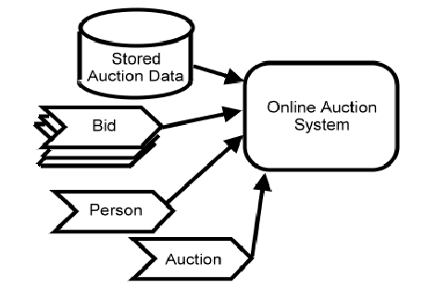
SYSTEM ARCHITECTURE

Slide 6
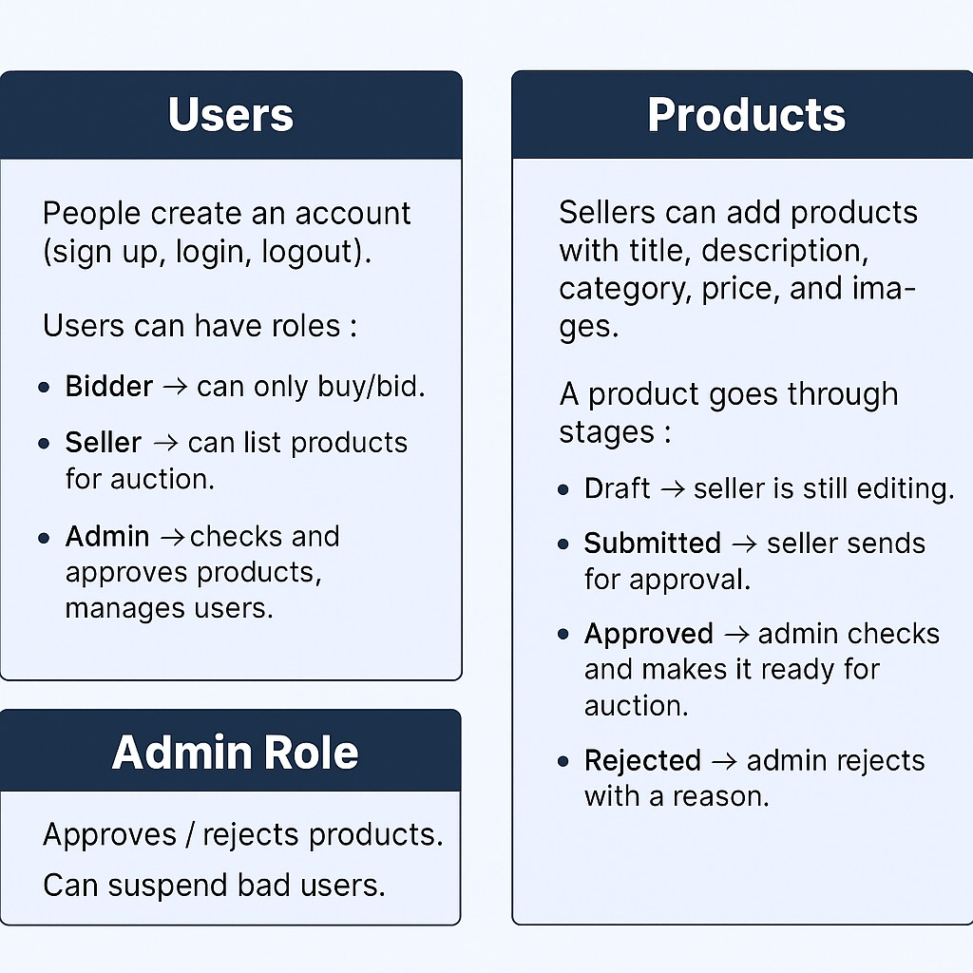
MODULE1
User and Product Management
This module manages all user-related activities such as registration, login, and profile management.
It allows administrators to view and control user accounts, including activating or deactivating users.
Users can add, update, or delete their product listings easily.
The system maintains a database of users and products for quick access and updates.
Validation and authentication are used to ensure secure user access.
This module forms the base of the online auction system, connecting users with their products for bidding.

Slide 7
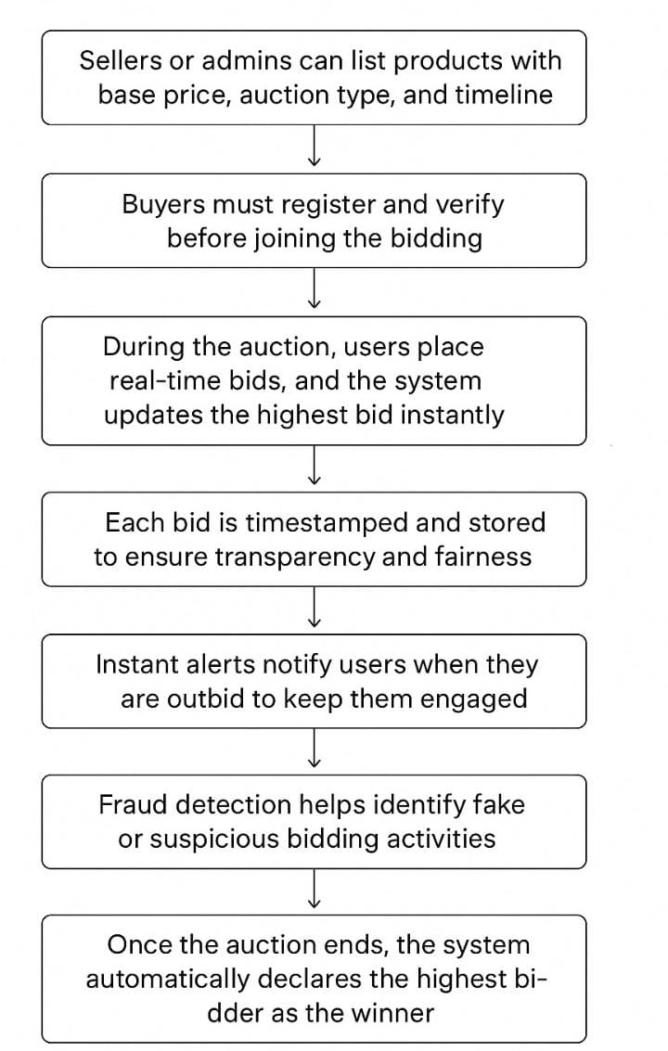
MODULE2
Auction & Bidding Management
Sellers or admins can list products with a base price, auction type, and timeline.
Buyers must register and verify before joining the bidding.
During the auction, users place real-time bids, and the system updates the highest bid instantly.
Each bid is timestamped and stored to ensure transparency and fairness.
Instant alerts notify users when they are outbid to keep them engaged.
Fraud detection helps identify fake or suspicious bidding activities.
Once the auction ends, the system automatically declares the highest bidder as the winner.
The winner completes payment, followed by confirmation and product handover.

Slide 8
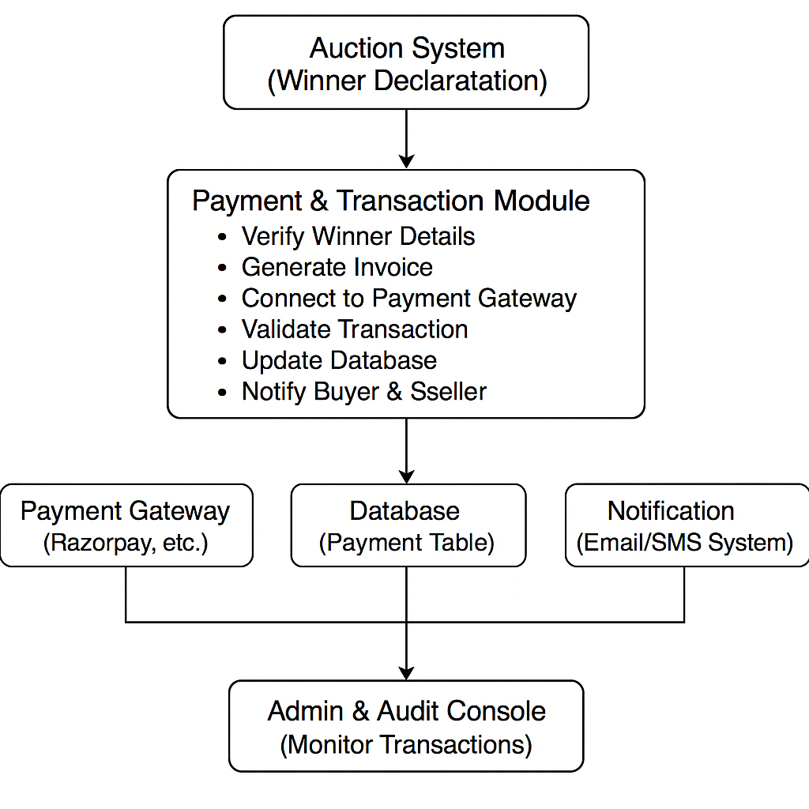
MODULE3
Payment and transaction Management
Once the auction ends, the system automatically generates a payment request for the winning bidder.
The winner receives an invoice and payment link through the system or email notification.
Payment gateway integration (like Razorpay, PayPal, or UPI) ensures secure online transactions.
Each transaction is validated with a unique transaction ID to prevent duplication or fraud.
The system verifies the payment status and updates the transaction record in the database.
After successful payment, the seller is notified and the product handover process begins.
The admin can monitor, verify, and audit all payments through a centralized dashboard.
In case of failed or disputed payments, the system supports refund initiation and resolution

Slide 9
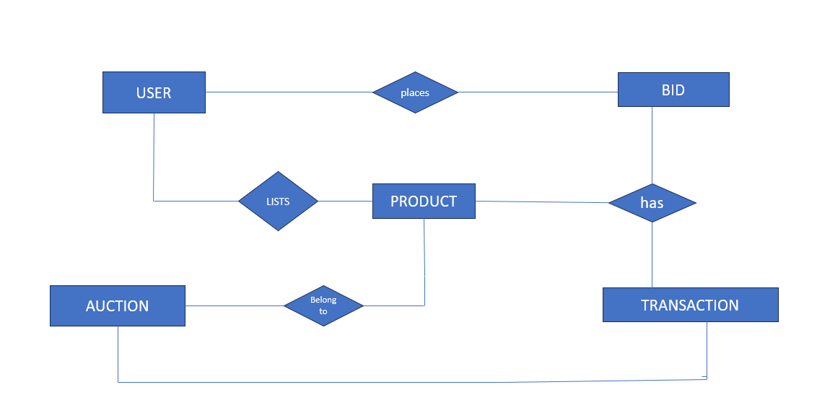
ER Diagram

Slide 10
RESULTS
The platform enables real-time bidding updates, ensuring fairness and transparency.
Auction deadlines are automatically enforced, reducing manual errors and delays.
System logs maintain a complete history of bids, useful for auditing and dispute resolution.
The design supports multiple concurrent auctions, improving scalability.
Secure authentication mechanisms prevent unauthorized access and fake users.
The system improves user engagement by sending notifications about bid status and auction results.
Compared to existing methods, it offers 24/7 accessibility without geographical restrictions.
Data analytics features help identify popular items, bidding trends, and user behavior.

Slide 11
CHALLENGES AND LIMITATIONS
Ensuring real-time synchronization of bids across multiple users was technically challenging.
Handling network latency and server downtime posed risks to fair bidding.
Implementing secure payment gateways required additional integration and compliance.
Preventing fraudulent activities such as fake bids or duplicate accounts was a key concern.
Managing large-scale concurrent auctions without performance drops was complex.
Designing a user-friendly interface that works across devices took additional effort.
Limited testing with real users may affect the reliability of results in real-world scenarios.
Dependence on internet connectivity makes the system inaccessible during network issues.

Slide 12
FUTURE ENHANCEMENTS
Addition of mobile app support for Android and iOS to reach a wider audience.
Incorporating blockchain technology for secure, transparent, and tamper-proof transactions.
Enabling multi-currency and cryptocurrency payments for global participation.
Introducing AI-driven price prediction models to guide bidders with estimated values.
Implementing voice-assisted bidding for enhanced accessibility.
Expanding to a cloud-based scalable infrastructure to handle millions of concurrent users.
Adding personalized dashboards using machine learning for bidder and seller insights.

Slide 13
CONCLUSION
The system provides a digital platform for conducting secure and transparent auctions.
It eliminates geographical and time limitations of traditional auctions.
Real-time bidding ensures fair competition among participants.
User authentication improves trust and prevents fraudulent activities.
The system offers a structured process for product listing, bidding, and result generation.
It enhances user convenience by enabling easy access through an online interface.
The project demonstrates how technology can modernize the auction process.
It lays a foundation for future improvements such as AI-based predictions and blockchain security.

Slide 14
REFERENCE
“A State-of-the-Art Approach for Securing Online Auction System,” IEEE Conference Publication, 2024.
A. Smith et al., “Integration of blockchain and auction models...,” IEEE Commun. Surveys & Tutorials, vol. 24, no. 4, pp. 2013–2040, 2022.
M. Wang et al., “SAFE: A general secure and fair auction framework...,” IEEE Trans. Dependable Secure Comput., vol. 20, no. 3, pp. 1535–1550, May–Jun. 2022.
F. A. Shaikh et al., “AuctiSafe: Building a robust and reliable auction system...,” in Proc. IEEE KHI-HTC, 2024, pp. 1–6.
IEEE P3809, IEEE Standard for Blockchain-based Electronic Bidding, Dec. 2022.
J. Doe et al., “A Novel Auction Blockchain System with Price Recommendation...,” Mathematics, 2021.
S. Khan & Z. Zeeshan, “Advanced and Secure Online Web-Based Auction System,” Int. J. Computer, vol. 43, no. 1, 2022.
Auction Theory, Wikipedia (principles used from IEEE-aligned studies), 2025.

Slide 15
THANK YOU!

