Slide 1

SALES DATA ANALYSIS: AdventureWorks
Turning sales data into clear insights and actionable decisions

Slide 2
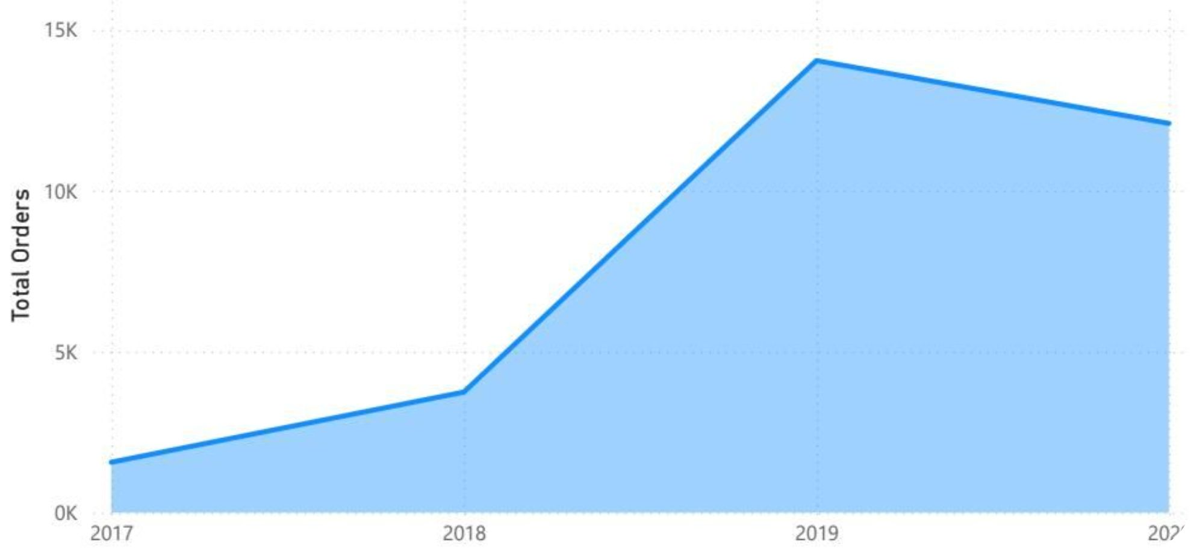
Executive Summary & Macro Performance
1. Total Revenue is $109.81M across 31K orders
2. Average Order Value = $3.49K
3. Overall profit margin = 11.43%
Sales peaked sharply in 2019 before stabilizing in 2020.

Slide 3
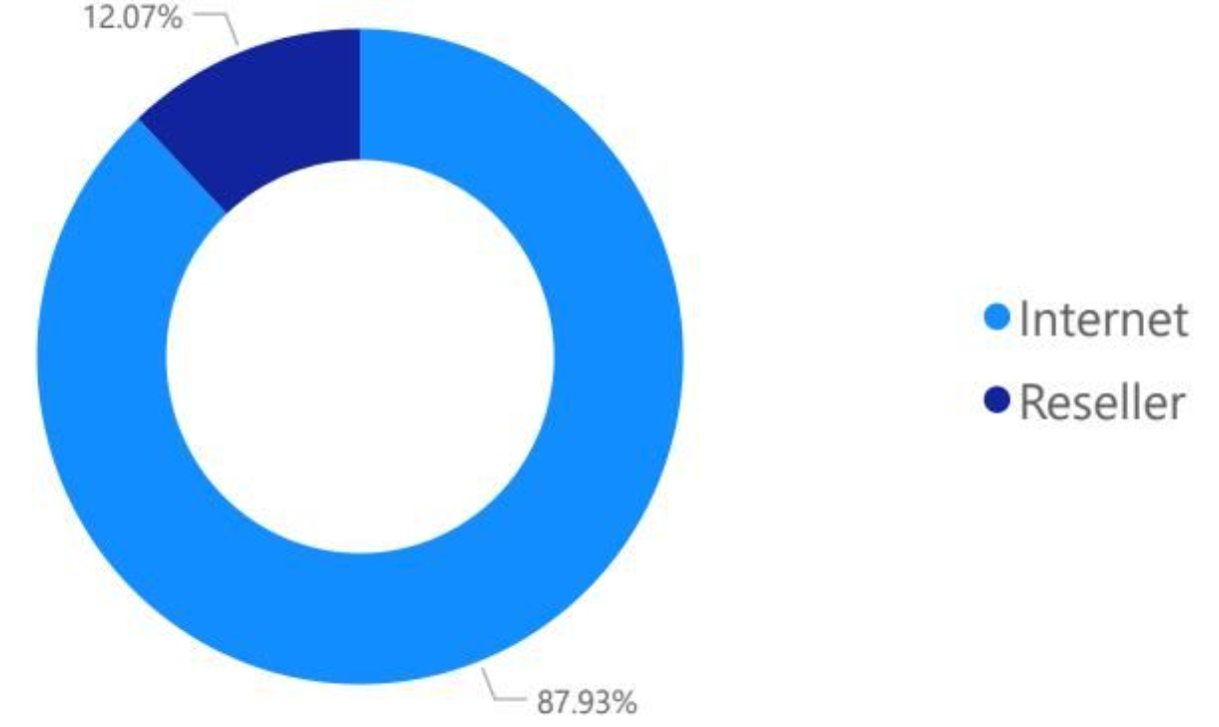
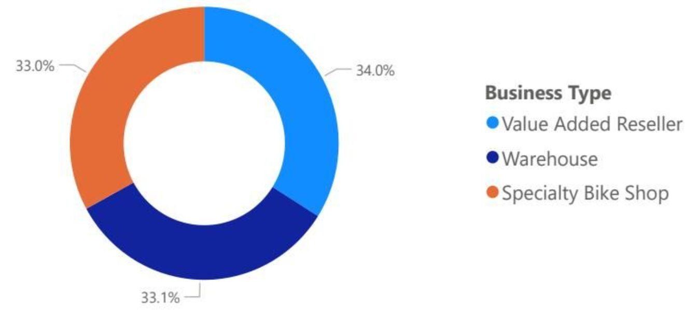
Channel & B2B Analysis
Reseller (B2B) drives the majority of revenue; Internet (B2C) is smaller but strategic.
Revenue Split:
B2B Composition:
Reseller - 87.93%
Internet - 12.07%
Value Added Reseller - 34.0%
Warehouse - 33.0%
Specialty Bike Shop - 33.0%

Slide 4
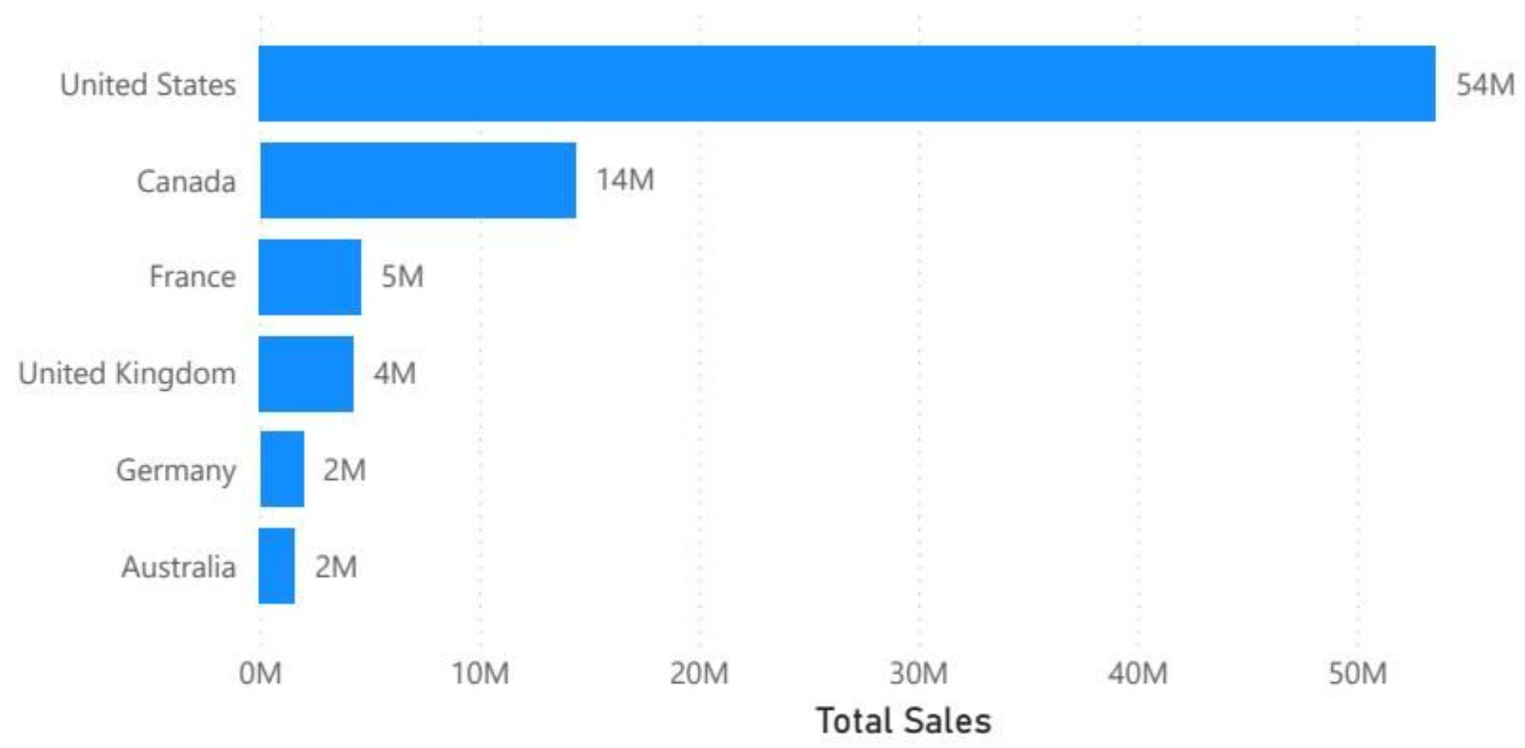
Geographic Footprint
United States is the largest market by far (> $50M). Followed by Canada, France, and the United Kingdom.
Prioritize US reseller playbook to scale in Europe and Canada.

Slide 5
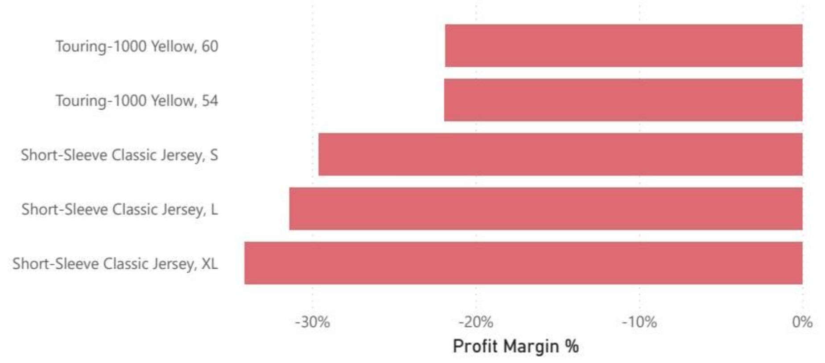
Margin Leak — Bottom 5 Products
Top-line sales hide severe product margin erosion. Five key products operate at negative margins between -15% and -32%, led by Short-Sleeve Classic Jerseys and Touring-1000 models.
Bottom Products:
Short-Sleeve Classic Jersey (S, L, XL): margins down to -32%.
Negative product margins materially depress overall profitability.

Slide 6




Strategic Recommendations
1. Price Floors
2. Supplier Review
3. International Expansion
Implement minimum margin price floors on apparel and touring bikes to stop margin erosion.
Re-evaluate supplier production costs for jerseys and negotiate better terms or alternative suppliers.
Expand the high-performing US reseller model into targeted European territories to grow B2B revenue.
Next steps:
1. Set margin thresholds
2. Run SKU-level cost audits
3. Pilot EU reseller partnerships Q4.

