Slide 1




DEFORESTATION DETECTION
(FIRE CLASSIFICATION)

Slide 2



Learning Objectives
Detect and classify fire types using MODIS satellite data.
Apply data preprocessing and feature scaling for ML models.
Build and deploy a Streamlit web app for real-time predictions.
Support deforestation monitoring and environmental protection.
Explore AI-driven solutions for disaster prevention.
GOAL
Source :
www.freepik.com/

Slide 3
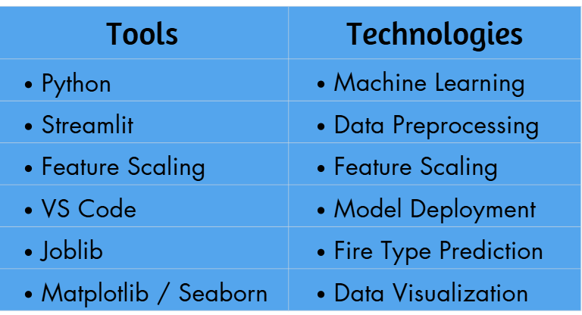
Tools and Technology used

Slide 4
Methodology
Data Collection & Understanding
Collected MODIS satellite fire dataset containing features like brightness, FRP, confidence, scan, and track.
Data Preprocessing
Cleaned and structured the dataset.
Encoded categorical features (confidence levels).
Applied feature scaling using scikit-learn to normalize inputs.
Model Development
Trained a Machine Learning model to classify fire types (Vegetation Fire, Offshore Fire, Other Land Source).
Saved the trained model and scaler using Joblib for deployment.
Model Evaluation & Testing
Evaluated model accuracy and reliability on unseen data.
Ensured correct classification of different fire types.

Slide 5
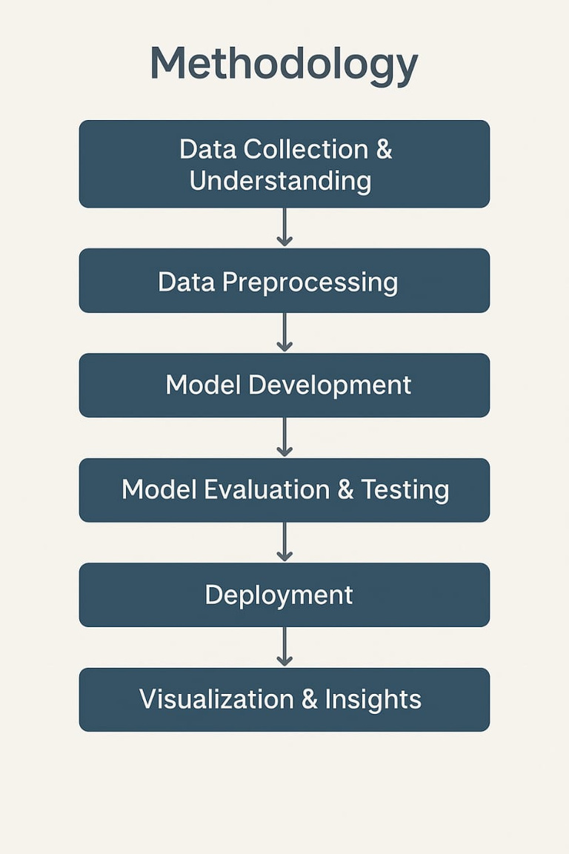
Methodology
Deployment
Built a Streamlit web application (app.py) for real-time fire type prediction.
Allowed users to input satellite parameters and get instant predictions.
Visualization & Insights
Created graphs and charts (from the Jupyter notebook) to visualize feature relationships and fire patterns.
Provided insights for deforestation monitoring and disaster prevention.

Slide 6

Problem Statement:
Uncontrolled forest fires are a major contributor to deforestation, biodiversity loss, and environmental damage.
Traditional fire monitoring methods are slow, manual, and lack real-time detection capabilities.
There is a critical need for a data-driven solution that leverages MODIS satellite readings to classify fire types—such as Vegetation Fires, Offshore Fires, and Other Land Sources—to enable early warning, improve disaster response, and support environmental protection.

Slide 7
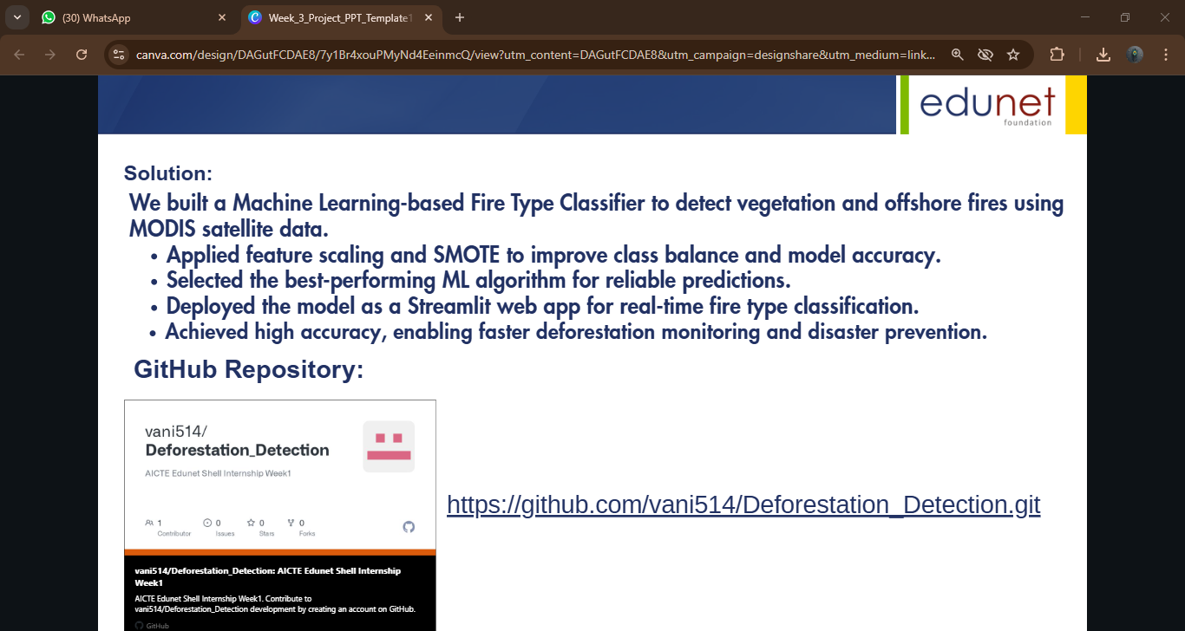
Solution:
We built a Machine Learning-based Fire Type Classifier to detect vegetation and offshore fires using MODIS satellite data.
Applied feature scaling and SMOTE to improve class balance and model accuracy.
Selected the best-performing ML algorithm for reliable predictions.
Deployed the model as a Streamlit web app for real-time fire type classification.
Achieved high accuracy, enabling faster deforestation monitoring and disaster prevention.
GitHub Repository:
https://github.com/vani514/Deforestation_Detection.git

Slide 8
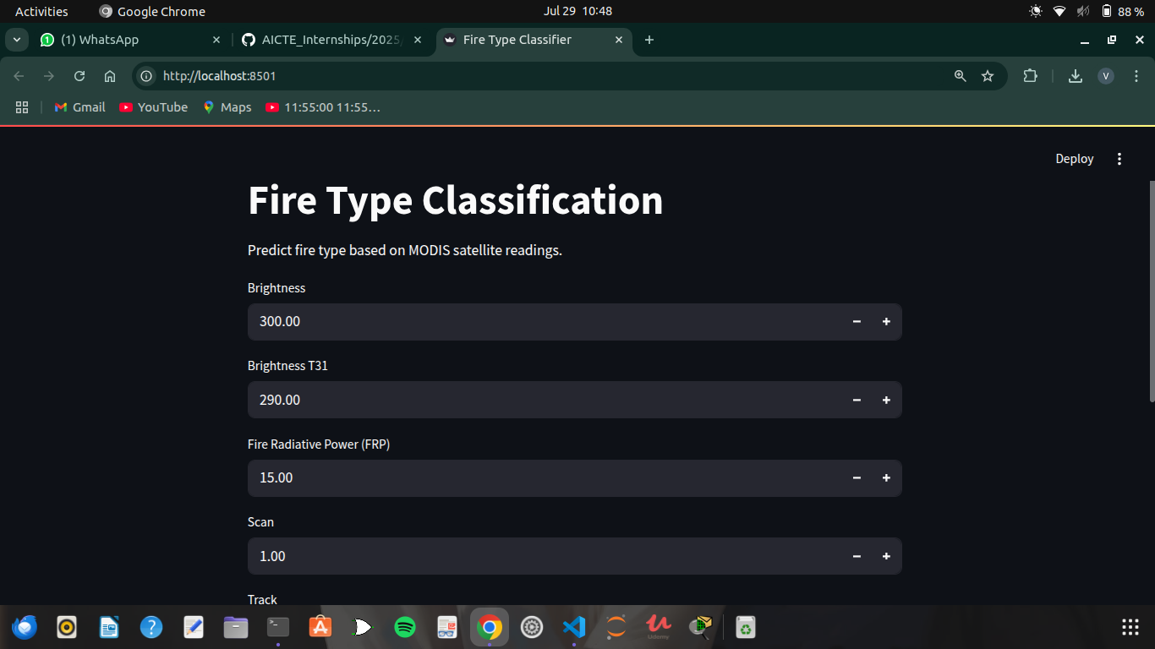
Screenshot of Output:

Slide 9
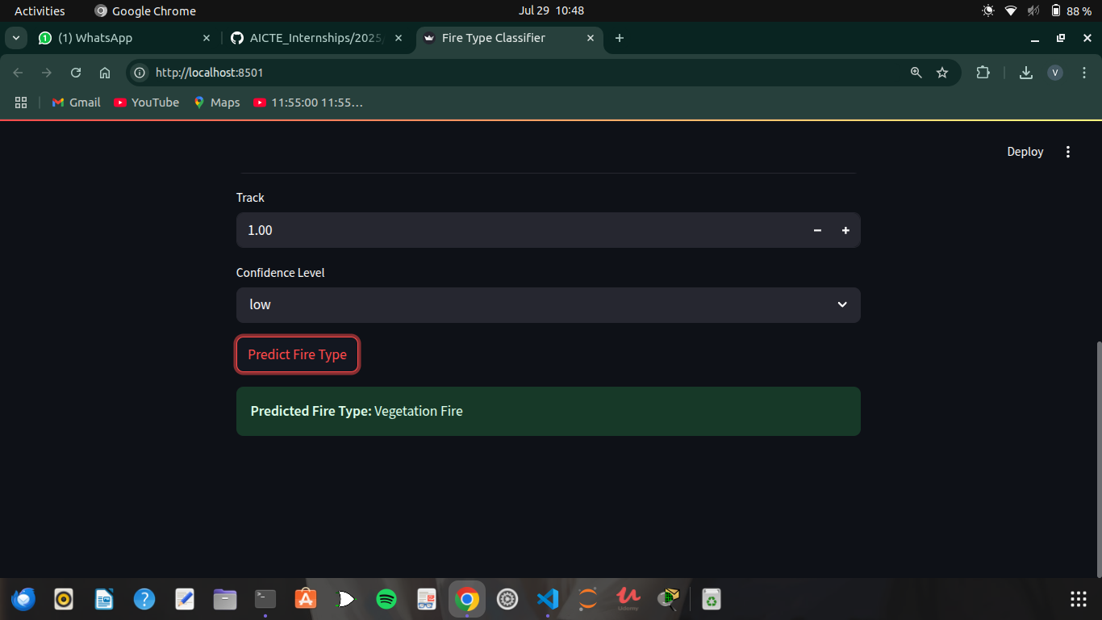
Screenshot of Output:

Slide 10
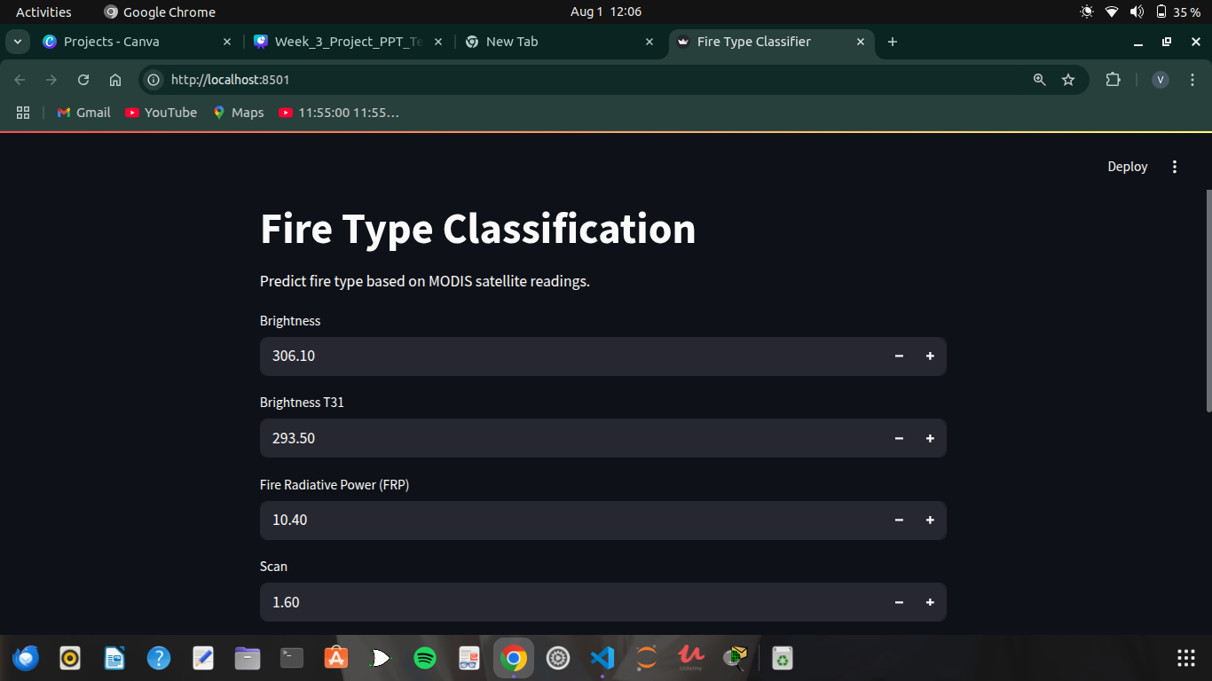
Screenshot of Output:

Slide 11
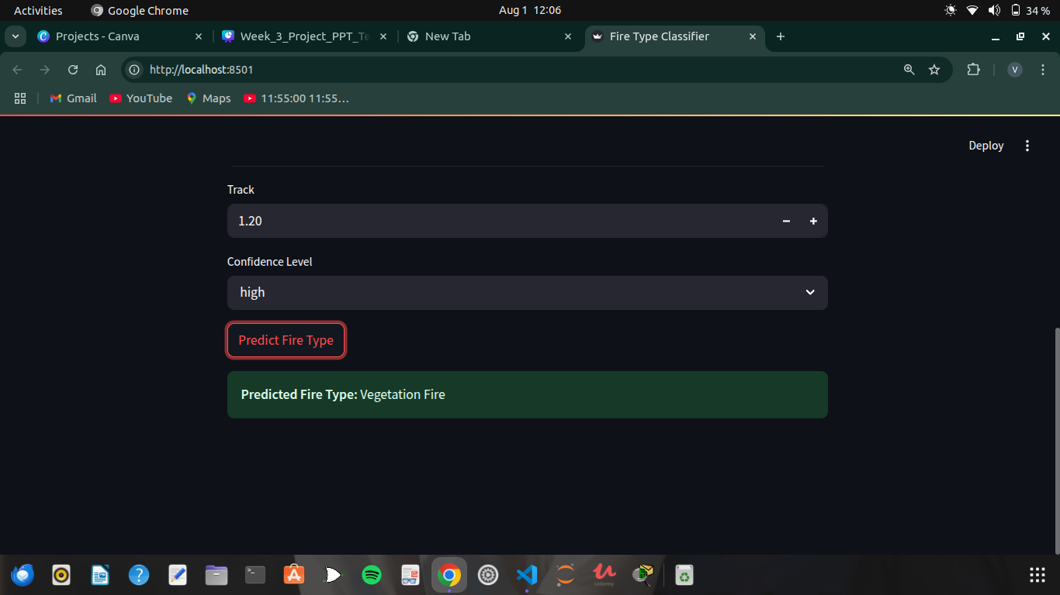
Screenshot of Output:

Slide 12
Conclusion:
The Fire Type Classification System successfully leverages MODIS satellite data and Machine Learning to classify fire types with high accuracy.
Its real-time predictions through the Streamlit web app support early fire detection, deforestation monitoring, and proactive environmental protection.
Future Scope:
Integration with real-time satellite APIs for automatic fire detection.
Deployment on cloud platforms to enable large-scale, global monitoring.
Addition of advanced models like Deep Learning for higher prediction accuracy.
Mobile and web dashboards for faster alerts to authorities and forest departments.
Incorporation of weather and vegetation data to predict fire risk zones proactively.

