Slide 1

SIGNATURE VERIFICATION SYSTEM
Authenticating Real vs Forged Signatures
Presented by
Vania Irene A

Slide 2

Problem Statement & Objective:
Problem Statement:
Signature forgery is a significant issue, causing billions in losses annually in financial and legal sectors.
Manual verification is time-consuming, prone to human error, and ineffective at scale.
Objective:
Accurately classify signatures as real or forged using deep learning models.
Evaluate the performance of Bi-RNN and LSTM models.
Develop a Django-based user-friendly interface for signature verification.
Enhance security in critical sectors by preventing forgery.

Slide 3








Technology Stack
Deep Learning Models:
Bi-RNN (Bidirectional Recurrent Neural Network)
LSTM (Long Short-Term Memory)
Backend Development:
Django (Python web framework)
Python (Programming Language)
Machine Learning Libraries:
TensorFlow / Keras (For building and training deep learning models)
NumPy (For numerical operations)
OpenCV (For image preprocessing and manipulation)
Frontend Development:
HTML/CSS (For basic page structure and design)
Database:
SQLite (For storing user data and verification logs in Django)
Version Control:
GitHub (For code version control and collaboration)

Slide 4
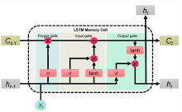
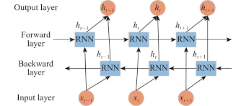
Methodology
Data Collection & Preprocessing:
Collected and preprocessed signature images (real/forged) for training.
Model Selection:
Used Bi-RNN and LSTM for sequence learning to classify signatures as real or forged.
Model Training & Evaluation:
Trained models and evaluated performance using confusion score.
Frontend Integration:
Developed a Django interface for image upload and displaying prediction results.

Slide 5

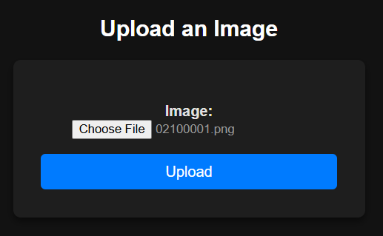
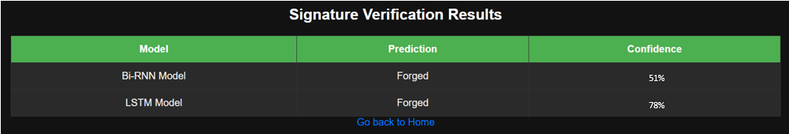
Results & Performance Metrics
Model Performance (Visual Output):

Slide 6
Conclusion & Future Work
Conclusion
Developed an effective Signature Verification System using Bi-RNN and LSTM models for real vs. forged signature classification.
Implemented a user-friendly Django interface for easy verification.
Confusion score confirmed the models’ accuracy in signature classification.
Future Work:
Model Improvement: Tune hyperparameters and explore new models like CNNs.
Dataset Expansion: Increase dataset size for better model generalization.
Deployment: Deploy on a cloud platform for real-time usage.
Security: Enhance system security to prevent forgery manipulation.

