Slide 1
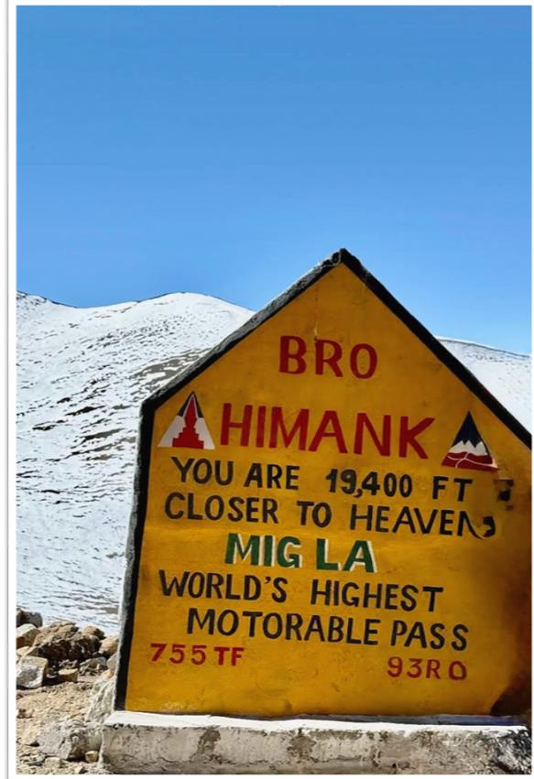
MIG LA PASS (19400FT)
WORLD’S HIGHEST & LONGEST MARATHON
Presented by
SABITA MAHATO
PARAM AJAY VEER SINGH GILL

Slide 2
RUNNING TOWARDS HISTORY AT THE
WORLD’S HIGHEST MOTORABLE ROAD
AIM OF RUNING
Women Empowerment |
Human Endurance | Youth Inspiration |
Environmental Awareness

Slide 3
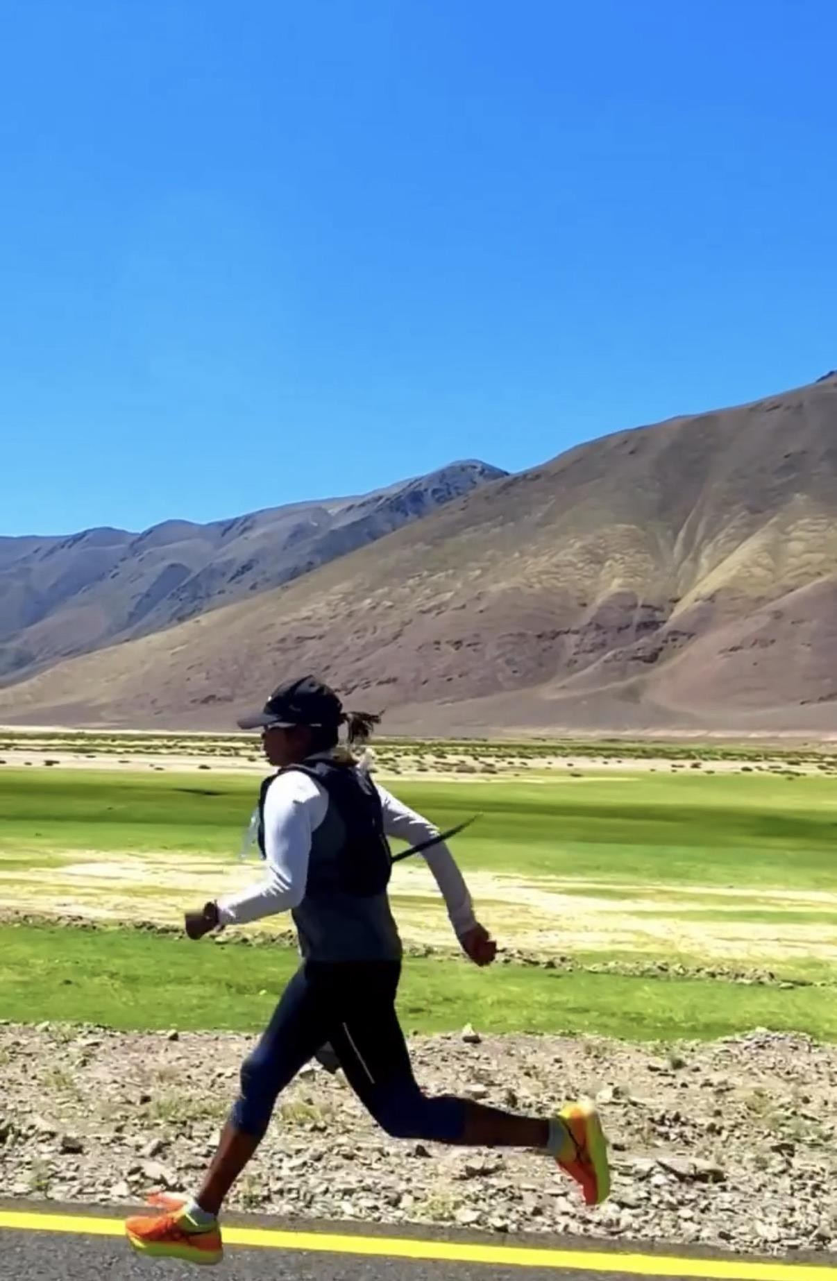
ABOUT SABITA MAHATO
Sabita Mahato is an ultra-endurance athlete from Bihar, India
Achievements:
In 2023, becoming the first woman in
the world to run from Manali to umling la 570 km
High-altitude runner and mountain athlete
Completed EVEREST base camp 104km from Lukla to Lukla in 64 hours
Promotes cleanliness and environmental awareness
Inspires young girls and athletes across India

Slide 4
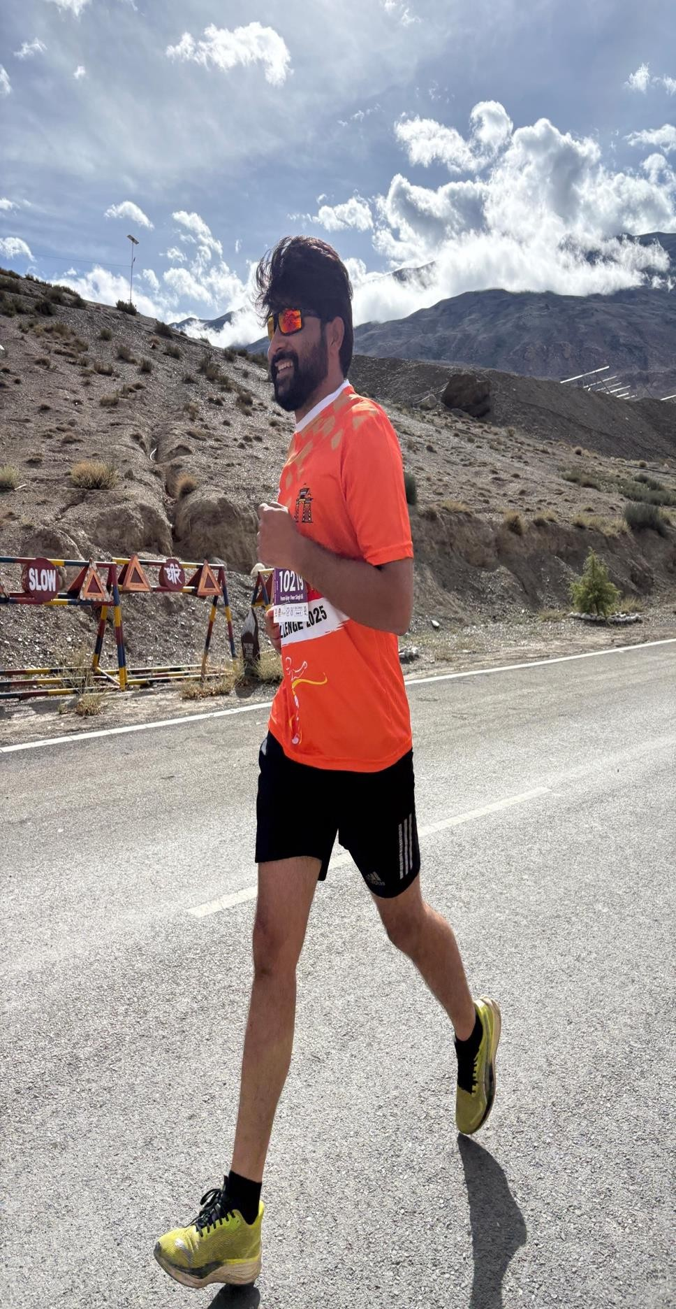
ABOUT :
PARAM AJAY VEER SINGH GILL
Param Ajay veer Singh Gill is a passionate endurance runner dedicated to pushing human limits through extreme running challenges and marathons.
Focus Areas:
Ultra-distance running
High-altitude endurance
Motivating youth through sports
Teamwork and national pride
Vision:“To prove that determination is stronger than limitations.”

Slide 5
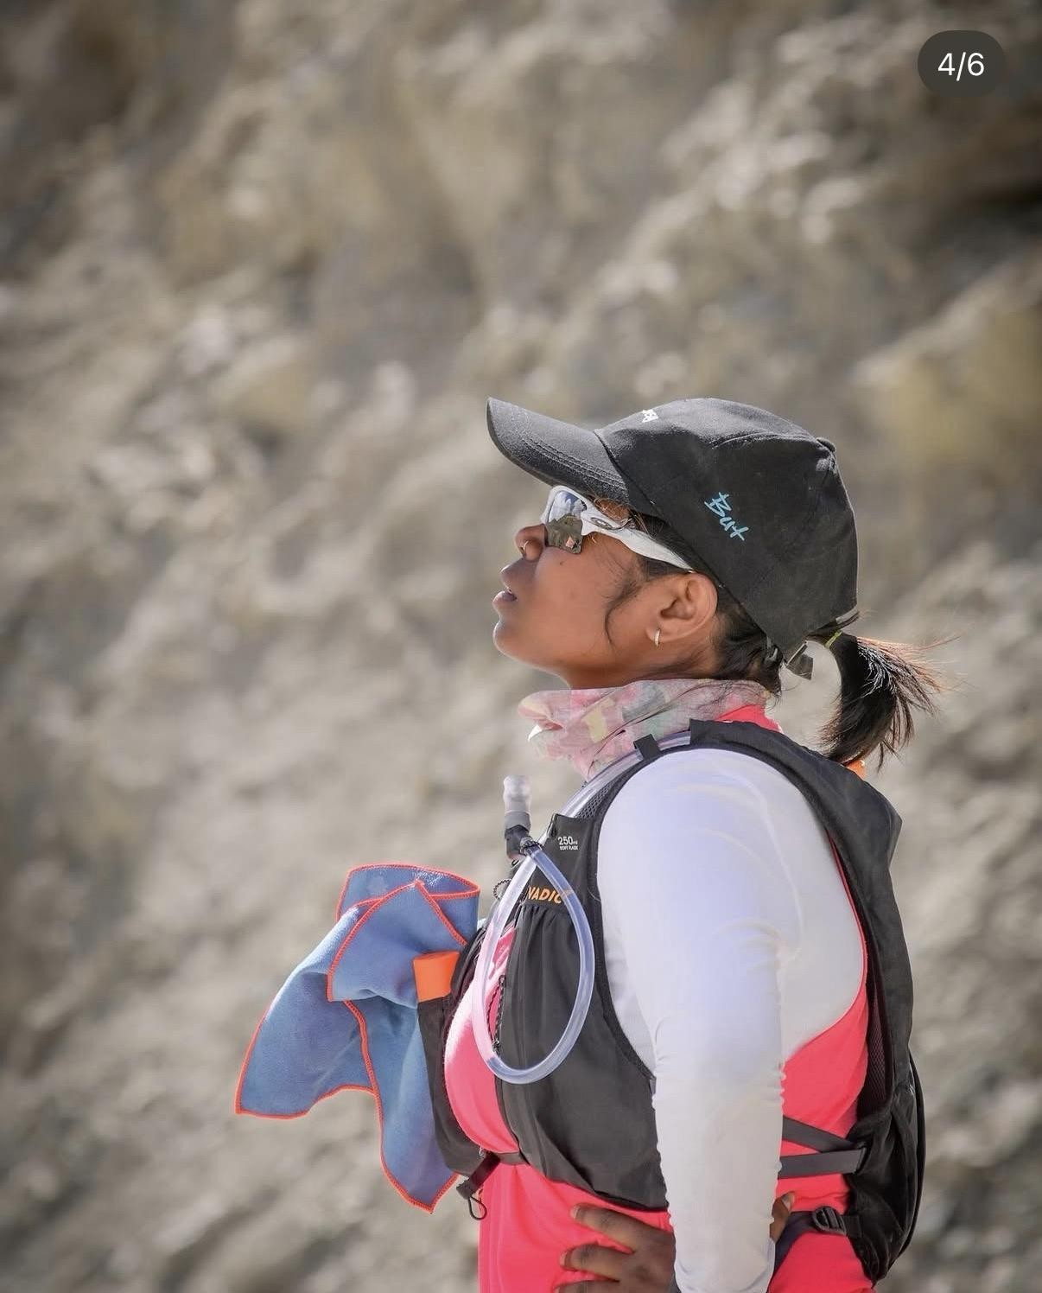
EXPEDITION HIGHLIGHTS:
Running at the world’s highest motorable roads* Extreme altitude above 5,900 meters (19,400 ft)* Harsh weather and low oxygen challenges* Promoting mental and physical strength* Inspiring youth through action and determination
Our Goal:
To complete this historic expedition successfully and set an example for millions across the world.

Slide 6
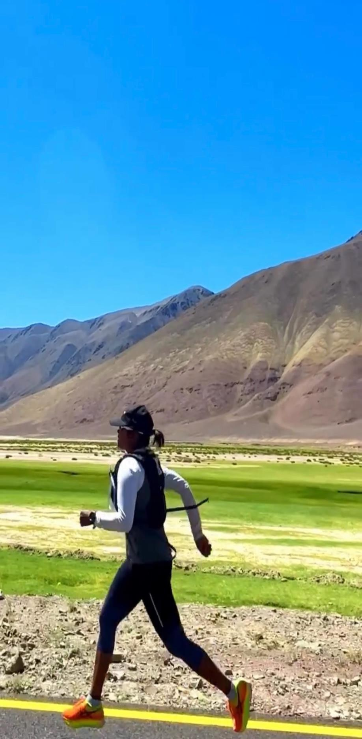
WHY THIS EXPEDITION MATTERS
This Is Not Just A Run
It is a message about:
Courage
Discipline
Women empowerment
Fitness and sports culture
Environmental responsibility
Breaking human limits
After completion, this expedition has the potential to create history and inspire thousands of young athletes across India.

Slide 7

MEDIA & BRAND VISIBILITY
Your company logo and branding will receive strong visibility through:
Social Media Platforms
Instagram
Facebook
Twitter/X
Running communities
Athlete collaborations
Media Coverage
News channels
Digital media platforms
Interviews and articles
Expedition documentaries
Brand Promotion
Sponsor mentions in posts and videos
Sponsor tags and collaborations
Expedition banners and press releases
Branding during the world’s highest ultra
marathon attempt
Recognition associated with a historic achievement.

Slide 8

WHY SUPPORT US
By supporting this expedition, your company becomes
part of:
A historic endurance mission
Positive youth impact
Women empowerment movement
A national inspiration story
Adventure and fitness promotionTogether, We Can Create History.

Slide 9
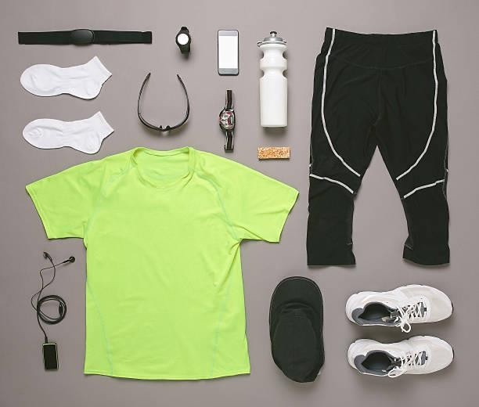
SUPPORT REQUIRED
Logistics
Transportation
Nutrition
Running gear
Medical support
Camera & media coverage
High-altitude Equipments
Accommodation and backup support
With your support, this mission can inspire people across the country and motivate the next generation to dream bigger.

Slide 10



TEAM:
SABITA MAHATO(WORLD RECORD HOLDER) PARAM AJAY VEER SINGH GILL(RUNNER)
CONTACT: 7060624324 / 8826054010 SABITAOFFICIAL224@GMAIL.COM
INSTAGRAM: @SABITATHERIDER
“RUN BEYOND LIMITS.”
THANK YOU

