Slide 1

A Graph Database Powered Recommendation System
COMPLETE PRESENTATION
Team Members:
Nupur Pathak
Sree Divya Cheerla
Vani Bhat

Slide 2



Agenda
Problem Statement
Why is the project related to this class ?
Area or scope of investigation
Problem Definition
Where our solution is different from others ?
Why our solution is better ?
Hypothesis
How to generate / collect input data
Languages used
Tools used
Mathematical Formulations:
Our solution
Data Analysis and Discussion
Recommender System Use Cases:
Content-based Filtering
Collaborative-based Filtering
Conclusions and Recommendations

Slide 3

Problem Statement
As the need for providing personalized services to the customers is growing, businesses are increasingly adopting recommendation systems. This will help to improve product discovery on the platforms, increase user engagement, and increase up-sell and cross-sell of their products.
These recommendation systems combine the large volume of data from different sources that reside in silos and generate insights to provide timely and accurate recommendations.
A database system that can handle large volumes of data with multiple relationships (connected data) is required to provide fast and efficient recommendations.

Slide 4
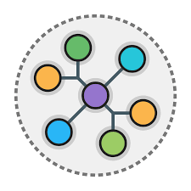
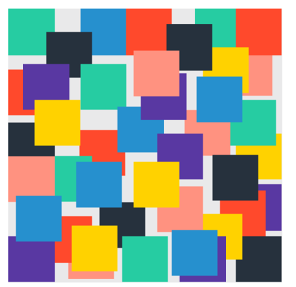

Why is the project related to this class ?
The course is ‘Database Systems for analytics’ where we have theoretically imbibed knowledge on 4 different NoSQL in which Graph database is one of them.
The project is going to be the practical implementation of knowledge gained in the course ‘Database Systems for analytics’ to solve a real-world problems caused due to the advent of unstructured big data.
The centre of attention of this project is using Neo4j which is a graph database platform and its inbuilt Graph Data Science library(GDS) to build and implement a recommender system to recommend the next watchable movie to the user.
This project is going to help us learn Neo4j graph database in detail starting from installation to using its inbuilt methods for implementing recommendation systems to address the real-world user and business problem caused by overload of information.

Slide 5
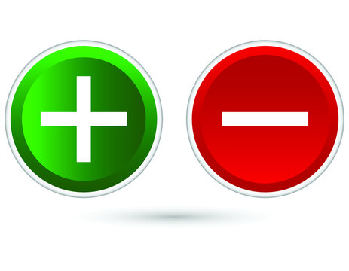
Area or scope of investigation:
Usage of Neo4j graph database- Load data, graph construction, querying the graph using cipher language and usage of graph algorithms like node similarity, KNN and GNN from the graph data science library(GDS).
The scope of the recommender systems using Neo4j is limited to recommend movies only from the prefetched data using content-based filtering, collaborative-based filtering(user-based filtering, item-based filtering) and Graph Sage GNN.
Cloud deployment, Real time recommendation of movies from the websites, YouTube video recommendations are considered out of scope.

Slide 6
Problem Definition:
Recommendation systems combine the large volume of data from different sources that reside in silos and generate insights to provide timely and accurate recommendations. A database system that can handle large volumes of data with multiple relationships (connected data) is required to provide fast and efficient real-time recommendations.

Slide 7
Where our solution is different from others ?
Recommender system would be implemented on Neo4j database and not on other platforms using python.
Usage of built-in functions in Neo4j GDS(Graph Data science library)
We would be implementing content-based filtering, collaborative based filtering, GNN using Node similarity , Node similarity & KNN and Graph Sage graph algorithms respectively .

Slide 8
Why our solution is better ?
We are implementing our solution on Neo4j where graphs can be constructed and queried with ease comparatively. And also, built-in functions are available within Neo4j for the implementation of various algorithms.
By using content-based filtering techniques we are providing personalized recommendations for the users where the model captures interests of only that user.

Slide 9
Hypothesis
To build real time recommendation systems that are scalable, robust, non-memory constrained using techniques like Content-based filtering, Collaborative filtering (user-user and item-item) and Graph Neural Network (GraphSAGE)
To use built-in graph algorithms like Node Similarity, K Nearest Neighbor and GraphSAGE on the top of the graph model built in Neo4J.

Slide 10
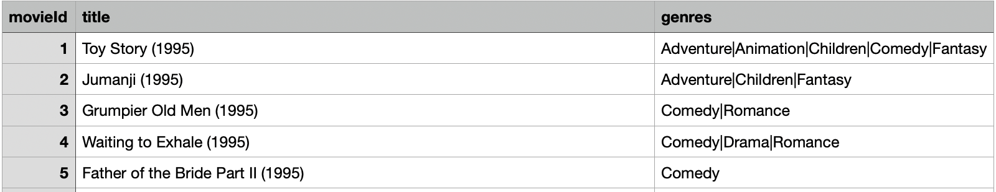
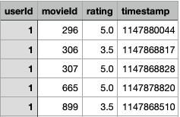
How to generate / collect input data
It contains information about the user, movies watched by each user, the genre of the movies and the individual user ratings through the years 1995 - 2015.
The dataset have information collected from 1,38,493 user chosen at random and has about 20,000,263 ratings across 27,278 movies with each user rating at least 20 movies each
Movie dataset – contains unique Movie IDs , their titles and the genre of each movie
User Movie Ratings dataset - contains unique User IDs , Movie IDs and the ratings given by each user on a scale of 1-5 scale along with timestamps.

Slide 11
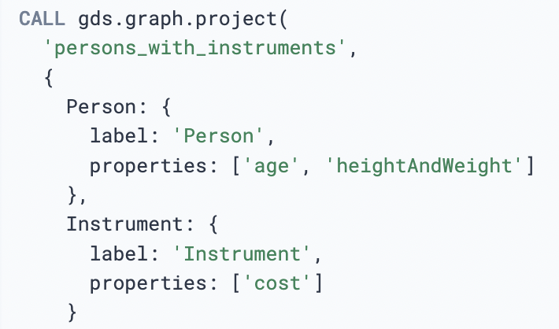
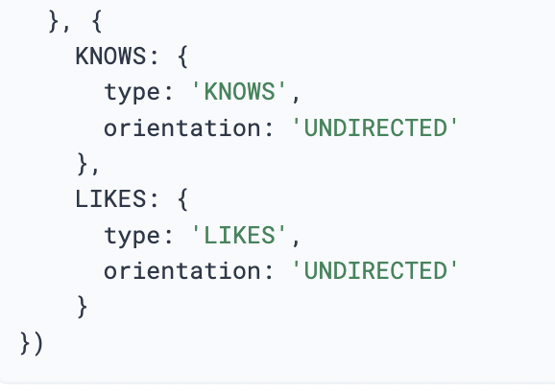
Languages used
Cypher Query Language(CQL)
Cypher is a graph query language
It allows for expressive and efficient data querying from the graph
Is unique as it provides a visual way of matching patterns and relationships
Is very similar to SQL and can be used for efficient data querying from the graph.
For our project , we use Cypher Query Language(CQL) to build and analyze the graph model as it is primary interface for Neo4J.
We use Cypher to construct expressive and efficient queries to do any kind of create, read, update, or delete (CRUD) on the graphs in Neo4J.

Slide 12
Tools used
Neo4j Desktop - Local instance of Neo4J with access to all the capabilities and features of Neo4j Enterprise Edition
Graph Data Science (GDS) library - GDS library includes many graph algorithms used for path finding, centrality, similarity and Node embeddings.
1. Production-quality : Indicates that the algorithm has been tested with regards to stability and scalability.
gds.<algorithm>
2. Beta : Indicates that the algorithm is a candidate for the production-quality tier
gds.beta.<algorithm>
Alpha: Indicates that the algorithm is experimental and might be changed or removed at any time
gds.alpha.<algorithm>

Slide 13
Tools used
Node Similarity :
Compares a set of nodes and consider them similar by checking if they share the same neighbors and computes pairwise similarities using functionalities like Jaccard Similarity Score, or the Overlap coefficient.
K Nearest Neighbors
The K-Nearest Neighbors algorithm compares the properties of each node and defines k nodes as its nearest neighbors if their properties are similar
It then computes the distance between all node pairs and creates new relationships between each node and its K nearest neighbors.
Graph SAGE
GraphSAGE is a node embedding algorithm which computes low-dimensional vector representations of nodes in a graph also called embeddings .
It creates function that generates embeddings by sampling and aggregating features from a node’s local neighborhood.

Slide 14
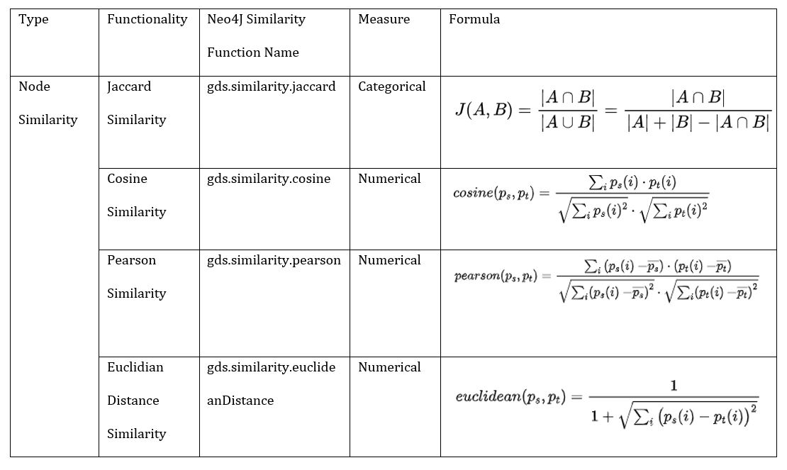
Mathematical Formulations:

Slide 15




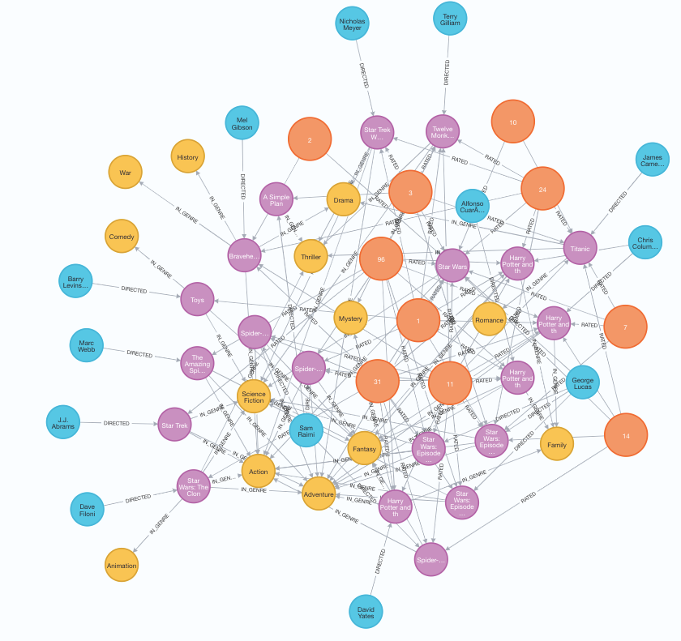
Our Solution: Graph Database Powered Recommendation
LOAD
DATASET
GRAPH CONSTRUCTION
GRAPH
ALGORITHM
MOVIE RECOMMENDATIONS
User Movie Ratings dataset: Information about the user, movies watched by each user, the genre of the movies ratings
Contains unique User IDs , Movie IDs and the ratings given by each user on a scale of 1-5 scale along with timestamps.
The dataset has information collected from 1,38,493 users chosen at random and has about 20,000,263 ratings across 27,278 movies
Movie dataset: Contains unique Movie IDs , their titles and the genre of each movie. The dataset has information collected from 10,866 movies
Subset dataset: We have filtered the dataset with 10 users that have 72 ratings across 20 movies.
We have used Neo4j database that is suitable platform to handle interconnected data in terms of graph representation and graph learning.
Using the subset dataset, following graph is created in the Neo4j application:
Content based filtering
Jaccard Similarity
Collaborative based filtering
Cosine Similarity
K Nearest Neighbours (KNN)

Slide 16
Graph Construction – Nodes and Edges
Director
DIRECTED
User
Movie
Genre
RATED
IN_GENRE
Graph Properties:
Heterogeneous Graph
Nodes: User, Movie, Director, Genre
Edges: RATED, DIRECTED, IN_GENRE
Directed Graph

Slide 17
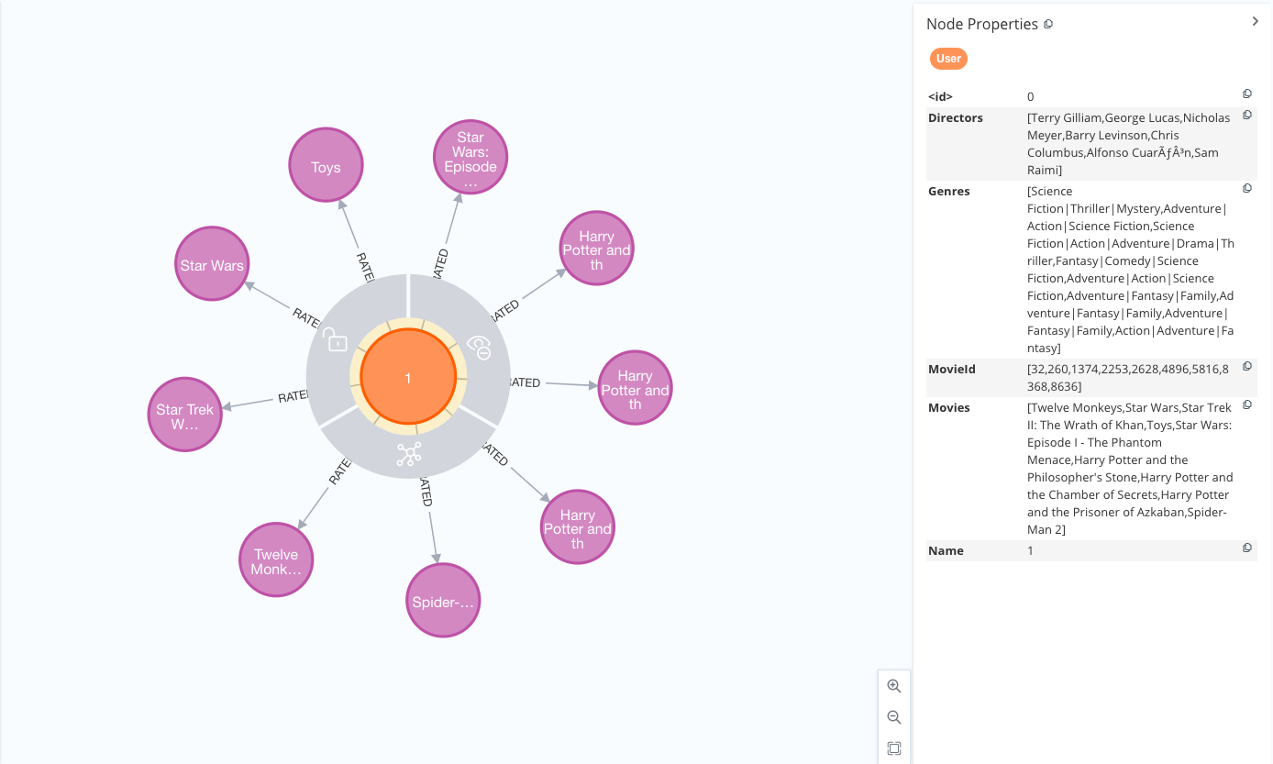
Graph Construction – User Node Properties for User 1

Slide 18
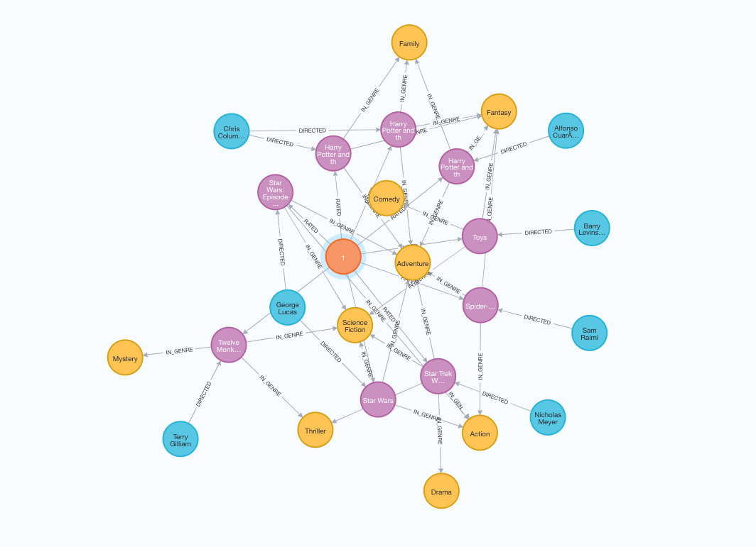
Graph Construction – User 1 Connections
User
Movie
Director
Genre

Slide 19
Content-Based Filtering: Flowchart
This algorithm allows us to search and recommend contents that are similar to what that user has done before.
Input
Movie – Unique Id
Recommender System
Recommended Movies
Neo4J Graph Construction
Similarity Based on Common Genres
Movie dataset
Neo4J Algorithm:
Jaccard Similarity
User Movie Ratings dataset
Similarity Based on Common Directors

Slide 20
Content-based Filtering: Use Cases
Use Case I:
Recommendation based on user’s genre preference
This is a simple content based filtering recommendation without using any formulas/functions.
Use Case II:
Weighted recommendation based on user’s genre or director preference
Recommendation based on the movies genres and directors the users has already watched.
Use Case III:
Jaccard similarity recommendation based on user’s genre or director preference
Recommendation based on the movies genres/directors the users has already watched.
We are recommending movies similar to those genre the user has already watched except the movies that he has already watched.
We have used the weighted technique where more weight has been assigned to genre
We are using Jaccard based similarity index to provide recommendation.

Slide 21
Content-based Filtering
Use Case I:
Recommendation based on user’s genre preference
This is a simple content based filtering recommendation without using any formulas/functions.
We are recommending movies similar to those genre the user has already watched except the movies that he has already watched.
Genre preferences based on the movies watched by User 1
Movie Recommendations
Based on the movies watched by User I, we can infer that the user has following genre preferences (decreasing order):
Adventure
Science Fiction
Fantasy
Family

Slide 22
Content-based Filtering
Use Case II:
Weighted recommendation based on user’s genre or director preference
Recommendation based on the movies genres and directors the users has already watched.
We have used the weighted technique where more weight has been assigned to genre
Genre and Director preferences based on the movies watched by User 1
Movie Recommendations

Slide 23
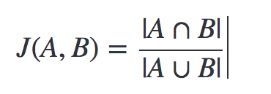
Content-based Filtering
Use Case III:
Jaccard similarity recommendation based on user’s genre or director preference
Recommendation based on the movies genres/directors the users has already watched.
We are using Jaccard based similarity index to provide recommendation.
Movies watched by User 1
Movie Recommendations

Slide 24
User-based Collaborative Filtering: Flowchart
An algorithm that considers users' interaction with products, with the assumption that other users will behave in a similar way. It takes into consideration similarity between users.
Input
Movie – Unique Id
Recommender System
Recommended Movies
Similar Users
Movies
Movie dataset
Neo4J Graph Construction
Similarity Based on Rating
Algorithm: Cosine Similarity
For K-nearest neighbors, recommend movies* based on viewed and ratings
User Movie Ratings dataset
Note: * KNN Sort based on rating*similarity

Slide 25
Collaborative-based Filtering : Use Cases
Use Case I:
Recommendation based on other similar users
This is a simple collaborative filtering recommendation without using any formulas/functions. We are recommending movies to a user based on other similar users
Use Case II:
Recommending movies based on users average ratings and genre preference
For a particular user, what genres have a higher-than-average rating? Use this to score similar movies
Use Case III:
Cosine Similarity recommendation based on user ratings
Recommending movies based on most similar user preferences to user 1 on user ratings by using cosine similarity function.
Use Case IV:
KNN recommendation based on similar users movie preferences
We are recommending movies to the user based on other similar users movie preferences. We are using KNN model to generate recommendations

Slide 26
Collaborative-based Filtering
Use Case I:
Recommendation based on other similar users
User-based Collaborative Filtering
This is a simple collaborative filtering recommendation without using any formulas/functions. We are recommending movies to a user based on other similar users
Movies watched by User 1 and similar users
Movie Recommendations

Slide 27
Collaborative-based Filtering
Use Case II:
Recommending movies based on users average ratings and genre preference
Item-based Collaborative Filtering
For a particular user, what movies have a higher-than-average rating? Use this to score similar movies
Average Rating for the Movies watched by User 1
Movie Recommendations

Slide 28
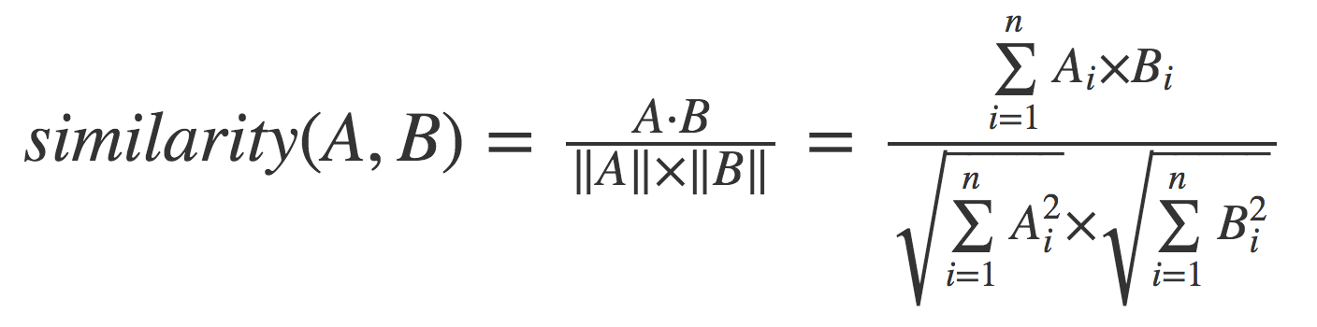
Collaborative-based Filtering
Use Case III:
Cosine Similarity recommendation based on user ratings
User-based Collaborative Filtering
Recommending movies based on most similar user preferences to user 1 on user ratings by using cosine similarity function.
Movies watched by User 1
Movie Recommendations

Slide 29
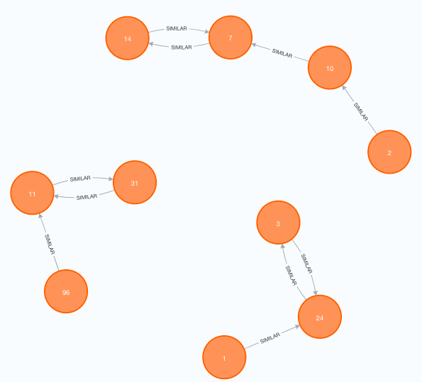
Collaborative-based Filtering
Use Case IV:
KNN recommendation based on similar users movie preferences
User-based Collaborative Filtering
We are using KNN model to generate recommendations (K = 1)
We are recommending movies to the user based on other similar users movie preferences.
Movies watched by User 1 and User 24
Movie Recommendations
Legend:

Slide 30
Summary and Conclusions
We have successfully implemented content based and collaborative based filtering techniques within Neo4j using node similarity and KNN graph algorithms.
A Content-Based filtering model does not need other users data, since the recommendations are specific to a particular user. This makes it easier to scale down the same to a large number of users.
A similar cannot be done for Collaborative Filtering Methods. Collaborative filtering methods use other user’s preference and hence gives exposure to various other movies.
We believe content based filtering outperforms collaborative based filtering technique as content based focuses on the history of the same user and hence is personalized.

Slide 31
Recommendations for future studies
The methods face First Rater Problem (cold start problem) which is the difficulty in making recommendations when users are new and also sparsity of data meaning too less data to understand the preferences of users which remains a great challenge. This needs to be studied further to analyse the measures that can be taken to address this within Neo4j.
The movie recommendation system can also be developed using Graph Neural Network(GNN) within Neo4j where Graph Sage algorithm can be used to develop the node embeddings.
Further study and analysis needs to be done on the choice of the algorithm to decode the embeddings to provide the necessary recommendations.

Slide 32


Thank You

