Slide 1

CREDIT CARD FRAUD DETECTION
Under the guidance of,
Prof. Shih Yu Chang
Group 4:
Nupur Pathak
Revathi Boopathi
Sree Divya Cheerla
Vani Bhat

Slide 2
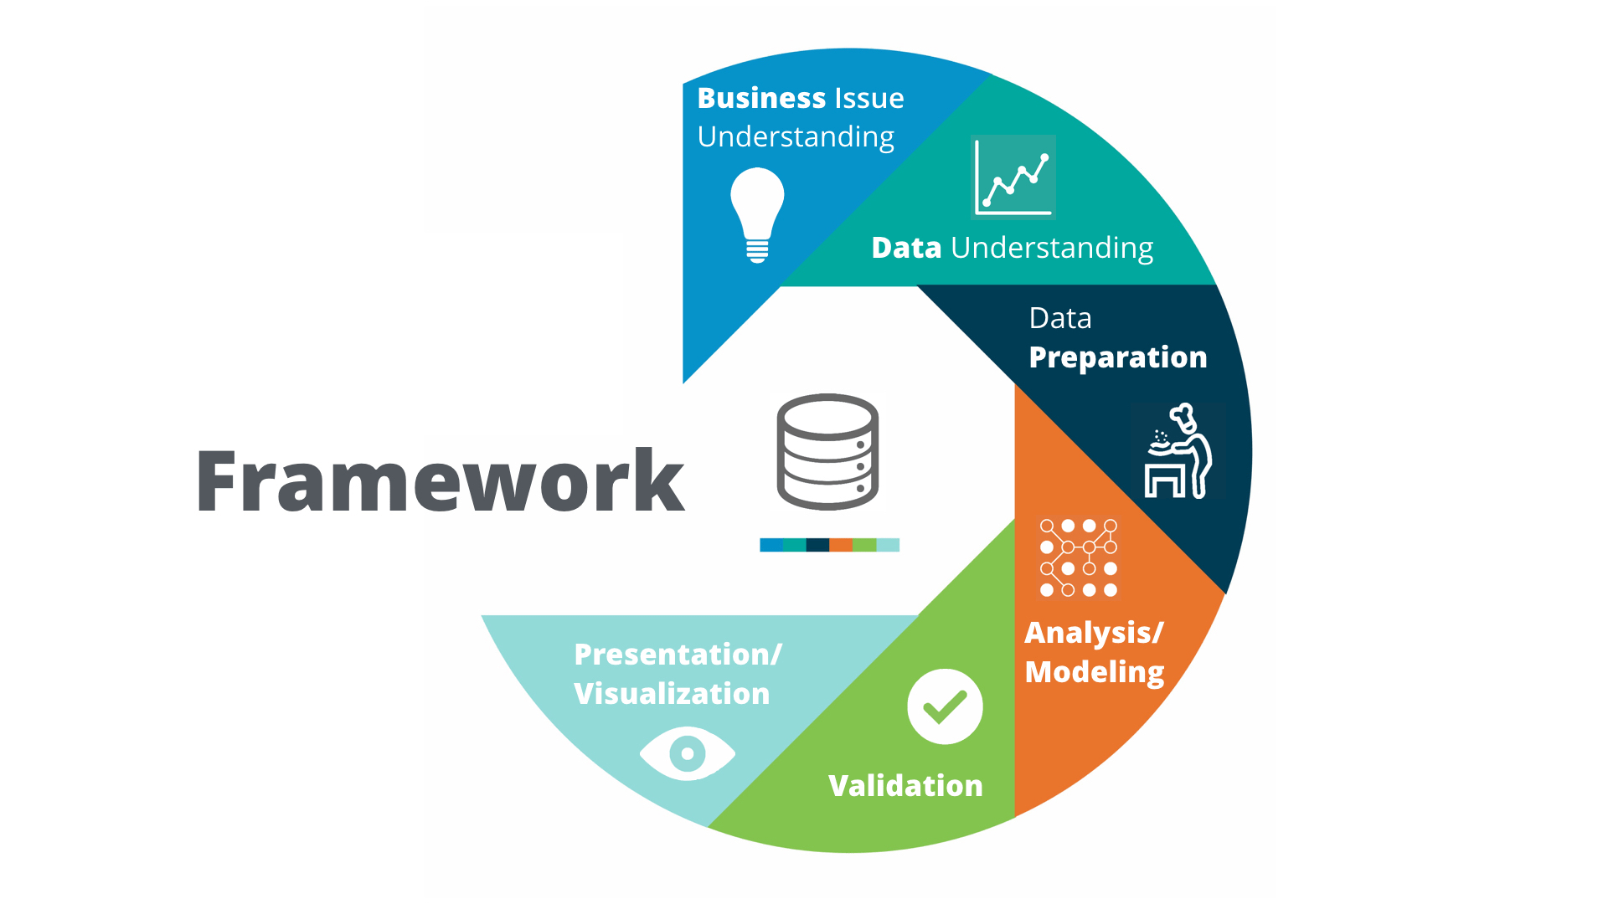
AGENDA
CRISP-DM
Business Understanding
Data Understanding
Data Preparation
Modeling
Evaluation
Deployment
Conclusion & Future Work

Slide 3

BUSINESS UNDERSTANDING
Problem and Motivation
Advancement in Science and Technology has increased a lot in recent years. The rapid development in e-commerce, tap and pay systems, and e-payment methods resulted in a tremendous increase in financial frauds.
In 2022, 46% of companies reported experiencing fraud, corruption and economic crimes compared to 47 % in 2020 and 49% in 2018.
Digital fraud has impacted 38% of Americans in Q1 2022, 29% of people experienced phishing, followed by 26% for stolen credit cards.
Credit card frauds escalated during the COVID pandemic
Big companies are looking forward to technological solutions including AI to solve credit card fraud.
Goals and Objective
Credit card usage has increased tremendously over the decade which revolutionized the cashless payment methods, but it comes with its own set of risks.
Our objective is to employ Machine Learning models and compare the performance of each model to locate the best fitting model which helps in reducing the frauds and upgrading the system

Slide 4
Literature Survey
Research Paper | Business Objective | Models Used | Performance Evaluation
Model for Credit Card Fraud Detection using Machine Learning Algorithm | Incorporated previous transactions details and identified the fraud transactions by analyzing inconsistent location calculations for every transaction | SVM, Logistic regression, KNN, and Random Forest. | Accuracy score F1 score Confusion matrix
Machine Learning Algorithms for Credit Card Fraudulent Transaction Detection: A Comparative Study | Implemented super classifier using ensemble methodology to detect credit card frauds | Logistic regression, Decision tree, Naïve bayes, KNN, SVM, Gradient boost and XGboost classifier | Accuracy Precision F1 score Recall
Credit Card Fraud Detection Using Machine Learning | Performed under sampling of the dataset to make it balanced and used outlier data mining technique to avoid bias and outliers from the dataset to achieve better accuracy | Logistic regression, Naive bayes, and Random Forest | Accuracy Precision F1 score Recall
Credit Card Fraud Detection Using State-of-the-Art Machine Learning and Deep Learning Algorithms | Implemented DL models to improve fraud detection performance and added layers to further increase the accuracy of detection. Variations in the number of hidden layers, epochs have been tested. | Decision tree, Random Forest, SVM, Logistic regression, XGBoost, CNN, LSTM and RNN | Sensitivity F1 score Precision

Slide 5
CRISP-DM FRAMEWORK
CRISP-DM
Notes:
https://www.section.io/engineering-education/data-mining-using-crisp-dm-methodology/

Slide 6
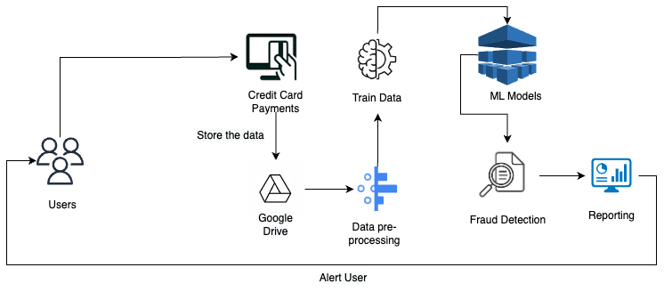
Architecture

Slide 7
AGENDA
CRISP-DM
Business Understanding
Data Understanding
Data Collection
Exploratory Data Analysis (EDA)
Data Preparation
Modeling
Evaluation
Deployment
Conclusion & Future Work

Slide 8

DATA UNDERSTANDING
Data Collection
Data Import and ABT
Exploratory Data Analysis
Synthetic data for credit card transactions for 1,000 customers using Sparkov_Data_Generation-master
Transaction duration: January 1, 2020, to December 31, 2021
Csv file for each customer will all transactions for the given customer
Union of all the transactions in the csv files and load in the dataframe for analysis
Features:
Raw Features (25)
Derived Features (10)
Data Exploration
Generate Data Quality Report for Categorical and Continuous features
Histogram/ Bar plot for the feature distribution
Correlation between continuous features

Slide 9
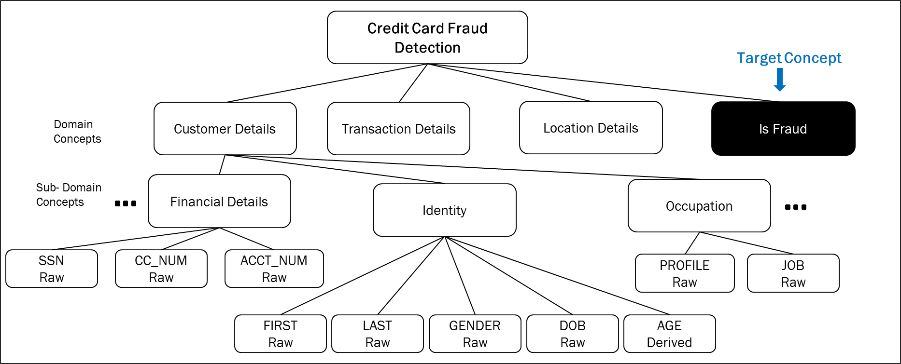
DOMAIN CONCEPTS

Slide 10
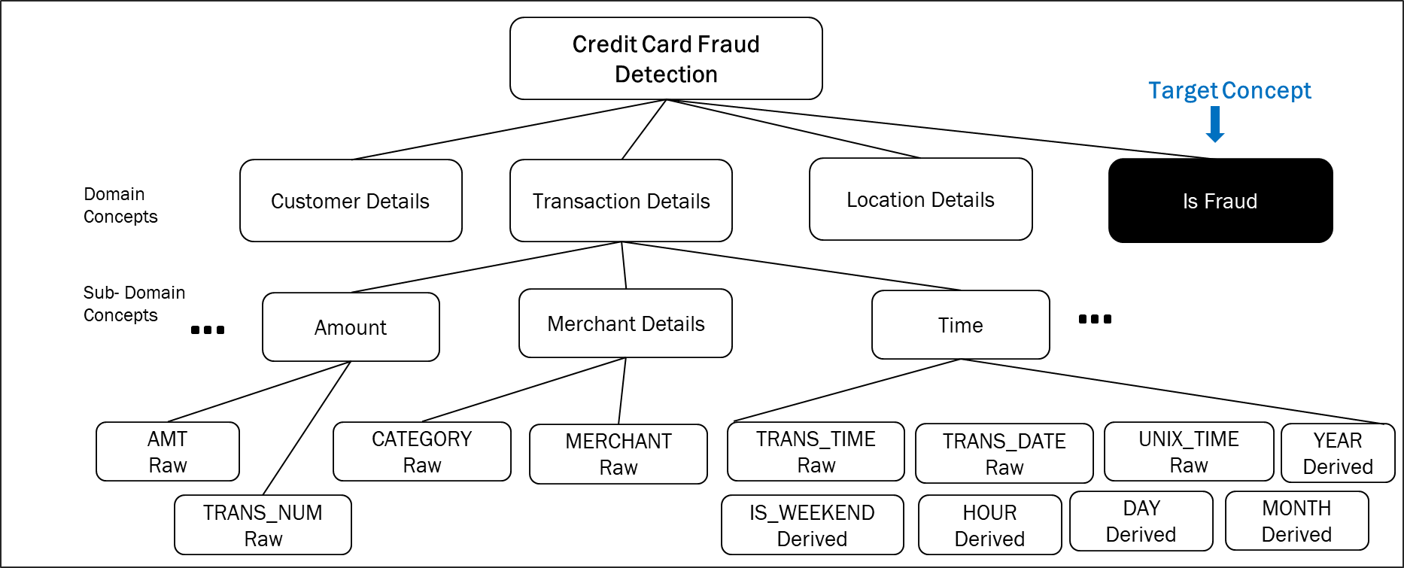
DOMAIN CONCEPTS

Slide 11

DOMAIN CONCEPTS

Slide 12
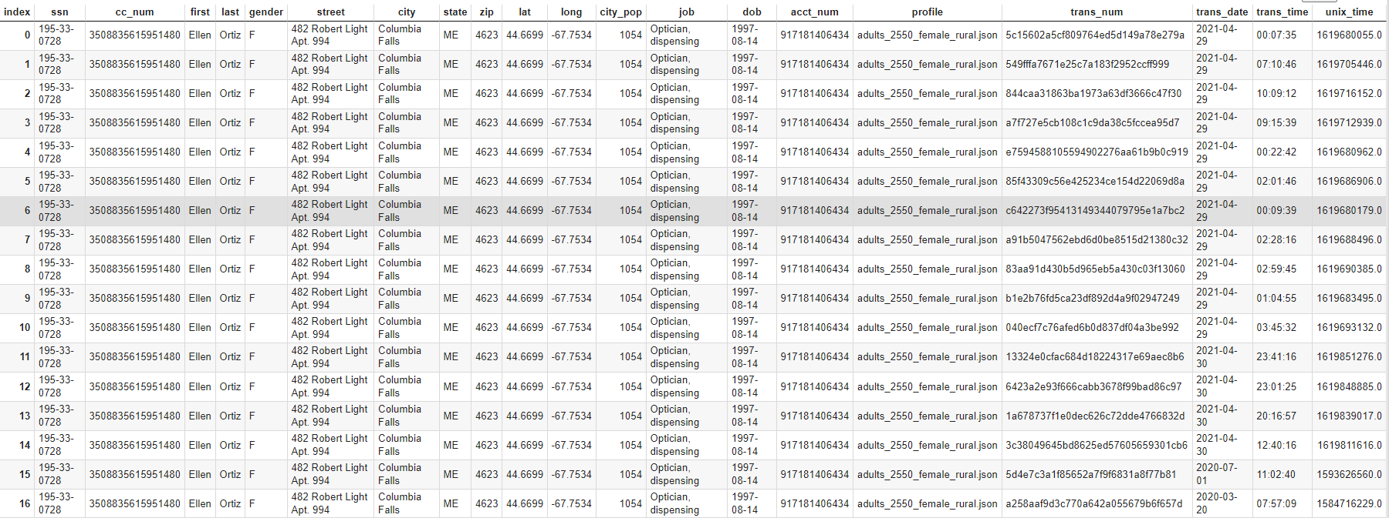
ANALYTICS BASE TABLE (ABT)

Slide 13
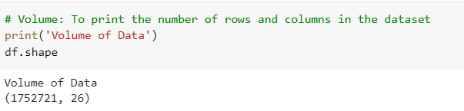
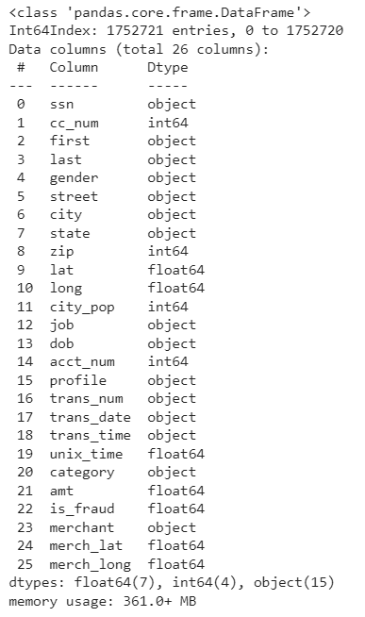
3V’s OF DATA
VOLUME
VARIETY
VELOCITY
We have generated the synthetic data once using theSparkov Generator.
This is a static one-time generated data.

Slide 14
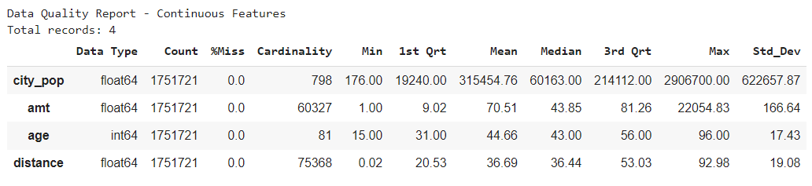
EDA – CONTINUOUS FIELDS

Slide 15
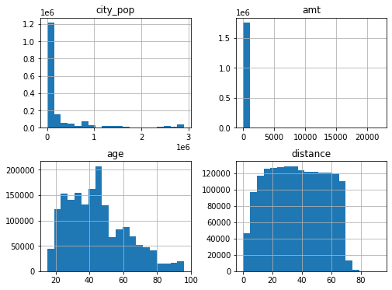
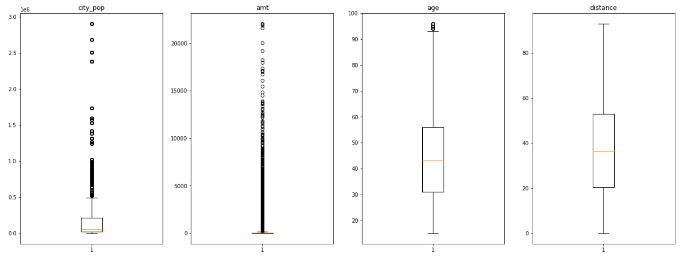
EDA – CONTINUOUS FIELDS

Slide 16
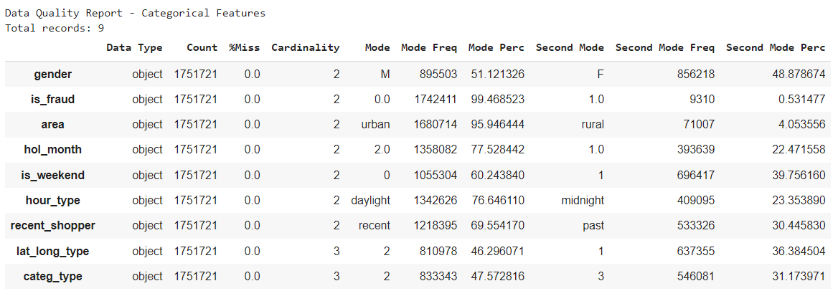
EDA – CATEGORICAL FIELDS

Slide 17
AGENDA
CRISP-DM
Business Understanding
Data Understanding
Data Preparation
Data Cleaning
Feature Engineering
Data Scaling
Sampling
Data Splitting
Modeling
Evaluation
Deployment
Conclusion & Future Work

Slide 18
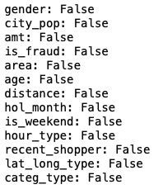

DATA CLEANING
Check for missing values in dataset
Dropped data rows where all data points are null
Dropped data rows where target variable ‘is_fraud’ is null
Drop data rows where any of the data points are null
Check for duplicates
Drop the duplicate data rows

Slide 19
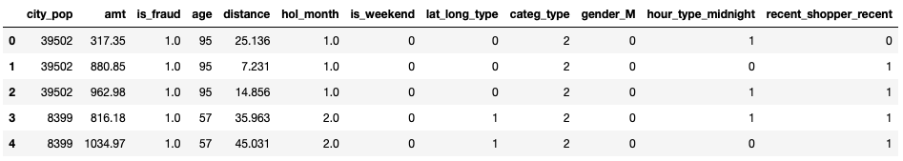
Feature engineering
Feature Extraction, One hot encoding and Label encoding
Age from ‘DOB’ feature
Distance between customer and merchant location
‘holiday month’ and ‘is_weekend’ from date feature
‘lat_long_type’ Fraud suspicious locations
‘Categ_type’ indicating category with max frauds
‘Night/day’ based on ‘trans time’
‘recent_shopper’ based on ssn and transation data

Slide 20
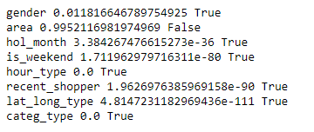
Feature engineering
Feature Selection
Chi squared test of independence
Significance Level of 5%
Eliminated ‘Area’ feature that consisted of urban or rural area
Correlation plot

Slide 21
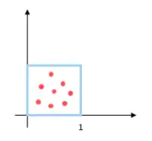
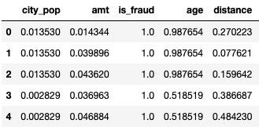
DATA SCaling
DATA NORMALISATION
city_pop, amt, age and distance

Slide 22
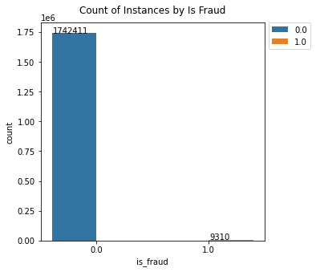
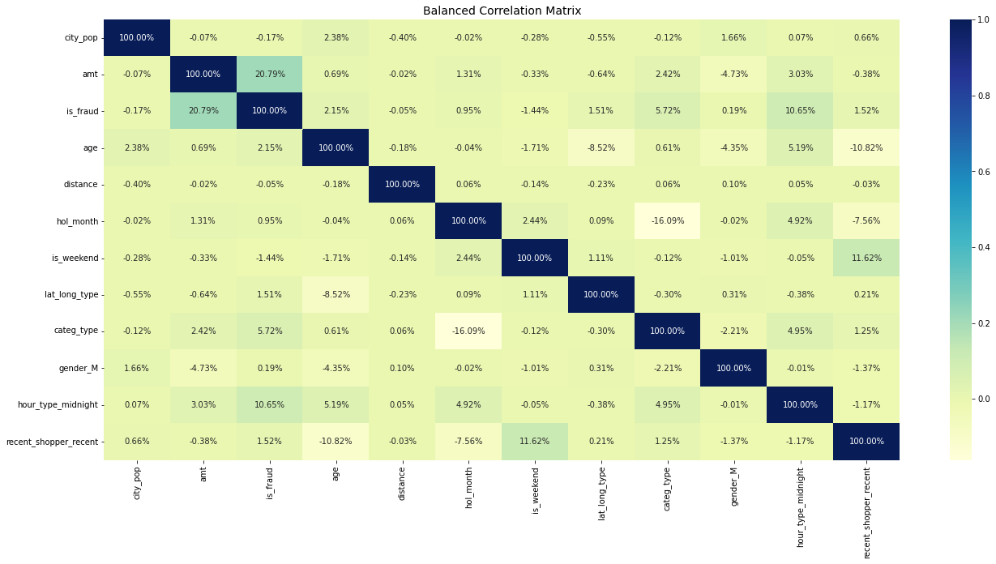
SAMPLING: IMBALANCED DATASET
Non-fraud transactions far outweigh fraud transactions
This will lead to a bias in the model
Impacts correlations between features

Slide 23
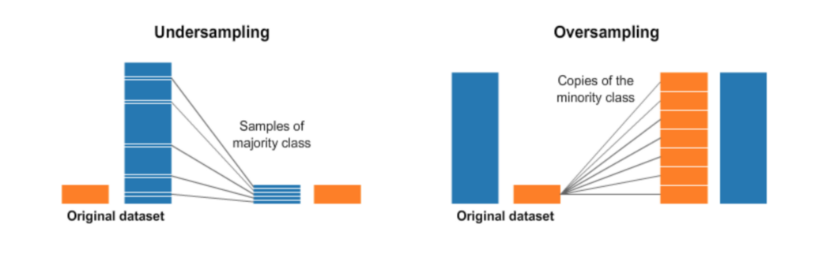
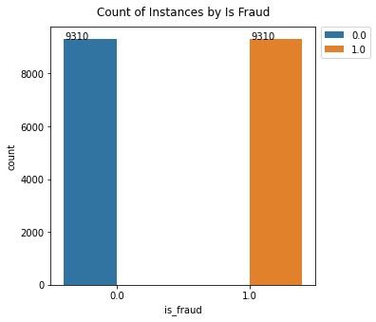
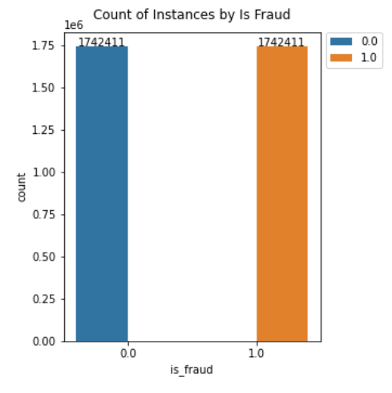
SAMPLING METHODS
Undersampling
Downsampling
Sampling
Upsampling
Oversampling
Upsampling with SMOTE
23

Slide 24
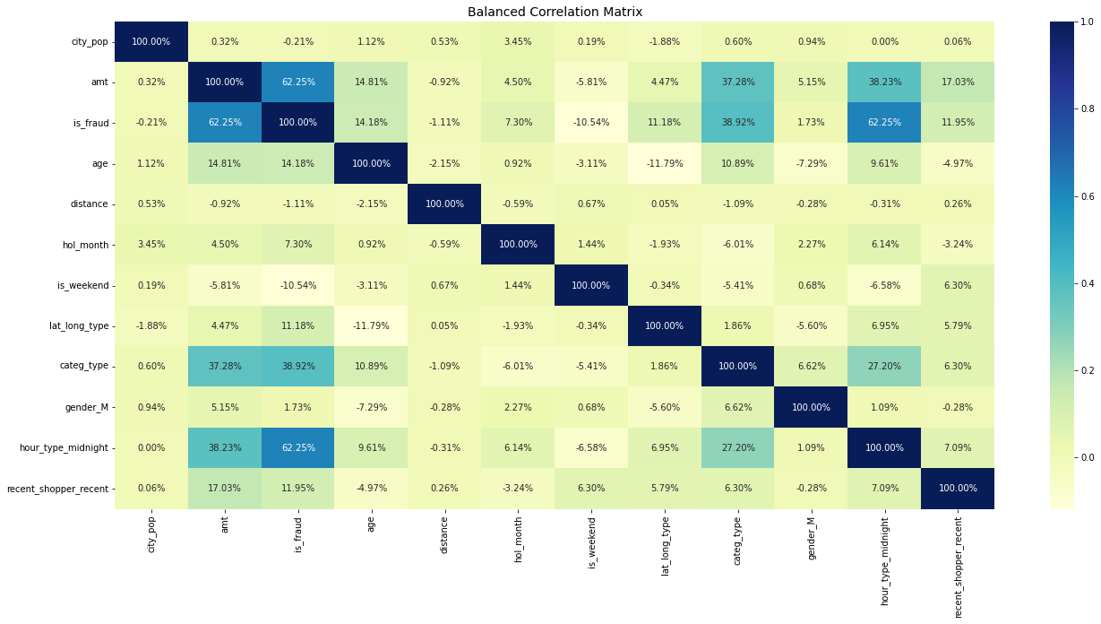
SAMPLING: BALANCED DATASET
Equal number of instances with fraud and non-fraud transactions
With a balanced dataset, the correlations of the features with the target feature have improved. This will improve the performance of the model
Notes:
Undersampling is the process where you randomly delete some of the observations from the majority class in order to match the numbers with the minority class

Slide 25
DATA SPLITTING
TRAINING SET ( 80% )
TESTING SET ( 20%)

Slide 26
AGENDA
CRISP-DM
Business Understanding
Data Understanding
Data Preparation
Modeling
Supervised Learning
Deep Learning
Evaluation
Deployment
Conclusion & Future Work

Slide 27

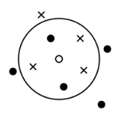

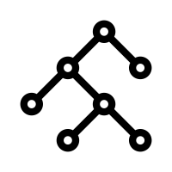




MODEL SELECTION
Models Shortlisted
Logistic
Regression
SVM
Ensemble
KNN
Naïve Bayes
Deep Learning
Modulations
Dimensionality Reduction
Hyperparameter Tuning
Resampling

Slide 28
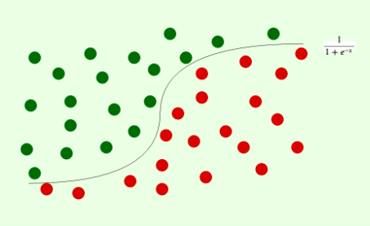
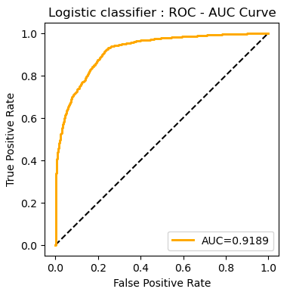
LOGISTIC REGRESSION
Logistic Regression – Supervised Machine Learning Classification Model
Binary Classifier to predict transaction as fraud/non-fraud
Uses Sigmoid function to predict the probabilities of each outcome based on the threshold.
Advantage:
Less inclined to overfitting
Disadvantage:
Linear boundary – Doesn’t work best with complex/non-linear / highly corelated data
Hyperparameters : c, penalty
 | Accuracy | Precision | Recall | F1 Score | AUC
Without Hyperparameter tuning | 83% | 0.8213 | 0.8518 | 0.8163 | 0.9189
With Hyperparameter tuning | 86% | 0.8701 | 0.8528 | 0.8614 | 0.9189

Slide 29
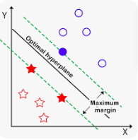
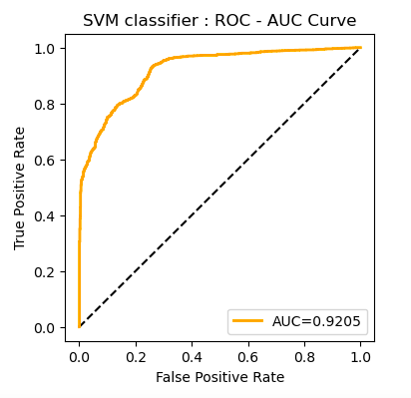
Support vector MACHINES (SVM)
SVM – Supervised Machine Learning Classification and Regression model
SVM aims to find the best hyperplane ( decision boundary ) which can separate 2- dimensional data into fraud/non-fraud class.
Advantage:
SVM is very effective in high dimensional spaces and memory efficient as they use only subset of training data in the decision phase.
Disadvantage:
SVM does not perform well when the target classes are overlapping and also with large datasets
 | Accuracy | Precision | Recall | F1 Score | AUC
Without Hyperparameter tuning | 82% | 0.7976 | 0.855 | 0.8253 | 0.9205
With Hyperparameter tuning | 88% | 0.879 | 0.8813 | 0.8801 | 0.921
Hyperparameters : c, gamma

Slide 30

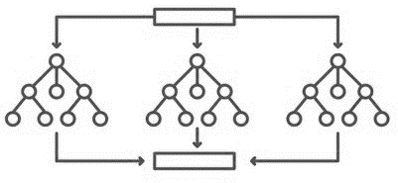
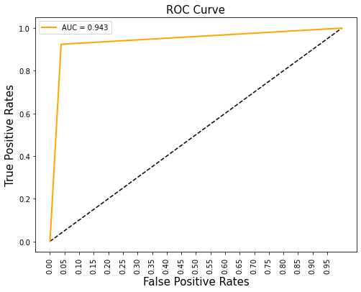
Ensemble – Random Forest
Bagging Classifier
Combination of decision trees
Parameters tuned: Maximum depth and features, criteria for tree split
Advantages:
Automatic variable selection
Suitable for wide data and large datasets
Disadvantages:
Biased for features with more levels
Slower process if more estimators exists
 | Accuracy | Precision | Recall | F1 Score | AUC
Without Hyperparameter tuning | 0.95 | 0.95 | 0.94 | 0.95 | 0.946
With Hyperparameter tuning | 0.94 | 0.96 | 0.92 | 0.94 | 0.943

Slide 31
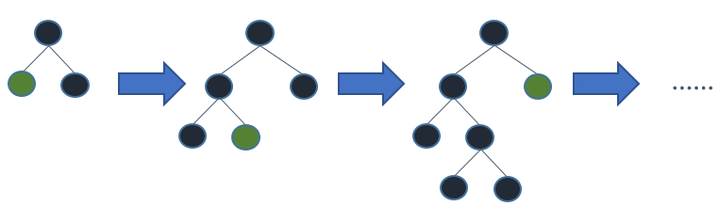
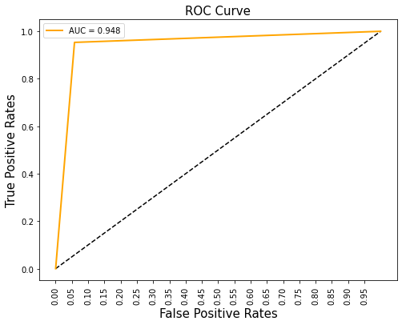
Ensemble – XGBoost
Boosting Classifier
Based on Gradient Descent
Parameters tuned: Learning rate, maximum depth and features
Advantages:
Regularized boosting preventing overfitting
Parallelized tree building
Disadvantages:
Does not perform well on sparse and unstructured data
 | Accuracy | Precision | Recall | F1 Score | AUC
Without Hyperparameter tuning | 0.95 | 0.95 | 0.95 | 0.95 | 0.946
With Hyperparameter tuning | 0.95 | 0.94 | 0.95 | 0.95 | 0.948

Slide 32
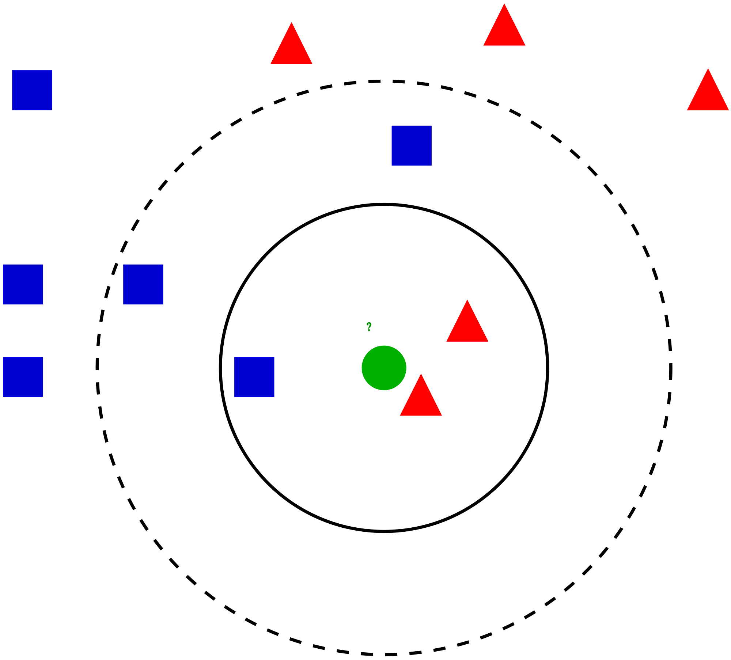
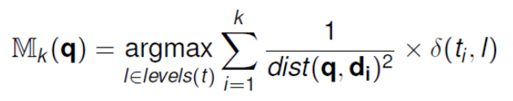
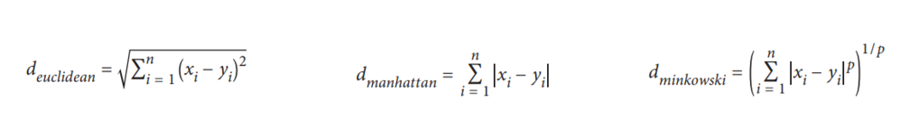
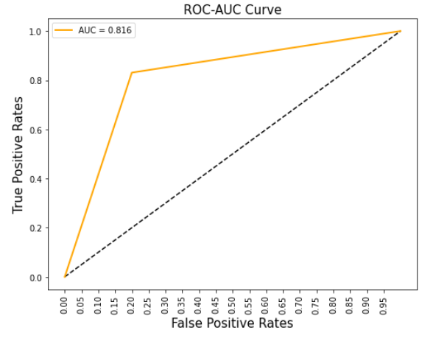
K-Nearest Neighbors (KNN)
K-Nearest Neighbors (KNN) model predicts the target level with the majority vote from the set of k nearest neighbors (training data) to the query q. The computation of the query using weighted knn is:
Advantages:
No training period
Easy implementation with distance metrics
Disadvantages:
Sensitive to noisy and missing data
Feature scaling
 | Accuracy | Precision | Recall | F1 Score | AUC
Without Hyperparameter tuning | 81.26 | 80.18 | 83.03 | 81.58 | 0.813
With Hyperparameter tuning (Best n_neighbors: 9, Manhattan distance) | 81.55 | 80.61 | 83.03 | 81.83 | 0.816
Notes:
Three distance metrics: Euclidean, Manhattan and Minkowski

Slide 33
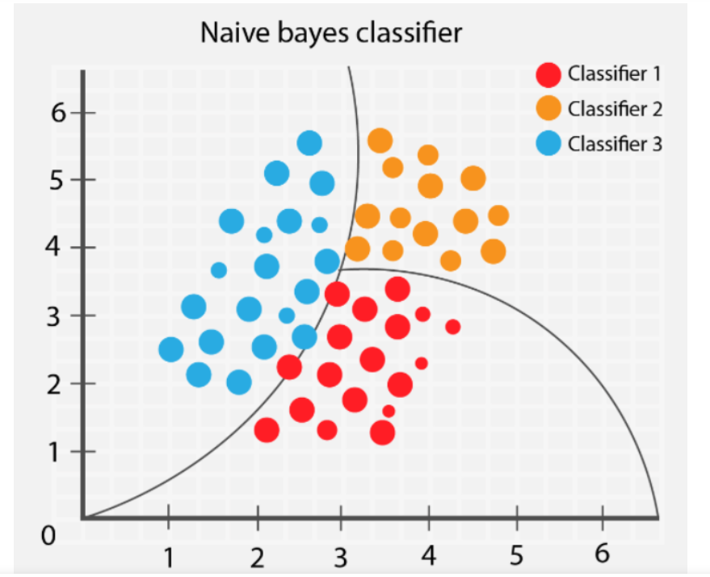

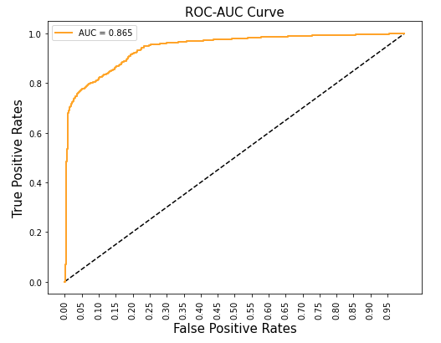
Naive Bayes
It is one of the probabilistic machine learning models widely used for classification and predictive modeling.
It is a collection of classification algorithms based on Bayes theorem which works on conditional probability. It gives the probability of some event happening based on some event already happened.
Bayes theorem:
Advantages:
Widely used for multiclass classification applications for both categorical and numerical datasets.
Highly extensible algorithm which learns very fast and can be used to make predictions in real time
Disadvantages:
It considers that all the variables are independent in natures which will not be the situation in real time as most of the time the variables will be dependent on each other which hinders the performance of the classifier
 | Accuracy | Precision | Recall | F1 Score | AUC
Without Hyper-parameter tuning | 0.86 | 0.89 | 0.8216 | 0.8545 | 0.86
With Hyper-parameter tuning | 0.865 | 0.888 | 0.8356 | 0.861 | 0.865

Slide 34
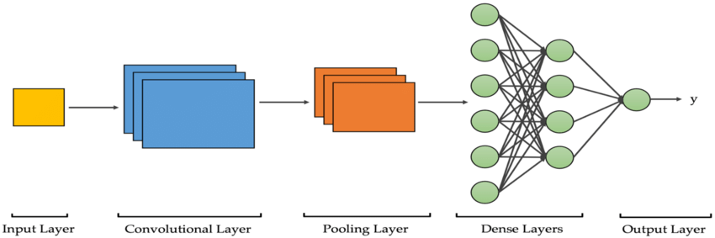
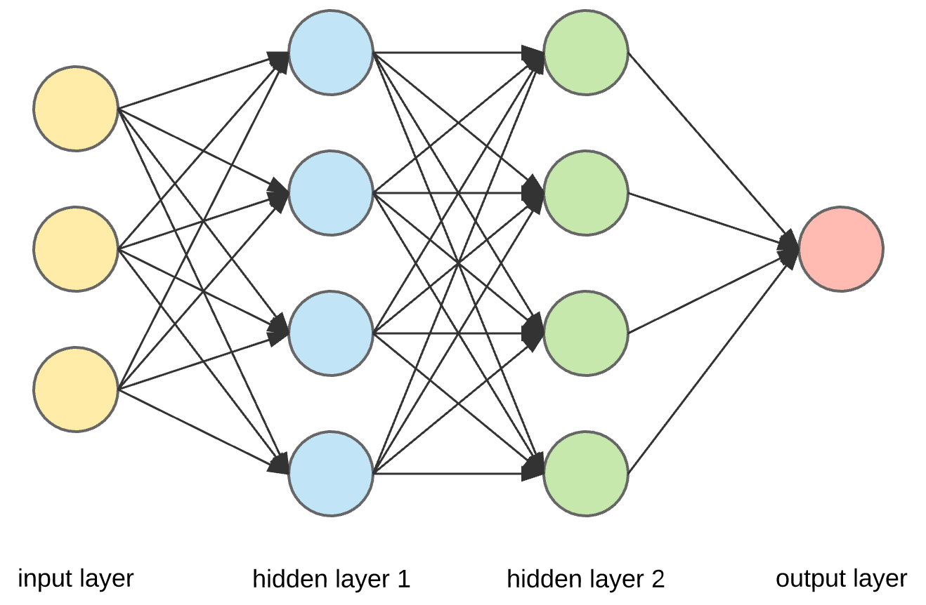
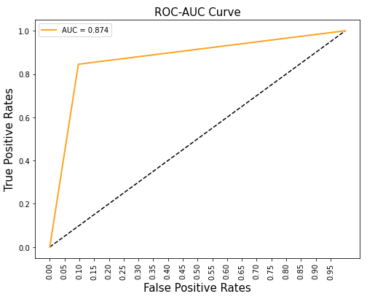
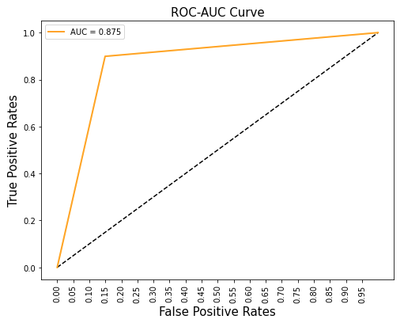
Deep Learning Model - CNN and ANN
CNN
.
Convolutional layer is the main building block of a CNN. It contains a set of filters/kernels, parameters of which are to be learned throughout the training.
Pooling layers are used to reduce the dimensions of the feature maps. It reduces the number of parameters to learn and the amount of computation performed in the network. It summarises the features present in a region of the feature map generated by a convolution layer.
Dense Layer is used to classify image based on output from convolutional layers. Each Layer in the Neural Network contains neurons, which compute the weighted average of its input and this weighted average is passed through a non-linear function, called as an “activation function”.
Hidden layers allow you to model complex data thanks to their nodes/neurons. They are “hidden” because the true values of their nodes are unknown in the training dataset. In fact, we only know the input and output. Each neural network has at least one hidden layer.
ANN
CNN
ANN
 | Accuracy | Precision | Recall | F1 Score | AUC
CNN | 0.8743 | 0.8973 | 0.8453 | 0.845 | 0.874
ANN | 0.8648 | 0.8575 | 0.899 | 0.877 | 0.875

Slide 35
AGENDA
CRISP-DM
Business Understanding
Data Understanding
Data Preparation
Modeling
Evaluation
Deployment
Conclusion & Future Work

Slide 36
MODEL COMPARISON
Model Name | Accuracy | Precision | Recall | F1 Score | AUC
KNN | 0.815 | 0.8061 | 0.8308 | 0.8183 | 0.816
Logistic | 0.86 | 0.8701 | 0.8528 | 0.8614 | 0.9189
Random Forest | 0.94 | 0.96 | 0.92 | 0.94 | 0.943
XGBoost | 0.95 | 0.94 | 0.95 | 0.95 | 0.948
SVM | 0.82 | 0.7976 | 0.855 | 0.8253 | 0.9205
Naive Bayes | 0.865 | 0.886 | 0.835 | 0.8613 | 0.865
Deep Learning model-CNN | 0.88 | 0.898 | 0.858 | 0.878 | 0.88
Deep Learning model-ANN | 0.874 | 0.8575 | 0.877 | 0.899 | 0.8748
Key Takeaways:
Among the Machine Learning models , it is observed that XGBoost algorithm performed the best with 95% of accuracy followed by Random forest with 94% of accuracy.
When compared among Deep learning models, Convolutional neural network gave better performance than Artificial neural network.

Slide 37

Best model post the comparison
Ensemble
Key Takeaway:
Ensemble models like XGBoost and Random Forest perform the best with higher AUC and recall as compared to other models

Slide 38
AGENDA
CRISP-DM
Business Understanding
Data Understanding
Data Preparation
Modeling
Evaluation
Deployment
Conclusion & Future Work

Slide 39
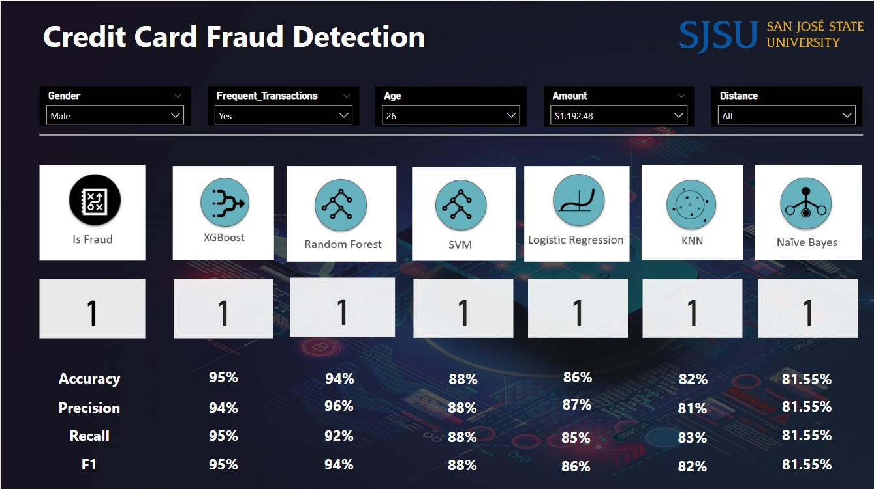
deployment

Slide 40
AGENDA
Business Understanding
Data Understanding
Data Preparation
Modeling
Evaluation
Deployment
Conclusion & Future Work

Slide 41
Conclusion and Future work
Conclusion & Learnings
Explored and decided various methodologies of feature transformation and hyper parameter tuning for modelling
Conclude the best model for the credit card fraud detection problem
Future Scope
Enhancing the number of features and making the model robust
Make the model scalable

Slide 42
References
https://www.analyticsvidhya.com/blog/2021/09/guide-for-building-an-end-to-end-logistic-regression-model/
https://machinelearningmastery.com/roc-curves-and-precision-recall-curves-for-classification-in-python/
https://scikit-learn.org/stable/modules/generated/sklearn.linear_model.LogisticRegression.html
https://medium.com/codex/do-i-need-to-tune-logistic-regression-hyperparameters-1cb2b81fca69
https://scikit-learn.org/stable/modules/generated/sklearn.metrics.get_scorer_names.html
https://machinelearningmastery.com/hyperparameter-optimization-with-random-search-and-grid-search/
https://www.geeksforgeeks.org/svm-hyperparameter-tuning-using-gridsearchcv-ml/
https://www.analyticsvidhya.com/blog/2017/09/understaing-support-vector-machine-example-code/
https://ieeexplore.ieee.org/document/9673381
https://ieeexplore.ieee.org/document/8424696
https://ieeexplore.ieee.org/document/9432308?signout=success
https://ieeexplore.ieee.org/document/9755930
https://machinelearningmastery.com/naive-bayes-for-machine-learning/
https://towardsdatascience.com/having-an-imbalanced-dataset-here-is-how-you-can-solve-it-1640568947ebhttps://towardsdatascience.com/having-an-imbalanced-dataset-here-is-how-you-can-solve-it-1640568947eb
https://rikunert.com/SMOTE_explained
https://towardsdatascience.com/having-an-imbalanced-dataset-here-is-how-you-can-solve-it-1640568947eb
https://github.com/HusseinAzeez/fraud-detection-model-using-deep-learning
https://github.com/sambit-0007/Credit-Card-Fraud-Detection-using-ANN/blob/main/Credit%20Card%20Fraud%20Detection%20ANN.ipynb

Slide 43


Thank you

