Slide 1
Getting started with R: Five steps
Gina Nichols
21 October 2024
For Marco et al.

Slide 2
1. Download R and Rstudio
2. Organize your folders
3. Create a project
4. Create a script
5. Read in some data, do something to the data, write new data

Slide 3
1. Download R and Rstudio
2. Organize your folders
3. Create a project
4. Create a script
5. Read in some data, do something to the data, write new data

Slide 4


A programming language
Free
Uses command line
A product of the company Posit
Free
Allows you to interact with R in a way that doesn’t make your eyes bleed

Slide 5
Why use RStudio
It is common
You can integrate it with github
Another option is Jupyter Notebooks, popular with Python users

Slide 6
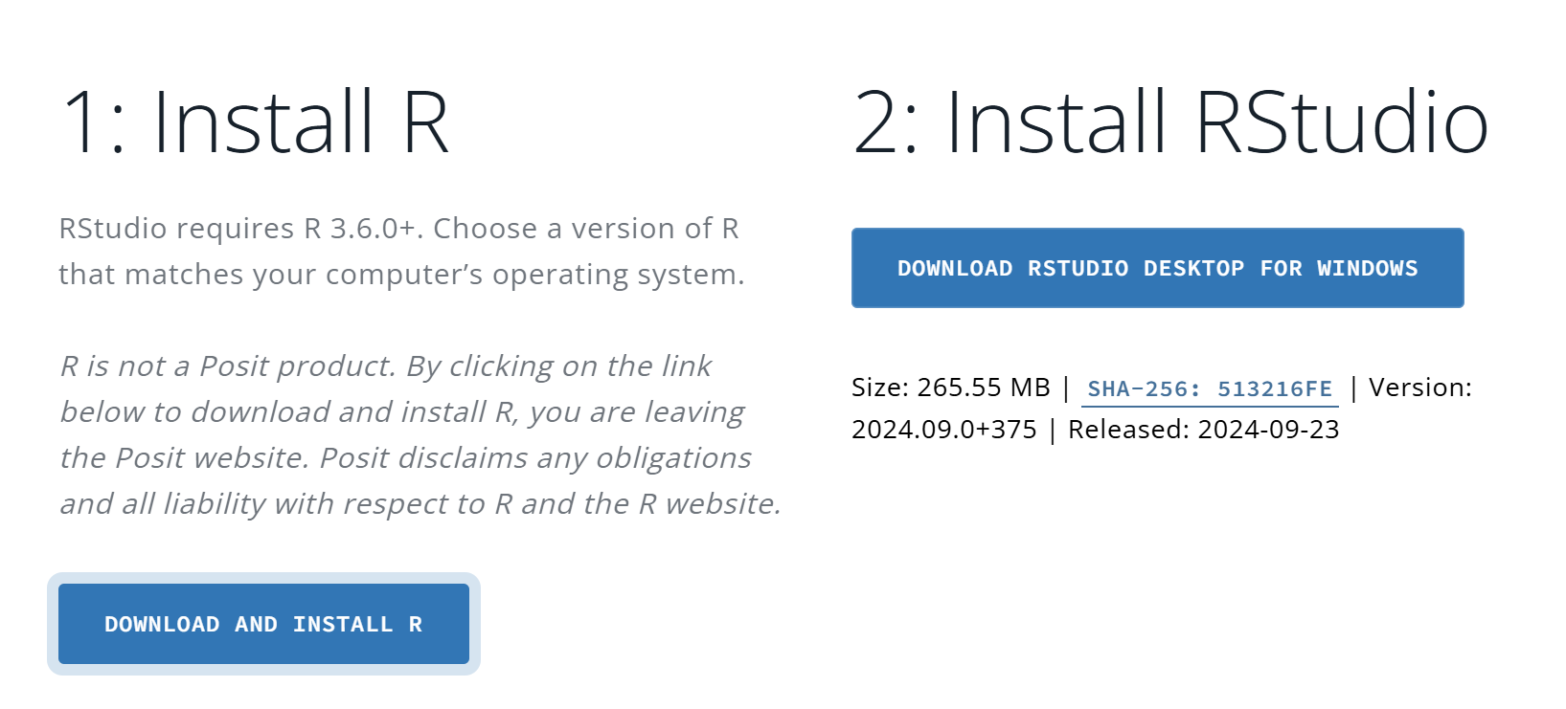
https://posit.co/download/rstudio-desktop/top - Posit

Slide 7

1. Download R and Rstudio
2. Organize your folders
3. Create a project
4. Create a script
5. Read in some data, do something to the data, write new data

Slide 8

Change the colors
Let’s take the time to do this…

Slide 9
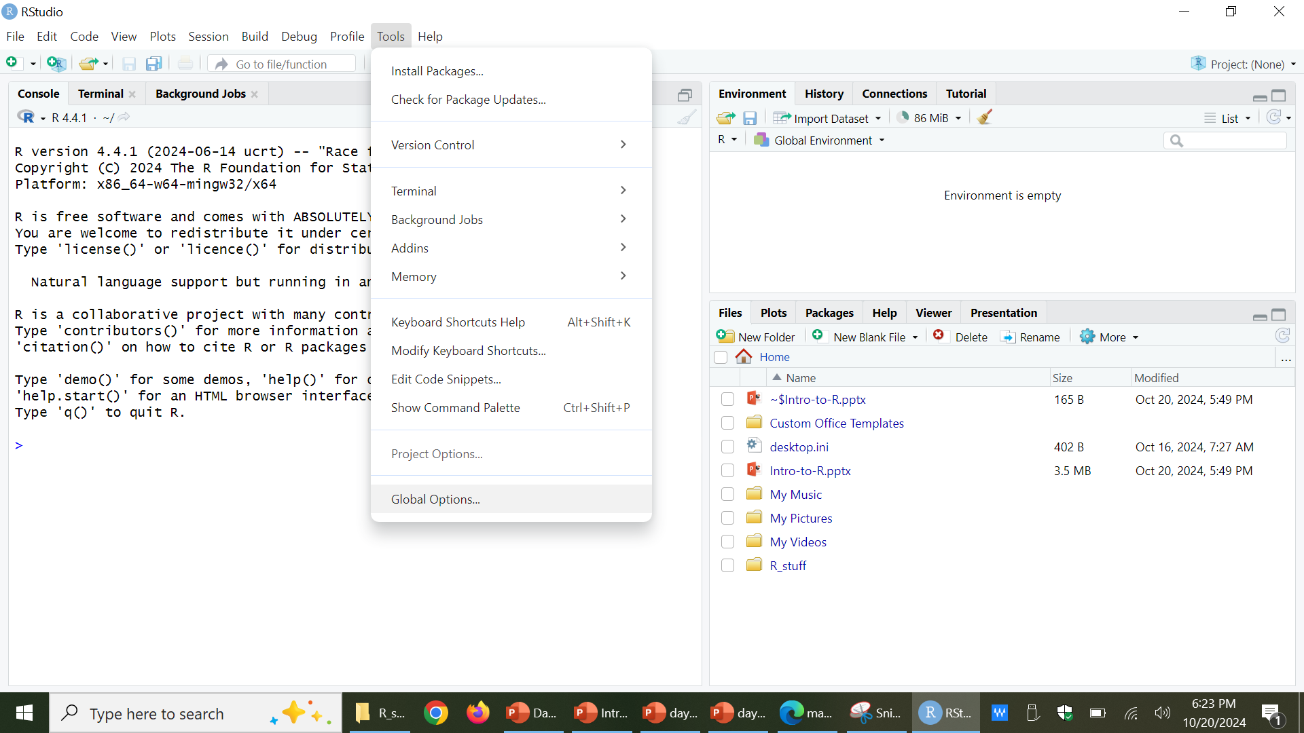

Slide 10
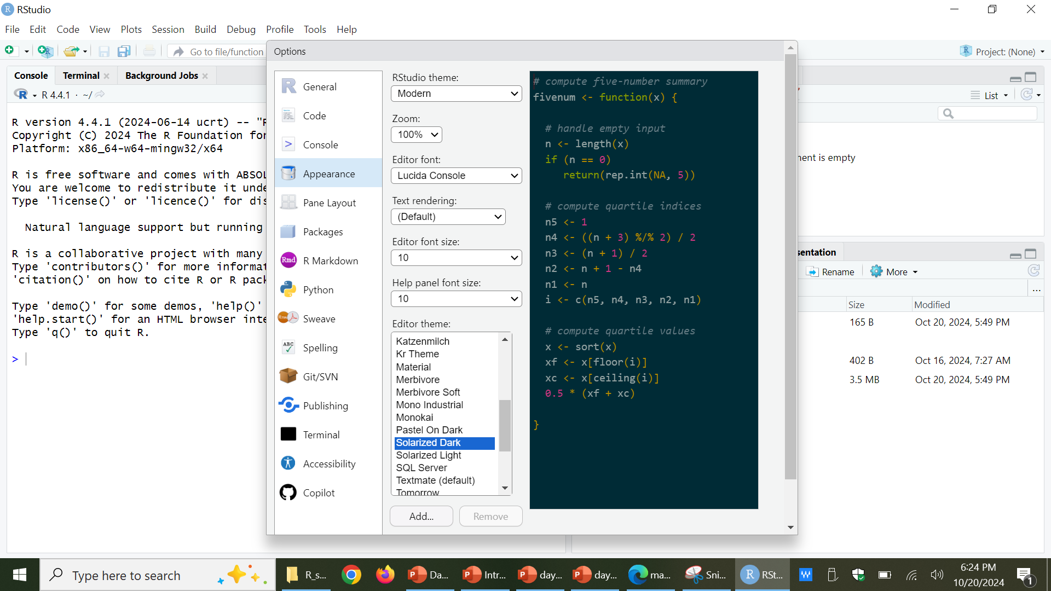

Slide 11
1. Download R and Rstudio
2. Organize your folders
3. Create a project
4. Create a script
5. Read in some data, do something to the data, write new data

Slide 12
1. Download R and Rstudio
2. Organize your folders
3. Create a project
4. Create a script
5. Read in some data, do something to the data, write new data

Slide 13
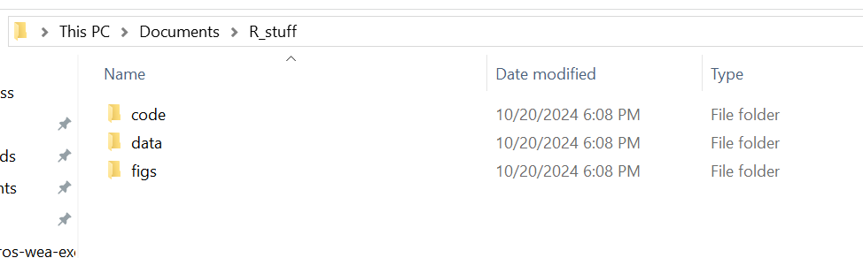
Name the mother folder something good

Slide 14
Naming
Case matters in R
Programming languages do not like spaces
Use underscores and dashes
Rproj_CropDiva
Crop Diva

Slide 15
Name the mother folder something good

Slide 16
1. Download R and Rstudio
2. Organize your folders
3. Create an R project
4. Create a script
5. Read in some data, do something to the data, write new data

Slide 17
1. Download R and Rstudio
2. Organize your folders
3. Create an R project
4. Create a script
5. Read in some data, do something to the data, write new data

Slide 18
WTF is an RProject
Just do it, it helps make your code easier to read and share
Makes file paths relative to RProject home
R/Rstudio - Why Use Projects? · David Chen

Slide 19
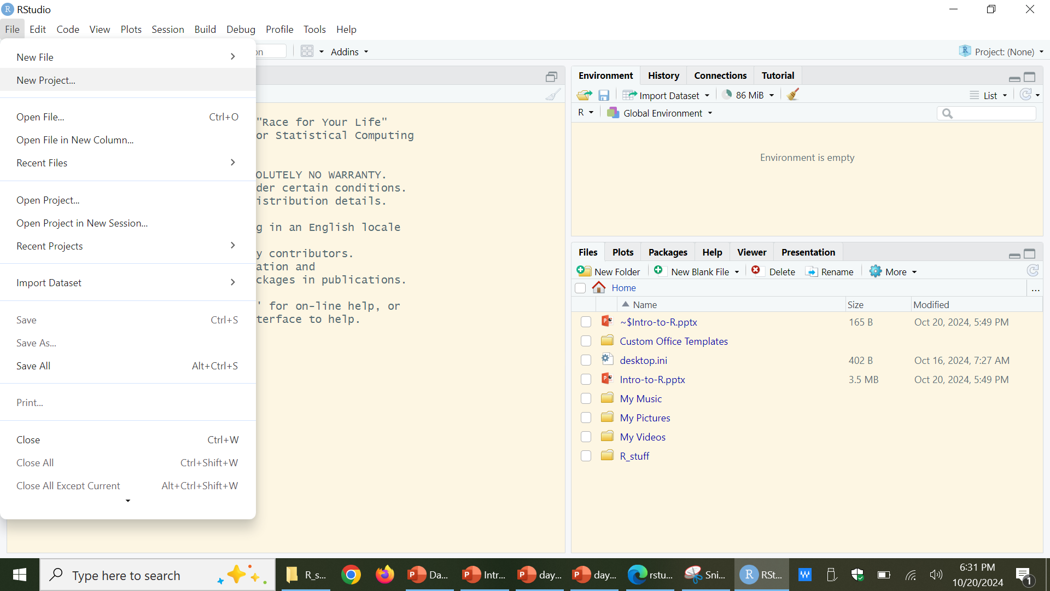

Slide 20
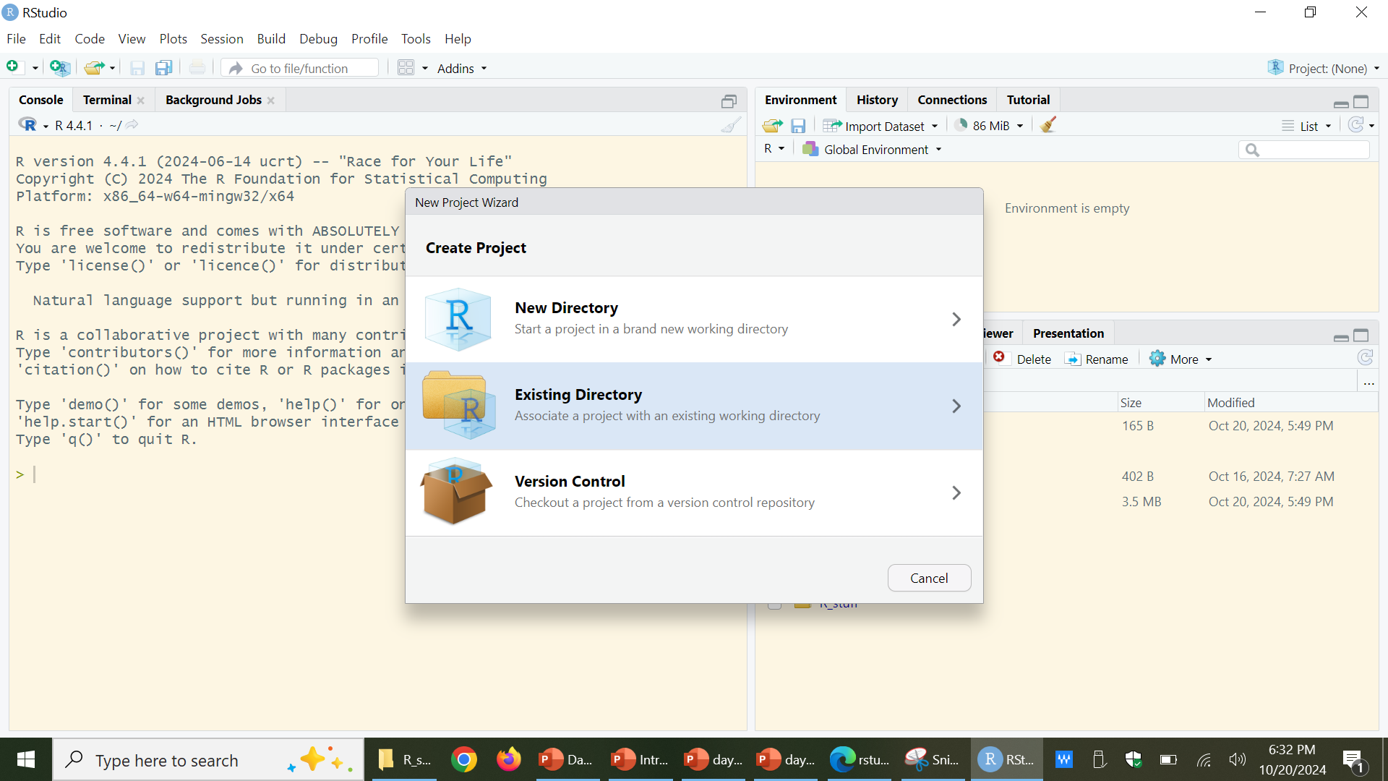

Slide 21
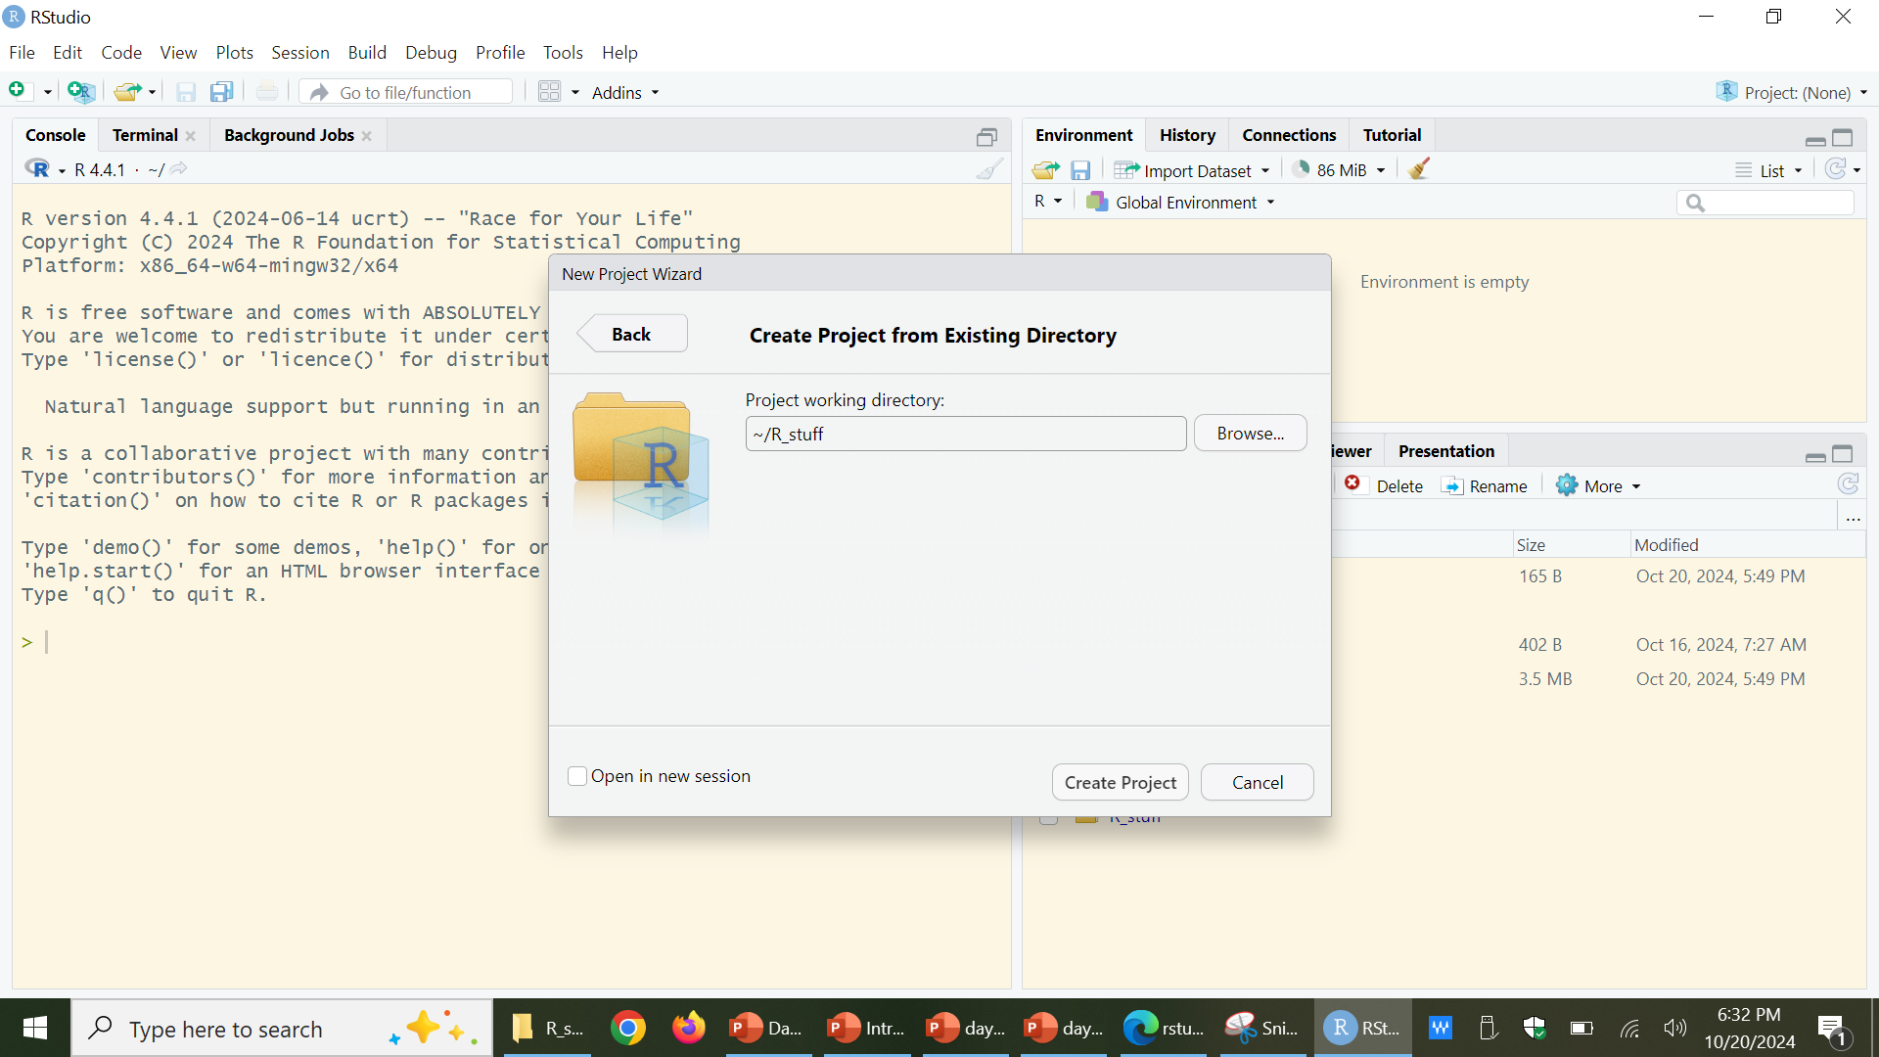

Slide 22
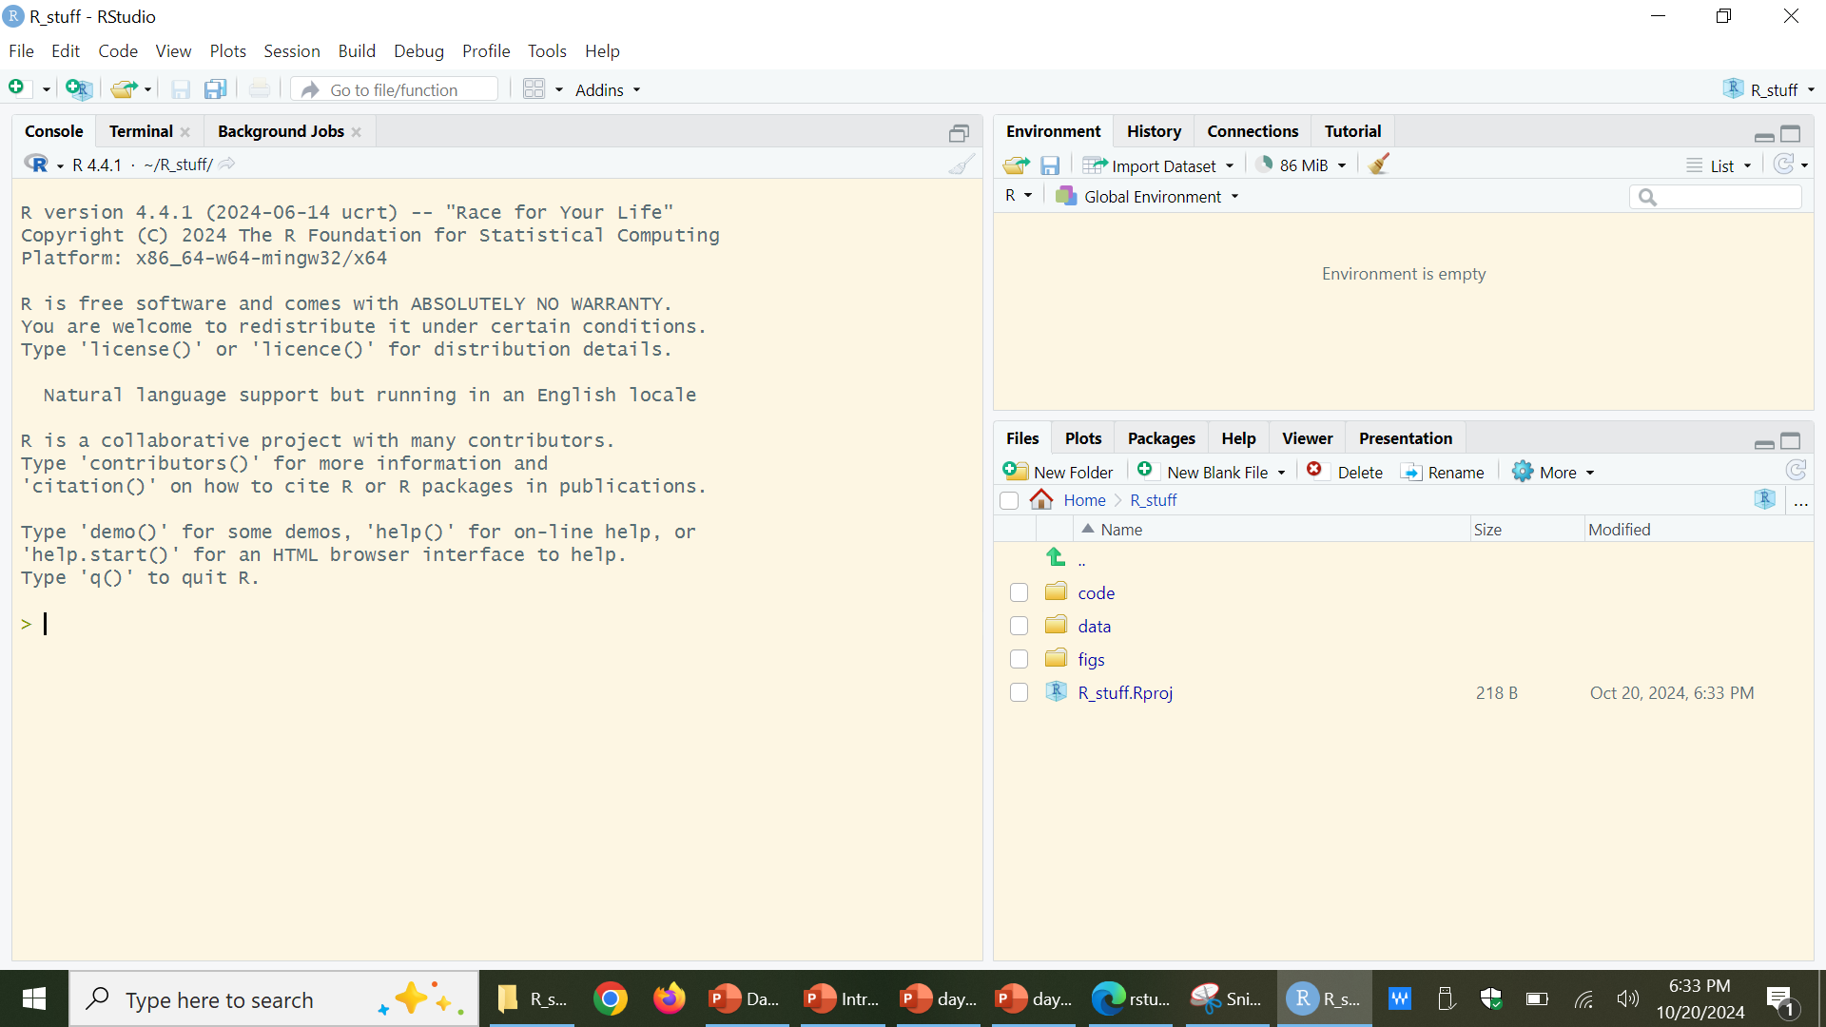

Slide 25
1. Download R and Rstudio
2. Organize your folders
3. Create an R project
4. Create a script
5. Read in some data, do something to the data, write new data

Slide 26
1. Download R and Rstudio
2. Organize your folders
3. Create an R project
4. Create a script
5. Read in some data, do something to the data, write new data

Slide 27
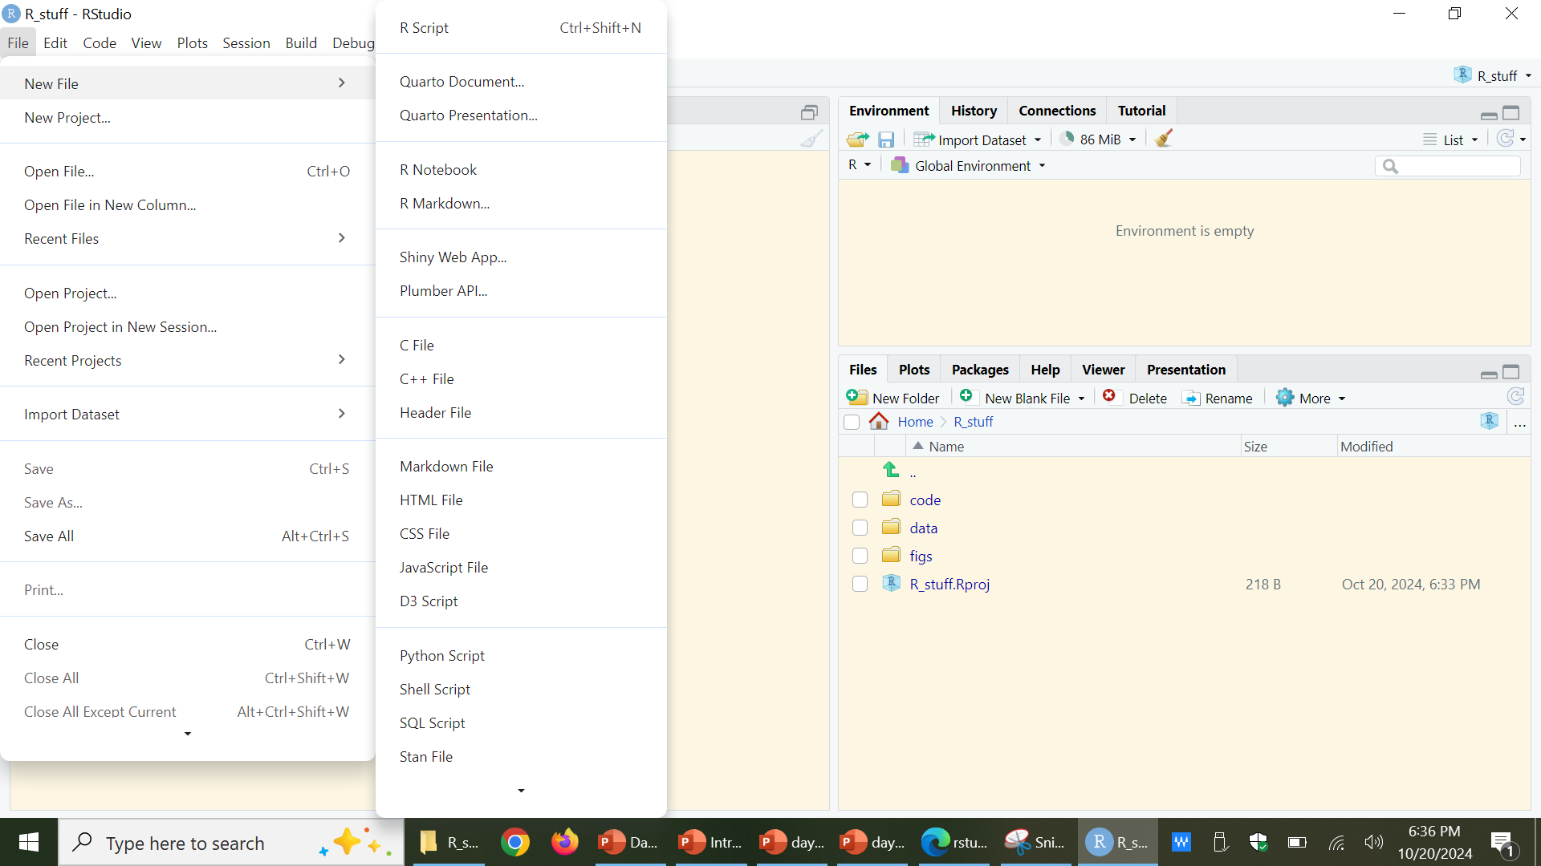

Slide 28
Code headings
# Your name
# Date code was created
# Date last modified
# Purpose
# Notes

Slide 29
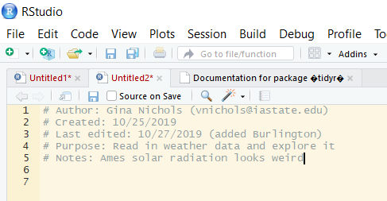
# means ‘I am not code’

Slide 30
Packages and libraries
Packages are the heart of R
Anyone can write an R package for other people to use
Not true for other languages (e.g., SAS)
Only need to install a package one time per computer
Let us install the ‘tidyverse’ package

Slide 31
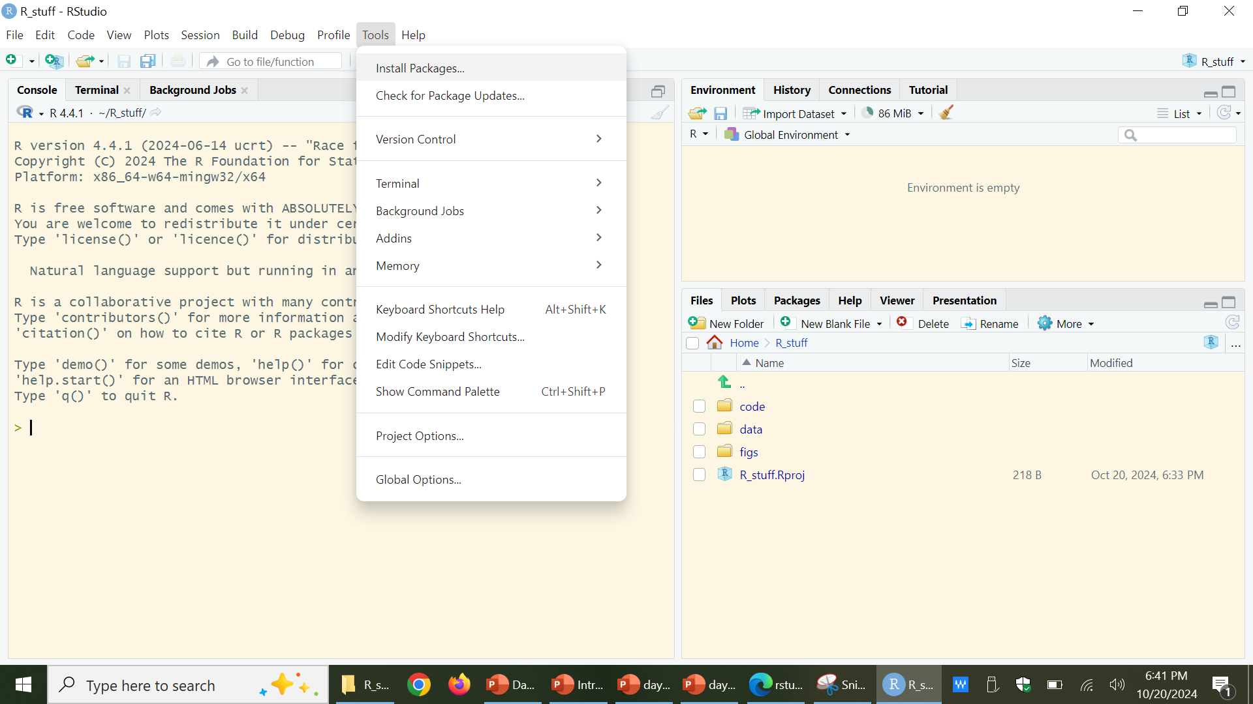

Slide 32
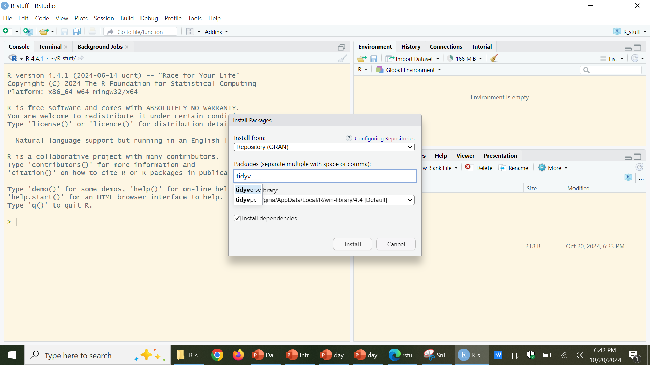

Slide 33


Slide 34
Packages and libraries
We have installed the ‘tidyverse’ package
To gain access to that package in your scripts, you:
library(tidyverse)

Slide 35
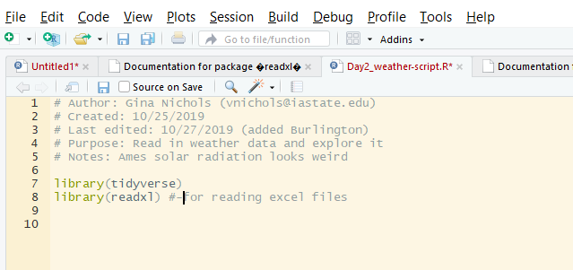
Install the readxl package on your own

Slide 36
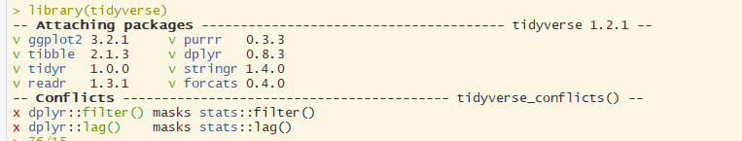
What happens when I execute (ctl+enter) library(tidyverse)

Slide 37
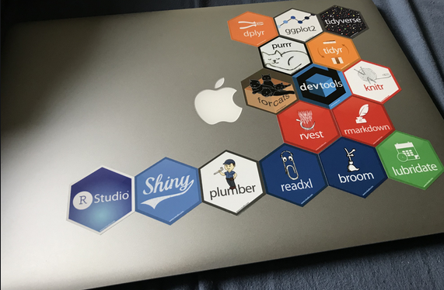

Slide 38
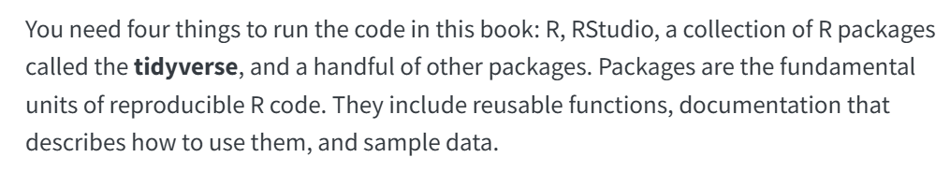
Now what?
Work through the book: R for Data Science (2e)

Slide 39
1. Download R and Rstudio
2. Organize your folders
3. Create an R project
4. Create a script
5. Read in some data, do something to the data, write new data

Slide 40
1. Download R and Rstudio
2. Organize your folders
3. Create an R project
4. Create a script
5. Read in some data, do something to the data, write new data

Slide 41
1. Download R and Rstudio
2. Organize your folders
3. Create an R project
4. Create a script
5. Read in some data, do something to the data, write new data
…read the book

