Slide 2
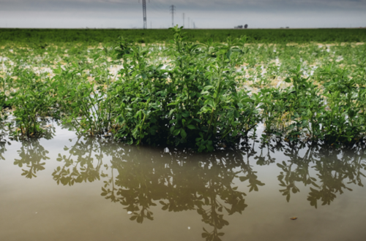
Narrow lens:
Not a great Californian crop
Broader lens:
A great Californian crop?

Slide 3
Motivation
Methodology
Learnings

Slide 4
Motivation
Methodology
Learnings

Slide 5
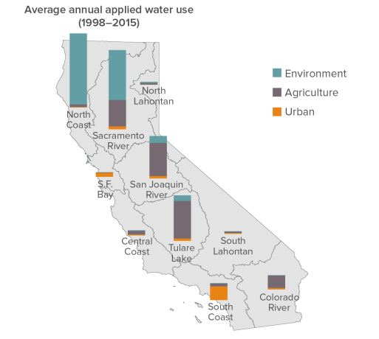
Motivation
Methodology
Learnings
Data from Department of Water Resources 2018, Figure from Public Policy Institute of California Fact Sheet
https://cwc.ca.gov/-/media/CWC-Website/Files/Documents/2019/06_June/June2019_Item_12_Attach_2_PPICFactSheets.pdf

Slide 6
Motivation
Methodology
Learnings

Slide 7
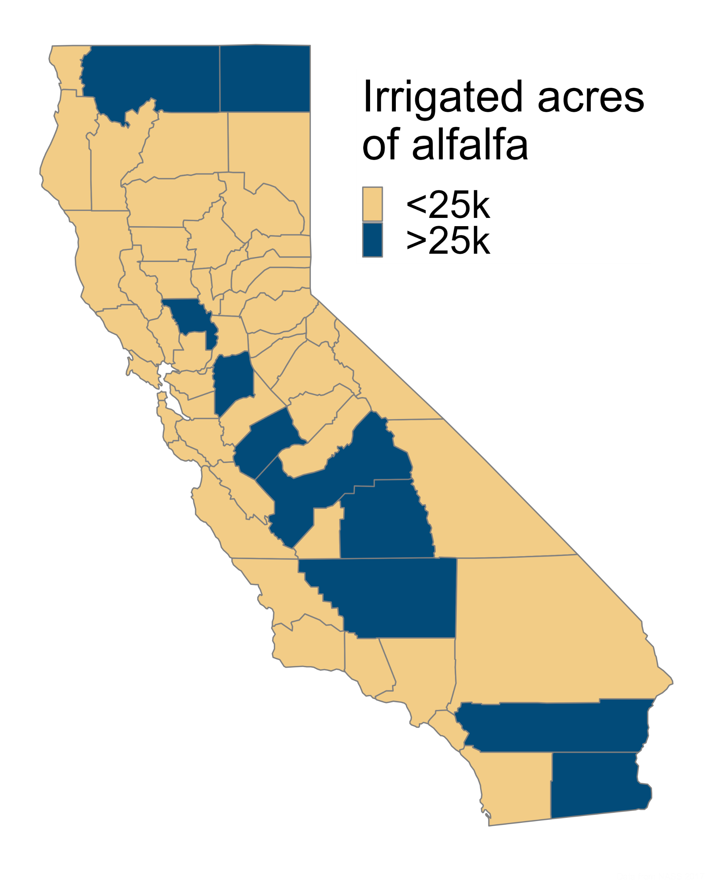
Motivation
Methodology
Learnings
Data from NASS 2017
Notes:
Environment includes water for ‘wild and scenic rivers’, required delta outflow, instream flows, managed wetlands. Ag includes water for crop production

Slide 8
Motivation
Methodology
Learnings
Notes:
Environment includes water for ‘wild and scenic rivers’, required delta outflow, instream flows, managed wetlands. Ag includes water for crop production

Slide 9
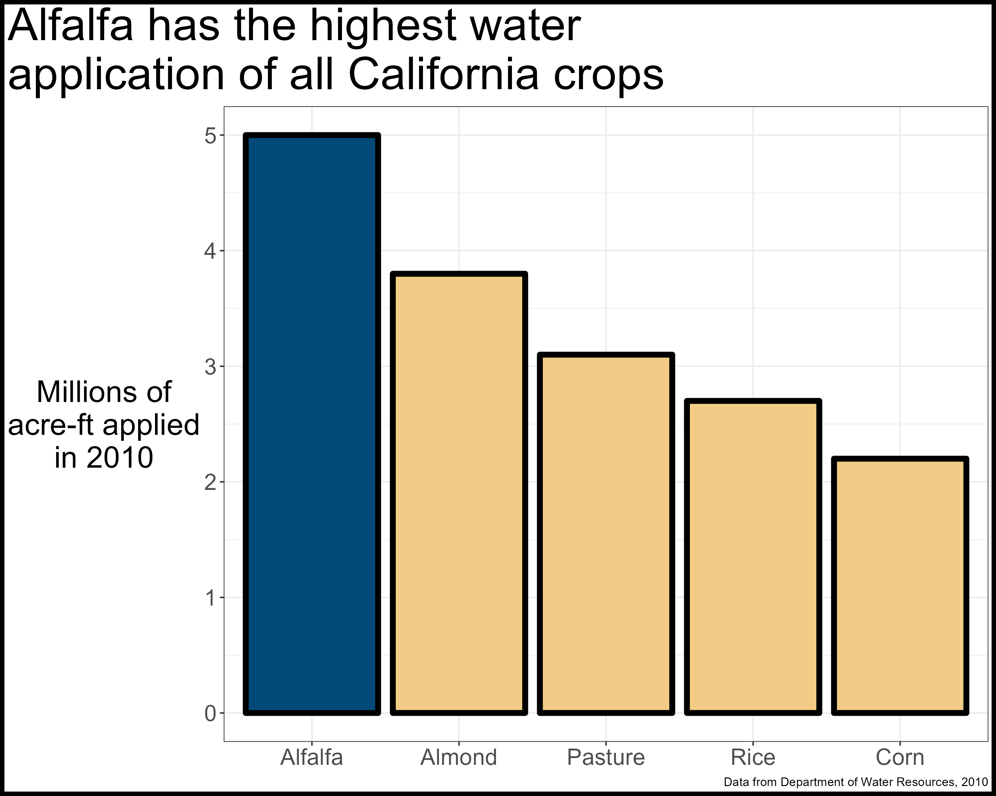
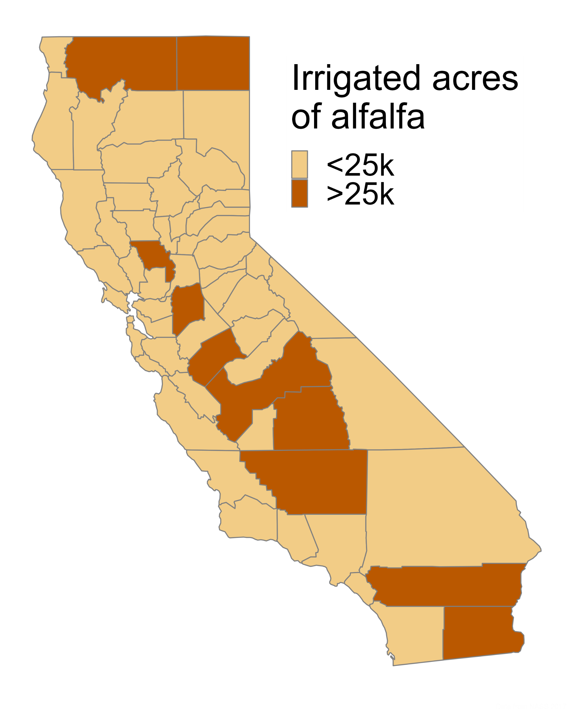
Motivation
Methodology
Learnings
Notes:
Environment includes water for ‘wild and scenic rivers’, required delta outflow, instream flows, managed wetlands. Ag includes water for crop production

Slide 10
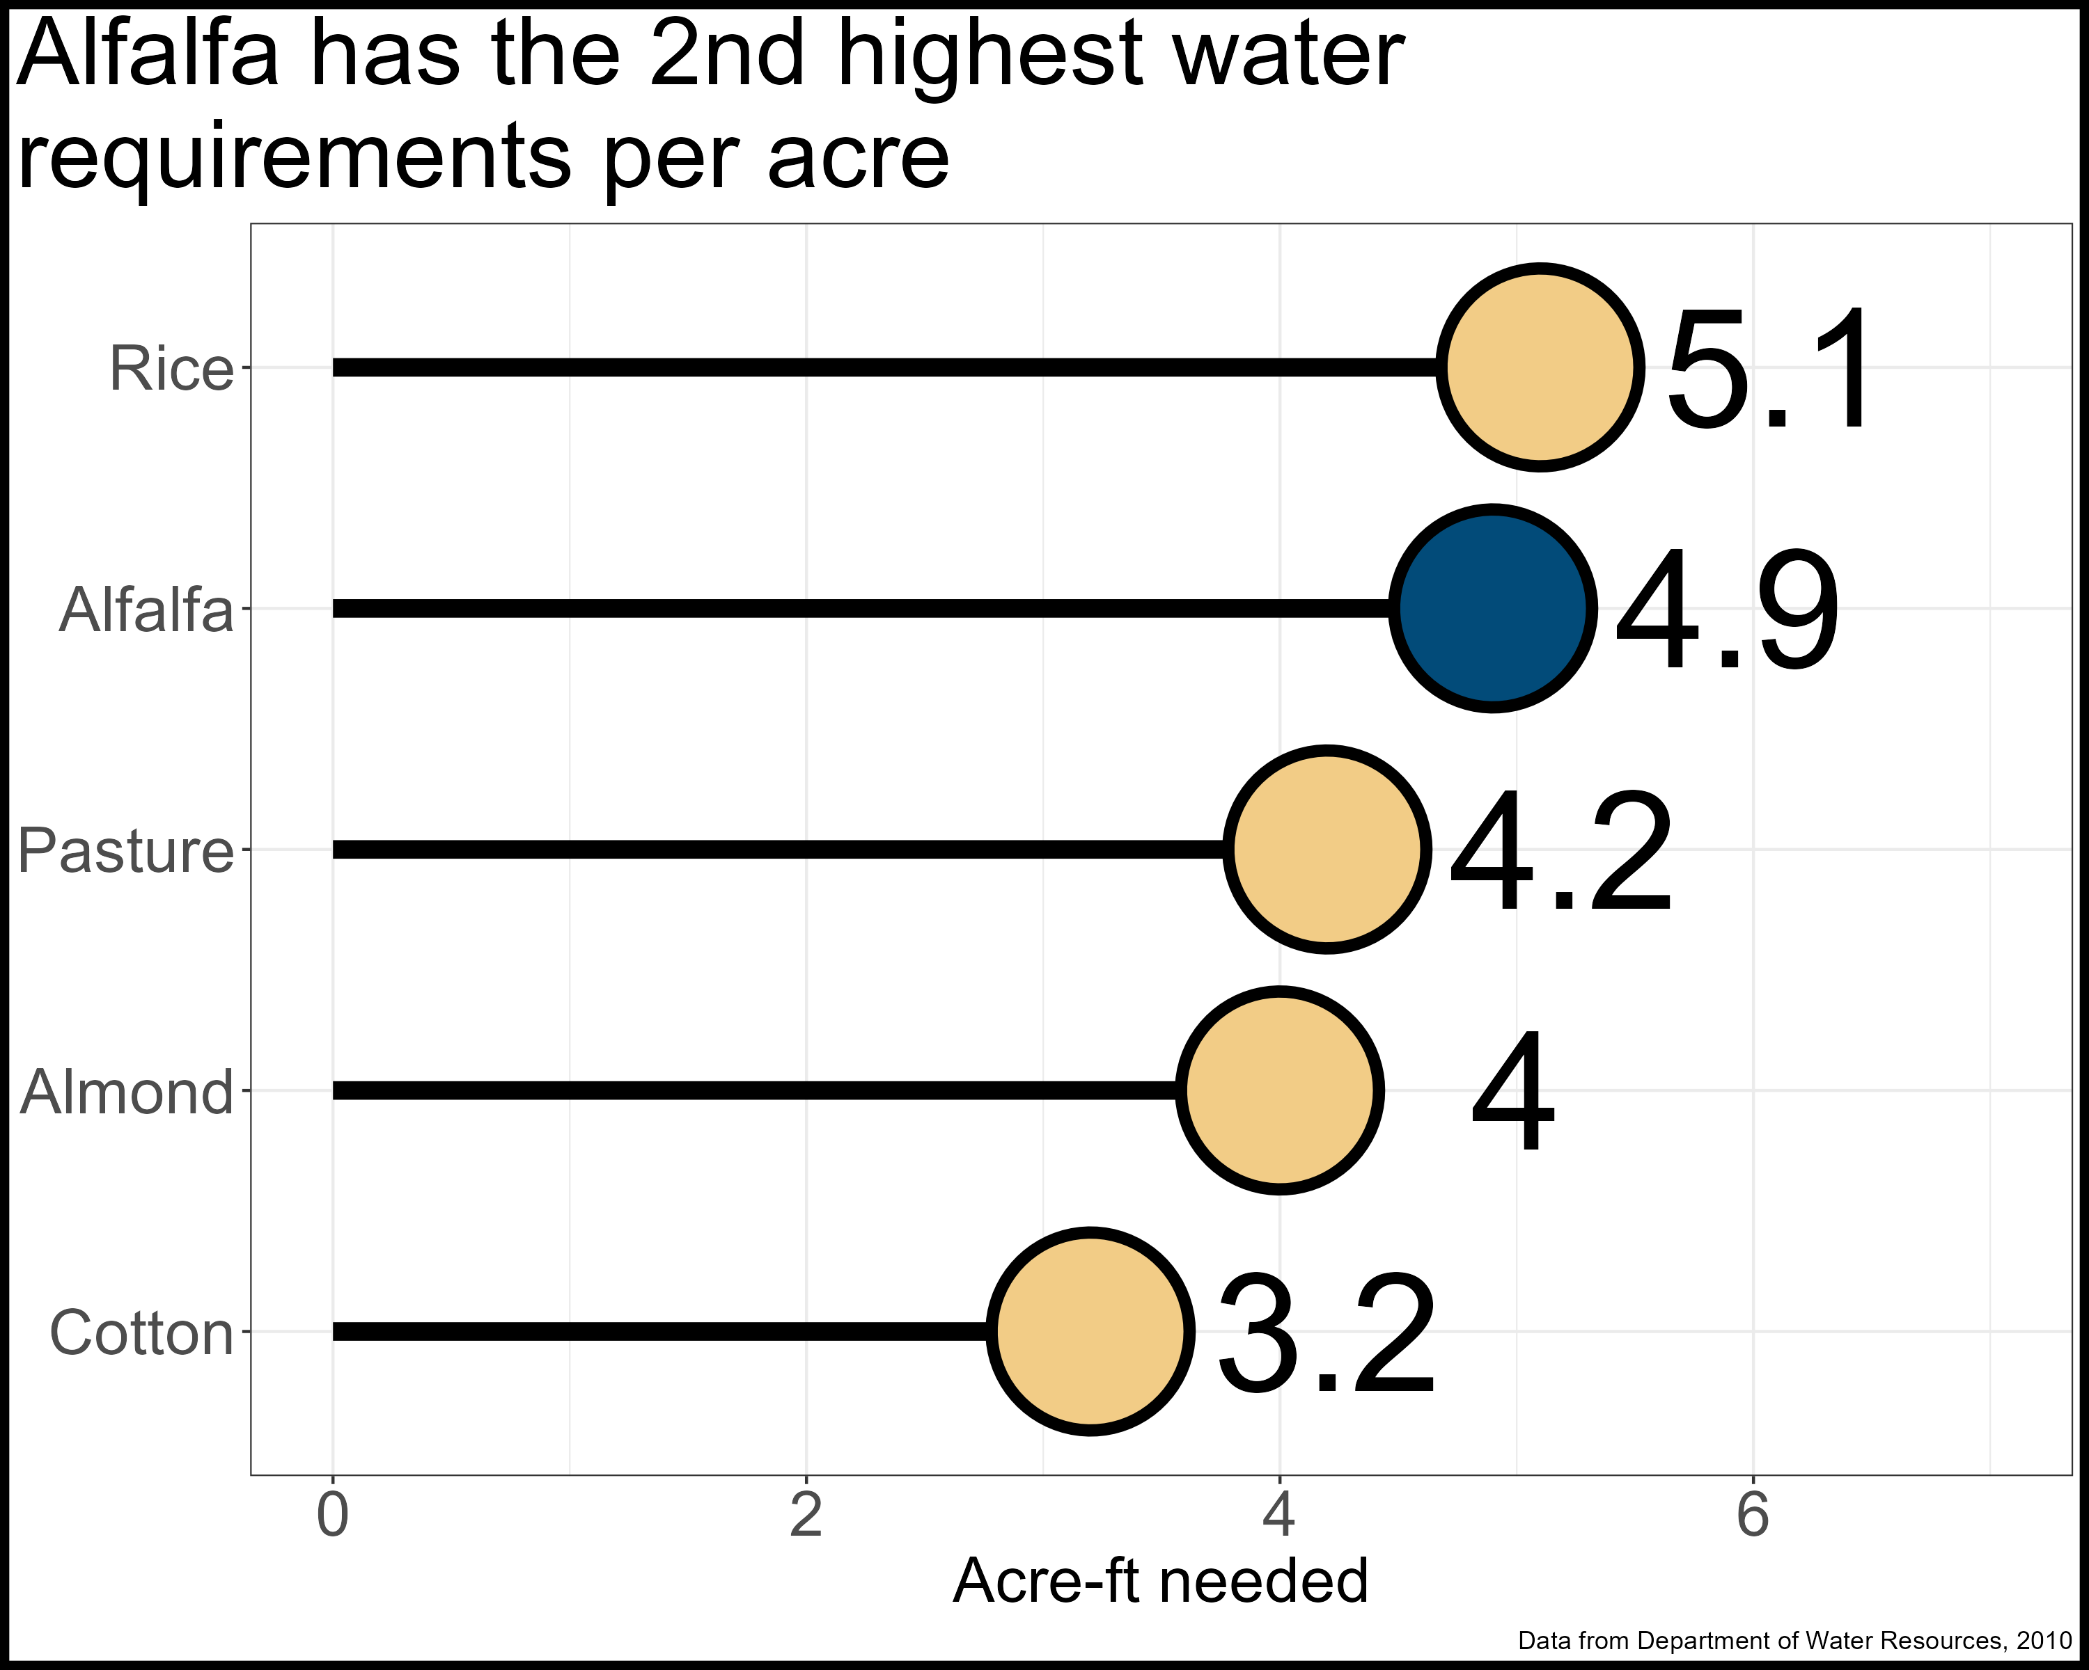
Motivation
Methodology
Learnings
Notes:
Environment includes water for ‘wild and scenic rivers’, required delta outflow, instream flows, managed wetlands. Ag includes water for crop production

Slide 11
Motivation
Methodology
Learnings

Slide 12
Motivation
Methodology
Learnings

Slide 13
Motivation
Methodology
Learnings

Slide 14
Motivation
Methodology
Learnings
Get rid of it.

Slide 15
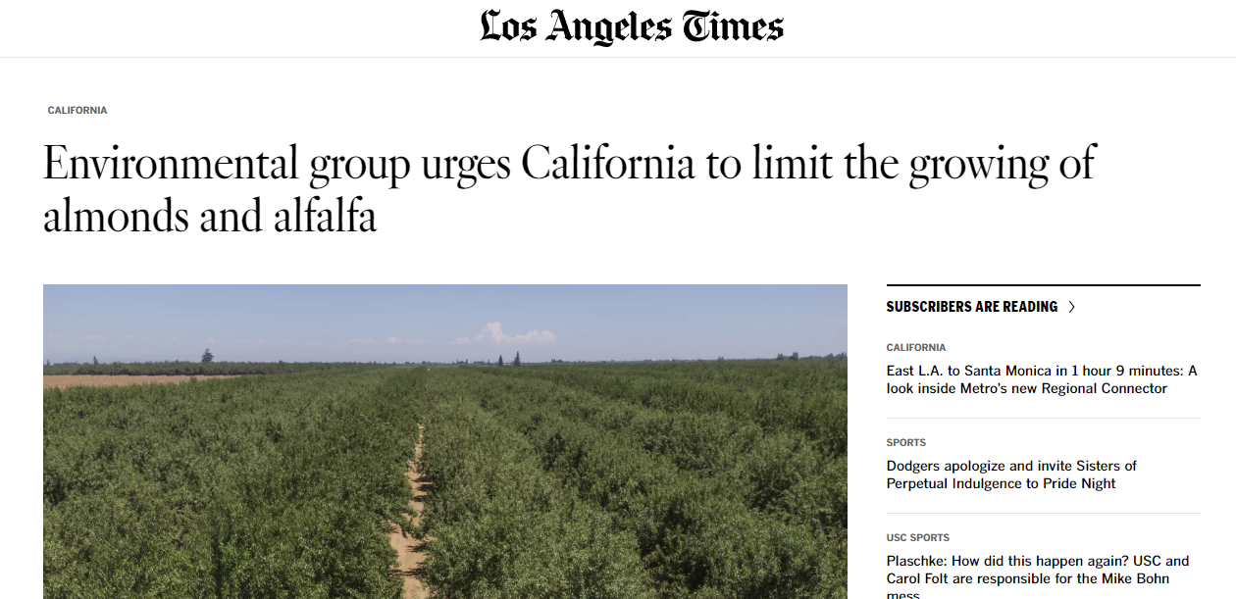
Motivation
Methodology
Learnings
https://phys.org/news/2023-02-environmental-group-urges-california-limit.html

Slide 16
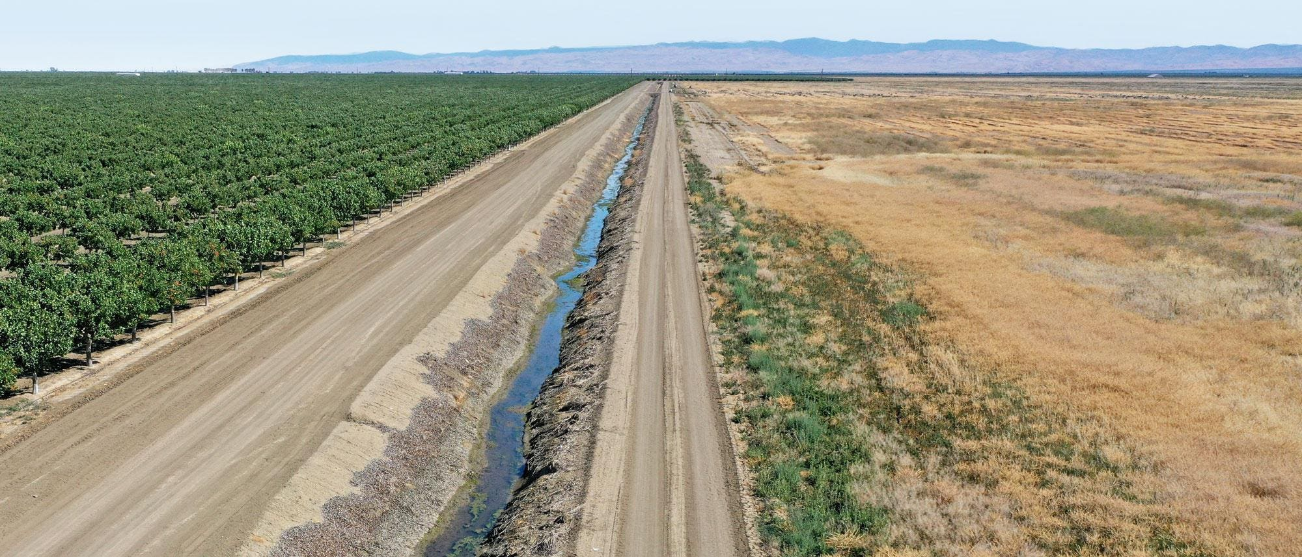
Motivation
Methodology
Learnings
https://www.forbes.com/sites/chloesorvino/2022/09/22/california-farms-pump-water-to-feed-crops-amid-extreme-heat-and-drought-but-residents-wells-are-running-dry/?sh=6550a2cd6eac

Slide 17

Motivation
Methodology
Learnings
One of the only wetland bird feeding areas left in California
Provides ‘free’ nitrogen to subsequent crop
Provides years without soil disturbance
Flexible water user

Slide 18

Motivation
Methodology
Learnings
Close proximity to dairies lowers transportation requirements
Lower yield variability compared to rainfed regions
Yields are consistently twice the US average

Slide 19
Motivation
Methodology
Learnings
?

Slide 20
Use Life Cycle Assessment methodologies to assess climate impacts of Californian alfalfa
Motivation
Methodology
Learnings
Uncertainty versus variation (Notarnicola et al. 2017)
Examine alfalfa production with regional nuance
Fully account for cropping system impacts (Costa et al. 2020)
Account for stand life and fertilizer reductions for subsequent crop
Identify and explore meaningful counterfactuals???

Slide 21
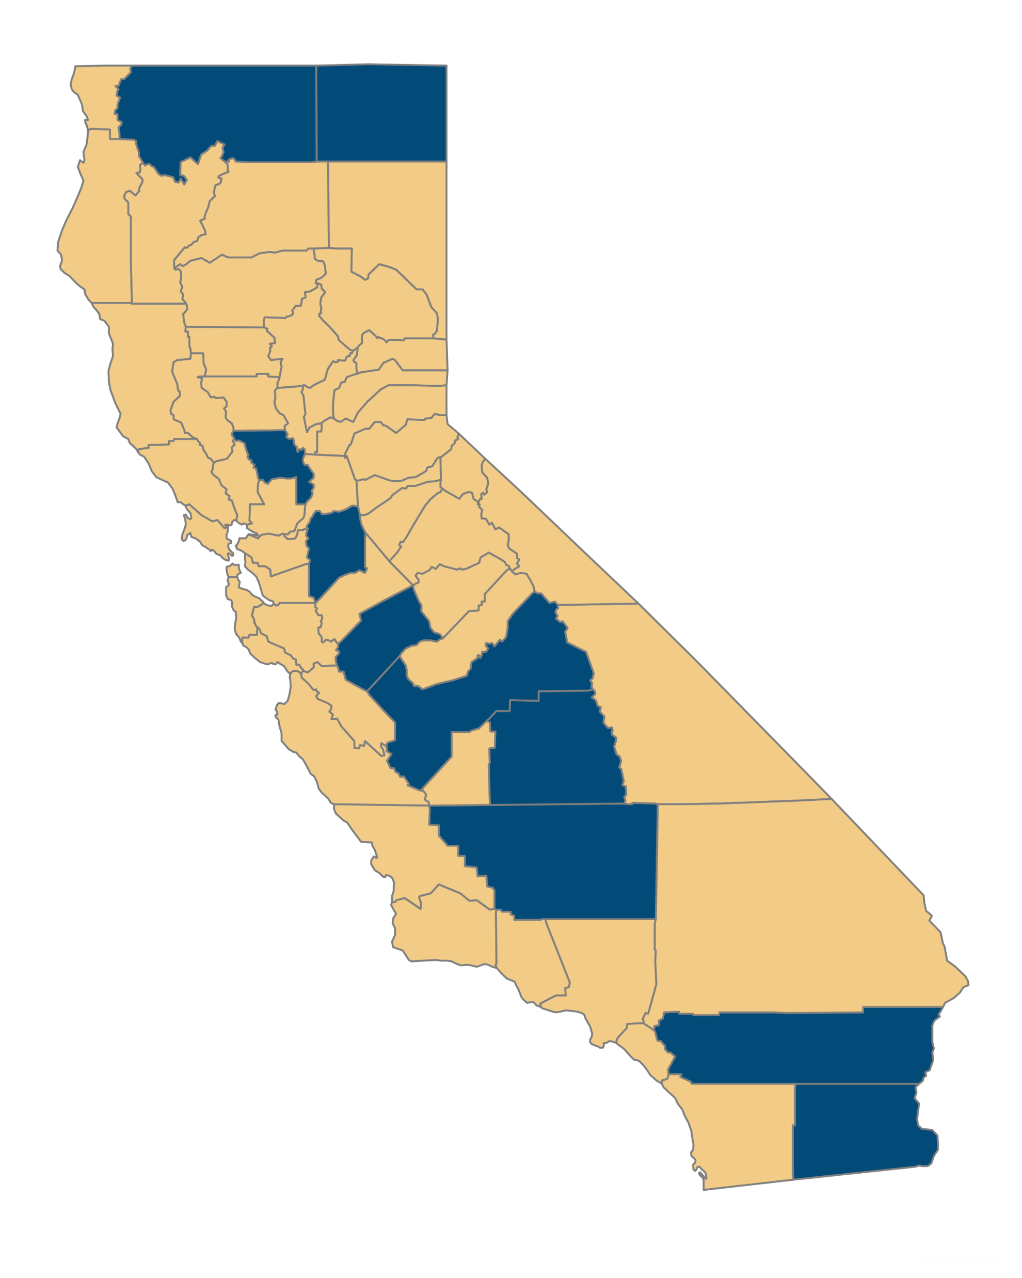
Motivation
Methodology
Learnings
Low input, low yields, major crop
Medium input, high yields, rotational crop
High input, high yields, major crop

Slide 22
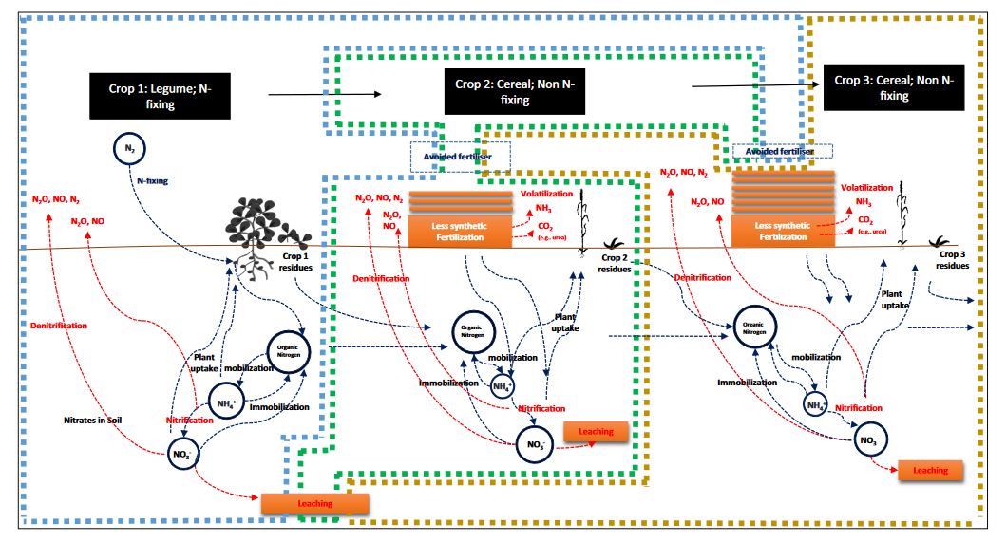

Slide 23
Functional unit:
1 hectare of land (carbon emissions)
1 Mg of dry yield (carbon efficiency)
System boundaries:
Cradle to roadside (~80% of alfalfa is sold)

Slide 24
Applied fertility products | Manufacturing
Applied pesticide products | Manufacturing
Irrigation | Manufacturing fuel, running pumps
Field passes | Manufacturing fuel for tractor, running tractor
Seed | Growing seed
Soil emissions | Soil N2O emissions | IPCC
Soil carbon changes | Sequestration of CO2 as soil carbon | California Healthy Soils
Avoided fertilizer application | Avoided manufacturing of fertility products
Avoided soil emissions | Avoided soil N2O emissions | IPCC

Slide 25

Motivation
Methodology
Learnings
http://comet-planner-cdfahsp.com/

Slide 26
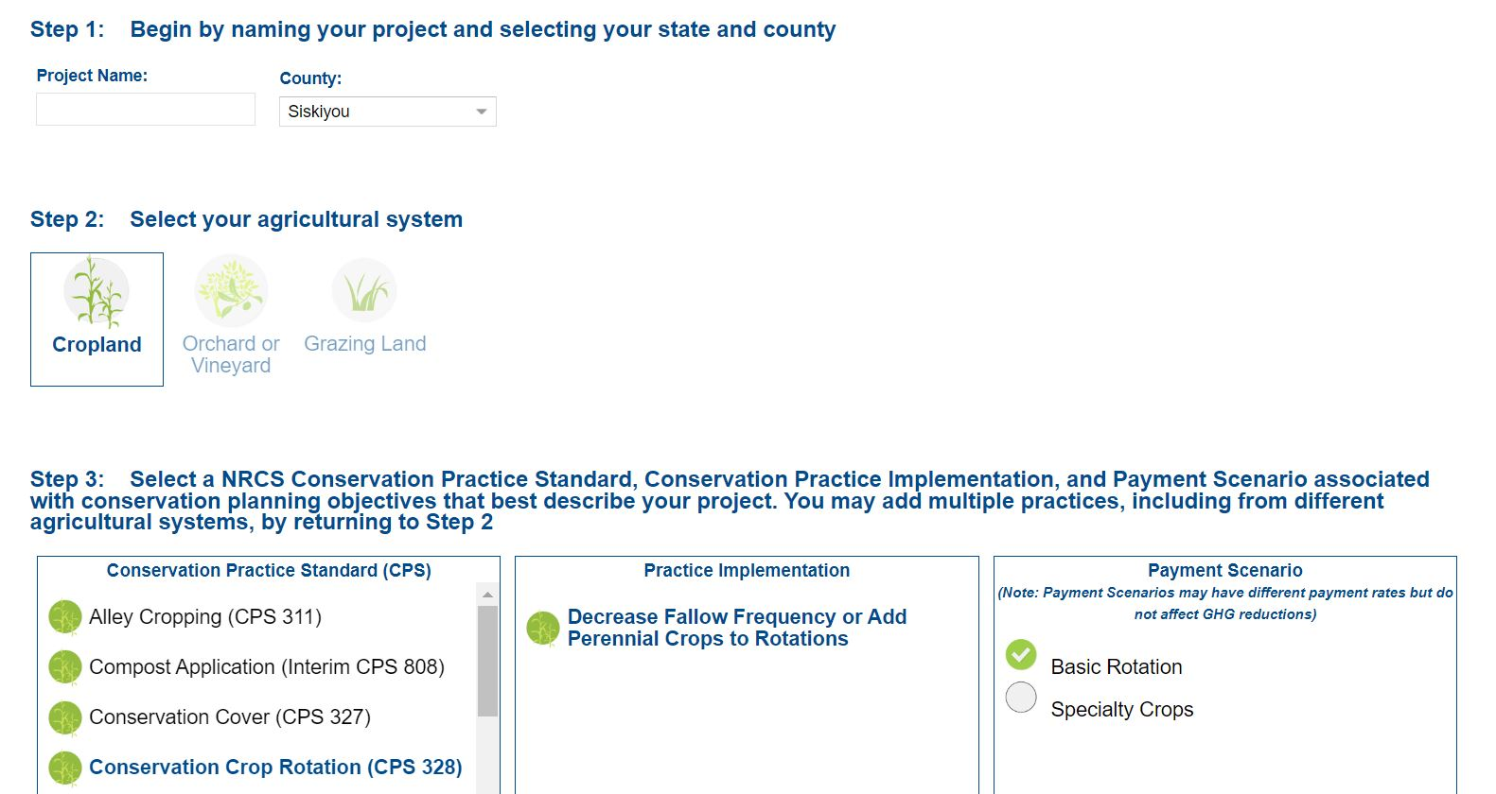
Motivation
Methodology
Learnings

Slide 27
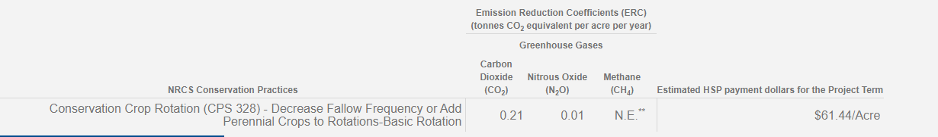
Motivation
Methodology
Learnings

Slide 28
Motivation
Methodology
Learnings
Decrease fallow frequency or add perennial crops to rotations

Slide 29
Motivation
Methodology
Learnings
Sequester carbon and reduce nitrous oxide emissions

Slide 30
Motivation
Methodology
Learnings
If alfalfa is sequestering 0.22 CO₂e per acre per year…
is there a scenario where it is climate neutral?

