Slide 1
Pressure of outlet
Depth to water source

Slide 2
Pressure of outlet
Energy required ~ f(depth to water,
pressure of outlet,
amount of water moved)
Depth to water source

Slide 3
Let’s say this pump requires 3 units of energy for this task.

Slide 4
Say the pump uses diesel.

Slide 5
Say the pump uses diesel.
One unit of diesel contains 3 units of energy.

Slide 6
Say the pump uses diesel.
One unit of diesel contains 3 units of energy.
FTM does this math, and says you need 1 unit of diesel (which is used for CO2 calcs). They also report your energy use as
3 units.

Slide 7
Methodology | Energy use | Diesel use
FTM | 3 units | 1 unit

Slide 8
Say the pump uses diesel.
However, diesel fuel only converts 30% of it’s energy into work (thermal efficiency). The rest is lost as heat, etc.

Slide 9
Say the pump uses diesel.
You will therefore actually need 3 units of diesel to run the pump.

Slide 10
Say the pump uses diesel.
You will therefore actually need 3 units of diesel to run the pump.
This translates to needing 9 units of energy for this pump, when you are using diesel to power it.

Slide 11
Methodology | Energy use | Diesel use
FTM | 3 units | 1 unit
NRCS¹ | 9 units | 3 units
¹https://ipat.sc.egov.usda.gov/Default.aspx

Slide 12
Different energy sources have different energy contents and efficiencies
Diesel contains the most energy per unit, and is 30% efficient.
Gasoline contains less energy per unit, and is only 25% efficient.
Electricity contains a small amount of energy per unit, but is 90% efficient.

Slide 13
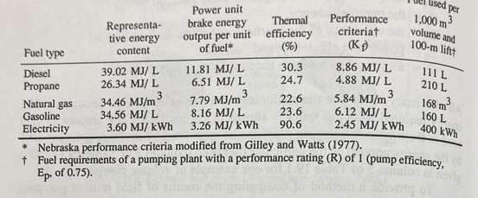
Field to Market references this table, but does not use it in its calculations.

Slide 14
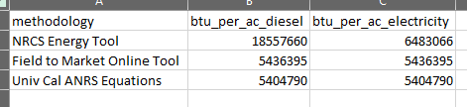
The energy used for irrigation should be responsive to the source of energy used.

