Slide 2
Why think like an LCAer?
Alfalfa. Narrow lens = not a great crop
Broader lens = a great crop?
Climate impacts?

Slide 3
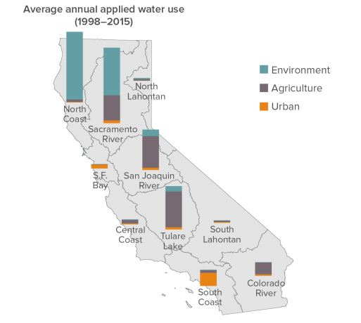
Motivation
Methodology
Learnings
Data from Department of Water Resources 2018, Figure from Public Policy Institute of California Fact Sheet
https://cwc.ca.gov/-/media/CWC-Website/Files/Documents/2019/06_June/June2019_Item_12_Attach_2_PPICFactSheets.pdf

Slide 4
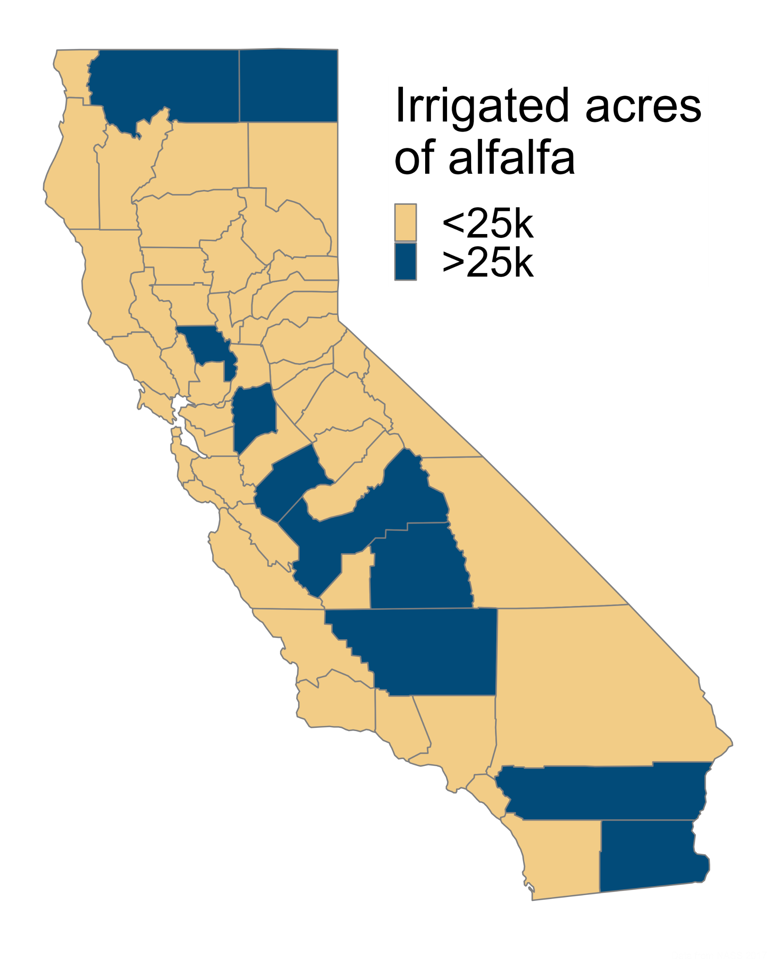
Motivation
Methodology
Learnings
Data from NASS 2017
Notes:
Environment includes water for ‘wild and scenic rivers’, required delta outflow, instream flows, managed wetlands. Ag includes water for crop production

Slide 5
Motivation
Methodology
Learnings
Notes:
Environment includes water for ‘wild and scenic rivers’, required delta outflow, instream flows, managed wetlands. Ag includes water for crop production

Slide 6
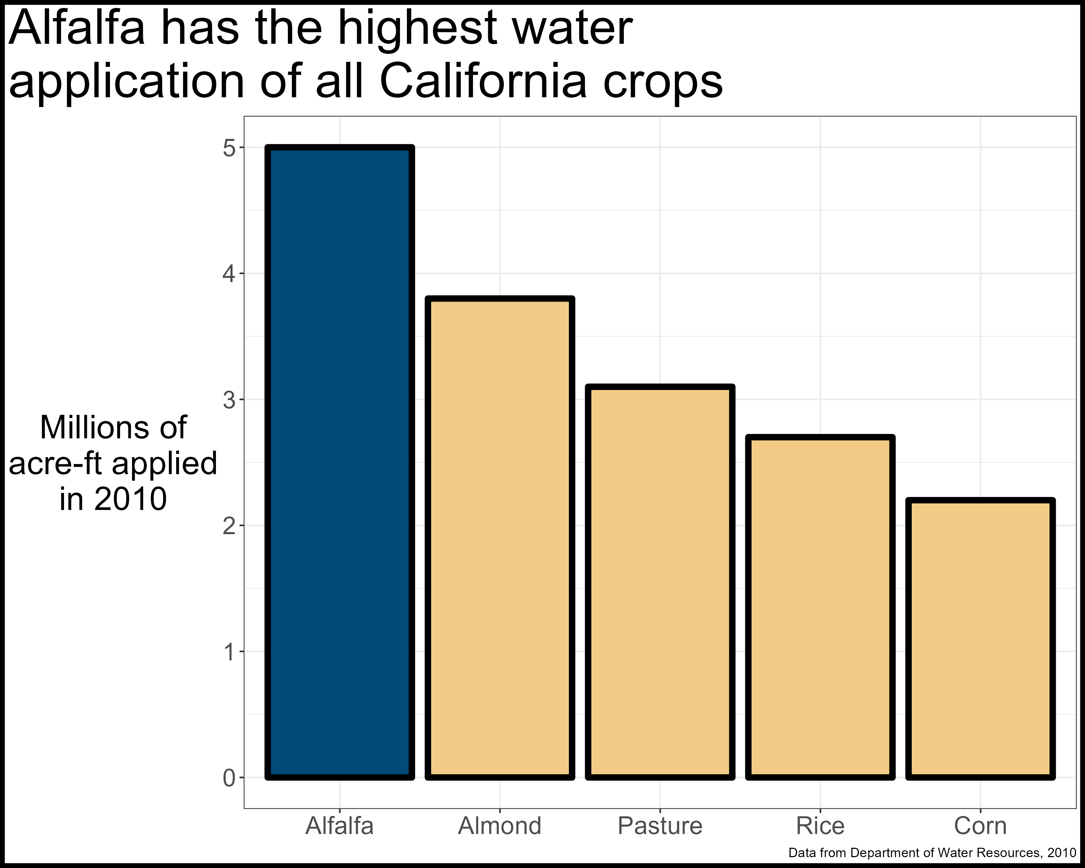
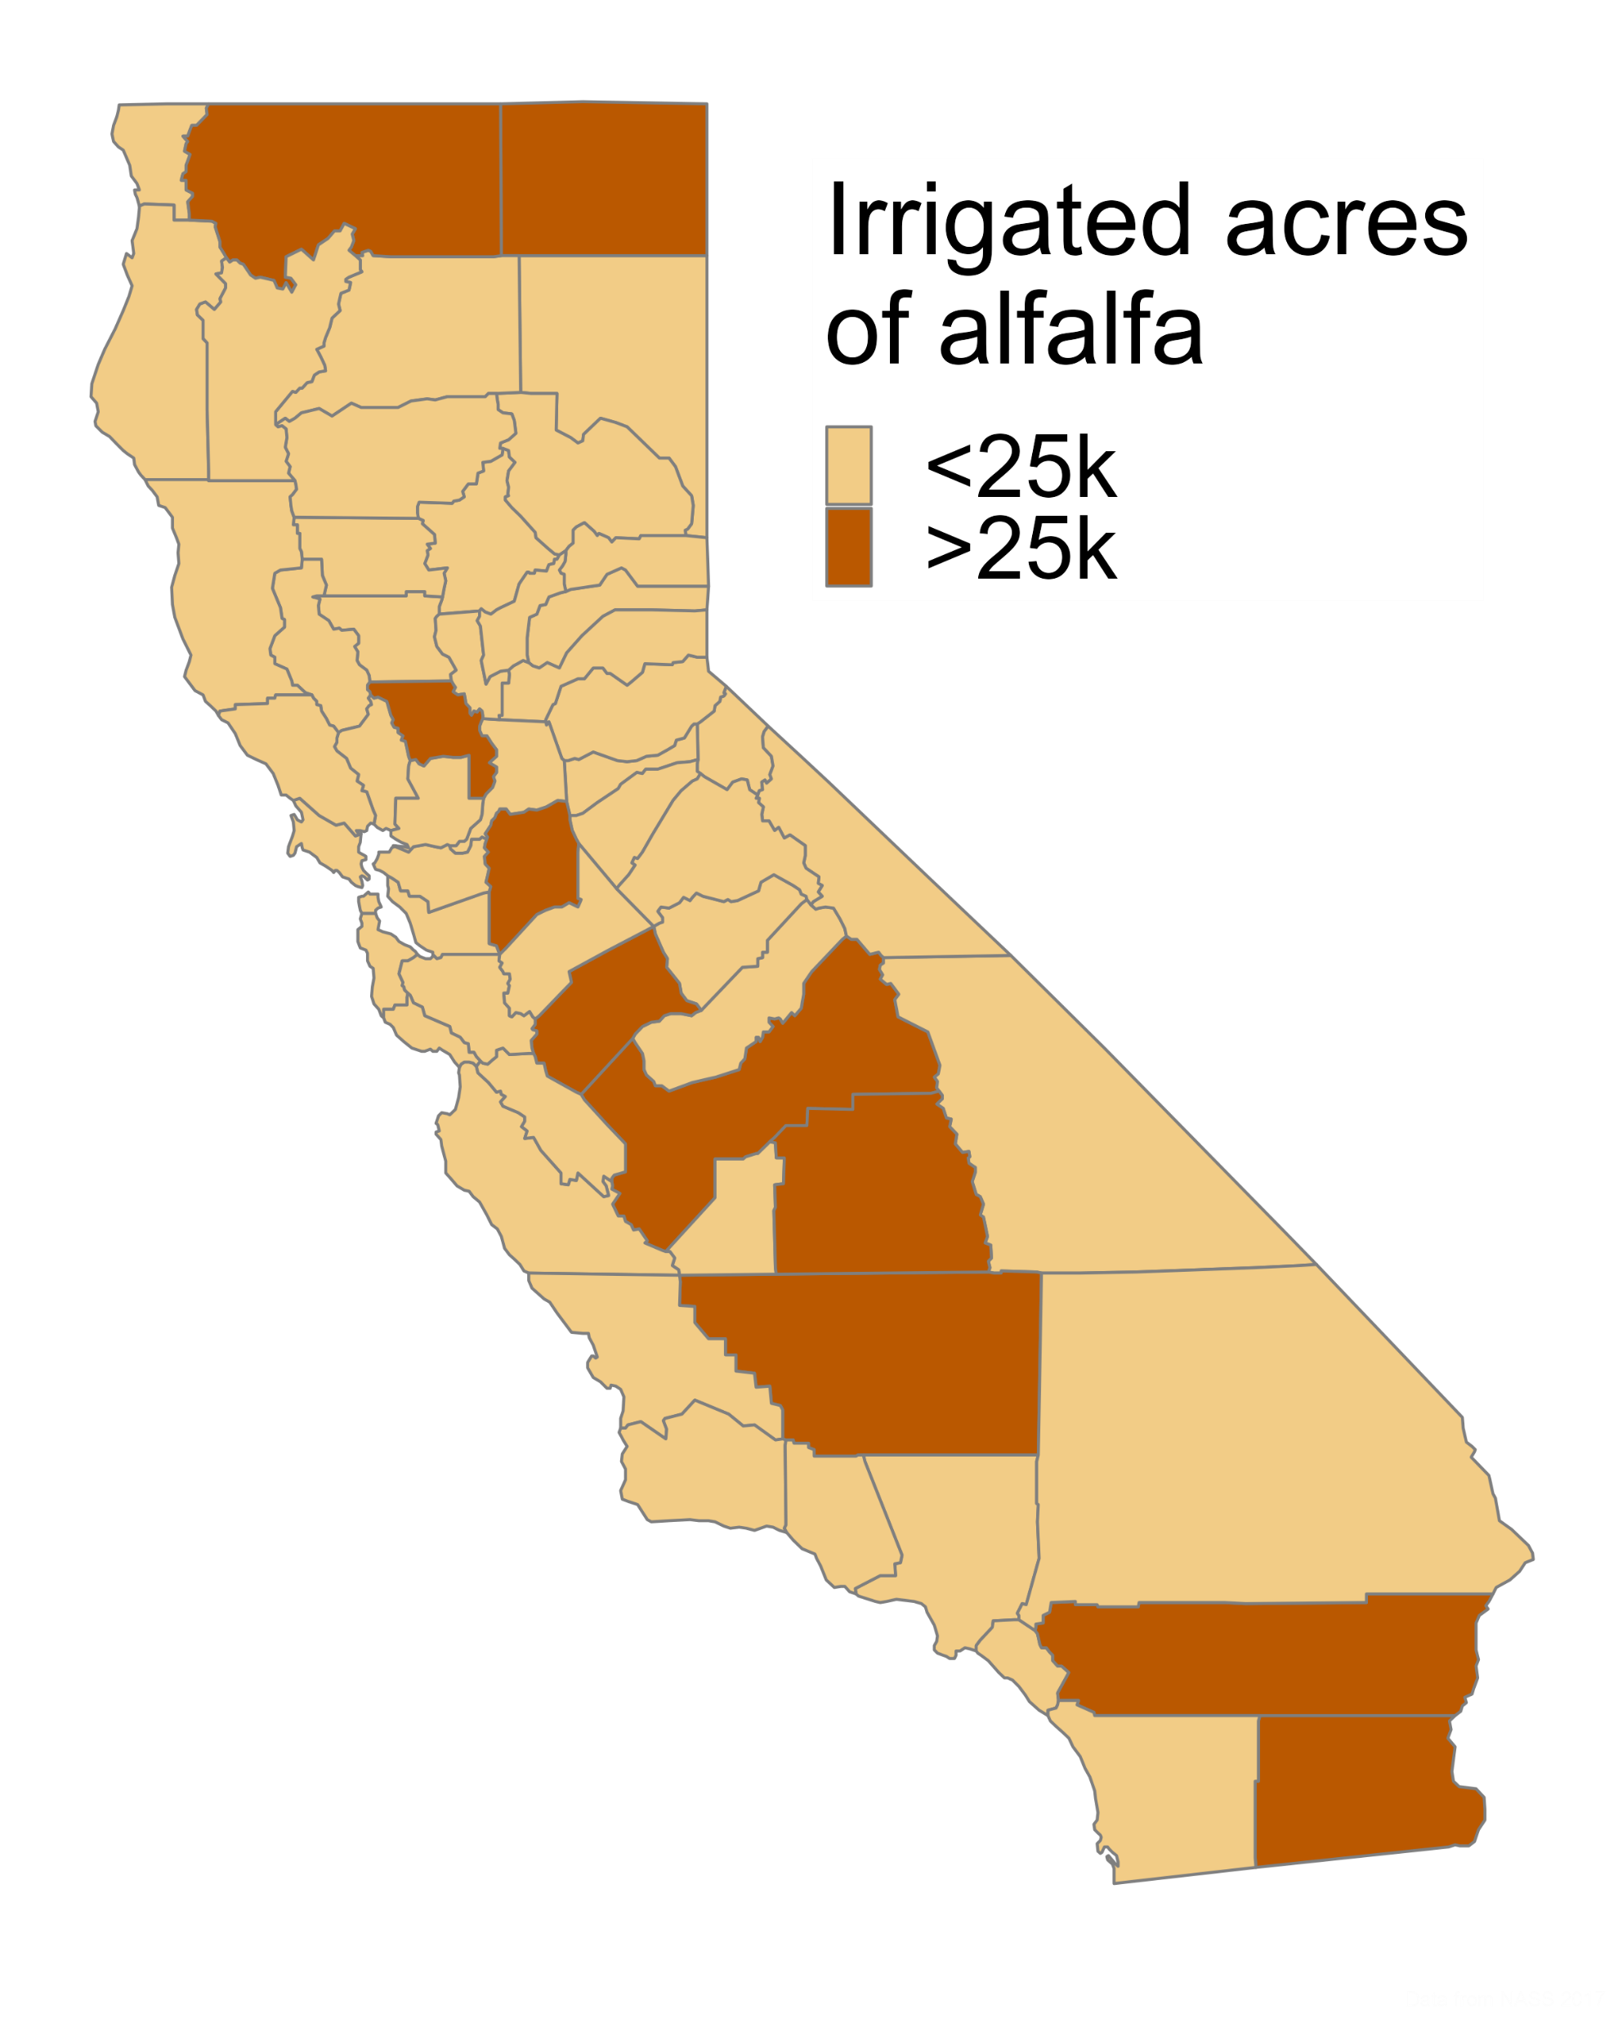
Motivation
Methodology
Learnings
Notes:
Environment includes water for ‘wild and scenic rivers’, required delta outflow, instream flows, managed wetlands. Ag includes water for crop production

Slide 7
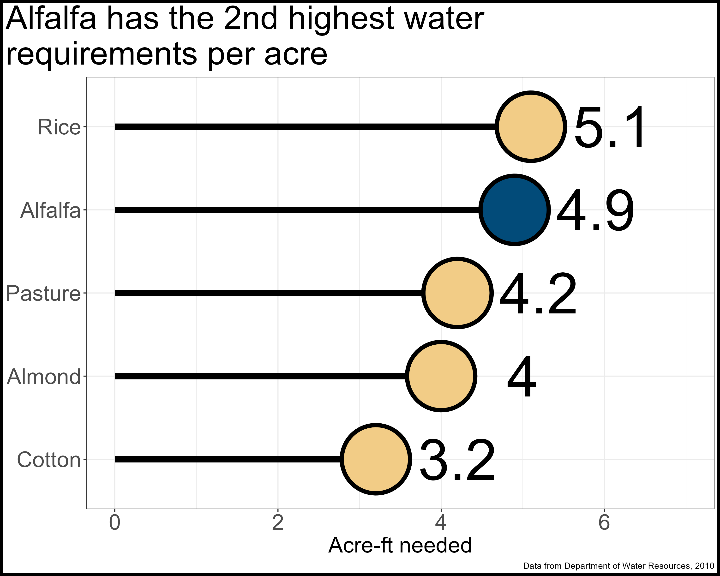
Motivation
Methodology
Learnings
Notes:
Environment includes water for ‘wild and scenic rivers’, required delta outflow, instream flows, managed wetlands. Ag includes water for crop production

Slide 8
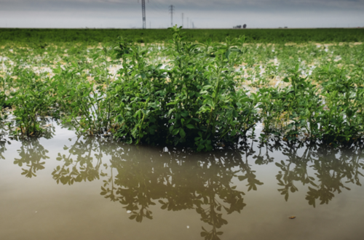
Motivation
Methodology
Learnings
Get rid of it.

Slide 9
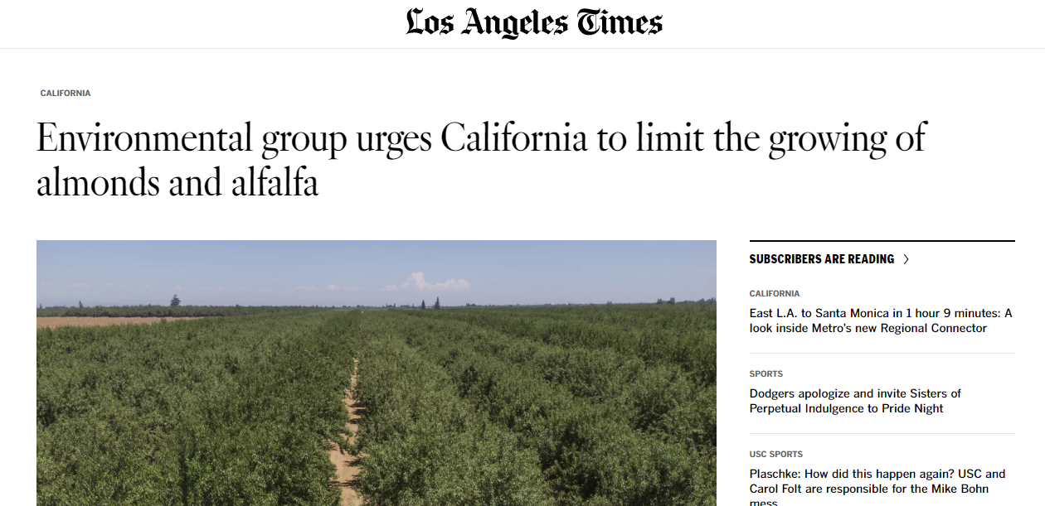
Motivation
Methodology
Learnings
https://phys.org/news/2023-02-environmental-group-urges-california-limit.html

Slide 10
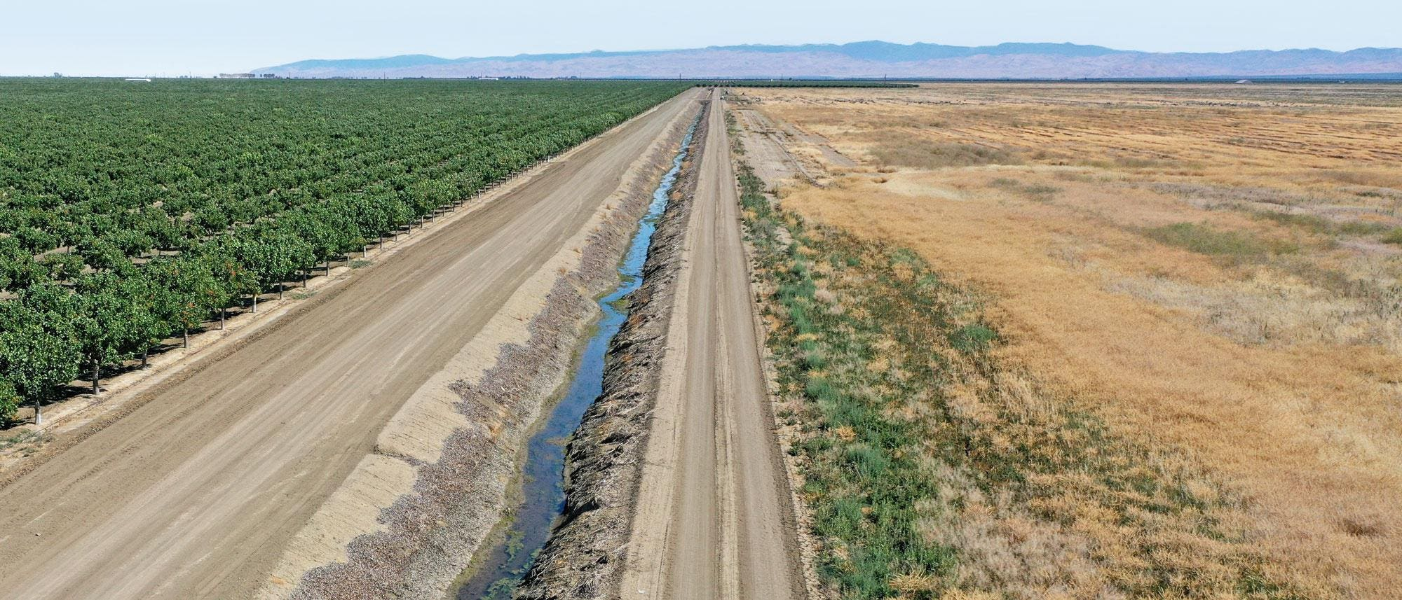
Motivation
Methodology
Learnings
https://www.forbes.com/sites/chloesorvino/2022/09/22/california-farms-pump-water-to-feed-crops-amid-extreme-heat-and-drought-but-residents-wells-are-running-dry/?sh=6550a2cd6eac

Slide 11
Motivation
Methodology
Learnings
One of the only feeding areas left in California for wetland birds. (Cite)
Provides ‘free’ nitrogen to subsequent crop. (Cite)
Provides years without soil disturbance. (Cite)
Potentially sequesters carbon deep into the soil. (Cite)

Slide 12

Motivation
Methodology
Learnings
http://comet-planner-cdfahsp.com/

Slide 13
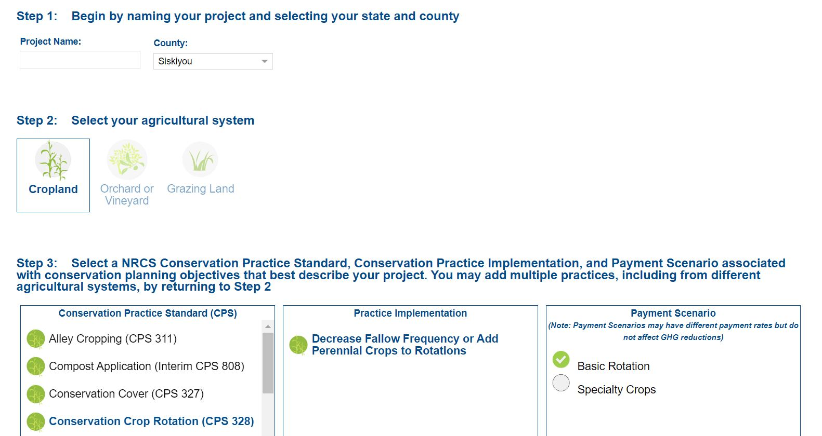
Motivation
Methodology
Learnings

Slide 14
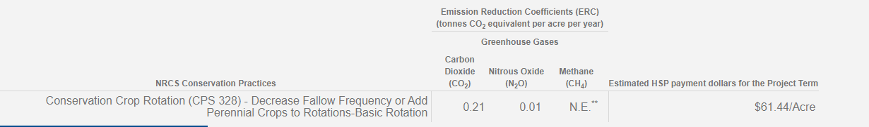
Motivation
Methodology
Learnings

Slide 15
Motivation
Methodology
Learnings
Decrease fallow frequency or add perennial crops to rotations

Slide 16
Motivation
Methodology
Learnings
Sequester carbon and reduce nitrous oxide emissions

Slide 17
Motivation
Methodology
Learnings
If alfalfa is sequestering 0.22 CO₂e per acre per year…
is there a scenario where it is climate neutral?

Slide 18
Motivation
Methodology
Learnings
Uncertainty versus variation (Notarnicola et al. 2017)
Examine alfalfa production with regional nuance
Fully account for cropping system impacts (Costa et al. 2020)
Account for stand life and fertilizer reductions for subsequent crop
Identify and explore meaningful counterfactuals???

Slide 19
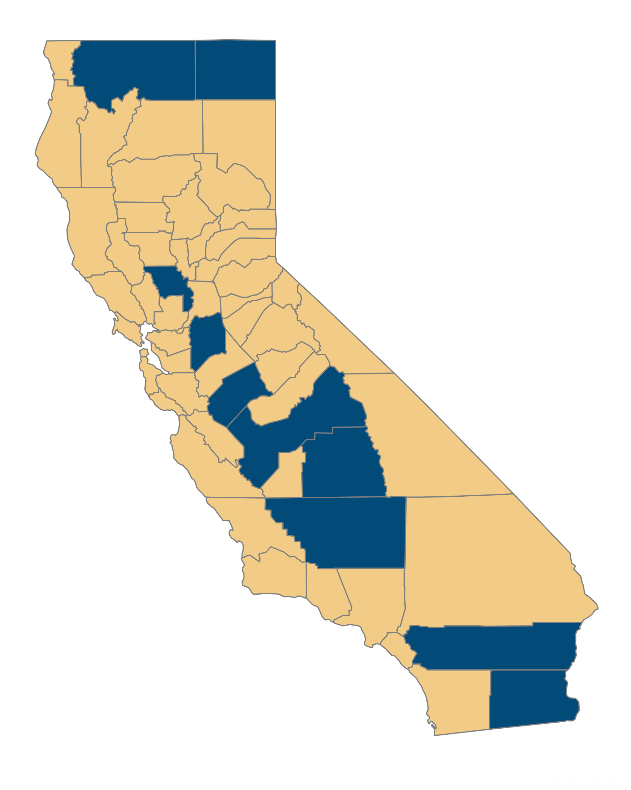
Motivation
Methodology
Learnings
Low input, low yields, major crop
Medium input, high yields, rotational crop
High input, high yields, major crop

Slide 20
