Slide 1
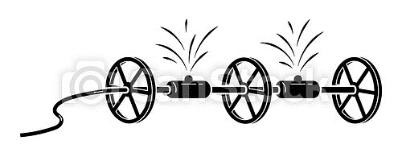
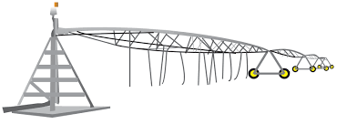
Siskiyou County alfalfa irrigation
Flood irrigation
Surface water
No additional pumping
50 psi pump to get water out of river
Wheel line
Needs 50 psi, but pump at river/well is enough? Wouldn’t that depend on location of field in relation to river/well?
Ground water
50-70 psi pump to get water out of well
Center pivot
Needs 40 psi, but…is that pump in addition to the river/well pump?

