Slide 1
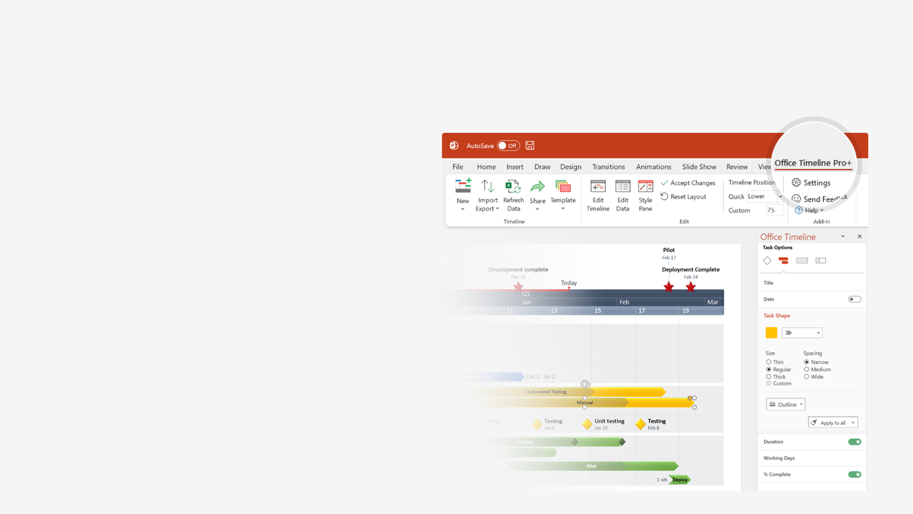

How to update this template in seconds
The Office Timeline add-in for PowerPoint will help you edit it with just a few clicks.
Get your free 14-day trial of Office Timeline here: https://www.officetimeline.com/office-timeline/14-days-trial Re-open this template, and create your impressive PowerPoint visual in 3 easy steps:
1
Click the Edit Data button on the Office Timeline tab.
2
Use the Data and Timeline views to edit swimlanes, milestones and tasks.
3
Click Save to instantly update the template.

Slide 2

131 days
41 days
54 days
76 days
Apr 25
Jun 17
Aug 15
Dec 4
2021
2023
Today
Q4
Q1
Sales Plan template
Major Milestone
Major Milestone
Major Milestone
Mar 31
Jun 30
Sep 30
Year 1
Q2
Q3
Q4
Dec
Feb
Apr
Jun
Aug
Oct
Dec
52
6
12
18
24
30
36
42
48
Task 1
Jan 1 - Feb 28
Phase 1
Milestone 1
Milestone 2
Milestone 3
Jan 15
Feb 27
Apr 10
Phase 2
Milestone 4
Mar 1 - May 15
Task 2
Milestone 5
May 25
Phase 3
Milestone 6
Milestone 7
Apr 15 - Oct 15
Task 3
Phase 4
Milestone 8
Sep 15 - Dec 29
Task 4

Slide 3
131 days
41 days
54 days
76 days
Apr 25
Jun 17
Aug 15
Dec 4
2021
2023
Today
Q4
Q1
Barley planting
Barley harvest
Oat harvest
Faba bean harvest
Mar XX
Mar XX
Jun 30
Sep 30
Year 1 (2018)
Year 2 (2019)
Year 3 (2020)
Jan
Apr
Jul
Oct
Jan
Apr
Jul
Oct
Jan
Apr
Jul
Oct
18
24
30
36
42
48
Task 1
Jan 1 - Feb 28
No cover crop
Milestone 1
Milestone 2
Milestone 3
Jan 15
Feb 27
Apr 10
Early planted mixture
Milestone 4
Mar 1 - May 15
Task 2
Milestone 5
May 25
Mid-planted mixture
Milestone 6
Milestone 7
Apr 15 - Oct 15
Task 3
Mid-planted radish
Milestone 8
Sep 15 - Dec 29
Task 4

